Slide 1
React Demo

Slide 2
How to install
Install Node.js Node.js is an asynchronous event-driven JavaScript runtime environment. It allows us to JavaScript to build scalable network applications. Node.js comes with the world’s largest software registry called ‘npm’ (Node Package Manager).
Install XAMPP
Make a new directory and cd into it
Run ‘npm init’ to create a new ‘package.json’ file. package.json is a JavaScript Object Notation (JSON) file that contains information used by Node.js to set up the RTE. JSON is an open standard file format.
Set the attribute “entry” to the [server file name].js file used to set up a connection to the database and define routes from the front-end to back-end using Express.
Run ‘npm i --save mysql express concurrently’ to install the Node.js packages mysql, express, and concurrently and set them as dependencies in package.json.

Slide 3
How to install (cont.)
Run ‘npm i –g create-react-app’ to install ReactJS.
Run ‘create-react-app [react app name]’. This will create a React app nested in a directory with the specified name.
Inside package.json, add these attributes to the “scripts” attribute: “start”: “node [server file name].js”, “[server file name]”: nodemon [server file name].js”, “[react app name]”: “npm start --prefix [react app name]” “dev”: “concurrently \”npm run [server file name]\” \”npm run [react app name]\”” This will make node call the server file upon start, nodemon allows Node.js to quickly compile and update the website quickly. The command ‘npm run dev’ will execute the server and client commands concurrently.
Cd into the react directory and insert the following attribute into package.json: “proxy”: “http://localhost:5000” This provides a location for back-end routes.

Slide 4
Setting up the database
Open XAMPP
Start Apache and then start MySQL after
In your browser, go to localhost/phpmyadmin
Outside of create an SQL file that will create a database, enter said database, and create a table(s) (refer to next slide)
In localhost/phpmyadmin, click ‘new’ on the left and ‘import’ the SQL file

Slide 5
INIT.SQL Example
CREATE DATABASE intervote;
USE intervote;
CREATE TABLE messages(id int AUTO_INCREMENT, message VARCHAR(255), upvotes INT, downvotes INT, PRIMARY KEY(id));
INSERT INTO messages SET message = "Pie is better than Cake", upvotes = 314, downvotes = 0;
INSERT INTO messages SET message = "Glass half full?", upvotes = 0, downvotes = 0;
INSERT INTO messages SET message = "Coronavirus", upvotes = 0, downvotes = 2020;

Slide 6
Connecting to your database
Edit the [server file name].js file. This is the main back-end file.
Establish the following constant variables: const express = require('express’); const bodyParser = require('body-parser’); const mysql = require('mysql’); const db = mysql.createConnection({ host: 'localhost’, user: 'root’, password: ‘’, database: 'intervote’, port: 3306 });
Make the connection: db.connect((err) => { if(err){throw err;} console.log('MySQL Connected...’); }); const app = express();

Slide 7
Establishing routING
Routing create endpoint responses for client requests.
In Express, we can create route methods that communicate with databases. Ex) app.get('/allmsgs', (req, res) => { let sql = 'SELECT * FROM messages’; let query = db.query(sql, (err, results) => { if(err){throw err;} console.log(results); res.json(results); }); });

Slide 8
Invoking route methods
Client files can invoke route methods by using the ‘fetch’ method. You pass the endpoint name as a parameter. Ex) componentDidMount() { fetch('/allmsgs’) .then(response => { if (response.status !== 200) { console.log('allmsgs fetch problem - status code: ' + response.status); return; } response.json() .then(allmsgs => { console.log('allmsgs fetched:’); console.log(allmsgs); this.setState({messages: allmsgs}); }) ;}) .catch(err => { console.log('allmsgs fetch error :-S', err); }); }

Slide 9
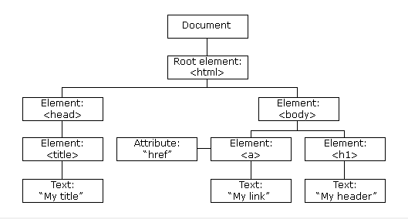
THE DOM
React withholds HTML’s Document Object Model (DOM)
React provides an Object called ‘Component’ in which all React Objects must inherit from. The render() method must be overridden in Child Objects.
React makes JS Objects into HTML Elements which can be included in HTML files.
Inheritance follows the DOM, meaning React Objects must be included in the render() method of the Parent Object.

Slide 10
