Slide 1
Pitcher Rankings
Descriptions of all pitcher ranking categories and how they are calculated.
11/24/20

Slide 2
Table of Contents
The Portfolio
Calculating Portfolio performance
Pitcher Ranking Categories
Comparison to S&P500
Comparison to Gruvest
User Feedback
Accuracy

Slide 3
The Portfolio
The subset of tracked stocks in a pitch that currently have capital invested into them.
3 options: Buy, Hold, or Sell
Buy: Stock price is expected to relatively increase. Add stocks in the Buy category to portfolio.
Hold: Stock price is expected to stay relatively the same. Keep stocks in the Hold category to portfolio, and do not add stocks in the Hold category to the portfolio. In other words, do not do anything.
Sell: Stock price is expected to relatively decrease. Sell stocks in the Buy category out of portfolio.

Slide 4
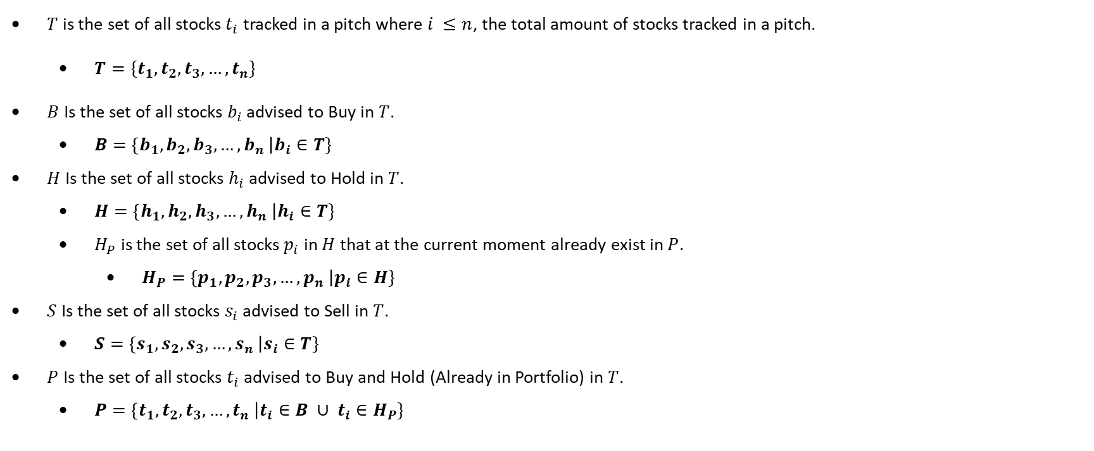
The Portfolio (Cont.)
$T$ is the set of all stocks $t_{i}$ tracked in a pitch where $i ≤n$, the total amount of stocks tracked in a pitch.
$T=\{t_{1},t_{2},t_{3},…,t_{n}\}$
$B$ Is the set of all stocks $b_{i}$ advised to Buy in $T$.
$B=\left\{b_{1},b_{2},b_{3},…,b_{n} \right|b_{i}∈T\}$
$H$ Is the set of all stocks $h_{i}$ advised to Hold in $T$.
$H=\left\{h_{1},h_{2},h_{3},…,h_{n} \right|h_{i}∈T\}$
$H_{P}$ is the set of all stocks $p_{i}$ in $H$ that at the current moment already exist in $P$.
$H_{P}=\left\{p_{1},p_{2},p_{3},…,p_{n} \right|p_{i}∈H\}$
$S$ Is the set of all stocks $s_{i}$ advised to Sell in $T$.
$S=\left\{s_{1},s_{2},s_{3},…,s_{n} \right|s_{i}∈T\}$
$P$ Is the set of all stocks $t_{i}$ advised to Buy and Hold (Already in Portfolio) in $T$.
$P=\left\{t_{1},t_{2},t_{3},…,t_{n} \right|t_{i}∈B ∪ t_{i}∈H_{P}\}$

Slide 5
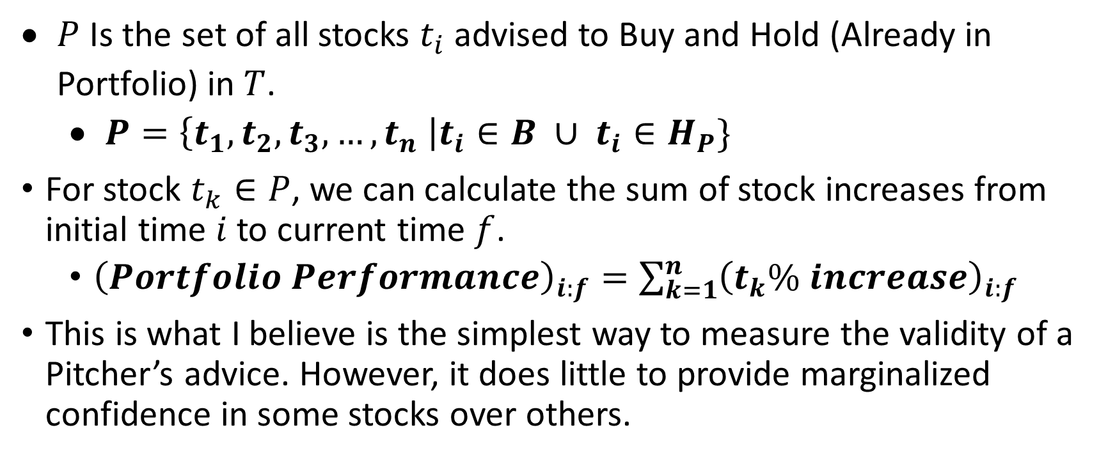
Calculating Portfolio performance
$P$ Is the set of all stocks $t_{i}$ advised to Buy and Hold (Already in Portfolio) in $T$.
$P=\left\{t_{1},t_{2},t_{3},…,t_{n} \right|t_{i}∈B ∪ t_{i}∈H_{P}\}$
For stock $t_{k}∈P$, we can calculate the sum of stock increases from initial time $i$ to current time $f$.
${\left(Portfolio Performance\right)}_{i:f}=\sum_{k=1}^{n}{{\left(t_{k}\% increase\right)}_{i:f}}$
This is what I believe is the simplest way to measure the validity of a Pitcher’s advice. However, it does little to provide marginalized confidence in some stocks over others.

Slide 6
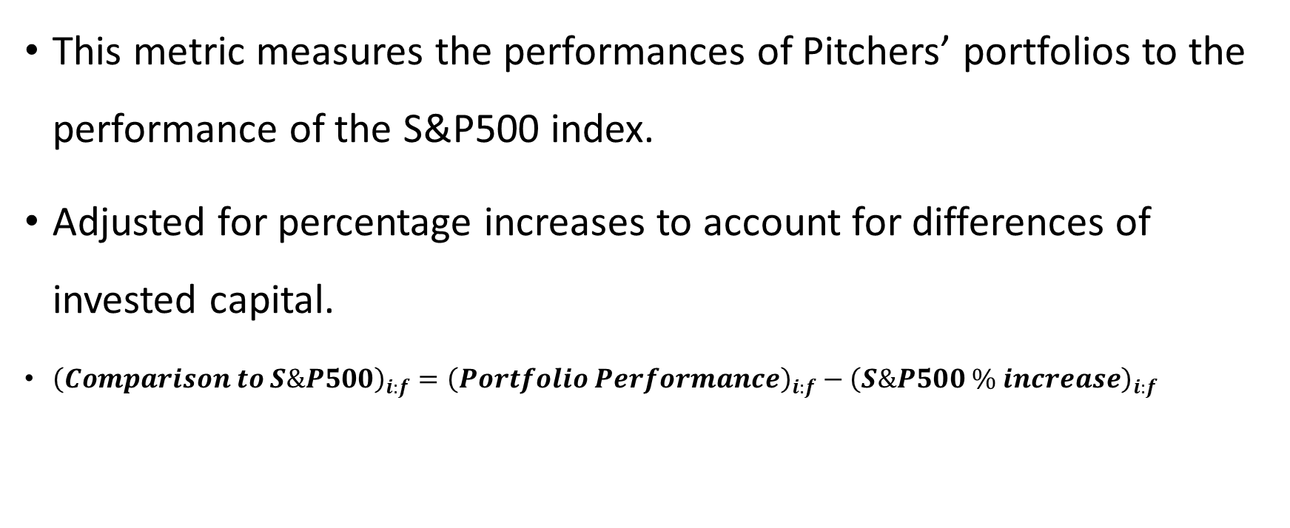
Category: Comparison to S&P500
This metric measures the performances of Pitchers’ portfolios to the performance of the S&P500 index.
Adjusted for percentage increases to account for differences of invested capital.
${\left(Comparison to S\&P500\right)}_{i:f}={\left(Portfolio Performance\right)}_{i:f}−{\left(S\&P500 \% increase\right)}_{i:f}$

Slide 7
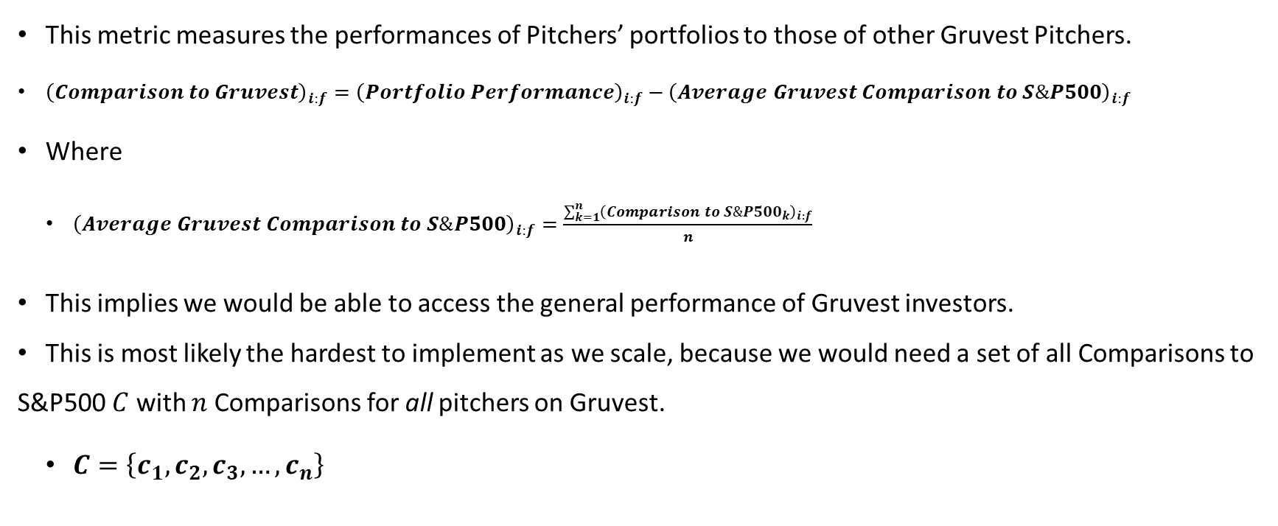
Category: Comparison to Gruvest
This metric measures the performances of Pitchers’ portfolios to those of other Gruvest Pitchers.
${\left(Comparison to Gruvest\right)}_{i:f}={\left(Portfolio Performance\right)}_{i:f}−{\left(Average Gruvest Comparison to S\&P500\right)}_{i:f}$
Where
${\left(Average Gruvest Comparison to S\&P500\right)}_{i:f}=\frac{\sum_{k=1}^{n}{{\left({Comparison to S\&P500}_{k}\right)}_{i:f}}}{n}$
This implies we would be able to access the general performance of Gruvest investors.
This is most likely the hardest to implement as we scale, because we would need a set of all Comparisons to S&P500 $C$ with $n$ Comparisons for all pitchers on Gruvest.
$C=\left\{c_{1},c_{2},c_{3},…,c_{n}\right\}$

Slide 8
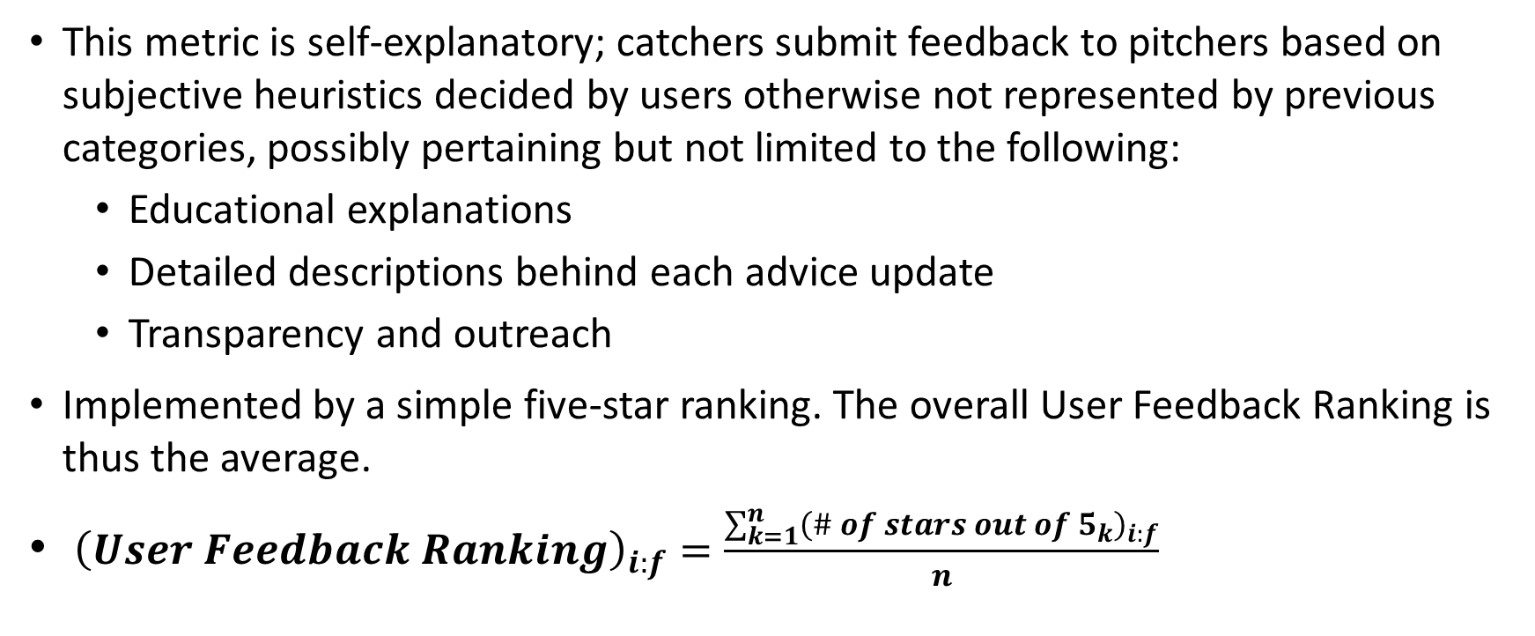
Category: User Feedback
This metric is self-explanatory; catchers submit feedback to pitchers based on subjective heuristics decided by users otherwise not represented by previous categories, possibly pertaining but not limited to the following:
Educational explanations
Detailed descriptions behind each advice update
Transparency and outreach
Implemented by a simple five-star ranking. The overall User Feedback Ranking is thus the average.
${\left(User Feedback Ranking\right)}_{i:f}=\frac{\sum_{k=1}^{n}{{\left({\# of stars out of 5}_{k}\right)}_{i:f}}}{n}$

Slide 9
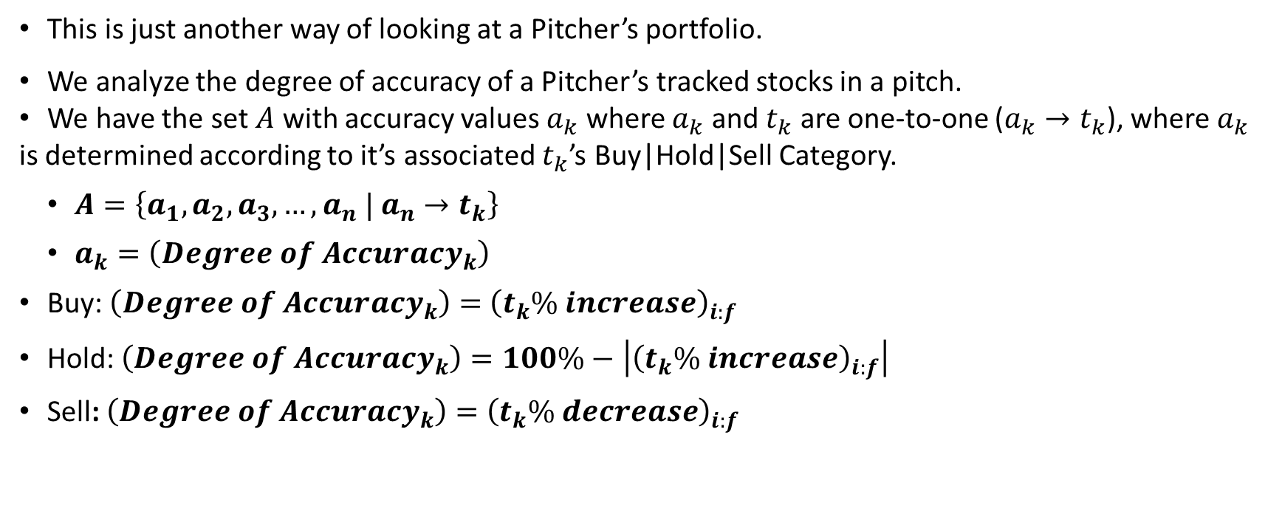
Category: Accuracy
This is just another way of looking at a Pitcher’s portfolio.
We analyze the degree of accuracy of a Pitcher’s tracked stocks in a pitch.
We have the set $A$ with accuracy values $a_{k}$ where $a_{k}$ and $t_{k}$ are one-to-one ($a_{k}→t_{k}$), where $a_{k}$ is determined according to it’s associated $t_{k}$’s Buy|Hold|Sell Category.
$A=\left\{a_{1},a_{2},a_{3},…,a_{n} | a_{n}→t_{k}\right\}$
$a_{k}=\left({Degree of Accuracy}_{k}\right)$
Buy: $\left({Degree of Accuracy}_{k}\right)=$ ${\left(t_{k}\% increase\right)}_{i:f}$
Hold: $\left({Degree of Accuracy}_{k}\right)=100\%−$ $\left|{\left(t_{k}\% increase\right)}_{i:f}\right|$
Sell: $\left({Degree of Accuracy}_{k}\right)=$ ${\left(t_{k}\% decrease\right)}_{i:f}$

