Slide 1
CheckMeWOD
Video analyzer for CrossFit Competitions

Slide 2
Team
Supervisors
Francisco Jesus, 89084
Gonçalo Freixinho, 89251
Daniel Pinto, 89341
Rodrigo Oliveira, 90514
Prof. António Neves
Prof. Alina Trifan

Slide 3
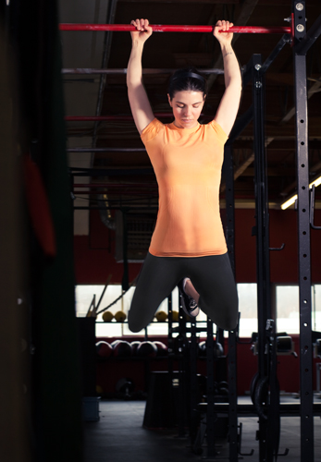
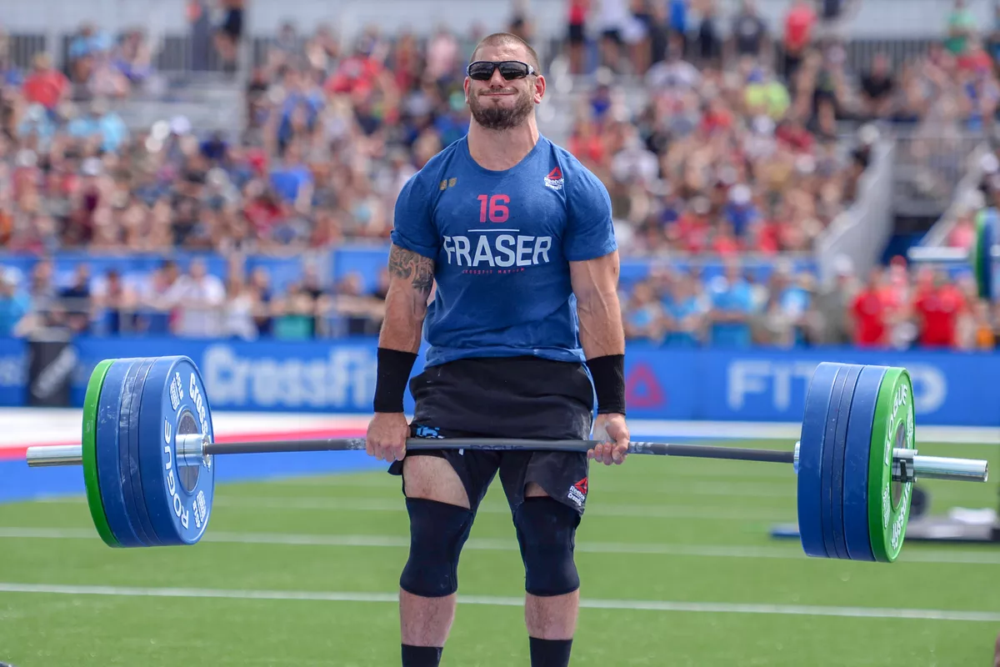

Context
“CrossFit is the application of the fundamentals of Newtonian mechanics to human movement”

Slide 4
Problem
Big number of athletes competing
Scores are verified by a present judge but validation by an affiliate manager is always required
Scoring given by different judges in different places is possibly biased
For smaller competition organizers it can be hard to get proper judges (associated costs are also a problem)

Slide 5
Goals
Online system capable of analysing videos automatically
Provide feedback to athletes about their scores
Promote the app to the CrossFit world in order to achieve a big adoption level

Slide 6
Tasks
Implement a video analyzer capable of detecting the athlete’s movement and validating the exercises performed in the workout
Create an online platform where a user can submit a video of the workout
Study the CrossFit exercises and judging techniques

Slide 7
Expected Results
By the end of this project, we expect to deliver a working application with all of the functionalities we planned in an optimized fashion and that it is ready for deployment on a larger scale.
i.e. Real life scenarios like actual CrossFit competitions.

Slide 8
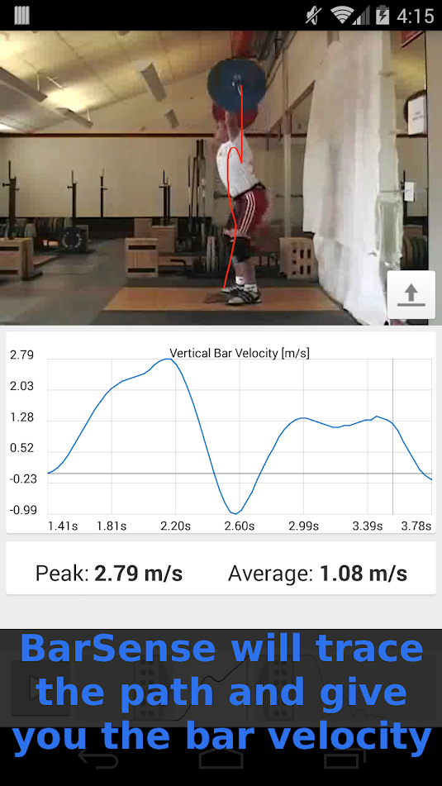
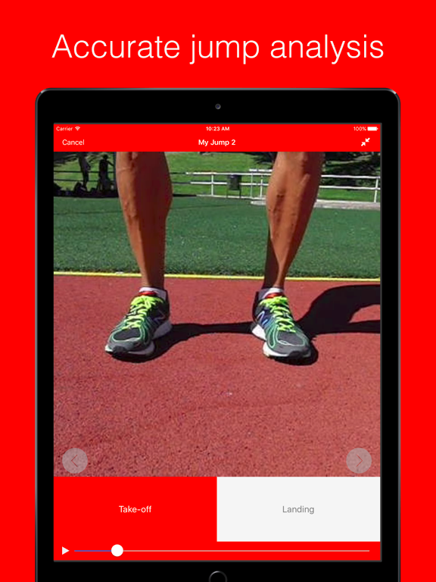
Related Work
BarSense Weight Lifting Log
My Jump 2

Slide 9

Calendar and Communication plan
M1 (24/2) | Project presentation
M2 (9/3) | Lifecycle architecture presentation. Movement detector implemented. structured website
M3 (20/4) | Video analyzer to, at least, 3 WODs. Working video submission
M4 (18/5) | Video analyzer with more WODs
Final (1/6) | Video analyzer with all WODs

Slide 10
Tasklist
Study the CrossFit exercises - everyone
Take a CrossFit judge course and share the information with the colleagues - TBD
Video analyzer - Francisco and Rodrigo
Implement an adequate library for motion tracking - Rodrigo
Structure the acquired data in a helpful format - Francisco
Analysis of the data for exercise validation - Francisco and Rodrigo
Website - Gonçalo and Daniel
Video submission system - Daniel
Website Design - Gonçalo

