Slide 1
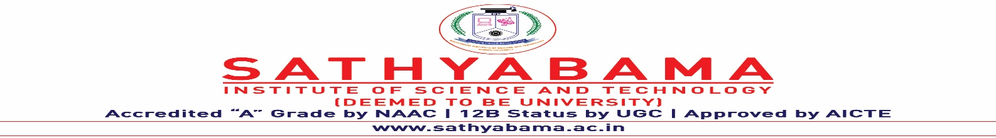
CHAUFFEUR TORPIDITY FOREWARNING AID USING CONVOLUTIONAL NEURAL NETWORKS
Under the guidance of
Dr. S. L.Jany Shabu M.Tech.,Ph.D
by
M Chidanand
(39110575)
K V Pavan Kumar
(39110548)

Slide 2
Presentation Outline
Introduction
Objectives
Literature survey
Inferences from Literature Survey
Existing System
Proposed system
Hardware and software requirements
System architecture
Implementation Modules
Algorithms Used
Result analysis
Conclusion
References

Slide 3
Introduction
Vehicle accidents are most common nowadays if the driving is inadequate these happen on most factors if the driver is drowsy or if he is alcoholic or inappropriate time.
Driver drowsiness is recognized as an important factor in the vehicle accidents.
Chauffeur drowsiness detection is a car safety technology which helps prevent accidents caused by the driver getting drowsy.
System will detect the early symptoms of drowsiness before the chauffeur has fully lost all attentiveness and warn the driver with a alarm that they are no longer capable of operating the vehicle safely.

Slide 4
Objectives
Aim to detect Real-time Chauffeur’s torpidity state using Convolutional Neural Networks (CNN)
Our objective of the project is to ensure the safety system software.
To produce a system that detects drowsiness by closing eyes and yawning.

Slide 5
Literature Review
AUTHOR | YEAR OF PUBLICATION | DESCRIPTIONS | PROS | CONS
Berkay Yazıcı, Tuba Ayhan | 2022 | System-on-Chip Based Driver Drowsiness Detection and Warning System | PERCLOS and CNN to detect eyes and wifi cloud database | No mouth yawing detection and late at data base cloud wifi
Baby Shamini ,M.Vinodhini | 2022 | Driver Drowsiness Detection based on Monitoring of Eye Blink Rate | It is based on computer vison using web cam drowsy detection | Alarm will projected on screen no sound of alarm
Gülin TÜFEKC ̇I ve Alper KAYABA ̧SI. | 2022 | A Comparative Analysis of Revealing Temporal Patterns for Driver Drowsiness Detection | Detection on spatio-temperal,bidirectional LSTM and fully fully with layers | Can be Tested on device with Minimum ram of 128 GB

Slide 6
Literature Review
AUTHOR | YEAR OF PUBLICATION | DESCRIPTIONS | PROS | CONS
LINLIN ZHANG 1,2 | 2022 | Privacy-Preserving Federated Transfer Learning for Driver Drowsiness Detection | It has better classification performance | Accuracy and Precision rate is low
Janhavi Baikerikar | 2021 | : Drowsiness Detection for Drivers | Using landmarks and flask and open cv only eyes | Running time is High and low accuracy
Dr.T.Kishore Kumar | 2021 | Real-Time Smart Drivers Drowsiness Detection Using DNN | Used DNN of yolo algorithm and Ear | It Does not Generates Alarm and run time low

Slide 7
Inferences from Literature Survey
In recent years, many scholars and institutions have conducted a lot of researches on the fatigue driving detection based on the computer vision.
In Existing study, a high cost, real time driver’s drowsiness detection systems is developed with some acceptable accuracy.
Facial landmarks on the detected face are pointed and subsequently the eye aspect ratio and mouth opening ratio are computed and depending on their values.
Features of the eyes and mouth were used to model the behavior of the chauffeur.
Changes in these characteristics were used to monitor the Yawning and frequent blinking are the most obvious signs of driver fatigue

Slide 8
Existing System
Driver Drowsiness Detection (DDD) Using Machine Learning. In this System, During the training stage, a machine learning model named Random forest is used for Detection.
Eye Ratio values are calculated and given as an input vector to the Random Forest model.
If the driver’s Eyes are closed then, it generates an alarm.
In the existing model driver drowsiness is detected only by the Eye Blink rate.
The results displayed that the Random Forest model has achieved good performance.

Slide 9
Proposed system
The video captured by a webcam is transformed into a series of frames.
For every frame, the face, eye,& mouth are perceived using predefined classifiers accessible in OpenCV.
Eye images are taken out and assigned to a, fully connected dense layer that analyzes whether the eyes are closed or not Value of Eye Aspect Ratio measured.
If the pair of eyes and mouth are closed successively for 30 frames then the system forecast as drowsy and a forewarning sound is activated to alert the chauffeur.
The classification of the chauffeur is done accurately and the normalization problems in the existing model are removed by using a custom-designed CNN

Slide 10
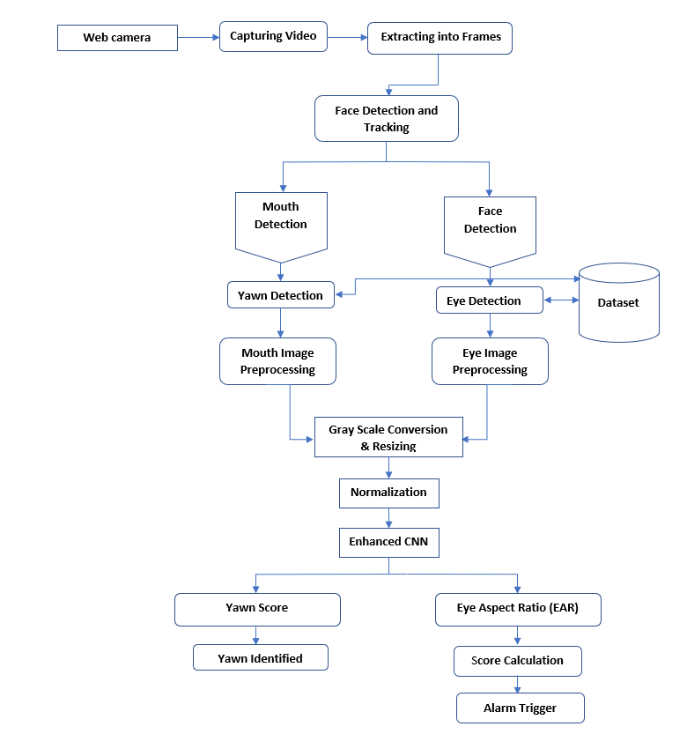
System Architecture

Slide 11
Hardware and Software Requirements
Software Requirements:
Operating System : Windows 7 , 8, 10 (64 bit)
Software : Python
Tools : Python 3.7 IDLE ,Anaconda, Jupyter
Webcam : 1
Hardware Requirements:
Hard Disk : 50GB
RAM : 2GB and Above
Processor : I3 and Above

Slide 12
Implementation Modules
Face cueing
Eye winking rate detection
Yawn detection
Forewarning Alert

Slide 13
Modules Description
Dataset Collection:
The dataset images are collected from Kaggle, pre-processing the image after the collection of various records.
I. Face cueing
Chauffeur is continuously monitored through a webcam as an input video.
Extracted, Input video streams are converted into a series of frames.
Extracted frames are converted from RGB to grayscale through OpenCV, resized to 24*24 pixels, and normalized.
II. Eye-winking rate detection
The eye region the state of the eye has been calculated which means if the eye is closed or opened.
Eye Aspect Ratio is employed to calculate the state of the eye coordinates.
EAR = ǁǁ p2– p6 ǁǁ + ǁǁ p3 – p5 ǁǁ / 2 ǁǁ p1 – p4 ǁǁ

Slide 14
Modules Description
III. yawn detection
Facial landmark detection is put in an application to localize significant regions of the face.
For yawn detection firstly, the top lip is restricted using a bundle of facial landmark detection through dlib and correspondingly the lower lip.
The mean for the top lip is calculated and the selfsame is computed for the lower lip.
IV. Forewarning Alert
Pygame library to give alerts to the chauffeur while get going sleep.
The EAR score value is utilized to find how long the chauffeur has closed their eyes. then the alert will ring.

Slide 15
Algorithms
Haar Cascade:
Haar cascade algorithm that can detect objects in images, This algorithm is not so complex and can run in real-time.
Haar-like feature considers adjacent rectangular regions at a specific location in a detection window.
Support Vector Machine:
SVM algorithm that uses to solve complex classification, and outlier detection problems by performing optimal data transformations.
It implies that when a dataset can be segregated into categories or classes with the help of a single straight line, it is termed as linear SVM.

Slide 16
Algorithms
Convolutional Neural Networks
The implementation uses a custom-designed CNN that has the following characteristics
The model type that is used is Sequential. Sequential is the easiest way to build a model in Keras. It allows you to build a model layer by layer
Our first 2 layers are Conv2D layers.
Activation is the activation function for the layer. That uses the first 2 layers are Rectified Linear Activation.
Dense is the layer type used for the output layer.
In B/w the Conv2D layers and the dense layer, there is a ‘Flatten’ layer. Flatten serves as a connection between the convolution and dense layers.
The activation is Softmax.
The model will then make its prediction based on which option has the highest probability.

Slide 17
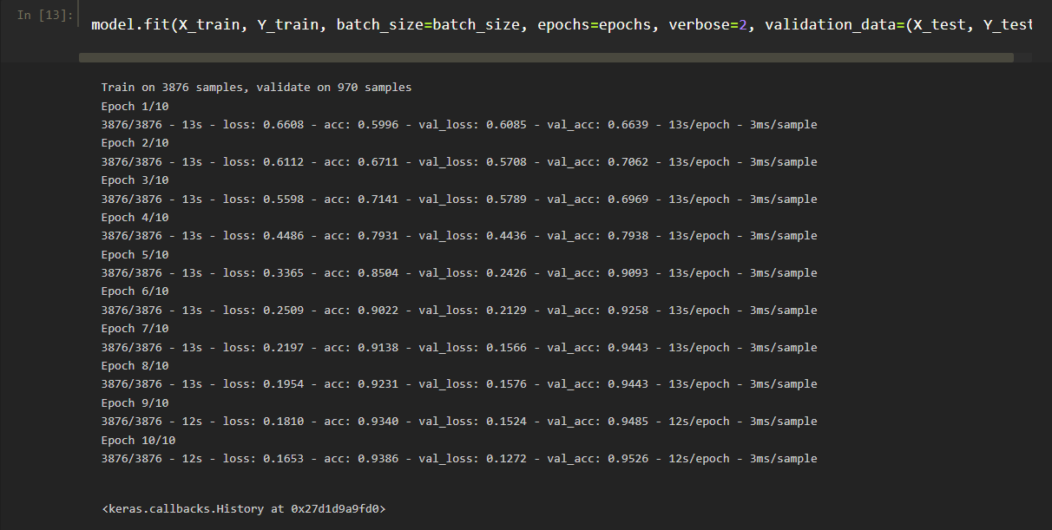
RESULT ANALYSIS
In this Module each Picture from dataset of the eyes are iterated 10 times and the mouth are iterated by 20 times.

Slide 18
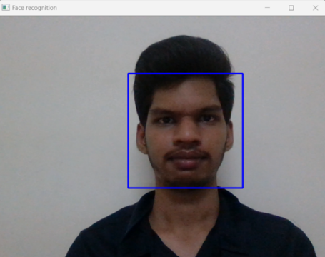
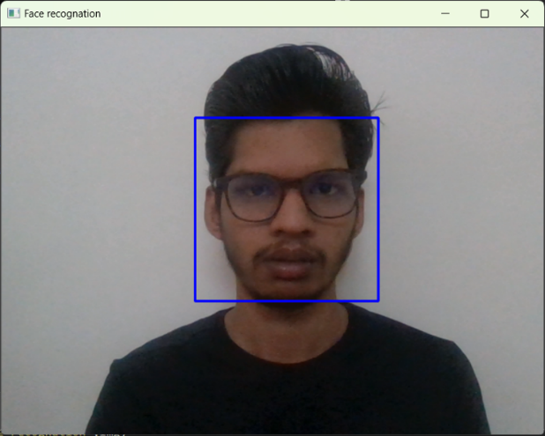
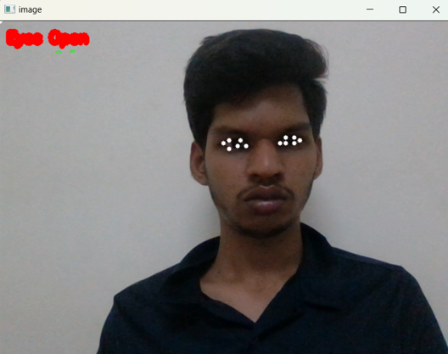
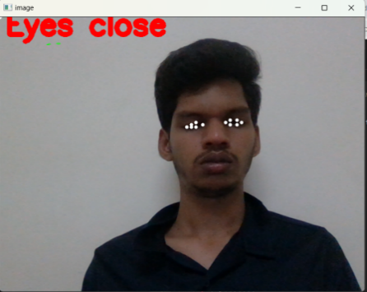
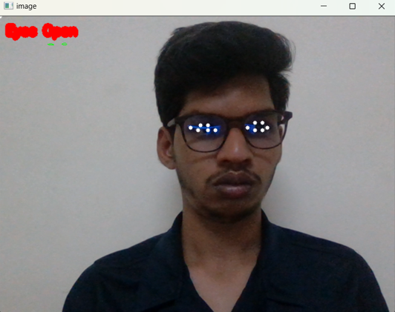
RESULTS
Face cueing: After an Out-and-Out model was developed. The aid, fortunately, detects the face with and without spects.
The Eye Detection images that display whether the Eyes are closed or not

Slide 19
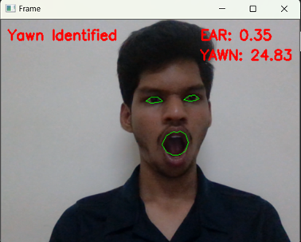
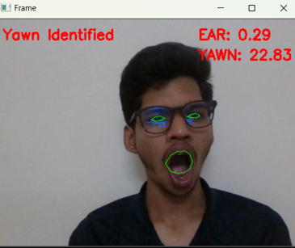
RESULTS
Detection when Eyes are open: the Eye Detection images that display whether the Eyes are closed or not
Non-Drowsy person: If the Eye Aspect Ratio(EAR) is greater than its threshold value (0.3) and Lip Distance(YAWN) is below its value of threshold (30). Hence, the chauffeur is non-drowsy.

Slide 20
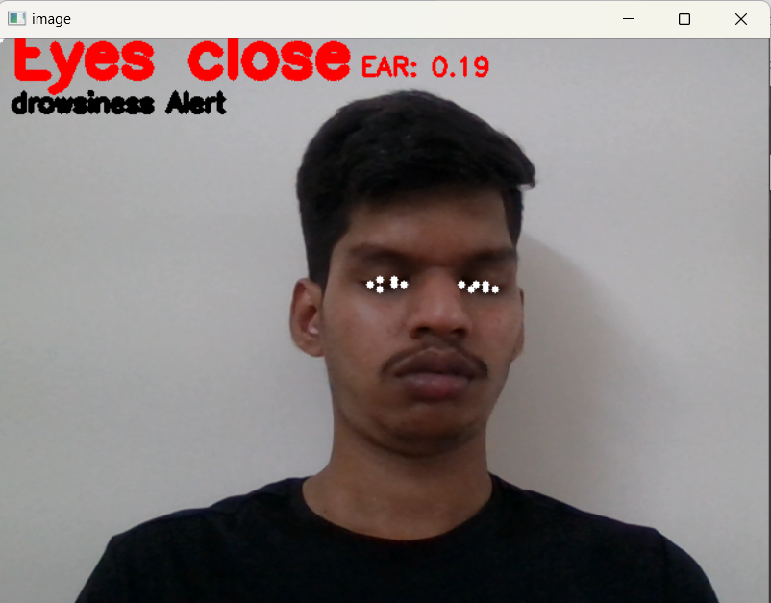
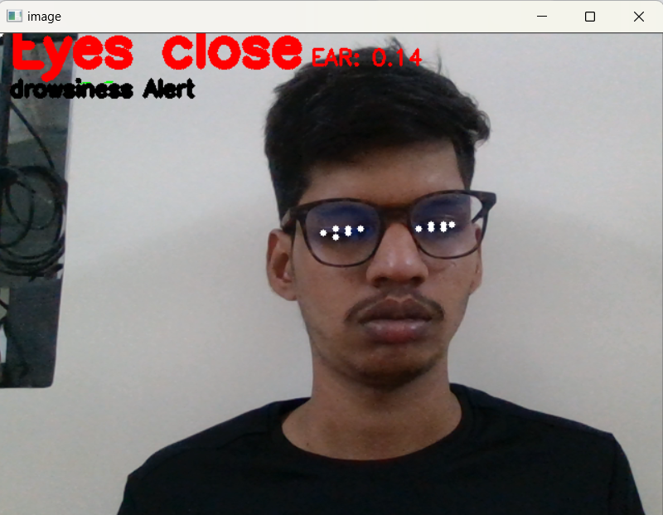
RESULTS
Drowsiness detection: If EAR< 0.3 for a maximum of 30 consecutive frames then drowsiness is detected as shown in the below figure.

Slide 21
Conclusion
Driver drowsiness detection is a car safety technology that helps prevent accidents caused by the driver getting drowsy.
The project aims at providing a solution for Driver Drowsiness Detection using CNN.
With this project implementation in vehicles, whenever the driver is drowsy the alarm is generated.

Slide 22
References
George. S. Maximous, Mohamed M. El-Barbary, Shehab Tarek,IEEE Student Validation of Driver Drowsiness on Humantenna Effect Using Facial Features,Electrical Engineering Department,The British University in Egypt©2022(IEEE).
L. Zhang et al.: Privacy-Preserving Federated Transfer Learning for Driver Drowsiness Detection,China Auto Information Technology Co., Ltd., Tianjin 300300, China©2022(IEEE).
Andrea Amidei,Angelica Poli,Federico Tramarin,Grazia IadarolaDriver Drowsines on Variation of Wearable Device;Dept. of Engineering"E. Ferrari"University of Modena and R. Emilia Modena, Italy©2022(IEEE).
Arda Özdemir, Tuba Ayhan, Berkay Yazıcı'System-on-Chip Based Driver Drowsiness Detection and Warning System,Electrical &Electronics Engineering Department, MEFUniversity,Istanbul, Turkey©2022(IEEE).
Long Chen, Guojiang Xin , Yuling Liu,Driver Fatigue Detection based on facial Key points and LSTM china hunan university©2021 HINDAWI.
A.Jeyasekar, Vivek Ravi Iyengar;Driver’s Drowsiness Detection Based on Behavioural Changes using ResNet©2021(IJRTE).
Mohammad Shahbakhti , Matin Beiramvand, Izabela Rejer, Piotr Augustynia Senior Member, IEEE, Anna Broniec-Wójcik , Michal Wierzchon , and Vaidotas Marozas , “Simultaneous Eye Blink Characterization and Elimination From Low-Channel Prefrontal EEG Signals Enhances Driver Drowsiness Detection”(IEEE-2021).

Slide 23
References
Tawsin Uddin Ahmed, Sazzad Hossain, Mohammad Shahadat Hossain, Raihan Ul Islam, Karl Andersson “Facial Expression Recognition using Convolutional Neural Network with Data Augmentation 2021(IEEE).
James Carlisle Genavia,Jaybriel Lincon,Somcio,Larry Vea School of Information Technology, Mapua University, Makati City, Philippine “An Innovative Approach on Driver's Drowsiness Detection through Facial Expressions using Decision Tree Algorithms”(IEEE-2020).
Ali Mansour Al-madani, Ahmed Abdullah A. Shareef,Zeyad A.T.Ahmed,Real-time Driver Drowsiness Detection based onEye Movement and Yawning using Facial Landmark;Ph.D. Research Scholar, Department of ComputerScience;Dr. Babasaheb Ambedkar Marathwada;University;Aurangabad, India©2020(IEEE).
Anuradha M,Ajay Kumar,Atul Kumar,Impana Girish,'driver fatigue detection,,Electronics & Communication Engineering,PES University,Bangalore, India©2019(IEEE).
ASELSAN Ara ,Gülin TÜFEKC ̇I ve Alper KAYABA ̧SI,Ilkay ULUSOY,A Comparative Analysis of Patterns for Driver Drowsiness ,Elektrik Elektronik Mühendisligi Bölümü,Orta Dogu Teknik Üniversitesi,Ankara, Türkiye©2019(IEEE).

Slide 24
THANK YOU
We Thank our guide and panel and all technical and non technical staff helped us in achieving this.

