Slide 1
SMART NIC
Getting faster and better...

Slide 2
What is it
NIC's few years back were dumb. Why?
Lazy! Pass on whatever they receive and let the kernel do the job
Intelligence need to be imparted to the NIC. But why?
Tremendous increase in the amount of networking speed (1GBE, 10GBE, 40GBE and 100GBE!). Even faster than the CPU
Let the mundane tasks do not hog the precious resource (CPU) and let the NIC do what it can. i.e Offload certain tasks to the NIC
How? NIC needs to smarter. i.e NIC needs to provide support and advertise to the kernel that it can be of help

Slide 3
Offload Features
TCP Offload Engine (TOE)
Offloads the entire TCP/IP stack to the network controller and let the NIC worry about it. Kaboom!
Advantages
Reduces driver – hardware communication
Reduces overhead in PCI traffic (for ex, smaller ack packets)
Relieves the host processor of a great bottleneck
Disadvantages
Everything comes with a cost. MOORE'S LAW
Cost of deploying is high too.
Thus not much accepted in Linux community

Slide 4
Offload Features
Generic / TCP segmentation Offload
Segmentation being performed at the NIC.
When applied to TCP alone called TCP segmentation offload.
Driver receives super sized blocks.
Can be observed in Wireshark.
Packet captures can show a packet of size > 1500 (MTU). No magic. Its segmentation Offload
Advantages
Reduced programming of hardware registers by driver
Comparatively less complex to implement.
Efficiently uses PCI bus and reduces CPU cycles
Majorly accepted in Linux community

Slide 5
Offload Features
Scatter Gather IO
Network packets need not be of Fixed size.
We can allocate two separate SKB's to hold this data. Can be waste of space
We can store as much as data in one SKB and then store the extra data alone in a data structure tailored for this
Appears as consecutive pages to the DMA

Slide 6
Receive Side Scaling
Receive Side Scaling
Enables NIC to distribute network packets across multiple processor cores in multi-core computers
Boosts performance in higher traffic laods
Supports multiple receive and transmit descriptor queues.
NIC can send different packets to different queues to distribute processing among CPUs.

Slide 7
Offload Features
Checksum Offloading
What everyone wants? More gain with little cost. Answer: TCP/UDP checksum offloading
Transmit
Inform the device to calculate the checksums. Tell the offset in the packet.
Receive
Device calculates the checksum and informs the stack
Stack can be relieved of petty checksum calculations
Implemented in Linux for TCP/UDP and IP

Slide 8
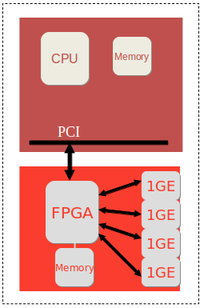
NetFPGA
Hardware accelerator built with FPGA
We focus on NetFPGA 10G
Has 4 10G ports
Sits on other side of PCIe bus
Driver is a loadable kernel module

Slide 9
Importance of Offload features
Why are the offload features important when discussing about NetFPGA
NetFGPA driver is still in rudimentary phase and needs lot of improvement
NetFPGA is of chief interest for researchers
The offload features which were mentioned can be implemented in NetFGPA too.
Program the NetFGPA driver so that it instructs the device to perform offloading.
Implement the offload features and measure the performance and tune the device to improve efficiency. Cannot be done with INTEL

Slide 10
Lets start
Packet transmission overview
Driver and device decide up in front
Agree on a ring structure
Stack receives a packet (non TSO context)
For each packet, calculates the Ethernet, IP and TCP/UDP headers
Interfaces with device driver and commands the driver to send out the packets
Driver puts the packets in the ring and indicates the H/W
H/W fetches packets from ring and sends out
H/W tells status to the device driver.

Slide 11
TX Ring
Important component in the transmission part.
FIFO buffer
Can be queued asynchronously by the software / hardware.
To appreciate the design, consider an alternate solution where the NIC has to regularly ask the s/w for packets to transmit. Not efficient
This solution is elegant. S/W and H/W can independently queue the packets.
The actual ring does not contain packet data. Contains descriptors
Descriptors contain pointers to skb's (socket buffers)
Also contain command and status bits
Physical address of the skb etc
Descriptors and skb's are created and allocated upfront.
They are reusable
NIC internally contains memory which stores (pre-fetches) the descriptors for faster access.

Slide 12
TX Ring ctd...
Pair of registers maintain the transmit queue
To transmit packets, s/w writes descriptors to the ring and moves the tail pointer.
Tail pointer points one entry beyond the h/w owned descriptor.
After transmitting, the NIC moves the head pointer and sets status bit
Transmission stops when head = tail.
S/W should not modify descriptors until the head pointer has been advanced past.
H/W should not send anything beyond tail pointers.

Slide 13
RX Ring
Analogous to TX Ring.
S/W adds receive descriptors by writing the tail pointer with the index of the entry beyond the last valid descriptor.
H/W increments the head pointer after storing the packets in the memory pointed to by the descriptor
When head = tail, queue is empty
NIC usually pre-fetches descriptors and store in its internal cache line for efficiency.
Has three registers to manipulate the ring
BAR – Base address register
LEN – length register
Head – Register denoting the position of head pointer
Tail – Register denoting the poistion of tail pointer

Slide 14
TX Descriptors
Contents of the TX ring
Describe the operation to be done
Data and Context descriptors
Data descriptors describe about the skb
Context descriptors describe the mode (TSO / Checksum offloading etc )
Context descriptors are set one time for each context. Performance benefit
To change the context over-write the context descriptor with necessary fields

Slide 15
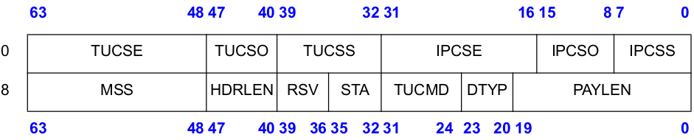
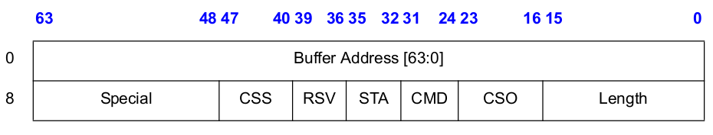
TX Descriptors contd...
Context Descriptors
Data Descriptors

Slide 16
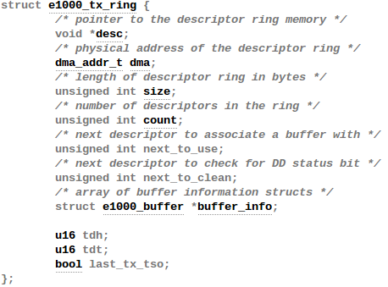
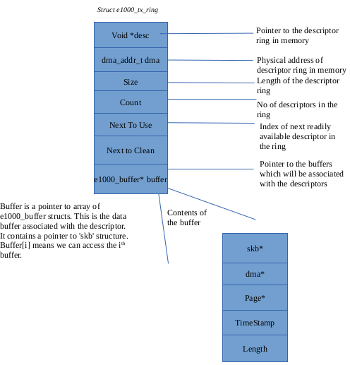
TX Ring in E1000

Slide 17
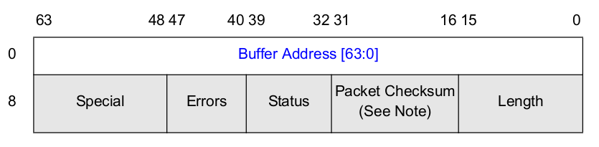
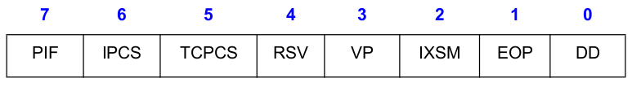
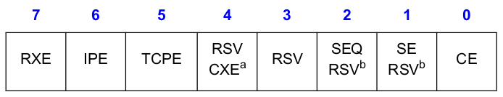
RX Descriptors
Similar to TX Descriptors
Status Field
Error field

Slide 18
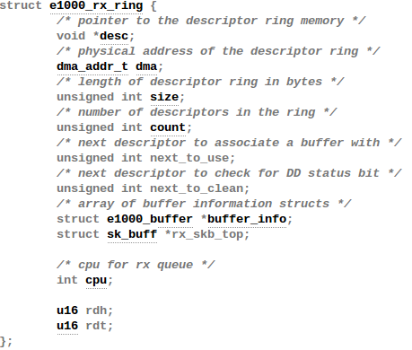
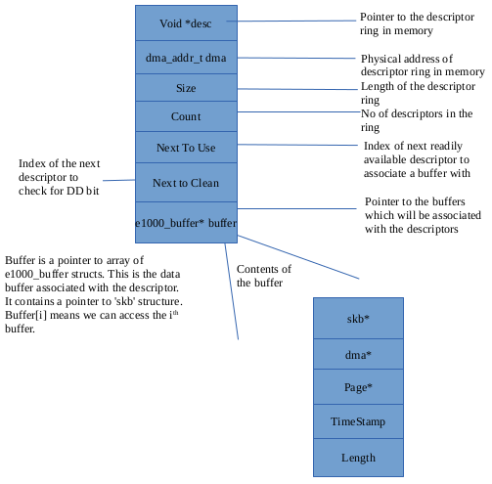
RX Ring in E1000

Slide 19
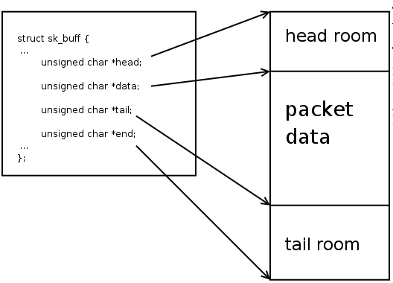
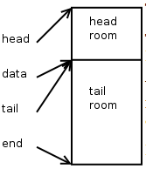
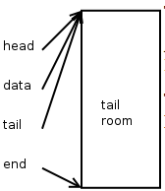
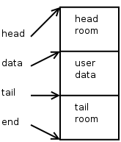
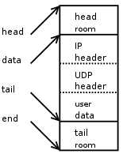
Quick overview on SKB

Slide 20
TX Checksum Offloading
Calculation of checksum – A chicken and egg problem.
Checksum not only includes headers. Includes pseudo headers as well.
Pseudo headers – Prepended to user datagram
Not transmitted with user data
L4 pseudo header includes some fields from L3 header. But why? To verify identity.
Final checksum calculation includes pseudo header, L4 header and L4 payload. Result stored in checksum field and passed down.
This entire thing can be done by NIC. Saves CPU cycles.
On reception, NIC passes packets with pre-calculated checksums and on transmission, NIC calculates the checksums.
Everything happens on a frame by frame basis
Software can help by storing the pseudo header alone, since it is light

Slide 21
TX Checksum Offloading in E1000
Important flags in device's structure (net_device)
NETIF_F_HW_CSUM – Clever NIC which can calculate the checksum for all protocols.
NETIF_F_IP_CSUM – NIC can calculate for IPV4
NETIF_F_IPV6_CSUM – Just for IPV6
Important flags in SKB (sk_buff)
skb->csum ( holds the checksum value if already calculated)
skb->ip_summed (CHECKSUM_NONE, CHECKSUM_HW, CHEKCSUM_UNNECESSARY, CHECKSUM_PARTIAL)
Feature flags are advertised during device registration
Flags in SKB are set by the driver and it can differ for each SKB

Slide 22
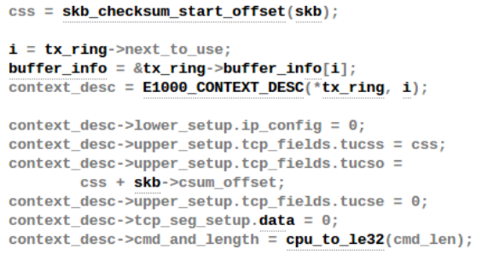
TX Checksum Offloading in E1000
e1000_xmit_frame – Main transmit function
Checks if it can accommodate the required number of descriptors.
Checks if the checksum offloading feature is enabled (e1000_tx_csum). If so, sets the context descriptor

Slide 23
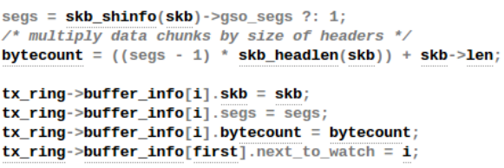
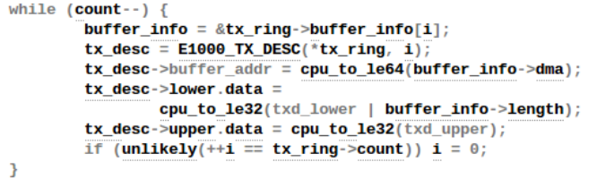
TX Checksum Offloading in E1000
After setting the context descriptors, it maps the buffers with descriptors (e1000_tx_map).
It finally queues the buffers and updates the data descriptors

Slide 24
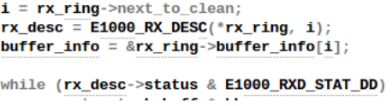
RX Checksum Offloading in E1000
NAPI – New API
Would be an overhead if an interrupt is generated for each and every packet
Alternate strategy
High load – Go to POLL mode
Low load – Go to INTERRUPT driven mode
Based on this the RX Ring is cleaned
NIC stores the data in the buffer specified by the descriptors and sets the DD bit.
Descriptors in RX Ring with DD bit are cleaned.

Slide 25
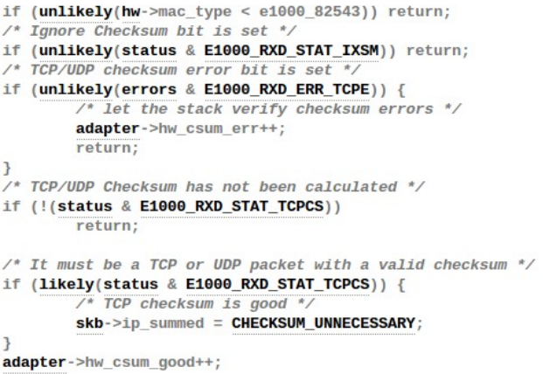
RX Checksum Offloading in E1000
If the DD bit is set, the packet is consumed.
Calls e1000_rx_checksum which sets the flags indicating the higher layer protocols of checksum calculation by the device

Slide 26
TCP Segmentation Offload in E1000
Transmission with TSO
Protocol stack receives a block from the application
Stack computes one Ethernet, IP and TCP header segment
Interfaces to driver only once per block and passes the block down
Driver sets up the TSO segmentation context descriptor.
Mostly software calculates the pseudo header and stores in the checksum field for the hardware to use.
Revisit the context descriptor
MSS – Maximum segment size
HDRLEN – Length of the header for each frame. First HDRLEN bytes stored from the data descriptors and used as prototype header.
PAYLEN – Total number of payload bytes for this context.
Command field
TSE bit need to be set.
If the context descriptor set without TSE bit, then it considered as checksum offload context

Slide 27
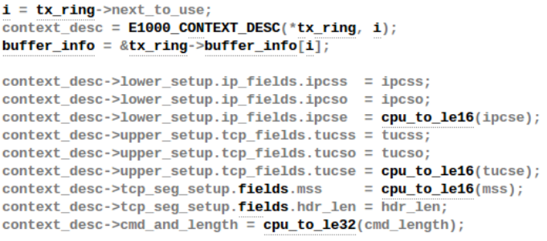
TCP Segmentation Offload in E1000
e1000_tso is the function responsible for setting up the context.
Needs device to support scatter-gather. Why? Device will receive super sized packets
Size is indicated in skb structure.

Slide 28
Thank You

