Slide 1
Smart NICs
Chidambaram Ramanathan

Slide 2
What is it
NICs few years back were dumb. Why?
  Lazy! Pass on whatever they receive and let kernel do the job
Intelligence need to be imparted to the NIC. But why?
  Tremendous increase in networking speed
  (1GBE, 10GBE, 40GBE and 100GBE!)
Let the mundane tasks not hog precious resource (CPU)
  Let NIC do what it can (i.e., offload tasks to the NIC)
How? NIC needs to smarter
  NIC can provide support and advertise to kernel that it can help

Slide 3
Offload Features
TCP Offload Engine (TOE)
  Offloads the entire TCP/IP stack to the network controller
    Let the NIC worry about it
  Advantages
    Reduces driver – hardware communication
    Reduces overhead in PCI traffic (e.g., smaller ack packets)
    Relieves the host processor of a great bottleneck
  Disadvantages
    Everything comes with a cost. MOORE'S LAW
    Cost of deploying is high too.
    Thus not much accepted in Linux community

Slide 4
Offload Features
Generic / TCP segmentation Offload
  Segmentation being performed at the NIC.
  Applied to TCP alone called TCP segmentation offload.
  Driver receives super sized blocks.
  Can be observed in Wireshark.
    Packet captures can show packet of size > 1500 (MTU)
      No magic. It’s segmentation Offload.
  Advantages
    Reduced programming of hardware registers by driver
    Comparatively less complex to implement.
    Efficiently uses PCI bus and reduces CPU cycles
    Majorly accepted in Linux community

Slide 5
Offload Features
Scatter Gather IO
  Network packets need not be of Fixed size.
  Can allocate two SKB's to hold this data.
    Can be waste of space
  Can store as much as data in one SKB
    Then store the extra data alone in a data structure tailored for this
  Appears as consecutive pages to the DMA

Slide 6
Receive Side Scaling
Receive Side Scaling
  Enables NIC to distribute packets across multiple cores
  NIC can send different packets to different queues
    Distribute processing among CPUs
  Boosts performance in higher traffic loads
  Supports multiple receive and transmit descriptor queues

Slide 7
Offload Features
Checksum Offloading
  What everyone wants? More gain with little cost.
    Answer: TCP/UDP checksum offloading
  Transmit
    Tell device to calculate the checksums.
      Indicate the offset of checksum in the packet.
  Receive
    Device calculates the checksum and informs the stack
  Stack can be relieved of petty checksum calculations
  Implemented in Linux for TCP/UDP and IP

Slide 8
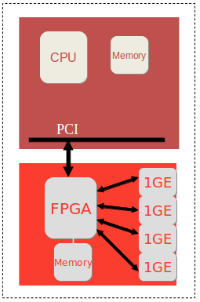
NetFPGA
Hardware accelerator built with FPGA
We focus on NetFPGA 10G
  Has 4 10G ports
  Sits on other side of PCIe bus
Driver is a loadable kernel module

Slide 9
Importance of Offload features
Why are offload features important in NetFPGA?
  NetFGPA driver is still in rudimentary phase
    Needs a lot of improvement
  NetFPGA is of chief interest for researchers
Offload features can be implemented in NetFGPA
NetFGPA driver can instruct device to do offload
Implement the offload features
  Measure the performance
  Tune the device to improve efficiency
    Cannot be done with INTEL

Slide 10
Let’s start
Packet transmission overview
  Driver and device decide up in front
  Agree on a ring structure
  Stack receives a packet (non TSO context)
    For each packet, calculates the Ethernet, IP, and TCP/UDP headers
    Interfaces with device driver, commands driver to send packets
    Driver puts the packets in the ring and indicates the H/W
    H/W fetches packets from ring and sends out
    H/W tells status to the device driver.

Slide 11
TX Ring
Important component in the transmission part.
  FIFO buffer
Can be queued asynchronously by the software / hardware.
  To appreciate the design, consider an alternate solution where the NIC has to regularly ask the s/w for packets to transmit. Not efficient
  This solution is elegant. S/W and H/W can independently queue packets.
Actual ring does not contain packet data (contains descriptors)
  Descriptors contain pointers to skb's (socket buffers)
    Also contain command and status bits
    Physical address of the skb etc.
  Reusable descriptors and skb's are created and allocated up front
NIC contains internal memory
  Stores (pre-fetches) descriptors for faster access

Slide 12
TX Ring ctd...
Pair of registers maintain the transmit queue
To transmit packets, S/W writes descriptors to ring
  Moves the tail pointer
    Tail points one entry beyond the H/W owned descriptor
After transmitting
  NIC moves head pointer and sets status bit
Transmission stops when head == tail
S/W waits to modify descriptors until head advances
H/W should not send anything beyond tail pointer

Slide 13
RX Ring
Analogous to TX Ring
S/W adds receive descriptors by writing tail pointer
  Index of the entry beyond the last valid descriptor
H/W increments head pointer after storing packets
  Uses DMA to memory pointed to by the descriptor
When head == tail, queue is empty (no packets received)
NIC pre-fetches descriptors and stores in internal cache
  More efficient than transferring every time
Has three registers to manipulate the ring
  BAR – Base address register
  LEN – length register
  Head – Register denoting the position of head pointer
  Tail – Register denoting the poistion of tail pointer

Slide 14
TX Descriptors
Contents of the TX ring
Describe the operation to be done
Data and Context descriptors
  Data descriptors describe the skb
  Context descriptors describe the mode
    TSO / Checksum offloading etc.
  Context descriptors are set one time for each context
    Performance benefit
  To change context, over-write the context descriptor

Slide 15
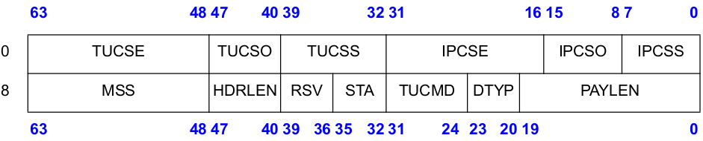
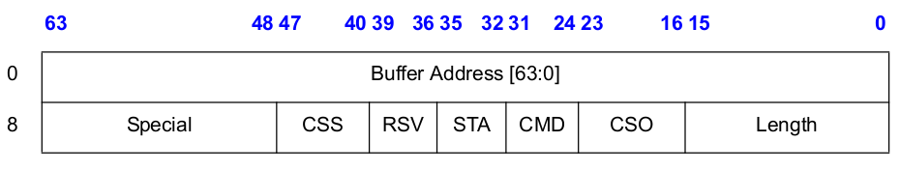
TX Descriptors cont'd…
Context Descriptors

Slide 16
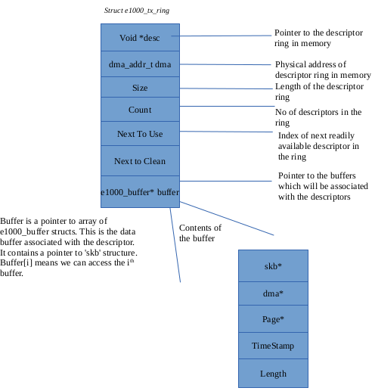
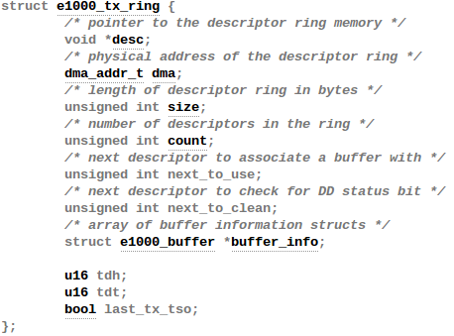
TX Ring in E1000

Slide 17
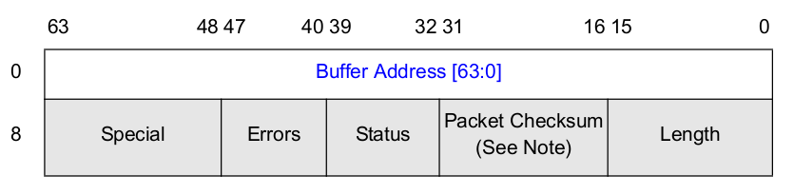
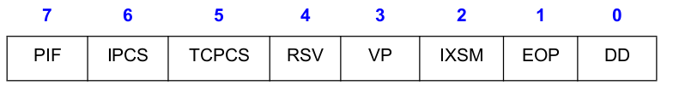
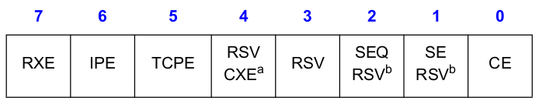
RX Descriptors
Similar to TX Descriptors
Status Field
Error field

Slide 18
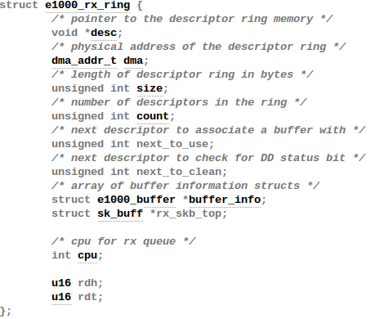
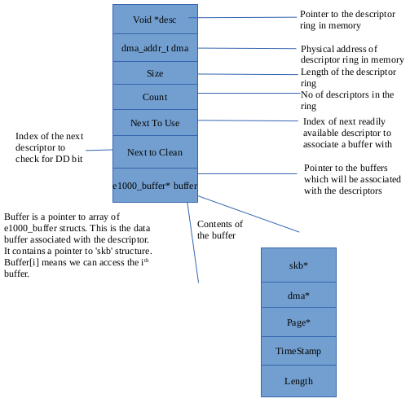
RX Ring in E1000

Slide 19
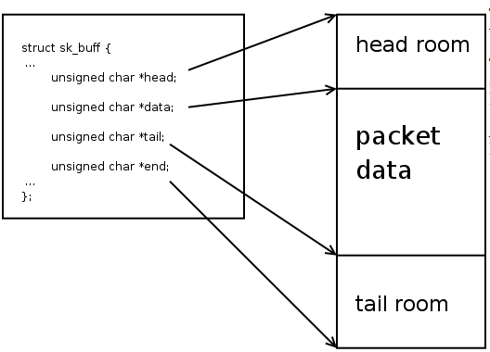
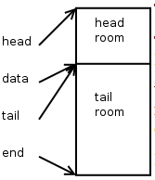
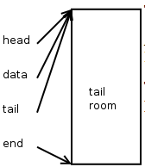
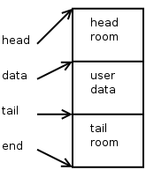
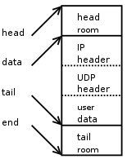
Quick overview on SKB

Slide 20
TX Checksum Offloading
Calculation of checksum – A chicken and egg problem.
  Checksum not only includes headers. Includes pseudo headers too.
Pseudo headers – Prepended to user datagram
  Not transmitted with user data
  L4 pseudo header includes fields from L3 header
    Why? To verify identity.
  Final checksum calculation includes …
    pseudo header, L4 header , L4 payload.
  Result stored in checksum field and passed down.
Entire calculation can be done by NIC. Saves CPU cycles.
  On reception, NIC passes packets with pre-calculated checksums
  On transmission, NIC calculates the checksums
Everything happens on a frame by frame basis
Software helps by storing pseudo header alone, since it is light

Slide 21
TX Checksum Offloading in E1000
Important flags in device's structure (net_device)
  NETIF_F_HW_CSUM – Can calculate checksum for all protocols
  NETIF_F_IP_CSUM – NIC can calculate for IPV4
  NETIF_F_IPV6_CSUM – Just for IPV6
Important flags in SKB (sk_buff)
  skb->csum (holds the checksum value if already calculated)
  skb->ip_summed (CHECKSUM_NONE, CHECKSUM_HW, CHEKCSUM_UNNECESSARY, CHECKSUM_PARTIAL)
Feature flags are advertised during device registration
Flags in SKB are set by driver and can differ for each SKB

Slide 22
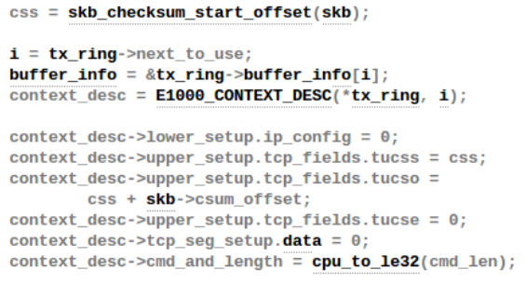
TX Checksum Offloading in E1000
e1000_xmit_frame – Main transmit function
  Checks if can accommodate number of descriptors
  Checks if the checksum offloading feature is enabled
    e1000_tx_csum
    If yes, sets the context descriptor

Slide 23
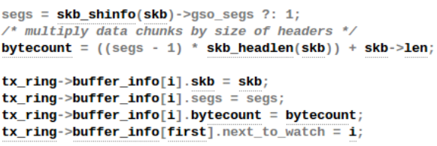
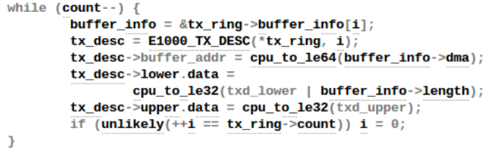
TX Checksum Offloading in E1000
After setting context descriptors
maps buffers with descriptors (e1000_tx_map).
Finally queues buffers and updates data descriptors

Slide 24
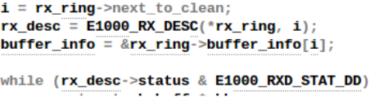
RX Checksum Offloading in E1000
NAPI – New API
  Lots of overhead if interrupt generated for each packet
  Alternate strategy
    High load – Go to POLL mode
    Low load – Go to INTERRUPT driven mode
    Based on this, RX Ring is cleaned
NIC stores data in buffer specified by descriptors
  Sets the DD bit
Descriptors in RX Ring with DD bit are cleaned

Slide 25
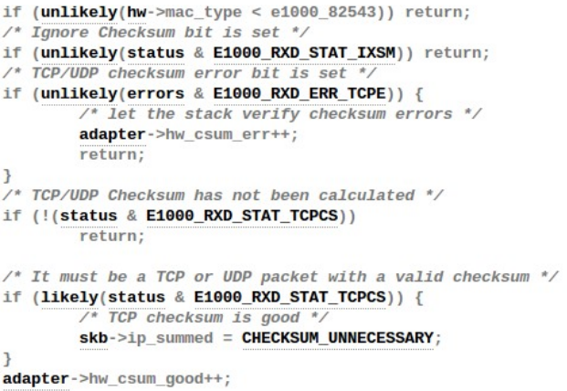
RX Checksum Offloading in E1000
If the DD bit is set, packet is consumed.
Calls e1000_rx_checksum
  Sets flags indicating higher layer protocols of checksum calculation by device

Slide 26
TCP Segmentation Offload in E1000
Transmission with TSO
  Protocol stack receives a block from application
  Stack computes Ethernet, IP, and TCP header segment
  Interfaces to driver once per block and passes block down
  Driver sets up TSO segmentation context descriptor
    Calculates pseudo header, stores in checksum field for H/W to use
Revisit the context descriptor
  MSS – Maximum segment size
  HDRLEN – Length of the header for each frame.
    First HDRLEN bytes from data descriptors used as prototype header
  PAYLEN – Total number of payload bytes for this context
  Command field
    TSE bit needs to be set
    If context set without TSE bit, considered checksum offload context

Slide 27
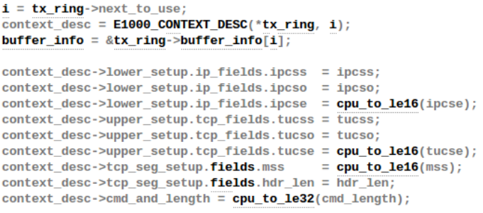
TCP Segmentation Offload in E1000
e1000_tso function responsible for context setup
  Needs device to support scatter-gather
    Why? Device will receive super-sized packets
Size is indicated in skb structure.

Slide 28
Thank You

