Slide 1
MINI-DSKG / PROJECT REVIEW
MINI-
DSKG
A knowledge graph of ML datasets and scientific papers
Jonnala Chidananda Reddy | B.Tech Computer Science | VIT-AP University
MINI-DSKG
PROJECT REVIEW
PAGE
1 / 13

Slide 2
MINI-DSKG / PROJECT REVIEW
PROBLEM 01
PROBLEM STATEMENT
It is hard to see which datasets a paper uses.
Many scientific papers use ML datasets. A paper can name a dataset in its title or in its abstract.
But a reader cannot easily see these links between papers and datasets.
PROBLEM 02
It is hard to find datasets that are similar. It is also hard to find datasets that apply to a problem.
MINI-DSKG
PROJECT REVIEW
PAGE
2 / 13

Slide 3
MINI-DSKG / PROJECT REVIEW
PROJECT OBJECTIVE
Make a knowledge graph that connects ML datasets to scientific papers.
PAPER
P
P
P
D
mentioned
D
DATASET
P
P
P
MATCH BY NAME
SMALL-SCALE DSKG
A paper connects to a dataset if its title or abstract has the name.
Use the DSKG method at a small scale. Make the graph with NetworkX.
MINI-DSKG
PROJECT REVIEW
PAGE
3 / 13

Slide 4
MINI-DSKG / PROJECT REVIEW
REFERENCES
LINKS
(A) TUTORIAL
Video: youtube.com/watch?v=n7BTWc2C1Eg
Notebook: github.com/bnsreenu/python_for_microscopists, file 354_knowledge_graphs_using_NetworkX.ipynb
(B) DSKG
Code: github.com/michaelfaerber/data-set-knowledge-graph
Paper: direct.mit.edu/qss/article/2/4/1324/108051
Mini-DSKG uses two sources. One source gives the graph procedures. The other source gives the method.
(A) TUTORIAL
DigitalSreeni, 'Knowledge Graphs in Python Using NetworkX'.
Use: make the graph, add node and edge attributes, find centrality, communities and similarity, write GraphML.
(B) DSKG
Faerber et al., 'The Data Set Knowledge Graph' (QSS).
Use: find dataset names in abstracts, link datasets to papers, find the impact of each dataset.
MINI-DSKG
PROJECT REVIEW
PAGE
4 / 13
Notes:
Sources:
https://www.youtube.com/watch?v=n7BTWc2C1Eg
https://github.com/bnsreenu/python_for_microscopists/blob/master/354_knowledge_graphs_using_NetworkX.ipynb
https://github.com/michaelfaerber/data-set-knowledge-graph
https://direct.mit.edu/qss/article/2/4/1324/108051/
Uses: /workspace/minidskg/README.md section 2.

Slide 5
MINI-DSKG / PROJECT REVIEW
AUTHOR
GRAPH STRUCTURE
writtenBy
PAPER
DATASET
PAPER
mentioned
An ML dataset from the catalog. A similarTo edge connects two datasets by the Jaccard score of shared papers.
A paper from OpenAlex or arXiv. A mentioned edge connects the paper to each dataset that it names.
similarTo
DATASET
usedFor
AUTHOR
TASK
A person who wrote a paper. A writtenBy edge connects the paper to the author.
The task of a dataset in the catalog. A usedFor edge connects the dataset to the task.
TASK
MINI-DSKG
PROJECT REVIEW
PAGE
5 / 13
Notes:
Source: /workspace/minidskg/README.md section 3; src/build_graph.py (node kinds, relations, Jaccard similar pairs).

Slide 6
MINI-DSKG / PROJECT REVIEW
BUILD
PIPELINE
01
Read the catalog.
data/datasets.csv
02
Get papers from OpenAlex. Use arXiv if OpenAlex refuses.
src/fetch_papers.py
DATA FILES, IN THE ORDER OF THE STEPS
03
Find dataset names in the paper text.
src/match_mentions.py
datasets.csv
papers.jsonl
mentions.csv
mini_dskg
.graphml
analysis.json
explorer.html
04
Make the NetworkX graph. Write GraphML, analysis and HTML.
build_graph.py, analyze.py, visualize.py
The data/ folder holds the CSV, JSONL and GraphML files. The outputs/ folder holds analysis.json and explorer.html.
MINI-DSKG
PROJECT REVIEW
PAGE
6 / 13
Notes:
Source: /workspace/minidskg/README.md section 4 (data flow and commands).

Slide 7
MINI-DSKG / PROJECT REVIEW
NAME MATCHING
# tests/test_match.py (short form)
text = ("We pre-train ResNet-18 on
CIFAR-10 and then fine-tune on
ImageNet. This paper presents
data for the experiment.")
hits = find_mentions(text, catalog)
assert "cifar-10" in hits
assert "imagenet" in hits
# "data" is not in the hits
The catalog gives each dataset a name and a list of aliases. The procedure looks for each alias in the title and the abstract of each paper.
An alias must not have a letter or a digit next to it. Short names in capital letters, such as COCO and GLUE, must match the case. Other names match in any case.
Aliases with fewer than 3 letters are not used. Common English words are not used. Thus "data" is not a dataset name.
CIFAR-10
The check finds CIFAR-10 and ImageNet in a sample abstract. It does not find "data".
MINI-DSKG
PROJECT REVIEW
PAGE
7 / 13
Notes:
Source: /workspace/minidskg/src/match_mentions.py (STOPWORDS, usable_alias, _flags, compile_alias_index) and tests/test_match.py.

Slide 8
MINI-DSKG / PROJECT REVIEW
ANALYSIS
METHODS
COUNT AND RANK
01. MENTIONS
The number of papers that name the dataset.
02. H-INDEX
h papers each have h or more citations.
03. BETWEENNESS
Datasets that connect different groups.
COMPARE AND FIND
04. JACCARD
Shared papers divided by all papers of two datasets.
05. SEARCH
Rank datasets by the problem words in their papers.
06. COMMUNITIES
Groups of datasets that share papers.
MINI-DSKG
PROJECT REVIEW
PAGE
8 / 13
Notes:
Source: /workspace/minidskg/src/analyze.py.
Betweenness, degree centrality and communities use a dataset graph: two datasets connect if they share a paper (weight = number of shared papers).
Problem search: the procedure removes small words from the problem text. For each paper, it counts the problem words in the title and abstract. Each dataset that the paper mentions gets that count. The datasets with the highest totals come first.

Slide 9
MINI-DSKG / PROJECT REVIEW
RESULTS
DATASETS
78
PAPERS
1,667
Dataset nodes in the graph. They connect to 36 tasks.
MENTIONS
2,104
Paper nodes in the graph, with 4,871 authors.
TOP DATASET: IMAGENET
ImageNet occurs in 106 papers.
The h-index of ImageNet is 50.
Links from a paper to a dataset that it names.
MINI-DSKG
PROJECT REVIEW
PAGE
9 / 13
Notes:
Source: /workspace/minidskg/outputs/analysis.json (n_datasets 78, n_papers 1667, n_tasks 36, n_authors 4871, top_mentions ImageNet 106 / h_index 50) and README.md section 6 (2104 mentions).

Slide 10
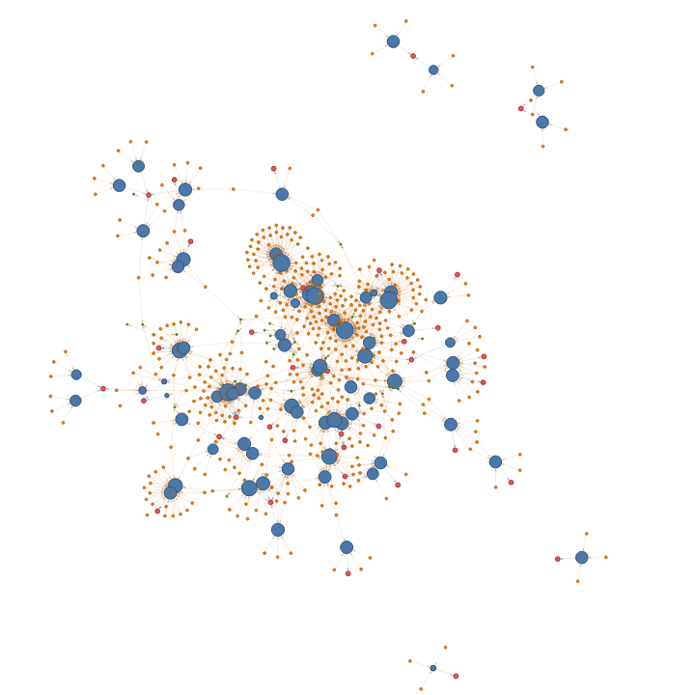
MINI-DSKG / PROJECT REVIEW
DEMO
The explorer shows the graph in a browser. The analysis gives answers to these questions.
SIMILAR TO IMAGENET
Jaccard score of shared papers
1. Tiny ImageNet
2. CIFAR-10
DATASETS FOR A PROBLEM
Problem text: "object detection in autonomous driving"
1. Waymo Open Dataset
2. nuScenes
3. KITTI
outputs/explorer.html. Blue: dataset. Orange: paper. Red: task.
MINI-DSKG
PROJECT REVIEW
PAGE
10 / 13
Notes:
Source: /workspace/minidskg/outputs/analysis.json (similar_to_imagenet, problem_search) and README.md section 6.
Screenshot: outputs/explorer.html rendered with headless Chrome, cropped to the graph.

Slide 11
MINI-DSKG / PROJECT REVIEW
SCOPE AND LIMITS
IN SCOPE
NOT IN SCOPE
Small-scale DSKG with papers from OpenAlex and arXiv.
No MAG dumps.
A NetworkX graph, written to GraphML.
No GraphDB and no SPARQL CONSTRUCT.
An HTML explorer and a test for name matching.
No LDA author disambiguation.
MINI-DSKG
PROJECT REVIEW
PAGE
11 / 13
Notes:
Source: /workspace/minidskg/README.md sections 2(b), 4, 4.7.

Slide 12
MINI-DSKG / PROJECT REVIEW
SUMMARY
CONCLUSION
FUTURE WORK
Mini-DSKG connects 78 datasets to 1,667 papers.
The graph answers questions on dataset use, impact and similarity.
It also finds datasets for a problem text.
Add more datasets and more papers.
Find dataset names in the full text of papers, not only in the title and the abstract.
Add author disambiguation. Put the graph in a graph database with a SPARQL endpoint.
MINI-DSKG
PROJECT REVIEW
PAGE
12 / 13
Notes:
Conclusion source: outputs/analysis.json, README.md sections 5 and 6. Future work: next steps from the limits in README.md section 2(b).

Slide 13
MINI-DSKG / PROJECT REVIEW
THANK
YOU
Questions?
Jonnala Chidananda Reddy | B.Tech Computer Science | VIT-AP University
MINI-DSKG
PROJECT REVIEW
PAGE
13 / 13

