Slide 1

◆ Loan Approval Prediction
Presented by :
Shammah Ndubuisi
Business
Understanding Report
Week 2 Internship Report

Slide 2

◆ Business Understanding Report
The Business Problem
THE DECISION
THE RISK
THE DATA CHALLENGE
A lender must decide whether each loan application is approved (Y) or not (N), using applicant details such as income, credit history, loan amount and property area.
Approving a weak application risks a loss; rejecting a strong one loses a customer. Decisions must be consistent and based on evidence, not guesswork.
Only 614 labelled applications, with gaps, skewed incomes and mixed data types. Raw data cannot go straight into a model.
The goal of the project was to turn raw applications into a clean, ML-ready dataset that predicts approval

Slide 3
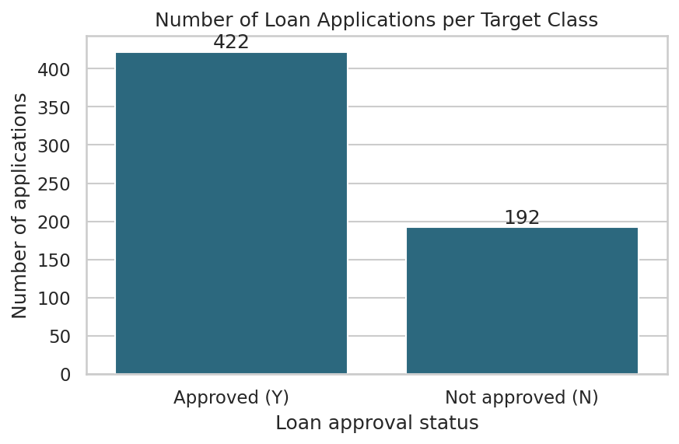
◆ Business Understanding Report
Understanding the Data
614
13
training applications
columns (12 features + target)
367
7
test applications, no answers
columns with missing values
69% approved, 31% not approved. The implication is that a model that always says "approved" is right 69% of the time, so accuracy alone would be misleading.

Slide 4
◆ Business Understanding Report
Preprocessing Decisions
01
Missing values
02
Duplicates and types
Filled with the training-set mode (categories, credit history, term) or median (loan amount).
No duplicates found. "3+" dependents became 3; credit history and term became whole numbers.
03
Outliers
04
Encoding and scaling
Capped at IQR limits instead of deleting rows. With 614 rows, every row counts.
Binary 0/1 labels, one-hot for property area, StandardScaler on continuous columns.

Slide 5
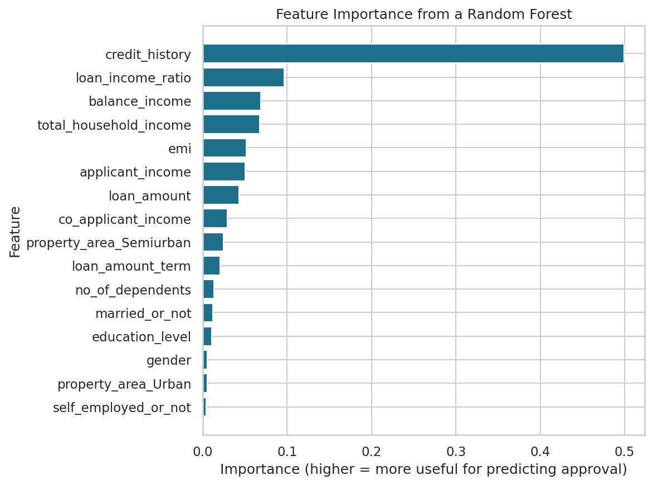
◆ Business Understanding Report
Feature Engineering
The following features were created to gain a better understanding of the data
total_household_income
Applicant + co-applicant income: lenders look at the whole household.
loan_income_ratio
Loan ÷ income: how large the loan is compared with ability to pay.
emi
Loan ÷ term: a rough monthly repayment.
balance_income
Income minus emi: money left after repayment.
loan_income_ratio ranked second in importance. emi and balance_income were later dropped as redundant.
Loan amount is in thousands, so it was multiplied by 1,000 before comparing with income.

Slide 6
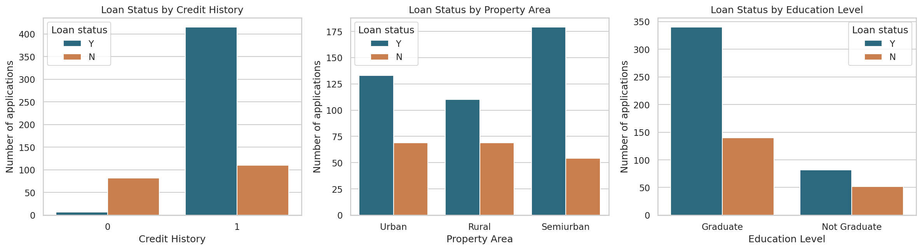
◆ Business Understanding Report
Key Observations
Credit history decides
Area and marital status help
Gender and self-employment
About 80% approved with a good credit history, versus about 8% without.
Semi-urban properties and married applicants have somewhat higher approval rates.
Little difference in approval, so they add almost no signal.

Slide 7
◆ Business Understanding Report
Why These Choices
Mode and median
Categories have no meaningful mean; the median is not pulled up by a few huge loans.
Cap, do not delete
High incomes look genuine, and the dataset is too small to lose rows.
Fit on training only
Fill values, outlier limits and the scaler come from training data to avoid leakage.
Remove gender
No link to approval, and a sensitive attribute that should not drive credit decisions.
Ready for modelling: 614 rows, numeric features, 0/1 target, no missing values. It is important to use a validation split, as the target is 69/31 imbalanced.

