Slide 1

◆ Loan Approval Prediction
Presented by :
Shammah Ndubuisi
Data
Preprocessing Report.
Week 2 Internship Report

Slide 2

◆ Data Preprocessing Report
Business Context
THE BUSINESS PROBLEM
THE PREPROCESSING GOAL
Predict whether a loan application is approved (Y) or not (N) from applicant details.
The raw data has 614 training rows and 13 columns, with missing values in 7 columns, heavily skewed incomes and a text value ("3+") in a numeric column.
Produce a clean, fully numeric dataset where train and test are prepared in exactly the same way, with nothing learned from the test set.
Every step is recorded with what was done and why.

Slide 3
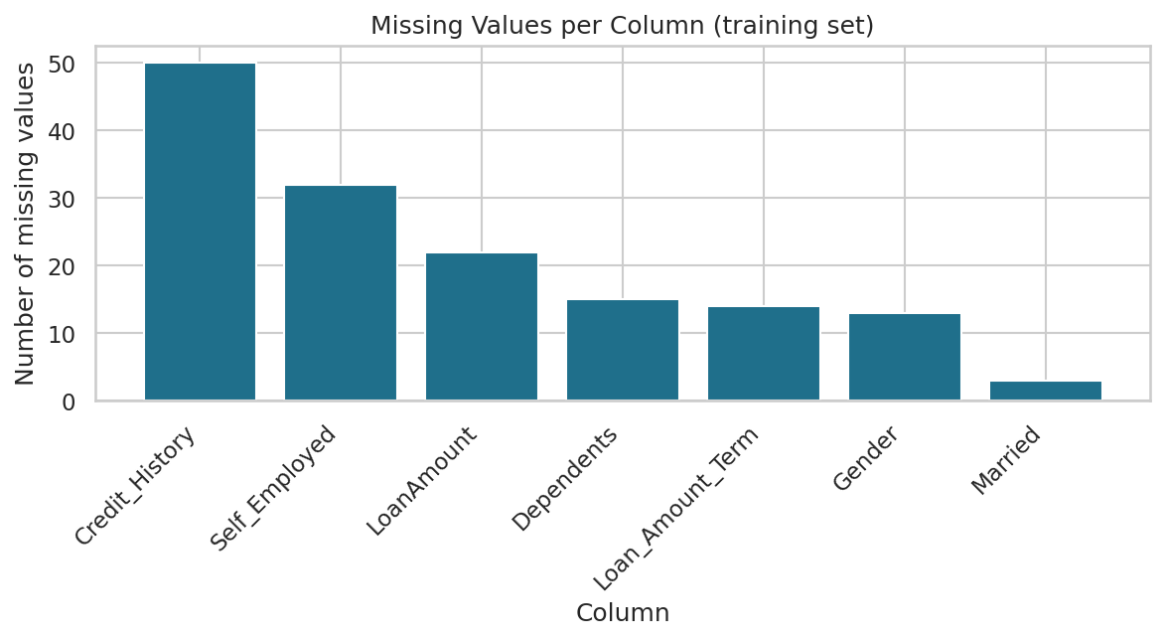
◆ Data Preprocessing Report
Cleaning Decisions
Categories, credit, term
Filled with the mode. Credit history is 0/1 and 83% of terms are 360 months.
loan_amount
Filled with the median, because a few very large loans pull the mean up.
Duplicates
Checked rows and loan_id in train and test. None found, none removed.
Credit_History (50), Self_Employed (32) and LoanAmount (22) have the most gaps.
Data types
"3+" became 3; credit history and term converted to whole numbers.

Slide 4
◆ Data Preprocessing Report
Feature Engineering & Encoding
New features
Encoding
total_household_income: applicant + co-applicant income
loan_income_ratio: loan ÷ total income
emi: loan ÷ term (monthly repayment)
balance_income: income − emi
Label encoding (0/1): gender, married, education, self-employed and the target. Two values need one column.
Kept as a number: dependents (0 to 3), because the order matters. 3+ is treated as 3.
One-hot encoding: property_area, because its 3 areas have no order. drop_first avoids a redundant column.
Loan amount × 1,000 first, as it is recorded in thousands.

Slide 5
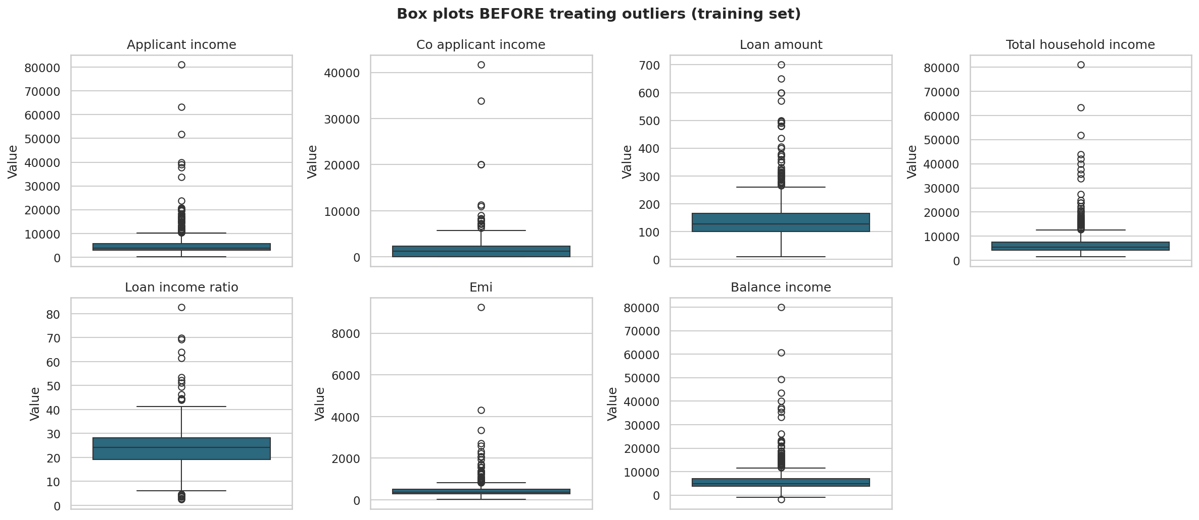
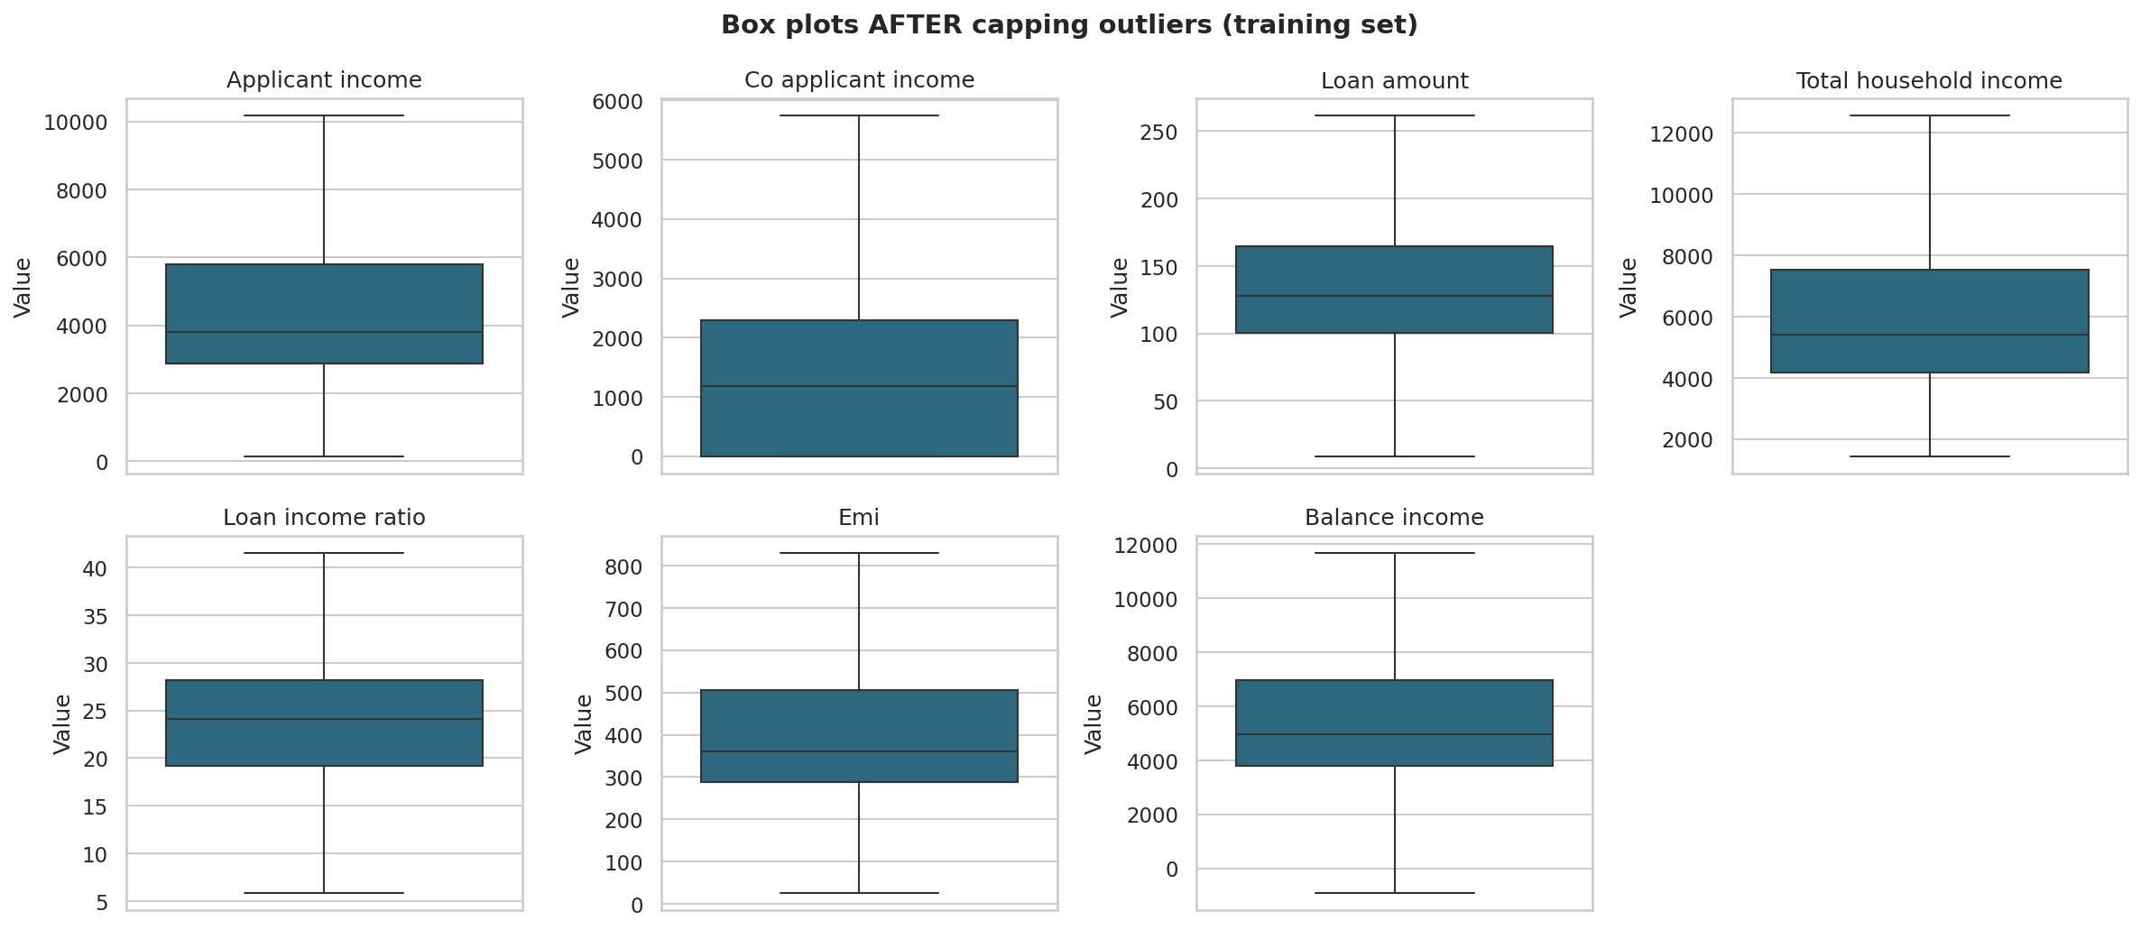
◆ Data Preprocessing Report
Outliers and Scaling
Detect
Treat
Scale
IQR rule (1.5 × IQR). Z-scores miss outliers in skewed data because they inflate the standard deviation.
Values capped at the IQR limits, not deleted. High incomes look genuine and rows are scarce.
StandardScaler on 8 continuous columns, fitted on train only. Safe after capping.

Slide 6
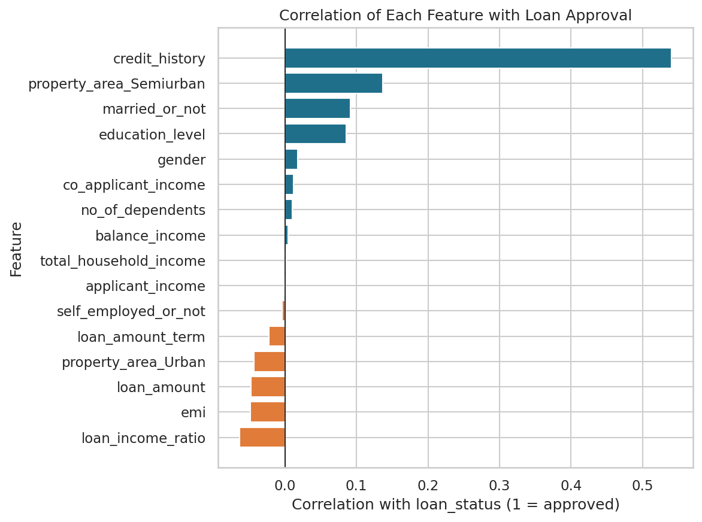
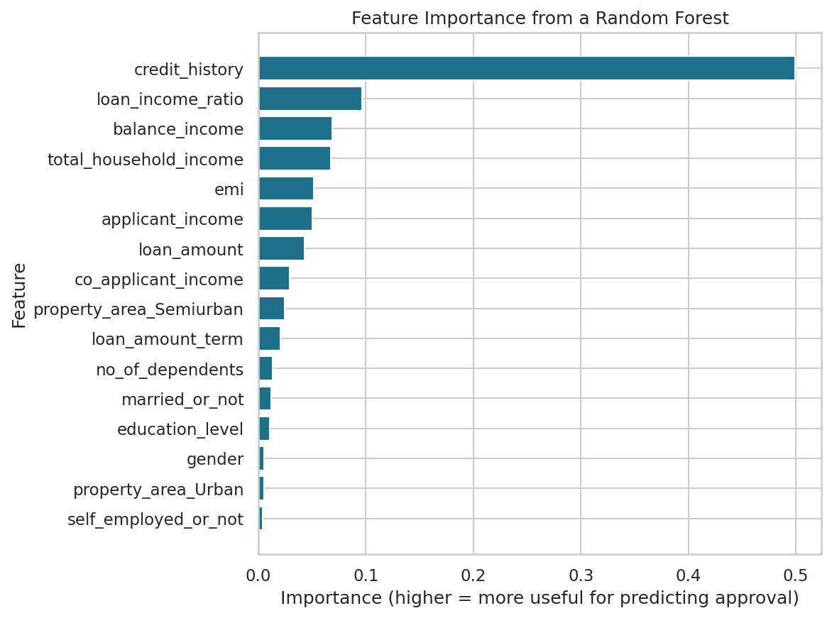
◆ Data Preprocessing Report
Feature Selection and Key Observations
credit_history: r ≈ 0.54 with approval, about half of total importance
Removed: balance_income, emi, gender, loan_id
balance_income (r = 0.99) and emi (r = 0.86) repeat other features. Gender had no link to approval.

Slide 7
◆ Data Preprocessing Report
Justification Summary
Mode / median
Suits categories and skewed numbers; no distortion from extreme loans.
Train-only fitting
Fill values, limits and scaler never see test data, so no leakage.
Cap outliers
Keeps all 614 rows while limiting extreme values.
One-hot vs label
Avoids implying a false order for property area.
Drop redundancy
Highly correlated pairs (|r| ≥ 0.8) add no new information.
The final machine learning data set is passed as all numeric with no missing value. The train and test sets share the same features and target is 0/1.

