Slide 1
FDM UK Mobile Analysis: Insights from October to December 2019
Weighted Sales: Avg. Number of Tariff plans * Avg. Monthly Cost
Packages: Mins | Text |Data
Promo Value: Standard – Headline
Promo Value Lift: (Standard – Headline)/Standard * 100
Cost Impact: MLR/Life Cost
Data Contribution: Monthly Cost Per GB/ Avg Monthly Cost
Data Boost Value: Data Promo Value (%) * (1 + Headline MLR Promo Value (%)/100)
In-Contract Price Escalation: ∑(In-Contract Price * Tenure)/ ∑(Tenure)
A/B Test: T.test (Two-sample equal variance (homoscedastic))
Additional KPI Formula Glossary
By: Chidiebere Ogbuchi

Slide 2
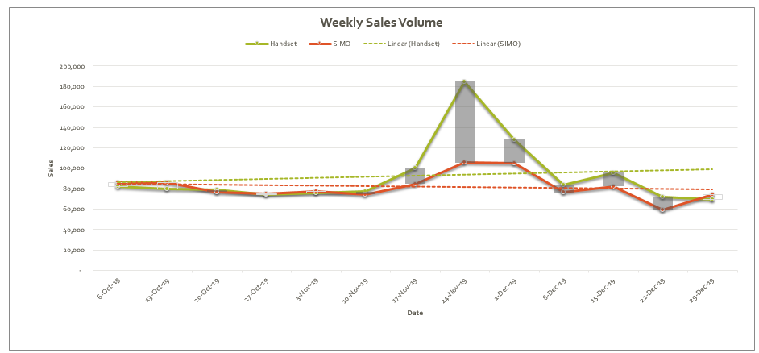
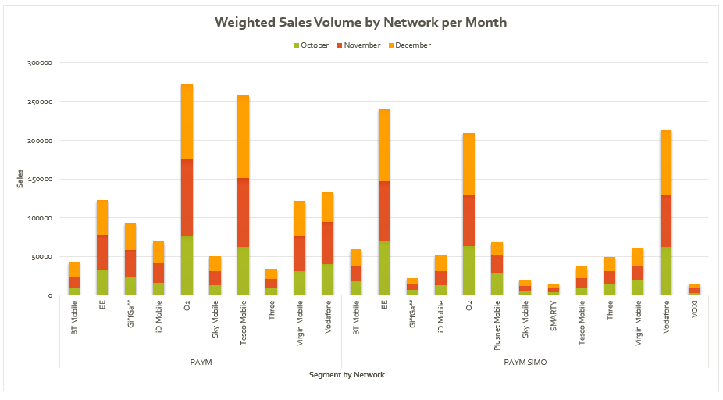
UK Mobile Market Insights: October to December 2019
The UK Mobile Market recorded average weekly sales of 92K Handsets and 82K SIMO plans, with November witnessing the highest sales difference of ~79K units.
PAYM Handset plans from O2 and Tesco Mobile drove the sales surge in November, contributing significantly to the peak performance.
SIMO plans consistently performed well, led by EE and Vodafone, supported by attractive data-focused promotions.
Promotional activities, particularly on PAYM plans, and competitive data boosts played a crucial role in driving segment-specific sales trends.
Assumption of equal sales across tariff plans and ignoring any effect of market dynamics
Notes:
Title: UK Mobile Market Insights: October to December 2019
Key Insights:
The UK Mobile Market recorded average weekly sales of 92K Handsets and 82K SIMO plans, with November witnessing the highest sales difference of ~79K units.
PAYM Handset plans from O2 and Tesco Mobile drove the sales surge in November, contributing significantly to the peak performance.
SIMO plans consistently performed well, led by EE and Vodafone, supported by attractive data-focused promotions.
Promotional activities, particularly on PAYM plans, and competitive data boosts played a crucial role in driving segment-specific sales trends.
MLR is correlated to Average monthly cost
Cost significantly affects sales by influencing pricing, profitability, and consumer purchasing behavior. Here's a breakdown of how cost impacts sales:
1. Pricing Strategies
Cost as the Basis for Pricing: Businesses set prices by adding a markup to the cost to ensure profitability. Higher costs often lead to higher prices, which can reduce sales if the product becomes unaffordable or uncompetitive.
Example: In the Telco sector, if the cost of rolling out 5G infrastructure is high, providers may charge premium prices for 5G plans. If customers perceive these prices as too high, adoption rates may slow.
2. Profit Margins and Flexibility
Low Costs Enable Competitive Pricing: Businesses with lower costs can offer competitive prices while maintaining profitability, driving higher sales volumes.
Example: MVNOs often operate with lower infrastructure costs by leasing network access, enabling them to offer cheaper plans that attract price-sensitive customers.
High Costs Can Limit Discounts: If costs are high, a company may lack flexibility to offer promotions, potentially losing customers to competitors.
3. Perceived Value
High Cost Doesn’t Always Deter Sales: If customers perceive the product as high-value or essential, they may be willing to pay a premium, even if costs and prices are high.
Example: A Telco provider offering exclusive, reliable network coverage may sustain high sales even with higher pricing.
4. Customer Demand and Affordability
Price Elasticity of Demand: The relationship between cost, pricing, and demand depends on how sensitive customers are to price changes.
If a product is price-sensitive (elastic), higher prices due to higher costs can result in reduced sales.
If the product is inelastic (e.g., essential services), sales may not drop significantly despite higher prices.
Example: Basic mobile connectivity plans are often inelastic, but premium add-ons like international roaming may see reduced sales if prices rise due to higher costs.
5. Cost Reduction to Boost Sales
Operational Efficiency: Companies that manage costs effectively (e.g., through automation or economies of scale) can reduce prices or increase marketing spend, driving more sales.
Example: A Telco operator that reduces network maintenance costs could offer more competitive tariffs, attracting more customers.
6. Psychological Pricing
If customers associate higher costs with better quality, businesses can leverage premium pricing to attract specific segments, even if overall sales volume is lower.
Conversely, aggressive cost-cutting leading to overly low prices may damage perceived quality and reduce sales.
Summary:
Cost affects sales primarily by shaping pricing, which influences customer behavior and market competitiveness. Companies need to balance cost management, pricing strategy, and perceived value to maximize sales without compromising profitability or customer satisfaction.

Slide 3
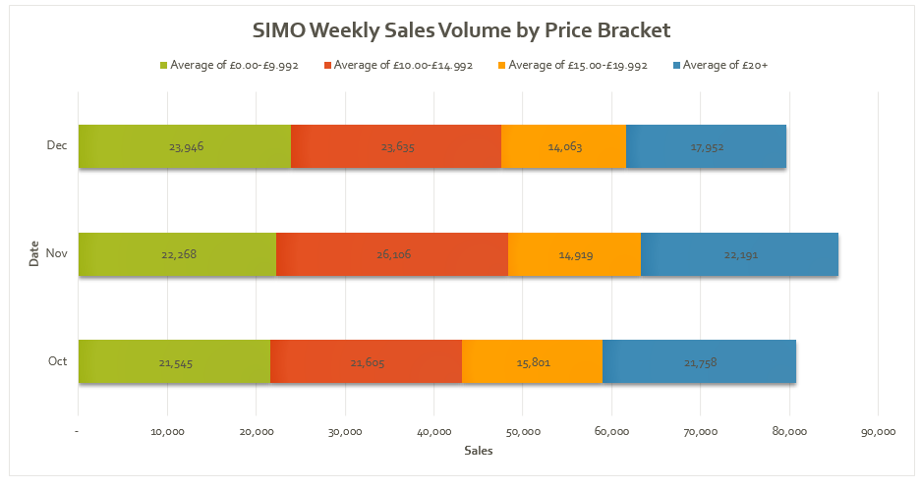
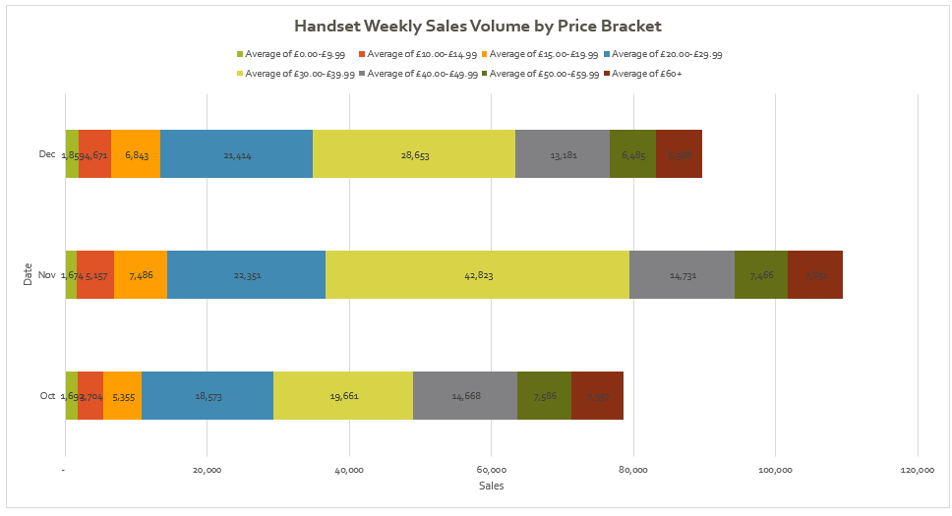
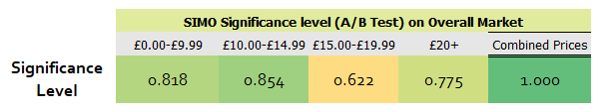
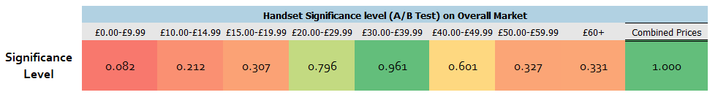
How did Pricing and Segment Preferences Impact Sales Performance?
Sales were distributed across different pricing brackets, revealing clear consumer preferences in both SIMO and Handset segments.
SIMO Plans: Performance was heavily influenced by the £0.00-£9.99 and £10.00-£14.99 brackets, indicating that users favor cheaper plans.
Handset Plans: Users showed a preference for mid-range pricing, particularly in the £20.00-£29.99 and £30.00-£39.99 brackets, which reflected in the overall sales volume dominance.
These trends emphasize the importance of pricing strategy tailored to segment-specific consumer behavior.
N.B: A/B test Significance level threshold – 0.95
Notes:
Title: Pricing Brackets and Segment Preferences in the UK Mobile Market
How did Segments Impact Sales Performance?
Key Insights:
Sales were distributed across different pricing brackets, revealing clear consumer preferences in both SIMO and Handset segments.
SIMO Plans: Performance was heavily influenced by the £0.00-£9.99 and £10.00-£14.99 brackets, indicating that users favor cheaper plans.
Handset Plans: Users showed a preference for mid-range pricing, particularly in the £20.00-£29.99 and £30.00-£39.99 brackets, which reflected in the overall sales volume dominance.
These trends emphasize the importance of pricing strategy tailored to segment-specific consumer behavior.
1. Cost-based pricing: When the subscriber meets the fixed cost with the fixed fee
2. Value-based pricing: Focuses on the value given (Flat or variable rates)
3. Bundling and discount pricing: Subscribers get a discount for making large transactions
Usually, telecom operators simplify these pricing techniques using revenue drivers (ex: monthly fees) and cost drivers (ex: subsidized devices, Value Added Services (VAS)) while having a floor margin for each offered service.

Slide 4
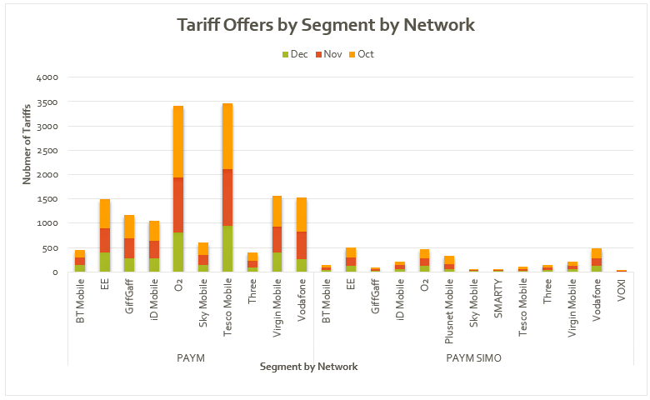
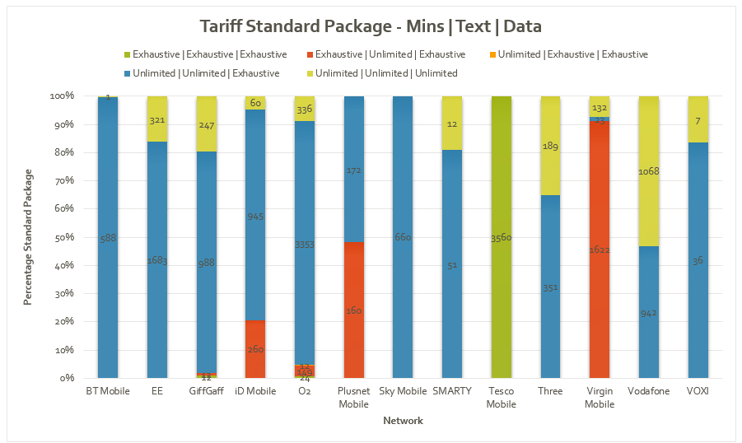
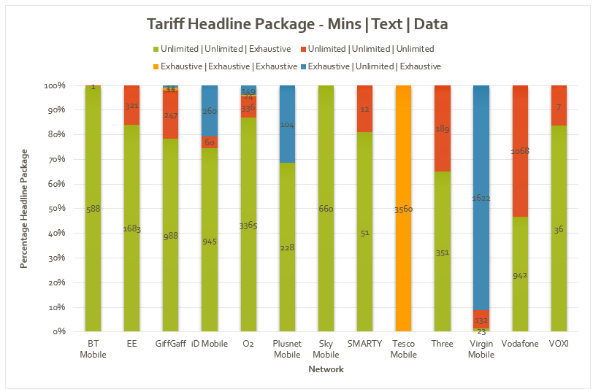
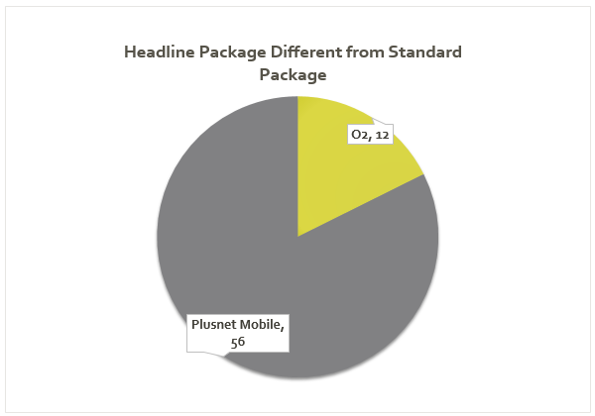
What Tariff Offers were most Popular Across Segment?
October had the highest number of tariff plans, likely influenced by upcoming holiday season promotions.
PAYM SIMO Plans: Primarily driven by EE and Vodafone, providing diverse offerings.
PAYM Plans: Dominated by Tesco and O2, offering the most tariff options.
Unlimited Plans: Most offers for both Standard and Headline packages included unlimited Mins and Texts, while data plans varied significantly.
Competitive Dynamics: Networks like EE, Three, O2, and Vodafone offered highly competitive unlimited and headline packages, closely aligned with standard plans, likely influencing consumer purchase decisions.
N.B: Package – Mins | Text | Data
Notes:
Title: Network Tariff Plans and Offer Dynamics
What Tariff Offers were most popular Across Segment?
Key Insights:
December had the highest number of tariff plans, likely influenced by holiday season promotions.
PAYM Plans: Dominated by Tesco and O2, offering the most tariff options.
PAYM SIMO Plans: Primarily driven by EE and Vodafone, providing diverse offerings.
Unlimited Plans: Most offers for both Standard and Headline packages included unlimited Mins and Texts, while data plans varied significantly.
Competitive Dynamics: Networks like EE, Three, O2, and Vodafone offered highly competitive unlimited and headline packages, closely aligned with standard plans, likely influencing consumer purchase decisions.

Slide 5
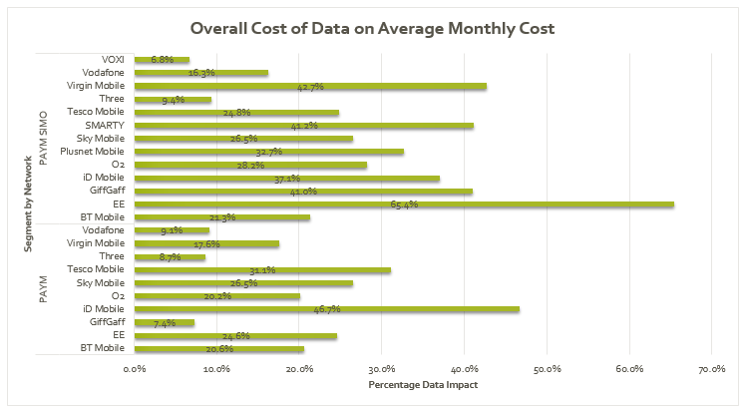
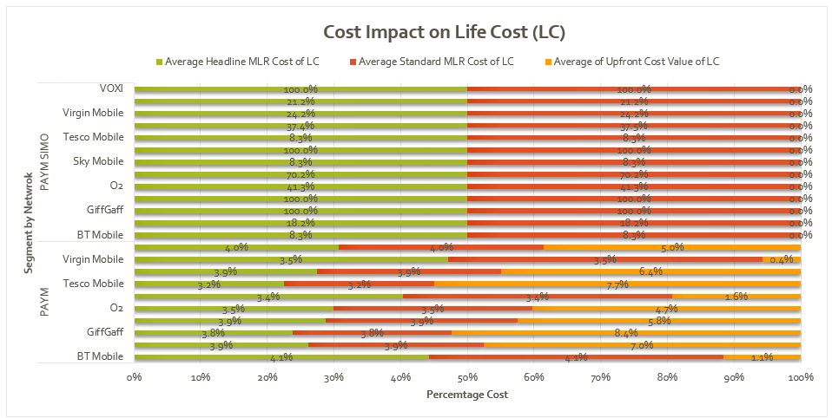
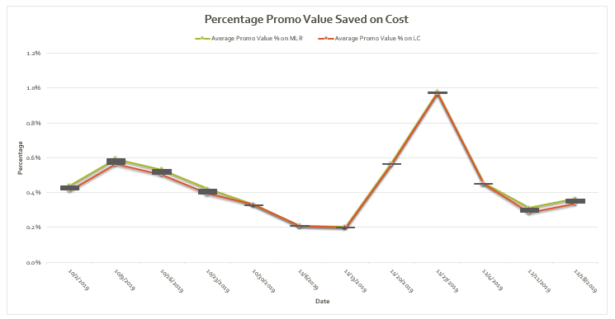
Did Promo Values and Cost influence Sales Trends?
Upfront Costs: Users typically paid 4.5% of the life cost upfront for PAYM plans. EE offered the most competitive MLR on Life Cost (LC) for both PAYM and PAYM SIMO plans, boosting tariff sales.
Data Costs: Data costs made up ~10% of the average monthly cost, potentially driving the preference of data plans offers to users.
Promo Value Impact: The MLR vs. LC Promo Value savings were negligible but aligned with weekly sales trends, particularly the November surge, reinforcing the influence of promo values on sales performance.
Notes:
Title: Data Costs, Promo Values, and Upfront Costs in Sales Trends
Did Cost influence Tariff Offers?
Key Insights:
Data Costs: Limited data plans made up ~10% of the average monthly cost, potentially driving the preference for unlimited data plans among users.
Upfront Costs: Users typically paid 4.5% of the life cost upfront for PAYM plans. EE offered the most competitive Life Cost (LC) for both PAYM and PAYM SIMO plans, boosting tariff sales.
Promo Value Impact: The MLR vs. LC Promo Value savings were negligible but aligned with weekly sales trends, particularly the November surge, reinforcing the influence of promo values on sales performance.
MLR helps identify plans with attractive short-term costs (e.g., promotional rates).Life Cost is crucial for understanding the total financial burden and comparing the overall value of different plans.

Slide 6
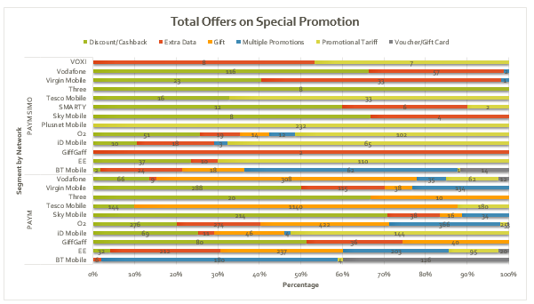
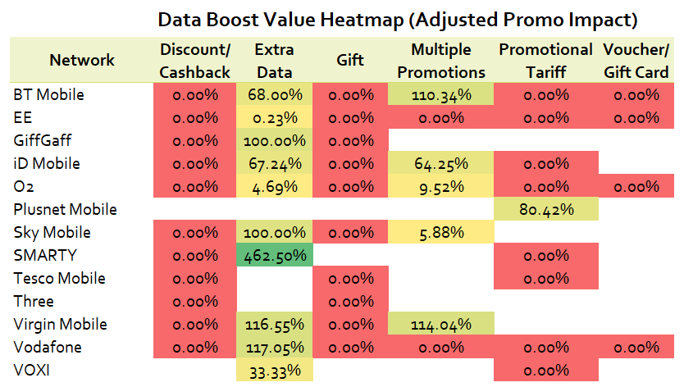
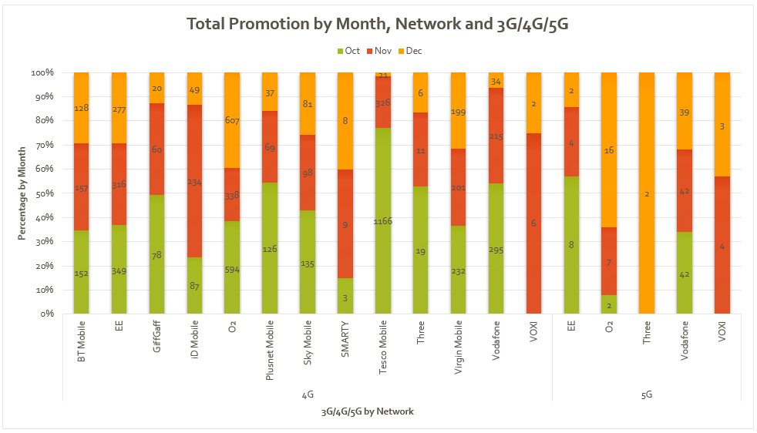
What kind of Promos were most Effective?
Value Perception: Offering Extra Data beyond the standard plan enhances the perceived value of the tariff, making it more attractive to customers.
Connectivity Focus: Promotions were largely centered around 4G and 5G connectivity, highlighting the importance of advanced network technologies in attracting customers.
O2's Competitive Edge: O2 stood out by offering the most special promotions on extra data, potentially giving it an advantage in terms of customer appeal and market positioning.
Notes:
The key insights from the provided information are:
Value Perception: Offering extra data beyond the standard plan enhances the perceived value of the tariff, making it more attractive to customers.
Connectivity Focus: Promotions were largely centered around 4G and 5G connectivity, highlighting the importance of advanced network technologies in attracting customers.
O2's Competitive Edge: O2 stood out by offering the most special promotions on extra data, potentially giving it an advantage in terms of customer appeal and market positioning.
These insights suggest that customers are likely to respond positively to offers that increase data allowances, especially if linked with modern and fast connectivity like 4G/5G, and that O2’s strategy may have enhanced its competitive positioning.
DBV Highlights plans where data promos are most impactful after considering MLR changes.

Slide 7
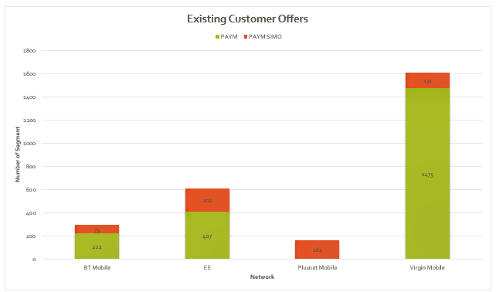
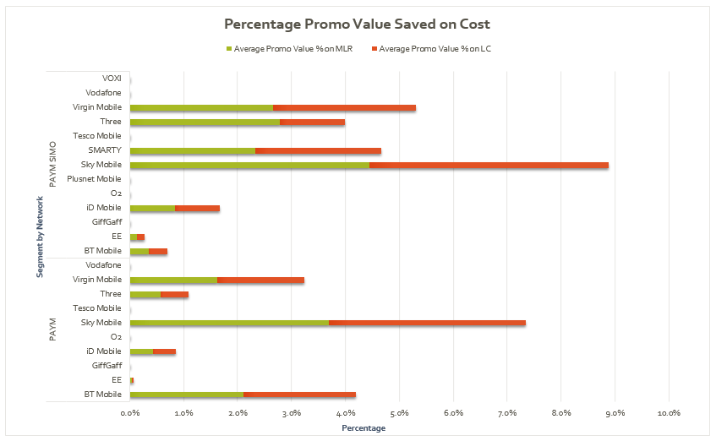
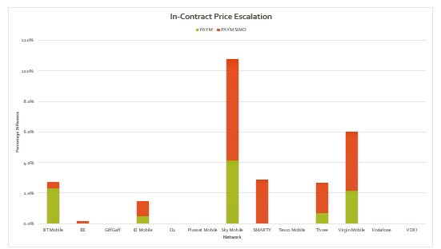
Did Promo features affect Promo Strategies?
Virgin Mobile: Focused heavily on promotions for existing customers, enhancing user retention within its subscriber base.
Sky Mobile: Led in offering the highest percentage promo savings, which likely boosted retention rates and overall customer satisfaction.
O2: Excelled in In-Contract Escalation, ensuring customers gained more value once they were out-of-contract, a strategy critical for attracting new users and maintaining loyalty.
Notes:
Title: Promotions and Contract Strategies Across Networks
User retention vs User acquisition (attraction)
Did Promo features affect promo offers?
Key Insights:
Virgin Mobile: Focused heavily on promotions for existing customers, enhancing user retention within its subscriber base.
Sky Mobile: Led in offering the highest percentage promo savings, which likely boosted retention rates and overall customer satisfaction.
O2: Excelled in In-Contract Escalation, ensuring customers gained more value once they were out-of-contract, a strategy critical for attracting new users and maintaining loyalty.

Slide 8



Thank You
SUMMARY
In October to December 2019, the top-performing UK mobile networks were:
EE: Best in leading in coverage, data speeds, and early 5G rollout.
O2: Strong in customer satisfaction and reliable 4G coverage, with added value from the priority rewards program focused on data.
Vodafone: Good balance of network performance and promo benefits.
Three: Best value for data-heavy users with competitive pricing and 4G/5G availability.
Tesco Mobile: Offered great value for money and diverse Tariff plans.
DATA DRIVEN RECOMMENDATION
Sales Drivers: Focus on competitive pricing in the £20-£40 range for handsets and under £15 for SIMO plans.
Unlimited Data: Promote unlimited data plans and emphasize 4G/5G connectivity.
Seasonal Promotions: Capitalize on peak periods like holidays with targeted offers.
Customer Retention: Use loyalty programs and in-contract escalations to retain existing customers.
Segmented Offers: Tailor plans to specific customer segments for better appeal and sales performance.
Notes:
Key Insights:
Sales Drivers: PAYM Handset plans from O2 and Tesco Mobile, and SIMO plans from EE and Vodafone, were key in driving sales, especially during promotions.
Consumer Preferences: Affordable SIMO plans (£0-£14.99) and mid-range handset plans (£20-£40) were most popular.
Tariff Dynamics: Unlimited plans, especially for minutes and texts, were in high demand. December saw a spike in tariff offers, driven by seasonal promotions.
Cost Impact: Users favored unlimited data plans, with EE offering the most competitive life costs. Upfront payments were modest (~4.5% of life cost).
Promo Effectiveness: O2’s extra data promotions stood out, while Virgin Mobile and Sky Mobile excelled in customer retention through targeted deals.
Recommendations:
Mid-Range Pricing: Focus on competitive pricing in the £20-£40 range for handsets and under £15 for SIMO plans.
Unlimited Data: Promote unlimited data plans and emphasize 4G/5G connectivity.
Seasonal Promotions: Capitalize on peak periods like holidays with targeted offers.
Customer Retention: Use loyalty programs and in-contract escalations to retain existing customers.
Segmented Offers: Tailor plans to specific customer segments for better appeal and sales performance.
In 2019, the top-performing UK mobile networks were:
EE: Best overall, leading in coverage, data speeds, and early 5G rollout.
O2: Strong in customer satisfaction and reliable 4G coverage, with added value from the "Priority" rewards program.
Vodafone: Good balance of network performance, customer service, and international roaming benefits.
Three: Best value for data-heavy users with competitive pricing and early 5G availability.
Tesco Mobile: Notable for its value for money and strong customer service, leveraging O2's network.
EE dominated in network quality, while O2 and Vodafone excelled in customer service and additional features.

