Slide 1
WEB DEVELOPMENT & DESIGN FOUNDATIONS WITH HTML5
7TH EDITION
Chapter 13
Key Concepts
Copyright © Terry Felke-Morris

Slide 2
LEARNING OUTCOMES
In this chapter, you will learn how to:
  Identify commonly used search engines and search indexes
  Describe the components of a search engine
  Design web pages that are friendly to search engines
  Submit a website for inclusion in a search engine or search directory
  Monitor a search engine listing
  Describe other website promotion activities
  Use the iframe element to create an inline frame

Slide 3
POPULAR SEARCH ENGINES
Market Share Survey Results for a Recent Month:
  Google 83%
  Yahoo! 8%
  Bing 5.63%
  Baidu 1.36%
Source:
http://www.netmarketshare.com/search-engine-market-share.aspx?qprid=4&qpcustomd=0

Slide 4
SEARCH INDEX (AKA SEARCH DIRECTORY)
Open Directory
http://www.dmoz.org
A search directory maintains a hierarchical category of topics and places web site listings into these categories.
Search either by typing in a search term OR "drilling" down into the hierarchy for relevant sites.
Each site is reviewed by an editor before accepted into a directory

Slide 5
SEARCH ENGINE COMPONENTS
Popular Search Engines:
  Google http://www.google.com
  Bing http://bing.com
Search engines use the following components:
  Robot or “spider”
  Database (also used by search indexes)
  Search form (also used by search indexes)

Slide 6
SEARCH ENGINE ROBOT
Also called a spider or bot
  A computer program that follows hyperlinks and “walks” the Web -- accessing and documenting web pages.
  Categorizes the pages and stores information in a database.
May access the following components of web pages:
  title,
  meta tag keywords & meta tag description
  text in headings
  other text on the page
  hyperlinks
See http://www.robotstxt.org

Slide 7
SEARCH ENGINE DATABASE
Database:
  A collection of information organized so that its contents can easily be accessed, managed, and updated.
Database Management Systems (DBMSs)
  Configure and manage database
    Oracle, MySQL, Microsoft SQL Server, IBM DB2
Search Engine Database
  Contains information about web pages

Slide 8
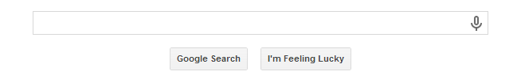
SEARCH ENGINE
SEARCH FORM
The part you are most familiar with!
The search form is the graphical user interface that allows a user to request a word or phrase to search for.
The visitor to the search engine types words (called keywords) related to their search into the text box.
When the form is submitted, the data typed into the text box is sent to server-side processing that searches the database using the keywords you have entered.
The search results (also called a result set) is a list that contains information such as the URLs for web pages that meet your criteria.

Slide 9
SEARCH ENGINE RESULTS PAGE (SERP)
A list of items that describe web pages matching the search terms.
  Each item contains a link to a page along with additional information that might include the page title, a brief description, the first few lines of text, the size of the page, and so on.
The order the web page items are displayed in the SERP may depend on:
  paid advertisements
  alphabetical order
  link popularity
Each search engine has their own policy for ordering the search results.

Slide 10
DESIGNING WEB PAGES FOR PROMOTION
Keywords
  Terms and phrases that people may use when searching for your site.
  Words or phrases that describe your web site or business.
  Create a list of them
  Include common misspellings
Description
  What is special about your web site that would make someone want to visit?
  25-30 words -- inviting and interesting
  Some search engines will display your description in the SERP

Slide 11
DESCRIPTION META TAG
The meta element
  A stand-alone tag
  Placed in the head section
  Attributes:
    name
    content
<meta name=“description" content="value">

Slide 12
EXAMPLE: DESCRIPTION META TAG
Example: “Acme Design”
<meta name="description" content="Acme Design, a
premier web consulting group that specializes in
E-commerce, website design, website development,
and website re-design.">

Slide 13
SEARCH ENGINE OPTIMIZATION (SEO)
Determine keywords
Page Title
  Include the company and/or website name
  Include selected keywords as approprite
Heading tags
  Include keywords
Text on page includes keywords

Slide 14
SEARCH ENGINE OPTIMIZATION (SEO) 2
Linking
  Provide text navigation hyperlinks
  Verify that all hyperlinks are functioning
Page Layout
  Use CSS for page layout
Images & Multimedia
  Configure meaningful alternate text
  Be aware that text and hyperlinks contained within multimedia may not be accessed by search engine robots

Slide 15
SEARCH ENGINE OPTIMIZATION (SEO) 3
Valid Code
  Validate XHTML
  Validate CSS
Content of Value
  Follow Web Design Best Practices
  Well-organized
  Meaningful & useful to your target audience

Slide 16
LISTING IN A SEARCH ENGINE
Wait until your site is finished
Don’t submit “under construction” Web sites!
Visit Search Engine and look for “Add URL” or “Suggest URL”, or “Add your Site”, etc.
Follow the directions and fill out the form
A robot from the search engine will visit your website and index it
Allow several weeks and test the search engine to see if your site is listed

Slide 17
PREFERENTIAL PLACEMENT
Offers vary:
  Google’s AdWords
  Yahoo!’s Sponsored Search
Commonly used acronyms:
  CPC – Cost Per Click (PPC – Pay Per Click)
  The price you are charged if you have signed up for a paid sponsor or ad program and a visitor clicks on a link to your Web site.
  CPM – Cost Per Impressions
  Your cost for every 1000 times that your ad is displayed on a Web page (whether or not the visitor clicks on your ad).
  CTR – Click Through Rate
  The ratio of the number of times an ad is clicked on to the number of times an ad is viewed.
  For example if your ad was shown 100 times and 20 people clicked on it, your CTR would be 20/100 or 20%.

Slide 18
MAPPING YOUR SITE
HTML Site Map Web page
  Used by visitors and accessed by search engines.
  See Figure 5.25
XML Sitemap file
  Accessed only by search engines
  List of Web pages with URL, last date updated, frequency of update, and priority indicators
  See http://google.com/support/webmasters

Slide 19
CHECKPOINT
Describe the three components of a search engine.
Describe the purpose of the description meta tag.
Is it beneficial for a business to pay for preferential listing? Explain.

Slide 20
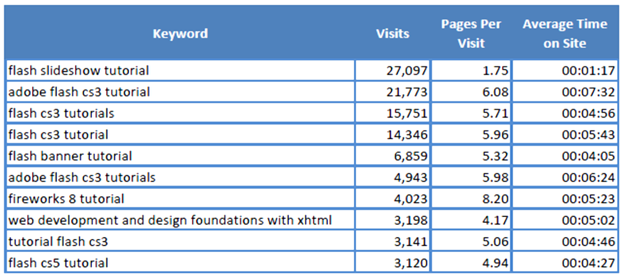
MONITOR SEARCH ENGINE LISTINGS
Web Analytics:
  "the measurement, collection, analysis and reporting of Internet data for the purposes of understanding and optimizing Web usage."
Analyze web site logs

Slide 21
LINK POPULARITY
Rating determined by a search engine based on the number of sites that link to a particular website and the quality
Checking Link Popluarity
  Analyze your log file
  Visit a link popularity checking service web site
    http://linkpopularity.com
    http://linkpopularitycheck.com
  Visit search engines and check for yourself:
    At Google and AltaVista type the following into the search box:
    link:yourdomainname.com

Slide 22
SOCIAL MEDIA OPTIMIZATION
Optimizing a website so that it is
“more easily linked to,
more highly visible in social media searches on custom search engines (such as Technorati),
and more frequently included in relevant posts on blogs, podcasts and vlogs”
— Rohit Bhargava
http://rohitbhargava.typepad.com/weblog/2006/08/5_rules_of_soci.html

Slide 23
SMO BENEFITS & METHODS
Benefits:
  Increased brand awareness
  Increased inbound links (helpful for SEO)
Methods
  Social bookmarking
  Blogs & RSS feeds
  Social Networking
    Twitter
    Facebook
    LinkedIn
    YouTube, etc.

Slide 24
OTHER SITE PROMOTION ACTIVITIES
QR (Quick Response) Cods
Affiliate Programs
Banner Ads
Banner Exchange
Reciprocal Link Agreements
Newsletters
“Sticky” Site Features
Personal Recommendations
Newsgroup and Listserv Postings
Traditional Media Ads
Leverage Existing Marketing Materials

Slide 25
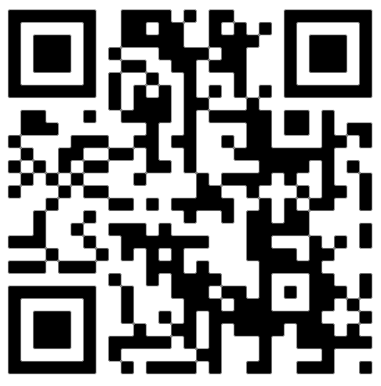
QR (QUICK RESPONSE) CODE
A two-dimensional barcode in a square pattern that is readable by a smartphone camera scan application or a
QR barcode reader
Free online QR code generators:
  http://qrcode.kaywa.com
  http://www.qrstuff.com.
  http://www.labeljoy.com/en/generate-qr-code.html

Slide 26
CHECKPOINT
1. Are the results returned by various search engines really different?
  Choose a place, music group, or movie to search for.
  Enter the same search terms, such as “Door County” into the following three search engines: Google, Yahoo!, Ask.com.
  List the URLs of the top three sites returned by each.
  Comment on your findings.

Slide 27
CHECKPOINT
2. How can you determine if your web site has been indexed by a search engine?
How can you determine which search engines are being used to find your site?
3. List four web site promotion methods that do not use search engines.
Which would be your first choice? Why?

Slide 28
INLINE FRAMES
Also called a floating frame
Embeds one web page within another in a scrolling area
Configure with the iframe element
<iframe src="trillium.html" title="Trillium Wild Flower" height="160" name="flower" width="350">
Description of the lovely Spring wild flower, the
<a href="trillium.html" target="_blank">Trillium</a>
</iframe>

Slide 29
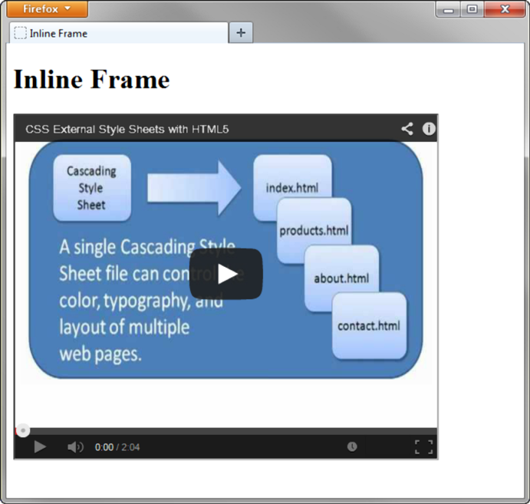
USE THE IFRAME ELEMENT
TO EMBED A YOUTUBE VIDEO
<iframe src="http://www.youtube.com/embed/VIDEO_ID" width="640" height="385">
View the
<a href="http://www.youtube.com/watch?v=VIDEO_ID">YouTube Video</a>
</iframe>

Slide 30
SUMMARY
This chapter introduced concepts related to promoting your website.
Techniques for search engine optimization were discussed.
The activities involved in submitting websites to search engines and search directories were discussed along with techniques for making your website more useful to search engines.
The new trend of social media optimization was introduced.
Other web site promotion activities such as banner ads and QR codes were also discussed.
You can help the marketing staff by creating websites that work with search engines and directories by following the suggestions in this chapter.

