Slide 1
Web Development & Design Foundations with HTML5
Chapter 14
Key Concepts
Copyright © Terry Felke-Morris

Slide 2
Learning Outcomes
In this chapter, you will learn how to:
  Describe common uses of JavaScript in web pages.
  Describe the purpose of the Document Object Model and list some common events.
  Create a simple JavaScript using the script element and the alert() method.
  Use variables, operators and the if control structure.
  Create a basic form validation script.

Slide 3
What is JavaScript?
Object-based scripting language
Works with the objects associated with a page document
  the window
  the document
  the elements
    such as forms, images, hyperlinks, etc

Slide 4
What is JavaScript?
Originally developed by Netscape
  Named LiveScript
Netscape & Sun Microsystems Collaboration
  LiveScript renamed JavaScript
JavaScript is NOT Java

Slide 5
Common Uses of JavaScript
Display a message box
Select list navigation
Edit and validate form information
Create a new window with a specified size and screen position
Image Rollovers
Status Messages
Display Current Date
Calculations

Slide 6
Coding JavaScript
JavaScript statements can be coded on a web page using two different techniques:
  Place JavaScript code between <script> tags
  Place JavaScript code as part of an event attached to an HTML element

Slide 7
JavaScript: Using The script Element
The script element
  A container tag
  May be placed in either the head or the body section of a web page
  Demo
<script type="text/javascript">
<!- -
alert("Welcome to Our Site");
// - ->
</script>
Alert Demo

Slide 8
Checkpoint
Describe at least three popular uses for JavaScript.
How many JavaScript code blocks can be embedded in an HTML document?
Describe a method that can be used to find an error in a JavaScript code block.

Slide 9
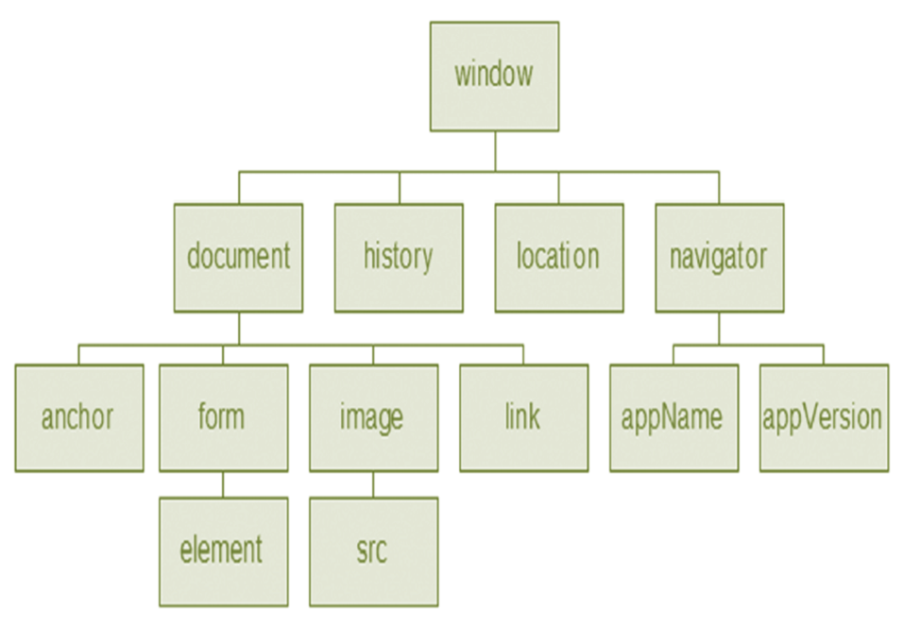
Document Object Model (DOM)
A portion of the DOM is shown at the left.
Defines every object and element on a web page
Hierarchical structure
Accesses page elements and apply styles to page elements

Slide 10
Object
An object is a thing or entity.
  Browser window
  Submit button
  Web page document

Slide 11
Property
A property is a characteristic or attribute of an object.
  The background color of a web page document
  document.bgcolor
  The date the web page file was last modified
  document.lastmodified
  The src file of an image object
  image1.src

Slide 12
Method
A method is an action (a verb)
  Writing text to a web page document
    document.write()
  Submitting a form
  form1.submit()

Slide 13
JavaScript and Events
Events:
actions taken by the web page visitor
  clicking (onclick),
  placing the mouse on an element (onmouseover),
  removing the mouse from an element (onmouseout),
  loading the page (onload),
  unloading the page (onunload), etc.

Slide 14
Events
Event | Event Handler
click | onclick
load | onload
mouseover | onmouseover
mouseout | onmouseout
submit | onsubmit
unload | onunload

Slide 15
JavaScript and Events
JavaScript can be configured to perform actions when events occur.
  The event name is coded as an attribute of an HTML tag
  The value of the event attribute contains the JavaScript code
Example:
Display an alert box when the mouse is placed over a hyperlink.
<a href="home.htm" onmouseover="alert('Click to go home')">Home</a>
Demo
More JS demos

Slide 16
JavaScript Debugging(1)
Check the syntax of the statements
  Pay very close attention to upper and lower case letters, spaces, and quotations
Verify that you have saved the page with your most recent changes
Verify that you are testing the most recent version of the page (refresh or reload the page)
If you get an error message, use the error messages that are displayed by the browser
  In Firefox: Select Tools > Error Console

Slide 17
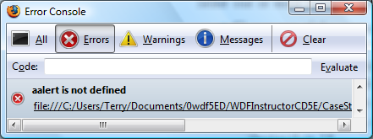
JavaScript Debugging(2)
Use the Firefox browser:
  Select Tools > Error Console from the Menu
    The Error Console will indicate an issue and the line number
    This may not be exactly where the problem is
    Sometimes the error is a one or two lines above the indicated line number.

Slide 18
Checkpoint
With respect to objects, describe the difference between a property and a method. Feel free to use words like “thing,” “action,” “description,” “attribute,” and so forth.
What is the difference between an event and an event handler?
Where are event handlers placed in the HTML document?

Slide 19
Variable
A variable is a placeholder for information.
The variable is stored in the computer’s memory (RAM).
var userName;
userName = "Karen";
document.write(userName);
Demo

Slide 20
Prompts
prompt() method
  Displays a message and accepts a value from the user
  myName = prompt(“prompt message”);
  The value typed by the user is stored in the variable myName
  Demo

Slide 21
Arithmetic Operators
Operator | Description | Example | Value of Quantity
= | assign | quantity = 10 | 10
+ | addition | quantity = 10 + 6 | 16
- | subtraction | quantity = 10 - 6 | 4
* | multiplication | quantity = 10 * 2 | 20
/ | division | quantity = 10 / 2 | 5

Slide 22
Comparison Operators
Operator | Description | Example | Sample values of quantity that would result in true
= = | Double equals sign (equivalent) “is exactly equal to” | quantity = = 10 | 10
> | Greater than | quantity > 10 | 11, 12 (but not 10)
> = | Greater than or equal to | quantity > = 10 | 10, 11, 12
< | Less than | quantity < 10 | 8, 9 (but not 10)
< = | Less than or equal to | quantity < = 10 | 8, 9, 10
! = | Not equal to | quantity ! = 10 | 8, 9, 11 (but not 10)

Slide 23
Decision Making
if (condition) {
… commands to execute if condition is true
}
else {
… commands to execute if condition is false
}

Slide 24
Function
A function is a block of one or more JavaScript statements with a specific purpose, which can be run when needed.
function function_name() {
... JavaScript statements …
}
Demo

Slide 25
Using Functions
Defining the Function
function showAlert() {
alert("Please click OK to continue.");
}
Calling the Function
showAlert();

Slide 26
Form Validation
It is common to use JavaScript to validate form information before submitting it to the web server.
  Is the name entered?
  Is the e-mail address of correct format?
  Is the phone number in the correct format?
See Hands-on Practice 14.8

Slide 27
Validating Form Fields
Use the "" or null to check to determine if a form field has information
if (document.forms[0].userName.value == "" ) {
alert("Name field cannot be empty.");
return false;
} // end if
Demo

Slide 28
JavaScript & Accessibility
Don’t expect JavaScript to always function for every visitor
  Some may have JavaScript disabled
  Some may be physically unable to click a mouse
Provide a way for your site to be used if JavaScript is not functioning
  Plain text links
  E-mail contact info

Slide 29
Checkpoint
What is meant by the term “form data validation”?
Give three examples of form data that may require validation.
Should you always expect your JavaScript to “work” – why or why not?

Slide 30
Summary
  This chapter introduced the use of JavaScript on web pages.
  Topics included:
    Common uses of JavaScript in web pages.
    The purpose of the Document Object Model
    The script element
    The alert() method
    Use variables, operators and the if control structure.
    Configure functions
    Using JavaScript to validate a form

