Slide 1
WEB DEVELOPMENT & DESIGN FOUNDATIONS WITH HTML5
7TH EDITION
Chapter 2
Key Concepts
Copyright © Terry Felke-Morris

Slide 2
LEARNING OUTCOMES
In this chapter, you will learn how to ...
  Describe HTML, XHTML, and HTML5
  Identify the markup language in a web page document
  Use the html, head, body, title, and meta elements to code a template for a web page
  Configure the body of a web page with headings, paragraphs, line breaks, divs, lists, and blockquotes
  Configure text with phrase elements
  Configure a web page using new HTML5 header, nav, main, and footer elements
  Configure special characters
  Use the anchor element to link from page to page
  Create absolute, relative, and e-mail hyperlinks
  Code, save, and display a web page document
  Test a web page document for valid syntax

Slide 3
WHAT IS HTML?
HTML:
The set of markup symbols or codes placed in a file intended for display on a Web browser page.
The World Wide Web Consortium (http://w3c.org) sets the standards for HTML and its related languages.

Slide 4
HTML ELEMENTS
Each markup code represents an HTML element .
Each element has a purpose.
Most elements are coded as a pair of tags:
an opening tag and a closing tag.
Tags are enclosed in angle brackets, "<" and ">" symbols.

Slide 5

WHAT IS HTML5 ?
Newest draft version of HTML/XHTML
Supported by modern browsers
  Safari, Google Chrome, Firefox, Internet Explorer 9
Intended to be backwards compatible
Adds new elements
Adds new functionality
  Edit form data
  Native video and audio
  And more!
Source: W3C http://www.w3.org/html/logo/

Slide 6
DOCUMENT TYPE DEFINITION
Document Type Definition (DTD)
  doctype statement
  identifies the version of HTML contained in your document.
  placed at the top of a web page document

Slide 7
DTD EXAMPLES
XHTML 1.0 Transitional DTD
<!DOCTYPE html PUBLIC "-//W3C//DTD XHTML 1.0 Transitional//EN"
http://www.w3.org/TR/xhtml1/DTD/xhtml1-transitional.dtd>
HTML5 DTD
<!DOCTYPE html>

Slide 8
EXAMPLE HTML5 WEB PAGE
<!DOCTYPE html>
<html lang="en">
<head>
<title>Page Title Goes Here</title>
<meta charset="utf-8">
</head>
<body>
... body text and more HTML5 tags go here ...
</body>
</html>

Slide 9
HEAD & BODY SECTIONS
Head Section
Contains information that describes the Web page document
  <head>
  …head section info goes here
  </head>
Body Section
Contains text and elements that display in the Web page document
<body>
  …body section info goes here
  </body>

Slide 10
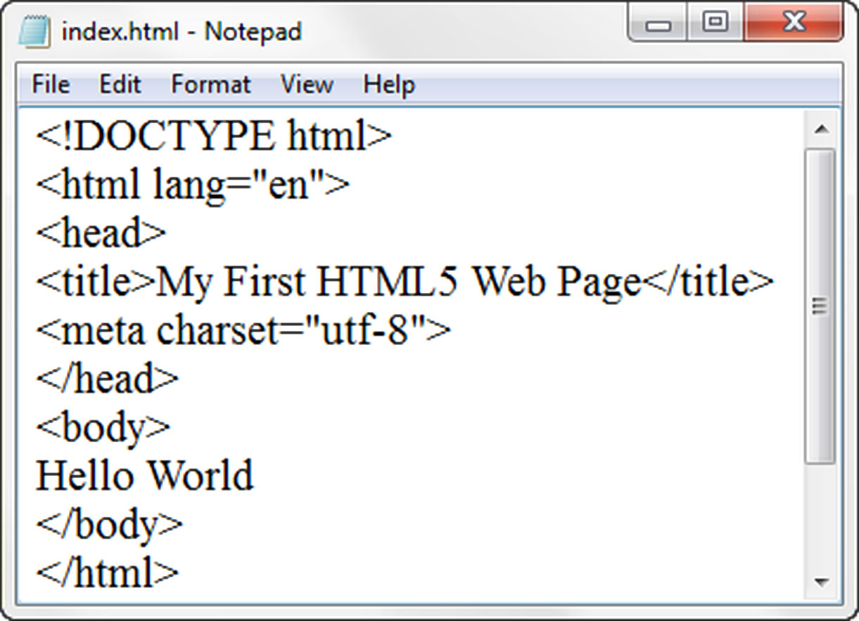
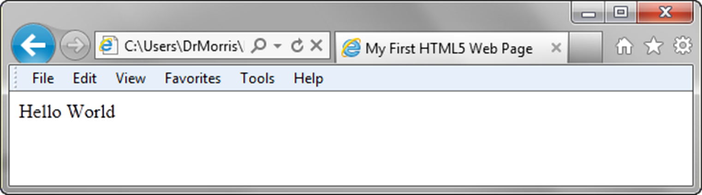
TITLE ELEMENT
META ELEMENT

Slide 11
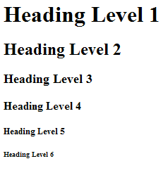
HEADING ELEMENT
<h1>Heading Level 1</h1>
<h2>Heading Level 2</h2>
<h3>Heading Level 3</h3>
<h4>Heading Level 4</h4>
<h5>Heading Level 5</h5>
<h6>Heading Level 6</h6>
Demo

Slide 12
PARAGRAPH ELEMENT
Paragraph element
<p> …paragraph goes here… </p>
  Groups sentences and sections of text together.
  Block Display – Configures empty space above and below
  Demo

Slide 13
LINE BREAK ELEMENT
Line Break element
  Stand-alone, or void tag
  …text goes here <br>
  This starts on a new line….
  Causes the next element or text to display on a new line
  Demo

Slide 14
BLOCKQUOTE ELEMENT
Blockquote element
  Indents a block of text for special emphasis
  <blockquote>
  …text goes here…
  </blockquote>
  Block Display – Configures empty space above and below
  Demo

Slide 15
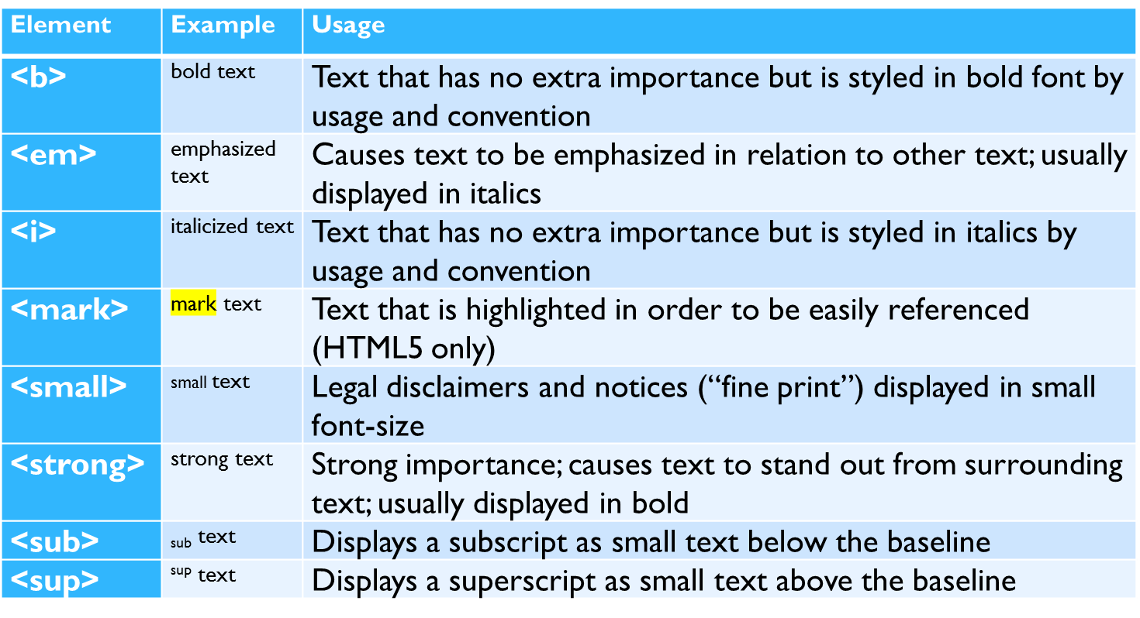
PHRASE ELEMENTS
Indicate the context and meaning of the text

Slide 16
PROPER NESTING
CODE:
<p><i>Call for a free quote for your web development needs: <strong>888.555.5555 </strong></i></p>
BROWSER DISPLAY:
Call for a free quote for your web development needs: 888.555.5555

Slide 17
HTML LISTS
Unordered List
Ordered List
Description List
formerly called a definition list

Slide 18
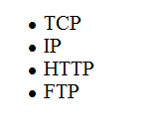
UNORDERED LIST
Displays a bullet, or list marker, before each entry in the list.
<ul>
Contains the unordered list
<li>
Contains an item in the list

Slide 19
UNORDERED LIST EXAMPLE
<ul>
<li>TCP</li>
<li>IP</li>
<li>HTTP</li>
<li>FTP</li>
</ul>
Demo

Slide 20
ORDERED LIST
Displays a numbering or lettering system to itemize the information contained in the list
<ol>
Contains the ordered list
  type attribute determines numbering scheme of list, default is numerals
<li>
Contains an item in the list

Slide 21
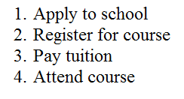
ORDERED LIST EXAMPLE
<ol>
<li>Apply to school</li>
<li>Register for course</li>
<li>Pay tuition</li>
<li>Attend course</li>
</ol>
Demo

Slide 22
DESCRIPTION LIST
Useful to display a list of terms and descriptions or a list of FAQ and answers
  <dl>
  Contains the description list
  <dt>
  Contains a term/phrase/sentence
  Configures empty space above and below the text
  <dd>
  Contains a description of the term/phrase/sentence
    Indents the text
    Configures empty space above and below the text

Slide 23
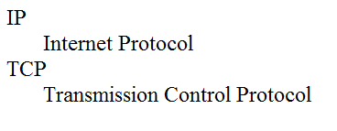
DESCRIPTION LIST EXAMPLE
<dl>
<dt>IP</dt>
<dd>Internet Protocol</dd>
<dt>TCP</dt>
<dd>Transmission Control Protocol</dd>
</dl>
Demo

Slide 24
CHECKPOINT
Describe the features of a heading element and how it configures the text.
Describe the difference between ordered lists and unordered lists.
Describe the purpose of the blockquote tag.

Slide 25
SPECIAL CHARACTERS
Display special characters such as quotes, copyright symbol, etc.
Character Code
© &copy;
< &lt;
> &gt;
& &amp;
&nbsp;

Slide 26
DIV ELEMENT
Configures a structural block area or “division” on a web page with empty space above and below.
Can contain other block display elements, including other div elements
<div>Home Services Contact</div>
Demo

Slide 27
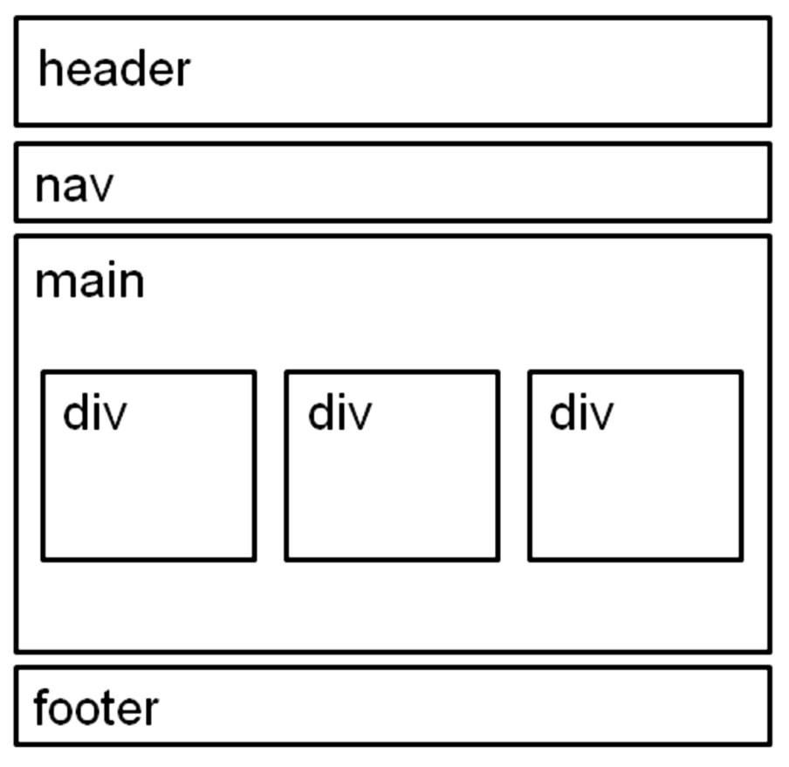
HTML5 STRUCTURAL ELEMENTS
header Element
  <header></header>
  Contains the web page
  document’s headings
nav Element
  <nav></nav>
  Contains web page
  document’s main navigation
main Element
<main></main>
Contains the web page
document’s main content
footer Element
  <footer></footer>
  Contains the web page
  document’s footer

Slide 28
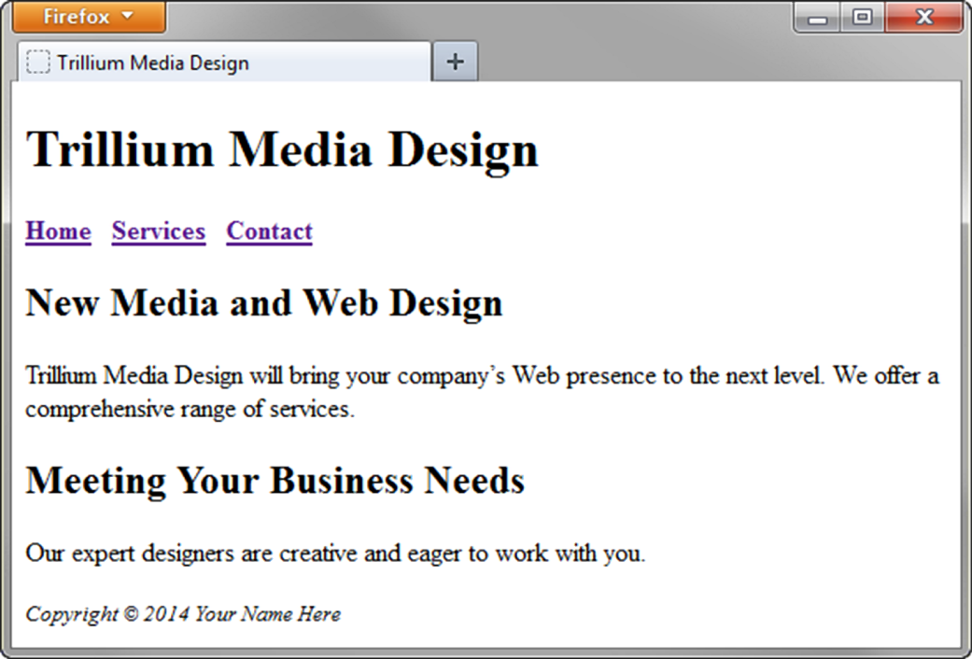
HTML5 STRUCTURAL ELEMENTS
<body>
<header> document headings go here </header>
<nav> main navigation goes here </nav>
<main> main content goes here </main>
<footer> document footer information goes here </footer>
</body>

Slide 29
ANCHOR ELEMENT
Specifies a hyperlink reference (href) to a file
Text between the <a> and </a> is displayed on the web page.
<a href="contact.html">Contact Us</a>
href Attribute
  Indicates the file name or URL
Demo

Slide 30
ABSOLUTE & RELATIVE HYPERLINKS
Absolute link
  Link to a different website
<a href="http://yahoo.com">Yahoo</a>
Relative link
  Link to pages on your own site
<a href="index.htm">Home</a>

Slide 31
E-MAIL HYPERLINK
Automatically launch the default mail program configured for the browser
If no browser default is configured, a message is displayed
<a href=“mailto:me@gmail.com”>me@gmail.com</a>

Slide 32
CHECKPOINT
Describe the purpose of special characters.
Describe when to use an absolute link.
Is the http protocol used in the href value?
Describe when to use a relative link. Is the http protocol used in the href value?

Slide 33
WRITING VALID XHTML
Check your code for syntax errors
  Benefit:
    Valid code →
    more consistent browser display
W3C HTML Validation Tool
  http://validator.w3.org

Slide 34
SUMMARY
This chapter introduced you to HTML.
You will use these skills over and over again as you create web pages.

