Slide 1
JavaScript

Slide 2
Bit of history
Javascript was created in 1995.
Javascript has nothing to do with Java! Javascript was originally named LiveScipt, but the marketing folks at Netscape decided they would get a little more publicity if they tried to associate the language with Java.

Slide 3
Javascript?
A limited programming language used to do things that HTML cannot do, such as build dynamic webpages, respond to events, or even validate forms.
Client-side language- Which means it works within your browser. Alternative to this would be a Server-side language. This would be php, .net, asp. Etc.
Client-side languages can react immediately and change what a visitor sees in his/her web browser without the need of downloading a new page.
Javascript is not the only client-side language in town. Flash, and Java Applets.

Slide 4
“Javascript can turn a page into an interactive application as opposed to a static, lifeless page”

Slide 5
Javascript sits with HTML and CSS as one of the 3 pieces of web page construction.
HTML – Provides the Framework
CSS – Adds the visual pizzazz
Javascript- Injects the functional sizzle, allowing the page to take action

Slide 6
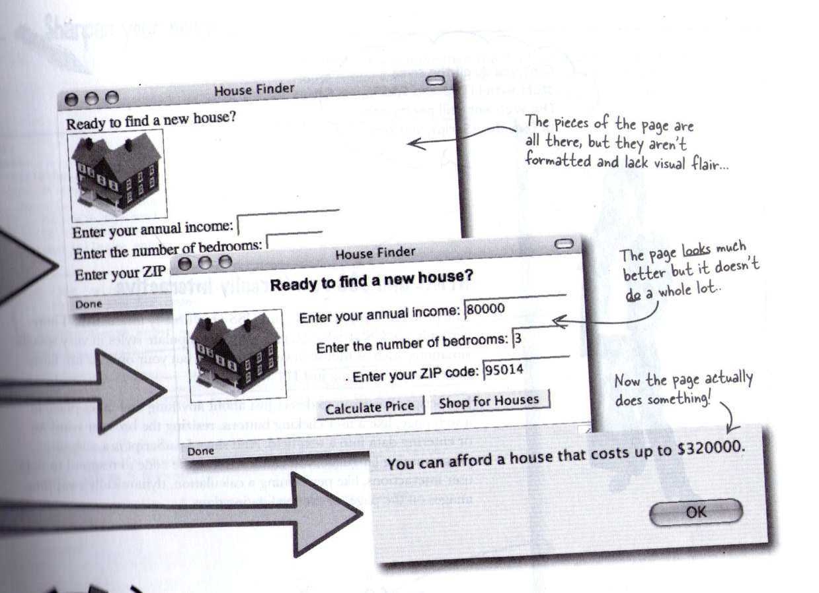

Slide 7
Adding javascript
Web browsers are built to understand HTML, and CSS. The part of the browser that understands this, is called the layout or rendering engine.
Most browsers have a Javascript Interpreter. This is part of the browser that understands this script, and will execute the commands.

Slide 8
Adding Javascript
Since the browser is specifically expecting to see HTML, you have to indicate that Javascript is coming by using the <script> tag.
Most of the time, the <script> tag will be added to your head section. You can also place it anywhere in your HTML section. It will run the script as it reads the code for the page.

Slide 9
Script Tag
<script>
function validateNumber(value) {
// Validate the number
if (!isNumber(value))
alert("Please enter a number."); }
</script>
*Note: This is used for HTML4
<script type="text/javascript"> Depending on validation, it might not pass validation with out the type attribute.

Slide 10
Lets create our first javascript
Open 1.1html within the begin folder
Click the line before the closing </head> and type: <script>
Press return, and type alert('hello world');
We need to close the script tag. To do so, type </script>
View your page

Slide 11
Important Note
A web browser will run a Javascript program the moment it reads in the Javascript code. In this example, the alert command appeared before the Web browser displayed the web page.

Slide 12
Lets see another example
Open date.html within NOTEPAD <script>
function displayDate() {
document.getElementById("demo").innerHTML=Date();
} </script>

Slide 13
View it!
Why does it not work?

Slide 14
Need an event
Add the following to your button attributes:
onclick="displayDate()"

Slide 15
Javascript events
Events are Javascript Notifications that let you know when something of interest has happened, such as a page loading(onLoad) or a button being clicked(onClick)
You can respond to events with your own Javascript Code.
Examples of events:
Clicking a button (or any other HTML element)
A page is finished loading
An image is finished loading
Moving the mouse-cursor over an element
Entering an input field
Submitting a form
A keystroke

Slide 16
Events
Preparing a web page to respond to an event is done in two parts.
First- Identify a page element that you wish to respond to an event
If you want to have a menu pop up when a visitor moves over the navigation bar, you will need to attach the mouseover event.
Assign an event and define a function to run when event occurs.

Slide 17
Javascript events
http://www.w3schools.com/js/js_events.asp
onload and onunload
The onload and onunload events are triggered when the user enters or leaves the page.
The onload event can be used to check the visitor's browser type and browser version, and load the proper version of the web page based on the information.
onfocus, onblur and onchange
The onfocus, onblur and onchange events are often used in combination with validation of form fields.
onsubmit
The onsubmit event can be used to validate form fields before submitting it.

Slide 18
Javascript events
onmouseover, onmouseout
The onmouseover and onmouseout events can be used to trigger a function when the user mouses over, or out of, an HTML element.
onmousedown, onmouseup and onclick

Slide 19
Document/Window events
onresize
The onresize event occurs when the size of an element has changed. Typically, added to the body element. When the page is resized, the event is triggered.
scroll
The scroll event occurs when the user scrolls in the specified element.

Slide 20
Simplest way to run a function
Is to use an inline event registration.
You add the event directly to the HTML element as an attribute.
<body onload="startGallery()">
The line of code above calls a function(that’s been defined somewhere else on the page) named startGallery() after the page and all required files had loaded.

Slide 21
Built-in Functions
Functions are reusable chunks of Javascript code that perform common tasks, such as displaying information in a pop-up window.
Example:
alert() - When you see parenthesis immediately next to a name, its often a function!
Lets take a close up look at it!!!

Slide 22
Functions
alert ( ' Hello, I am your pet rock. ');
Alert is the name of the built-in function that displays an alert box.
Every function uses parenthesis to enclose information being passed to the function.
The text to be displayed in the in alert box – make sure to place it within apostrophes or quotes.
The semi-colon marks the end of a line of Javascript code. Kind of like a period at the end of a sentence.
Other built in functions? http://www.tutorialspoint.com/javascript/javascript_builtin_functions.htm

Slide 23
Lets add this to the body element of irock1.html
onload="alert ( ' Hello, I am your pet rock. '); "

Slide 24
Custom Function
Always start off with function followed by the name of the function.
After the name will go the parenthesis, and the followed by { }
function touchRock() { }
*do not forget to add the script tag.

Slide 25
Custom Function
var userName = prompt("What is your name?", "Enter your name here."); if (userName) { alert("It is good to meet you, " + userName + "."); document.getElementById("rockImg").src = "rock_happy.png";}

Slide 26
Custom Function
<img id="rockImg" src="rock.png" alt="iRock" style="cursor:pointer" onclick="touchRock();" />

