Slide 1
JavaScript

Slide 2
Everything has its place
In the real world, people often overlook the importance of having a place to store stuff.
In Javascript, everything has its place. The issue is data- how to represent it, how to store it, and how to find it once you’ve put it somewhere. “Headfirst Javascript by Michael Morrison”

Slide 3
Storing data, cont
The Javascript interpreter is responsible for setting aside little areas of storage for Javascript data.
It is your job, however, to spell out exactly what the data is and how you intend to use it.

Slide 4
Scripts think in data types
You organize and categorize real world data into types without even thinking about it: names, numbers, sounds, and so on.
Javascript uses three basic data types:
Text- Also know as strings, and typically found within quotes.
Number- Store numeric data, can be whole numbers or decimals.
Boolean- It is either one of these two states, True or False. If it has two possible settings, a boolean will be used.
Null and Undefined are special and consist of a single value.
Data types directly affect how you work with data. Alert boxes only display text, not numbers. So numbers are converted to text behind the scenes before they are displayed.

Slide 5
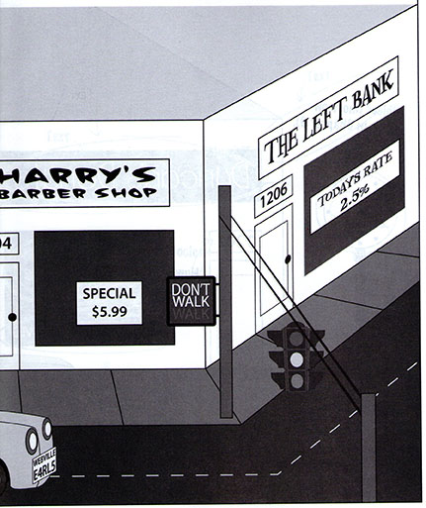
Scripts think in data types

Slide 6
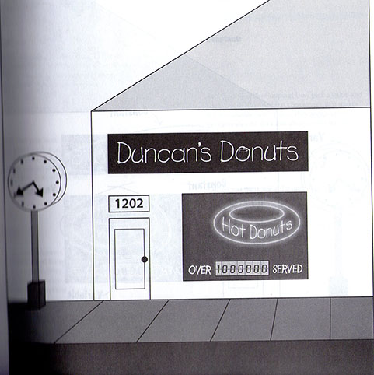
Variable and Constants
A variable changes throughout the course of a script, while a constant never changes value.

Slide 7
A constant or variable?
Sunrise at 6:43am ?
URL of a web page?

Slide 8
Variables
A variable is a storage location in memory with an unique name.
You create a variable using the keyword var, and the name of the variable. (Keyword is a word set aside in Javascript to perform a particular task)
var moleCount;
The var keyword indicates your creating a variable.
Variable name be anything you want, as long as it is unique. A newly-created variable has reserved storage set aside, and is ready to store data. Important for the name to be unique.
Semicolon- End of the line.
Variable is initially empty…it has no value.

Slide 9
Naming your variable
The unique name is also called an identifier. Identifiers are not as flexible, so uniqueness is the key, and must follow a certain set of rules.
Identifier must be at least one character in length.
The first character must be a letter, an underscore, or a dollar sign (See page 30)
Each character after the first character can be a letter, an underscore, a dollar sign or a number!
Spaces are not allowed!!!
Follow camelCase numCakeDonuts\
Do not use keywords reserved for Javascript. See page 31

Slide 10
Naming your variable
Legal or not legal names:
5to10
ka_Chow
top100
!guilty
_topSecret
$total
counting Crows

Slide 11
Variables
You can declare a variety of variables with one line.
Make sure to separate each declaration with a comma.
var firstName, middleName, lastName;

Slide 12
Variables - initialization
Pretty good idea to give a variable a value when first creating it. This is called initializing a variable.
Now you will be adding the = sign to the var keyword.
var timeLeft = 30;
Unlike its blank counterpart, an initialized value is immediately ready to be used…it already has a value stored in it.
The equal sign is an assignment operator.

Slide 13
Constants
Set up just like the variable.
const is the keyword.
The name of the constant should be typed in all caps. It will help you to distinguish between a variable and constant within the script.
const TAXRATE = .925;

Slide 14
Concatenation
When you join strings together it is called concatenation.
The operator used is the +
If one string is a number, and the other is text, they will both be concatenated as a string.
If both are numbers, the + sign will be an addition operator.
document.write("pop" + "corn"); Results in popcorn
document.write("Route " + 66); Results in a string , Route 66.
Expression 5 + 100 results in 105, whereas “5” + 100 results in 5100.

Slide 15
Concatenation
If you want to call a function or variable within concatenation field, it will be used without quotes.
alert("It is good to meet you, " + userName + ".");

Slide 16
What is the answer?
var b= "10";
var c= "100";
var calculation= c + b;

Slide 17
Open Prompt.html
When a viewer comes to the page, I want to prompt them for the price of the product, and then I will take that price, and calculate the sales tax(6%), and then alert them with the value of the tax.

Slide 18
What do you need first?

Slide 19
Did you guess the script tag?
In the body section, add the <script> </script>

Slide 20
We need to prompt the user.
We need a prompt the user for the value. The value itself will need to be stored so it can be used in a calculation.
We typically will always declare the variable first. That way the storage area is ready for your data.
var purchasePrice=0;
Why do I declare the value as 0?

Slide 21
Prompting time!
The variable should store the value that will be prompted. This can be simply written out with the "variable name" =
purchasePrice = prompt('Please Enter the purchase price',' ');
Notice the string text., and the use of apostrophes/quotation marks. There are two arguments to the prompt, and it is separated by a comma. The second argument is left blank, but the apostrophes are still needed.

Slide 22
Sales tax
How do I calculate the sales tax? What will you do?

Slide 23
Sales tax
Another variable is needed to store the sales tax value.
var salesTax=purchasePrice*.06;
Now you need an alert that brings back the value to the viewer

Slide 24
Sales tax
alert('Sales tax is $' + salesTax);
Notice how the concatenated field is being used. Notice the literal text is always within apostrophe or quotation marks, and the variable name is not.
If you want to round to two decimals, you will need to utilize toFixed(2)
var num = salesTax.toFixed(2);
alert('Sales tax is $' + num);

Slide 25
Lets write out what is stored
We can do so by using the document.write object.
It has one argument, and that is what you want to write out. This will be added within your body.
To write out your text, document.write ( ) ;
What will go within the parenthesis?

Slide 26
Write
document.write('<p> 'Sales tax is $' + salesTax '</p>');

