Slide 1
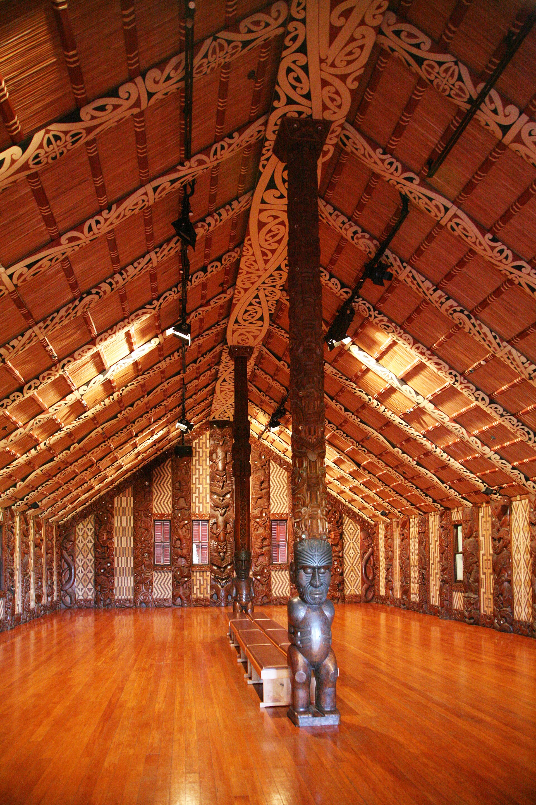

MĀORI DATA SOVEREIGNTY
CLEANING
MĀORI DATA
A routine recode can change identity, visibility, and authority.
“
OUR ARGUMENT
Standardisation is useful only when the original meaning remains visible and Māori authority shapes the decision.
POOJA • PRASANTHI • ROBBIE • SAHIL
Whare whānui — the meeting house where decisions are made

Slide 2

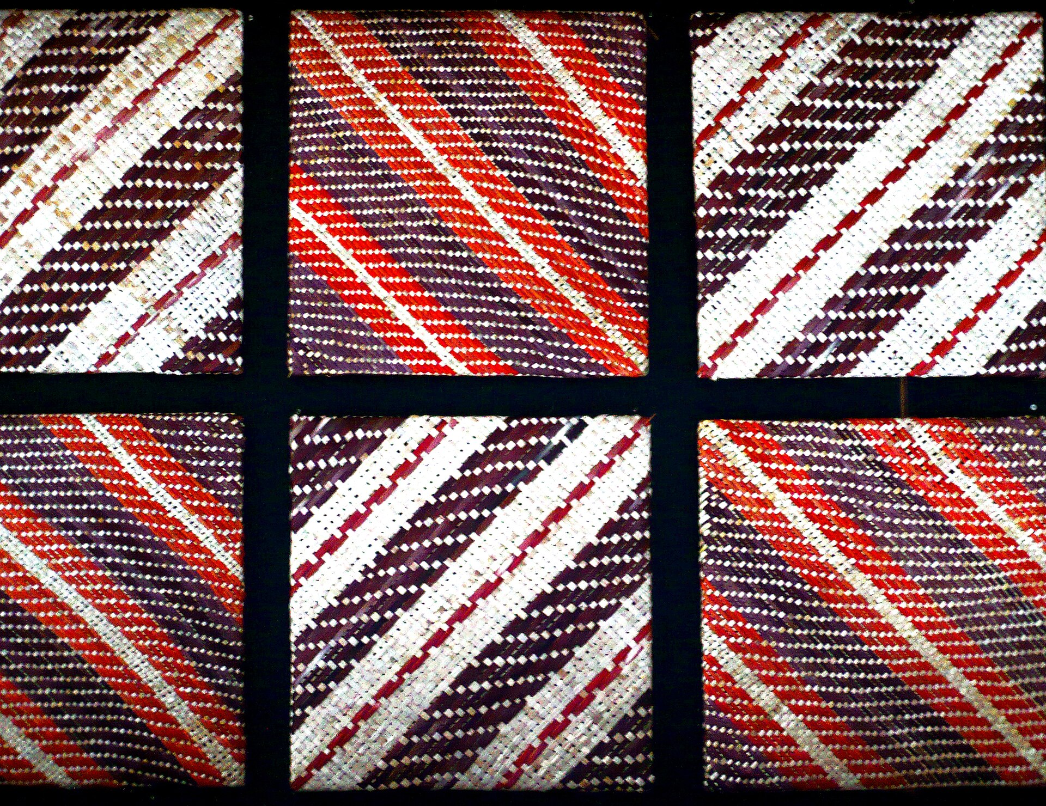
WHAT DATA ARE WE CLEANING?
The data are relationships,
not just labels
Iwi and hapū affiliation fields can contain multiple affiliations, local names, aliases, and responses that do not fit a single broad category.
Stats NZ's 2023 design makes that complexity visible:
139
45
16
fully coded
iwi categories
partially coded
iwi-related categories
maximum iwi
selections
Tukutuku panel weaving — pattern carries meaning, not decoration.
A category even exists for hapū affiliated to more than one iwi.
02

Slide 3



WHO HOLDS AND USES IT, AND WHY?
Cleaning choices travel
into real decisions
HOLDERS
USERS
PURPOSE
Stats NZ, health and education agencies, researchers, and iwi-controlled platforms.
Analysts, service planners, iwi authorities, Māori communities, and decision-makers.
Reporting, research, service planning, resource decisions, and iwi-led priorities.
TE WHATA — A DIFFERENT GOVERNANCE MODEL
Iwi-appointed information managers can shape their own dashboard narrative and priorities.
03

Slide 4
THE CENTRAL RISK
A tidy recode can erase
a valid distinction
BEFORE: SELF-IDENTIFIED RESPONSES
ONE BROAD
CATEGORY
Iwi name
MERGE
CORRECT
DELETE
Hapū name
Technically simpler, but potentially less faithful.
Local spelling
Multiple affiliations
WHAT CAN BE LOST?
MEANING
VISIBILITY
PROVENANCE
AUTHORITY
04

Slide 5
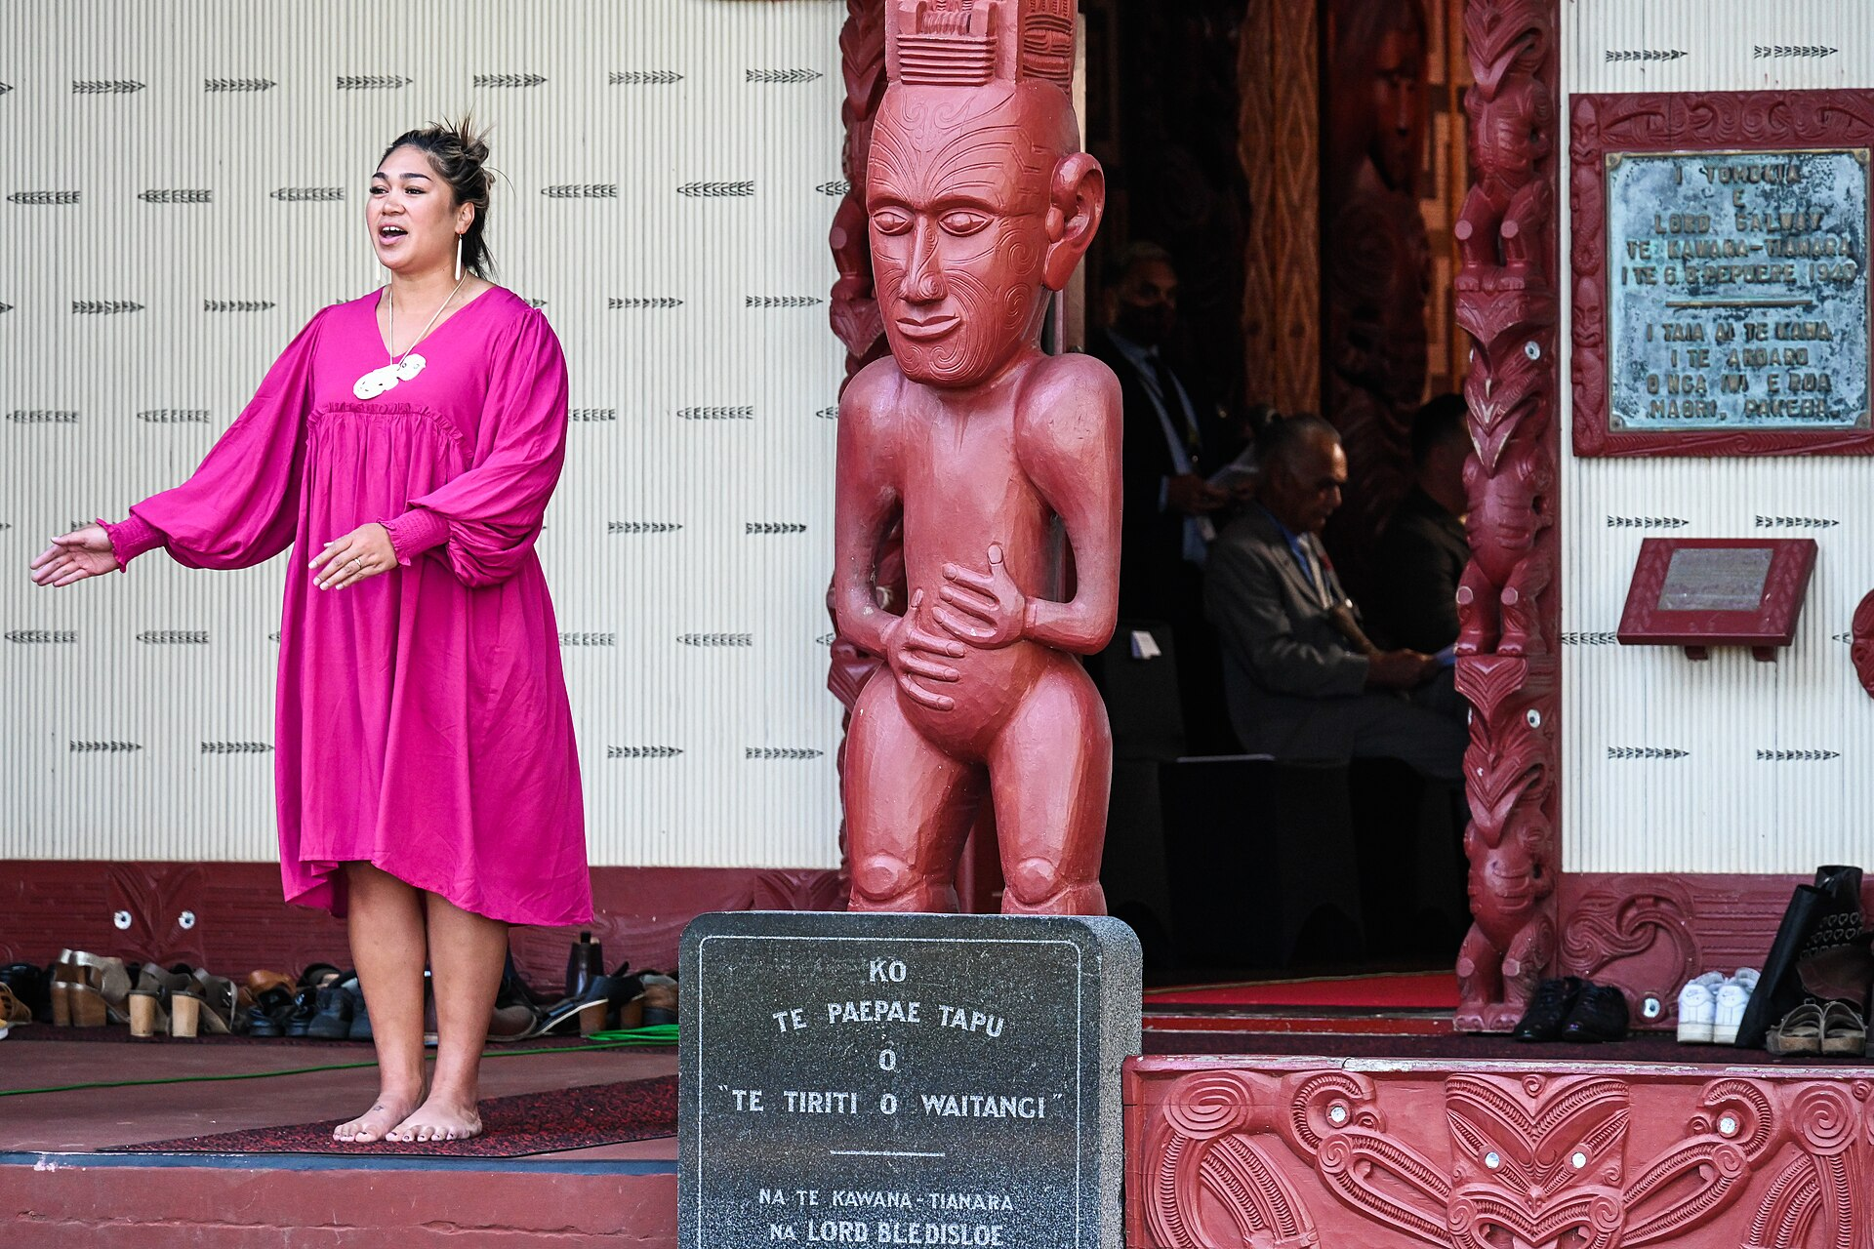


TWO PRINCIPLES CHANGE THE DECISION
Cleaning becomes a
governance question
Kaikaranga, Waitangi
RANGATIRATANGA
WHAKAPAPA
Authority
Relationships
Māori have an inherent right to control the analysis, interpretation, use, and reuse of Māori data.
Data has provenance, purpose, context, and future consequences; disaggregation can increase relevance for iwi.
Decision test: Who can approve this recode?
Decision test: What relationships disappear?
05

Slide 6




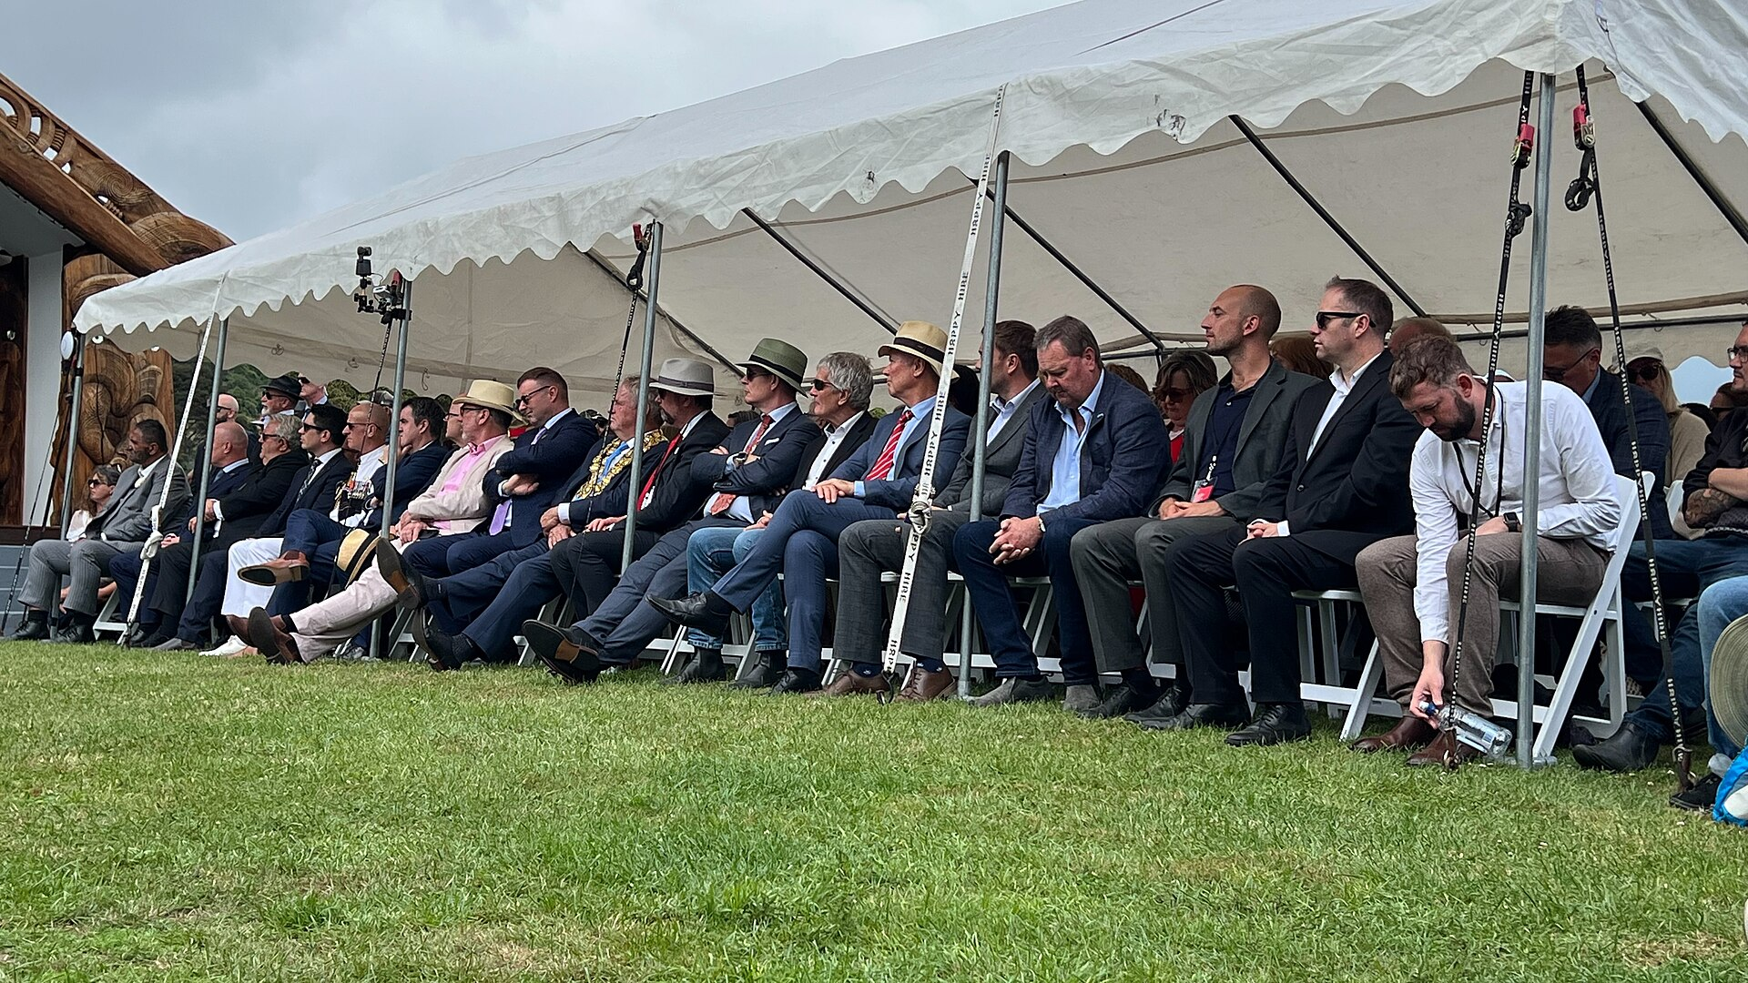
WHY THE ISSUE MATTERS
What disappears from data
can disappear from decisions
IDENTITY
VISIBILITY
ACCOUNTABILITY
FUTURE USE
A recode can change how a person’s affiliations appear.
Small groups can become harder to see in aggregated results.
The reason for a change can become impossible to audit.
Later analysts may inherit a simplified value without its context.
WHO MAY BE AFFECTED
Māori individuals • whānau • iwi and hapū • data stewards • service decision-makers
What disappears from data can disappear from decisions.
Waitangi Day, Onuku
06

Slide 7
REASONING AND REFLECTION
The right question is not
simply, ‘Can we merge it?’
Verified corrections can improve data quality. The risk begins when meaning changes without review, context, or reversibility.
01
02
03
IS IT AN ERROR?
WHO HAS AUTHORITY?
CAN WE REVERSE IT?
A rare value may be valid.
Convenience is not consent.
Keep the raw response.
A technically consistent dataset can still be culturally wrong.
07

Slide 8




OUR CONCRETE RECOMMENDATION
A Māori-led approach
across the data lifecycle
1
2
3
COLLECTION
STORAGE
GOVERNANCE
Participatory, using Te Mana Whakatipu.
Te Whata — a web-based Māori data platform (tewhata.io).
Māori data in Māori hands: control and authority held through Te Whata.
4
5
6
ACCESS
ANALYSIS
SHARING / USAGE
Ongoing, fee-free access for Māori communities; open access needs explicit permission and oversight.
A Māori-led classification review gate — detailed next.
Full, prior and informed consent at minimum; individual and/or collective.
Māori data in Māori hands.
08

Slide 9



RECOMMENDATION — ANALYSIS
From principle to practice
Add a Māori-led classification review gate
before any iwi or hapū value is merged, removed, or assigned a new meaning
1
2
3
4
PRESERVE RAW
STANDARDISE SEPARATELY
REFER UNCERTAINTY
RECORD + AUDIT
Keep the self-reported value unchanged.
Write any code to a new field.
Send rare, new, or ambiguous values for Māori review.
Document rule, reviewer, date, effect, and reversal.
OWNER Data holder owns the gate • analyst implements it • iwi/hāpu expertise approves meaning-changing rules
09

Slide 10
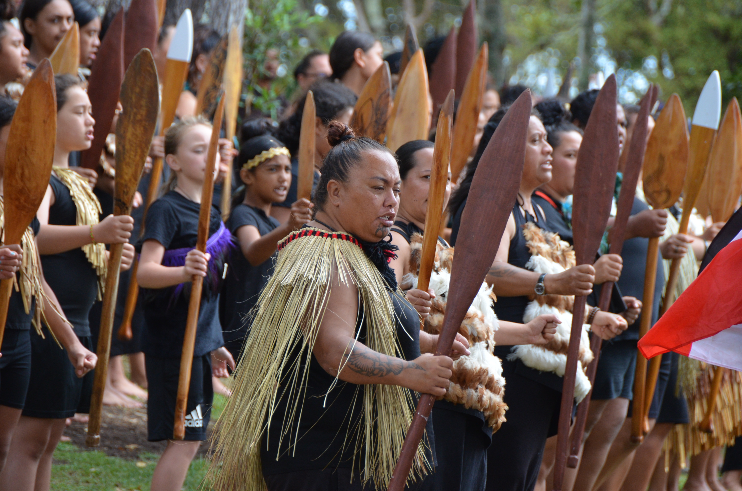
LOOKING AHEAD
Long-term engagement
with iwi and hapū
CONSULT RELEVANT GROUPS
Te Whata Iwi Information Managers
Two per iwi
Te Mana Raraunga
Māori Data Sovereignty Network
Te Kāhui Raraunga
Data Iwi Leaders Group
ORGANISE DATA UNDER THESE CATEGORIES
HAPŪ
TŪPUNA
MARAE
PAPAKĀINGA
AWA / PUNA
Pōwhiri, Waitangi Treaty Grounds
Host wānanga (forums) to carry out whakapapa research and kaupapa discussions at the marae — with formal greetings — across one or several marae.
MAUNGA
WĀHI TAPU
10

Slide 11
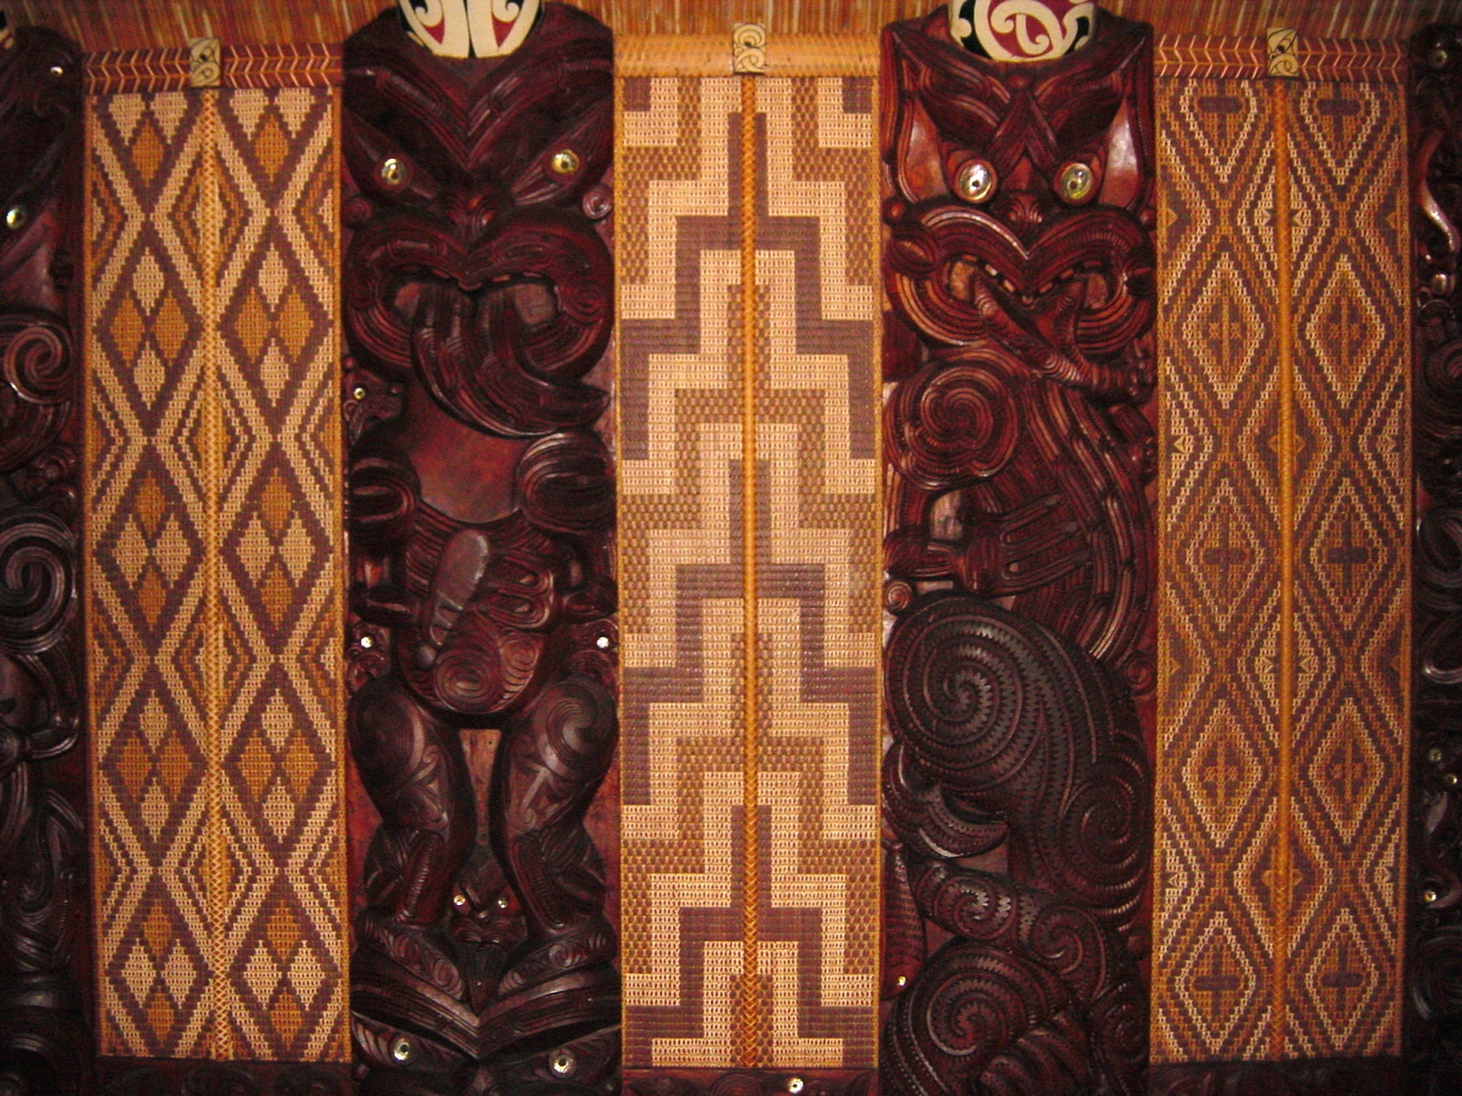
EVIDENCE BASE
The argument is grounded in
Māori-led frameworks and public evidence
Tukutuku & poupou
CORE FRAMEWORKS
EVIDENCE + PRACTICE
Te Mana Raraunga (2018)
UC LEARN
Principles of Māori Data Sovereignty
Week 6 guest lecture and Week 7 brief
Te Kāhui Raraunga (2023)
Māori Data Governance Model
Stats NZ (2023/2025)
Iwi affiliation concepts and classification
Te Whata
Clark et al. (2025)
Iwi data and information managers
Hapū data sovereignty: tips for getting started
IMAGE CREDITS NZ Government / Office of the Governor-General • W. Bulach • LBM1948 • Allie Caulfield • David Palmer — Wikimedia Commons licences shown in speaker notes
11

Slide 12

BETTER DATA ARE NOT
SIMPLY TIDIER DATA
Better data preserve the raw voice, explain every mapping, and keep meaning-changing decisions under Māori authority.
OUR FINAL POSITION
Clean for consistency. Govern for meaning.
POOJA • PRASANTHI • ROBBIE • SAHIL

