Slide 1
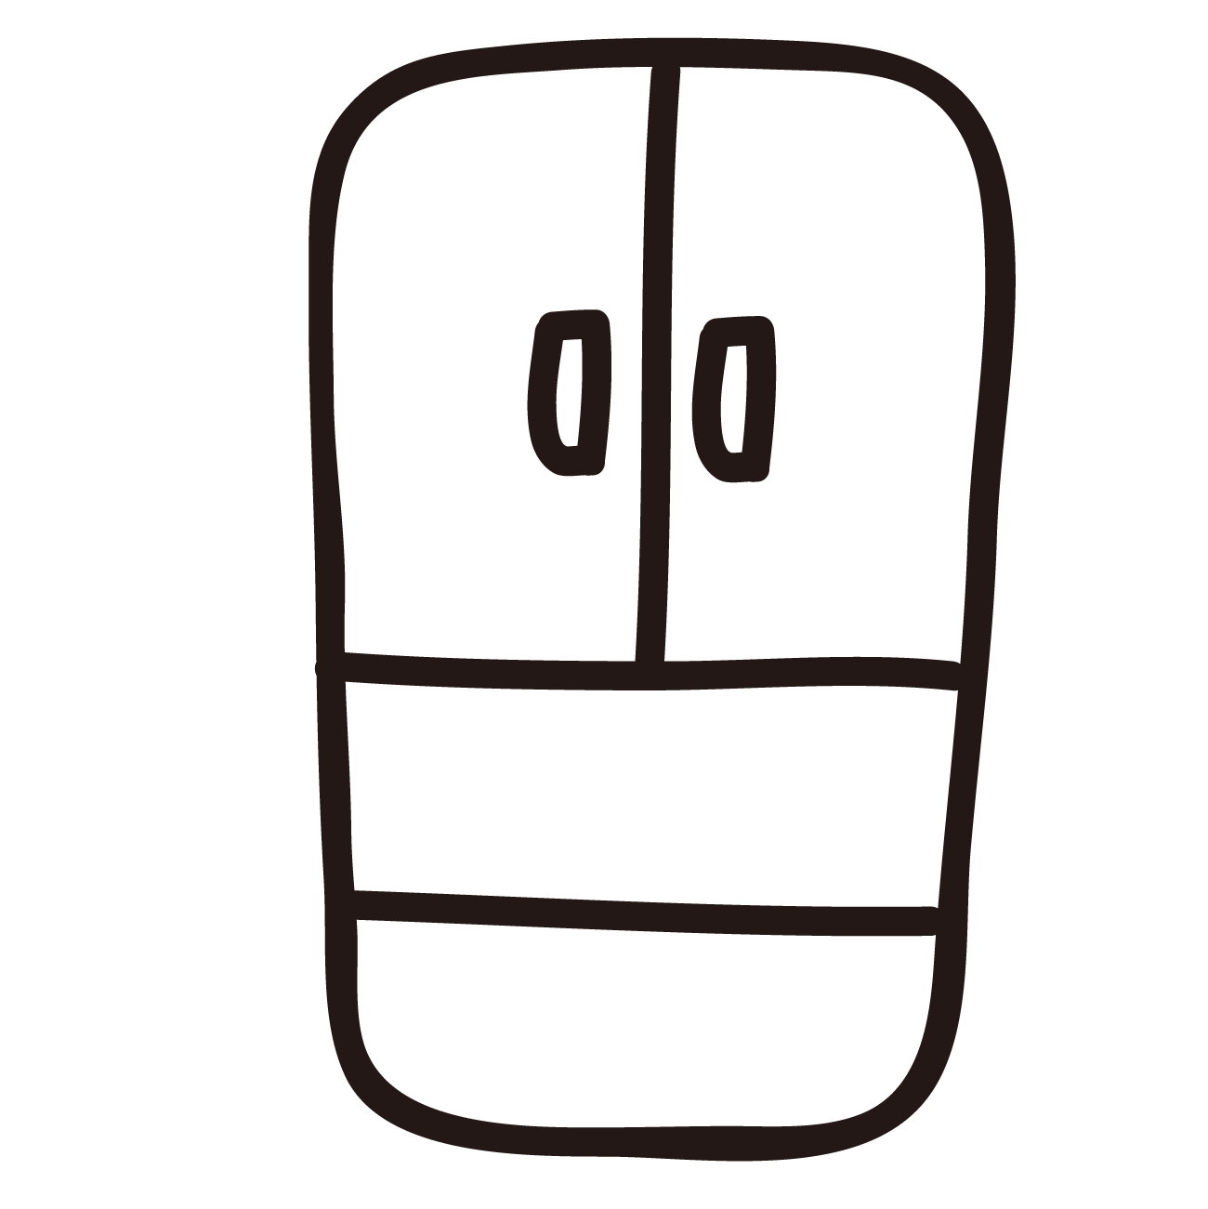
GRAY: D6D3D4
GREEN: 00C6A5

Slide 2
GRAY: D6D3D4
GREEN: 00C6A5

