Slide 1
Tools

Slide 2

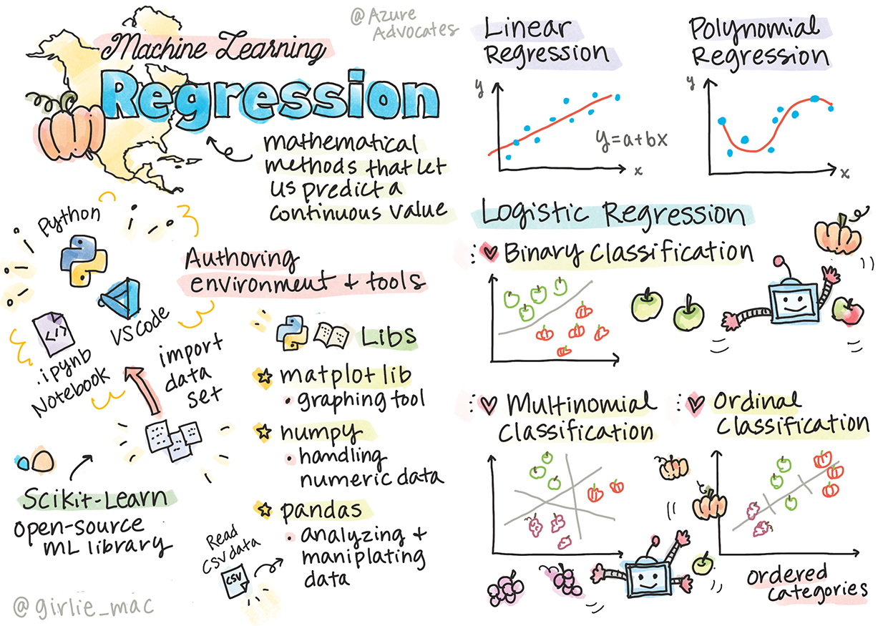
Get started with Python and Scikit-learn
for regression models
Sketchnote by Tomomi Imura

Slide 3
Pre-lecture quiz
https://gray-sand-07a10f403.1.azurestaticapps.net/quiz/9/
This lesson is available in R!
Introduction
In these four lessons, you will discover how to build regression models. We will discuss what these
are for shortly. But before you do anything, make sure you have the right tools in place to start the
process!
In this lesson, you will learn how to:
Configure your computer for local machine learning tasks.
Work with Jupyter notebooks.
Use Scikit-learn, including installation.
Explore linear regression with a hands-on exercise.
Notes:
Pre-lecture quiz-https://gray-sand-07a10f403.1.azurestaticapps.net/quiz/9/

Slide 4
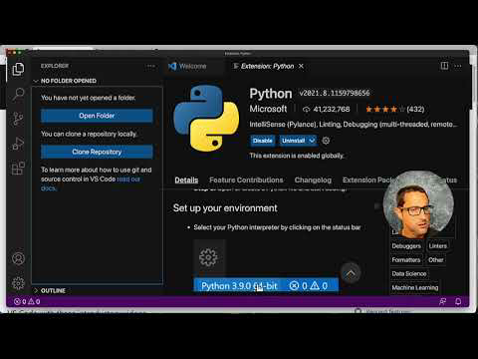
Installations and configurations
🎥 Click the image above for a video: using Python within VS Code.
1. Install Python. Ensure that Python is installed on your computer. You will use Python for many
data science and machine learning tasks. Most computer systems already include a Python
installation. There are useful Python Coding Packs available as well, to ease the setup for some
users.
Some usages of Python, however, require one version of the software, whereas others require a
different version. For this reason, it's useful to work within a virtual environment.
Notes:
https://youtu.be/-DfeD2k2Kj0

Slide 5
Installations and configurations cont…
2. Install Visual Studio Code. Make sure you have Visual Studio Code installed on your computer.
Follow these instructions to install Visual Studio Code for the basic installation. You are going to
use Python in Visual Studio Code in this course, so you might want to brush up on how to
configure Visual Studio Code for Python development.
Get comfortable with Python by working through this collection of Learn modules
3. Install Scikit-learn, by following these instructions. Since you need to ensure that you use Python3
, it's recommended that you use a virtual environment. Note, if you are installing this library on a
M1 Mac, there are special instructions on the page linked above.
4. Install Jupyter Notebook. You will need to install the Jupyter package.

Slide 6
Your ML authoring environment
You are going to use notebooks to develop your Python code and create machine learning models.
This type of file is a common tool for data scientists, and they can be identified by their suffix or extension .ipynb.
Notebooks are an interactive environment that allow the developer to both code and add notes and
write documentation around the code which is quite helpful for experimental or research-oriented projects.
Exercise - work with a notebook
In this folder, you will find the file notebook.ipynb.
1. Open notebook.ipynb in Visual Studio Code.
A Jupyter server will start with Python 3+ started. You will find areas of the notebook that can be
run, pieces of code. You can run a code block, by selecting the icon that looks like a play button.
2. Select the md icon and add a bit of markdown, and the following text # Welcome to your
notebook.
Next, add some Python code.
3. Type print('hello notebook') in the code block.

Slide 7
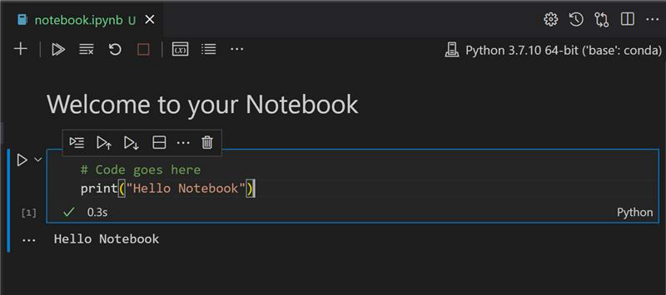
4. Select the arrow to run the code.You should see the printed statement:
output
hello notebook
You can interleaf your code with comments to self-document the notebook.
✅ Think for a minute how different a web developer's working environment is versus that of a data
scientist.

Slide 8
Up and running with Scikit-learn
Now that Python is set up in your local environment, and you are comfortable with Jupyter
notebooks, let's get equally comfortable with Scikit-learn (pronounce it sci as in science).
Scikit-learn provides an extensive API to help you perform ML tasks.
According to their website, "Scikit-learn is an open source machine learning library that supports
supervised and unsupervised learning. It also provides various tools for model fitting, data
preprocessing, model selection and evaluation, and many other utilities.“
In this course, you will use Scikit-learn and other tools to build machine learning models to perform
what we call 'traditional machine learning' tasks. We have deliberately avoided neural networks and
deep learning, as they are better covered in our forthcoming 'AI for Beginners' curriculum.
Scikit-learn makes it straightforward to build models and evaluate them for use. It is primarily focused
on using numeric data and contains several ready-made datasets for use as learning tools. It also
includes pre-built models for students to try. Let's explore the process of loading prepackaged data
and using a built in estimator first ML model with Scikit-learn with some basic data.

Slide 9

Exercise - your first Scikit-learn notebook
This tutorial was inspired by the linear regression example on Scikit-learn's web site.
In the notebook.ipynb file associated to this lesson, clear out all the cells by pressing the 'trash can'
icon.
In this section, you will work with a small dataset about diabetes that is built into Scikit-learn for
learning purposes. Imagine that you wanted to test a treatment for diabetic patients. Machine
Learning models might help you determine which patients would respond better to the treatment,
based on combinations of variables. Even a very basic regression model, when visualized, might
show information about variables that would help you organize your theoretical clinical trials.
✅ There are many types of regression methods, and which one you pick depends on the answer
you're looking for. If you want to predict the probable height for a person of a given age, you'd use
linear regression, as you're seeking a numeric value. If you're interested in discovering whether a
type of cuisine should be considered vegan or not, you're looking for a category assignment so you
would use logistic regression. You'll learn more about logistic regression later. Think a bit about some
questions you can ask of data, and which of these methods would be more appropriate.
Let's get started on this task.

Slide 10
Exercise - your first Scikit-learn notebook cont…
Import libraries
For this task we will import some libraries:
matplotlib. It's a useful graphing tool and we will use it to create a line plot.
numpy. numpy is a useful library for handling numeric data in Python.
sklearn. This is the Scikit-learn library.
Import some libraries to help with your tasks.
1. Add imports by typing the following code:
python
import matplotlib.pyplot as plt
import numpy as np
from sklearn import datasets, linear_model, model_selection
Above you are importing matplotlib, numpy and you are importing datasets,
linear_model and model_selection from sklearn. model_selection is used for
splitting data into training and test sets.

Slide 11
Exercise - your first Scikit-learn notebook cont…
The diabetes dataset
The built-in diabetes dataset includes 442 samples of data around diabetes, with 10 feature
variables, some of which include:
age: age in years
bmi: body mass index
bp: average blood pressure
s1 tc: T-Cells (a type of white blood cells)
✅ This dataset includes the concept of 'sex' as a feature variable important to research around
diabetes.
Many medical datasets include this type of binary classification. Think a bit about how
categorizations such as this might exclude certain parts of a population from treatments.
Now, load up the X and y data.

Slide 12
Exercise - your first Scikit-learn notebook cont…
🎓 Remember, this is supervised learning, and we need a named 'y' target.
In a new code cell, load the diabetes dataset by calling load_diabetes(). The input
return_X_y=True signals that X will be a data matrix, and y will be the regression target.
1. Add some print commands to show the shape of the data matrix and its first element:
python
X, y = datasets.load_diabetes(return_X_y=True)
print(X.shape)
print(X[0])
What you are getting back as a response, is a tuple. What you are doing is to assign the two first
values of the tuple to X and y respectively. Learn more about tuples.
You can see that this data has 442 items shaped in arrays of 10 elements:
text
(442, 10)
[ 0.038075910.050680120.061696210.02187235 -0.0442235-0.03482076
-0.04340085 -0.002592260.01990842 -0.01764613]

Slide 13
Exercise - your first Scikit-learn notebook cont…
✅ Think a bit about the relationship between the data and the regression target. Linear
regression predicts relationships between feature X and target variable y. Can you find the target
for the diabetes dataset in the documentation? What is this dataset demonstrating, given that target?
2. Next, select a portion of this dataset to plot by selecting the 3rd column of the dataset. You can do this by using the `:` operator to select all rows, and then selecting the 3rd column using the index (2). You can also reshape the data to be a 2D array - as required for plotting - by using `reshape(n_rows, n_columns)`. If one of the parameter is -1, the corresponding dimension is calculated automatically.
python
X = X[:, 2]
X = X.reshape((-1,1))
✅ At any time, print out the data to check its shape.
3. Now that you have data ready to be plotted, you can see if a machine can help determine a logical
split between the numbers in this dataset. To do this, you need to split both the data (X) and the
target (y) into test and training sets. Scikit-learn has a straightforward way to do this; you can split
your test data at a given point.
python
X_train, X_test, y_train, y_test = model_selection.train_test_split(X, y, test_size=0.33)

Slide 14
Exercise - your first Scikit-learn notebook cont…
4. Now you are ready to train your model! Load up the linear regression model and train it with your X
and y training sets using model.fit():
python
model = linear_model.LinearRegression()
model.fit(X_train, y_train)
✅ model.fit() is a function you'll see in many ML libraries such as TensorFlow
5. Then, create a prediction using test data, using the function predict(). This will be used to
draw the line between data groups
python
y_pred = model.predict(X_test)

Slide 15
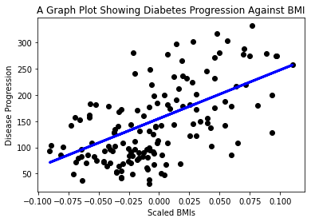
Exercise - your first Scikit-learn notebook cont…
6. Now it's time to show the data in a plot. Matplotlib is a very useful tool for this task. Create a
scatterplot of all the X and y test data, and use the prediction to draw a line in the most
appropriate place, between the model's data groupings.
python
plt.scatter(X_test, y_test,color='black’)
plt.plot(X_test, y_pred, color='blue', linewidth=3)
plt.xlabel('Scaled BMIs’)
plt.ylabel('Disease Progression’)
plt.title('A Graph Plot Showing Diabetes Progression Against BMI’)
plt.show()

Slide 16
Exercise - your first Scikit-learn notebook cont…
✅ Think a bit about what's going on here. A straight line is running through many small dots of
data, but what is it doing exactly? Can you see how you should be able to use this line to predict
where a new, unseen data point should fit in relationship to the plot's y axis? Try to put into words
the practical use of this model.
Congratulations, you built your first linear regression model, created a prediction with it, and
displayed it in a plot!
🚀Challenge
Plot a different variable from this dataset. Hint: edit this line: X = X[:, np.newaxis, 2]. Given
this dataset's target, what are you able to discover about the progression of diabetes as a disease?
Post-lecture quiz
https://gray-sand-07a10f403.1.azurestaticapps.net/quiz/10
Notes:
[Post-lecture quiz](https://gray-sand-07a10f403.1.azurestaticapps.net/quiz/10/

Slide 17
Review & Self Study
In this tutorial, you worked with simple linear regression, rather than univariate or multiple linear
regression. Read a little about the differences between these methods, or
take a look at this video
Read more about the concept of regression and think about what kinds of questions can be answered by this technique. Take this tutorial to deepent your understanding.
Assignment
A different dataset
Build a regression model using Scikit-learn: prepare and visualize data

Slide 18
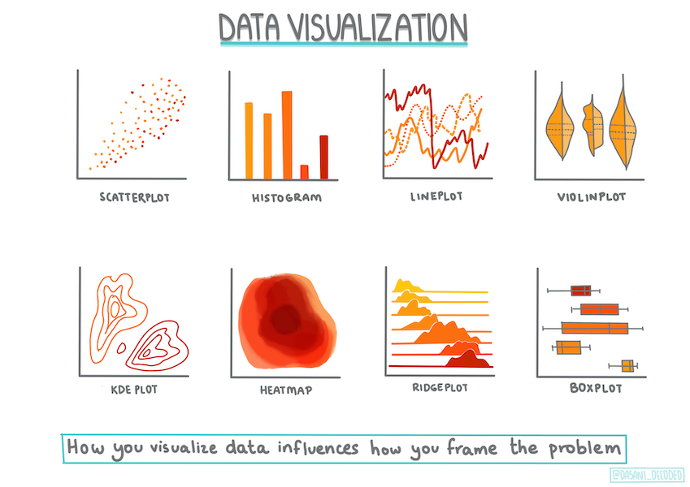
Review & Self Study
Infographic by Dasani Madipalli

