Slide 1
Thesis Meeting
26-04-2024

Slide 2
Agenda
Quick code update
Discuss methodology and mathematical formalizations
Next steps

Slide 3
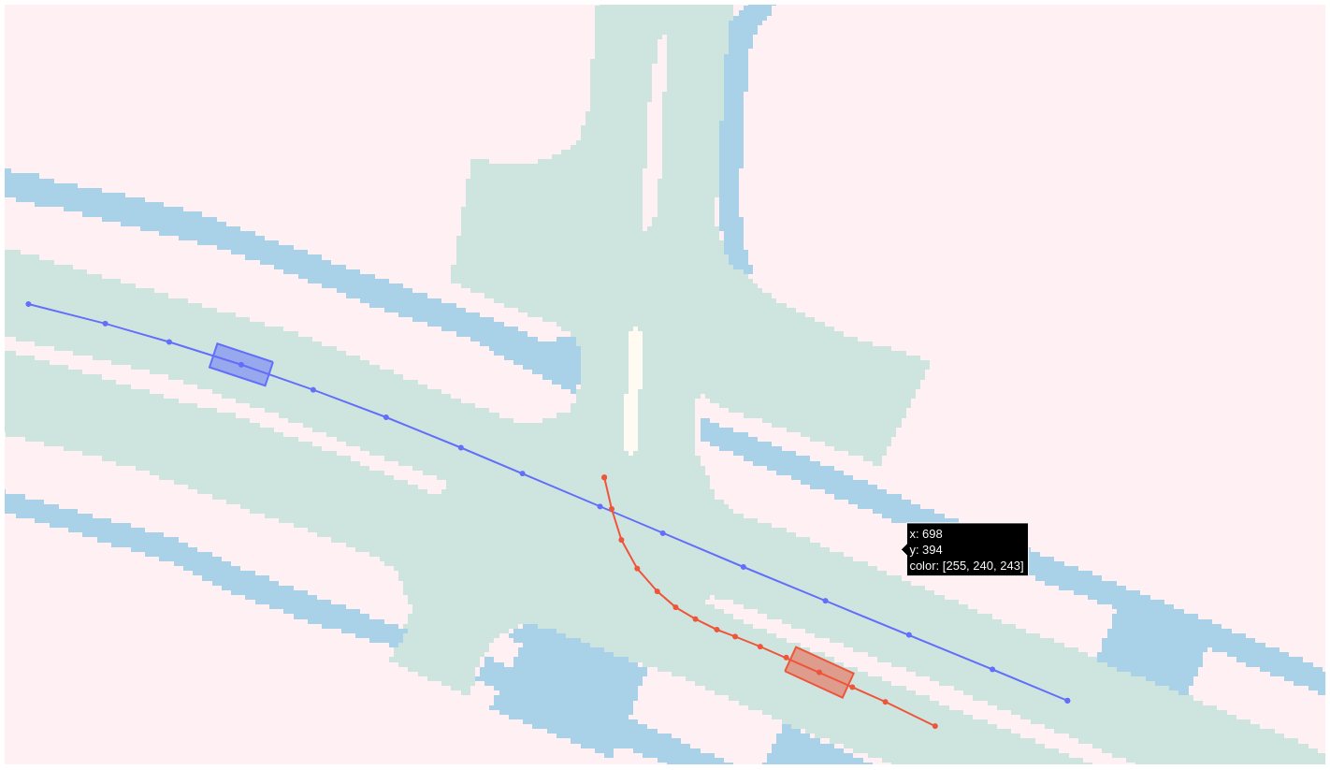
Quick code update
Implemented proper collision detection function:
Fit 3 disks: bumpers + center
Calculate trajectories of all disks and minimum distance between all combinations between agent pairs
Pragmatic and computationally efficient
Improved visualization colors

Slide 4
Introduction
Research gap VTP evaluation metrics:
No explicit mode-collapse metric
No metrics for interaction among agents
Metrics very data-dependent; constraint on datasets and models
Therefore, not intuitive / insightful / interpretable
Proposition:
Explicitly evaluate predicting correct/covered interaction
Only evaluating interesting, path crossing, interactions (more data-independent)
Time-based metric (intuitive and task-agnostic)

Slide 5
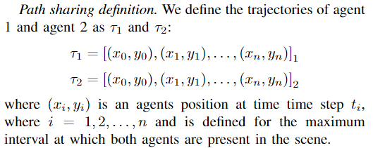
Safety critical interactions

Slide 6
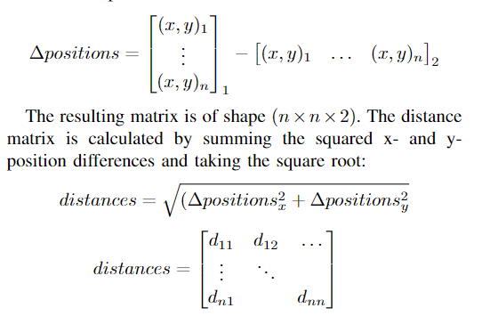
Safety critical interactions

Slide 7
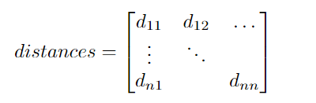
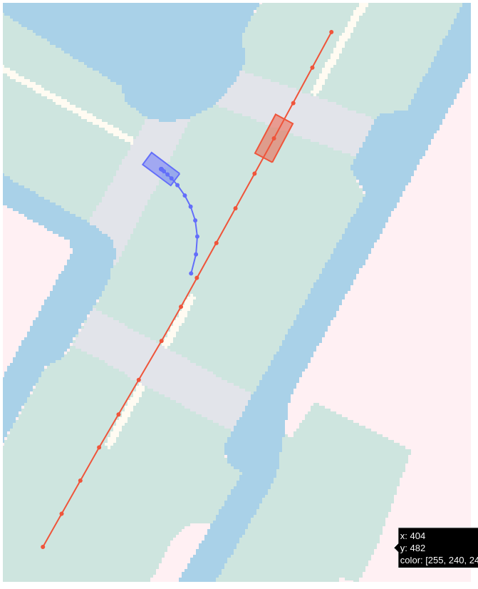
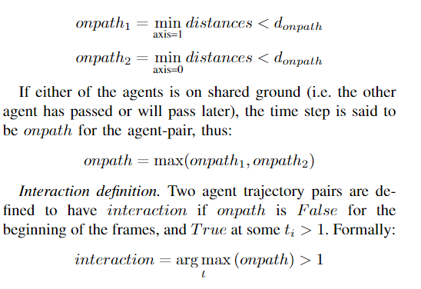
Safety critical interactions
e.g. merging: [0, 0, …, 1, 1, 1, 1]
Notes:
>0 or >1 ??? Add examples
<number>

Slide 8
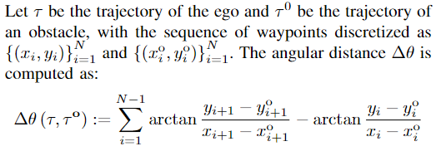
Homotopy classes
Evaluate interaction between agents (a2a modes) with homotopy classes → free-end homotopy

Slide 9
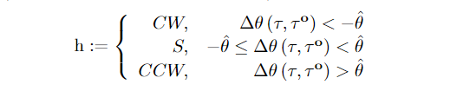
Homotopy classes
Put threshold = 0, only CW and CCW class

Slide 10
Inevitable homotopy-collapse state: roll-outs
Only evaluate predictions up to the point where the class inevitable.
Does not inflate metric performance
Use this for time-based metric (more intuitive / insightful)
Simulate yielding/going trajectories for agent pairs
Keep ground truth paths
Respect longitudinal and lateral acceleration limits

Slide 11

Inevitable homotopy state: collision checker
Binary collision detection function (disk approach, taking headings and vehicle sizes into account):

Slide 12



Inevitable homotopy state

Slide 13
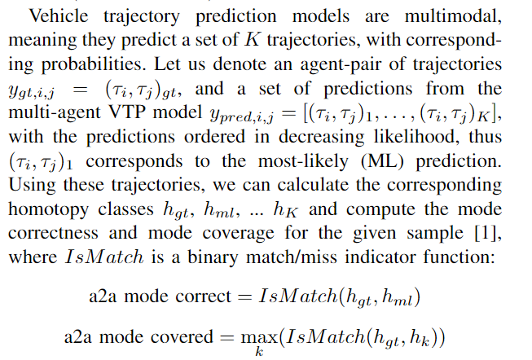
a2a mode metrics

Slide 14
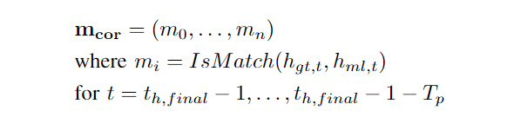

Time-to-correct-mode-prediction

Slide 15
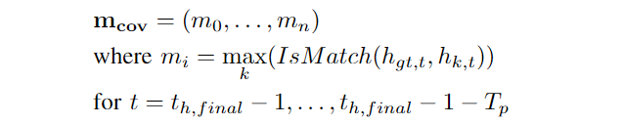

Time-to-covered-mode-prediction

Slide 16
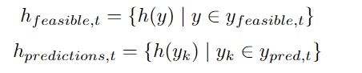
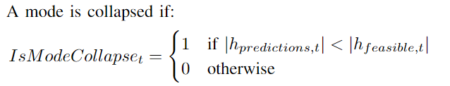
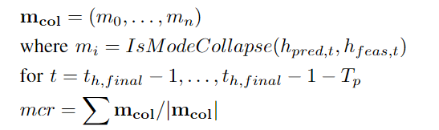
Mode-collapse ratio

Slide 17
Prediction consistency
???

Slide 18
Next steps
…
Plan meeting with Jens

