Slide 1


Sales Performance
Analysis Project
Supervised
By
Dr. Ahmed Ismael

Slide 2
Dataset Overview
💰 Total Sales
📈 Total Profit
🛒 Total Orders
📦 Total Quantity
$2.30M
$286K
5,009
37,873
🎯 Profit Margin
🏷️ Avg Discount
👥 Customers
🗂️ Products
12.5%
15.6%
793
1,862
By Category
By Region
By Segment
Dataset Info
Category
Sales
%
Region
Sales
%
Segment
Sales
%
Metric
Value
Technology
$836K
36%
West
$725K
32%
Consumer
$1.16M
51%
Tables
5
Orders Rows
9,994
East
$670K
29%
Furniture
$742K
32%
Corporate
$706K
31%
Columns
15
Central
$501K
22%
Customers
793
Office Sup.
$719K
31%
Home Off.
$430K
19%
Products
1,862
South
$401K
17%
Top State
California
Data covers 4 years (2020–2023) | 5 relational tables | Total Sales: $2.30M | Top Region: West | Top Category: Technology

Slide 3
1. Business Problem
The Challenge
The company faces challenges in monitoring sales performance across multiple dimensions.
Key Pain Points:
• Difficulty monitoring sales performance and profitability in real time.
• Lack of visibility into customer purchasing behavior and patterns.
• No centralized view of product contribution across categories.
• Geographic performance gaps across regions remain unidentified.
• Year-over-year growth trends difficult to track without integrated data.
Management requires a centralized analytical solution to identify high-performing products,
profitable customers, regional opportunities, and year-over-year growth trends.

Slide 4
2. Dashboard Objectives
Track Performance
Year Comparison
Product Analysis
Geographic Insights
Monitor Sales, Profit, Orders and Margin KPIs in real time.
Compare performance metrics across fiscal years.
Identify best-performing product categories and customers.
Analyze regional and geographic sales distribution across the US.
These objectives guide the Power BI dashboard design and data model architecture.

Slide 5
3. Dashboard Screenshots & Explanations
Executive Summary
High-level KPIs: Total Sales, Profit, Orders, Margin %. Yearly/monthly trends, category distribution, and order analysis. Enables quick performance monitoring vs targets.
Product Analysis
Analyzes performance by category and sub-category. Top 10 Sub-Categories (Phones, Chairs), scatter plots for Sales vs Profit, treemaps for category contribution, decomposition tree by region.
Customer Analysis
Evaluates customer behavior and profitability. Segment comparison: Consumer, Corporate, Home Office. Ship mode analysis and top-customer ranking tables by sales and profitability.
Geographic Analysis
Regional performance across the US. West and East regions lead in sales. Map visualization identifies state-level performance gaps and expansion opportunities.
Data Model
Star Schema design: Orders (Fact Table) connected to Date, Products, Customers, and Location dimension tables via one-to-many relationships for efficient filtering.

Slide 6
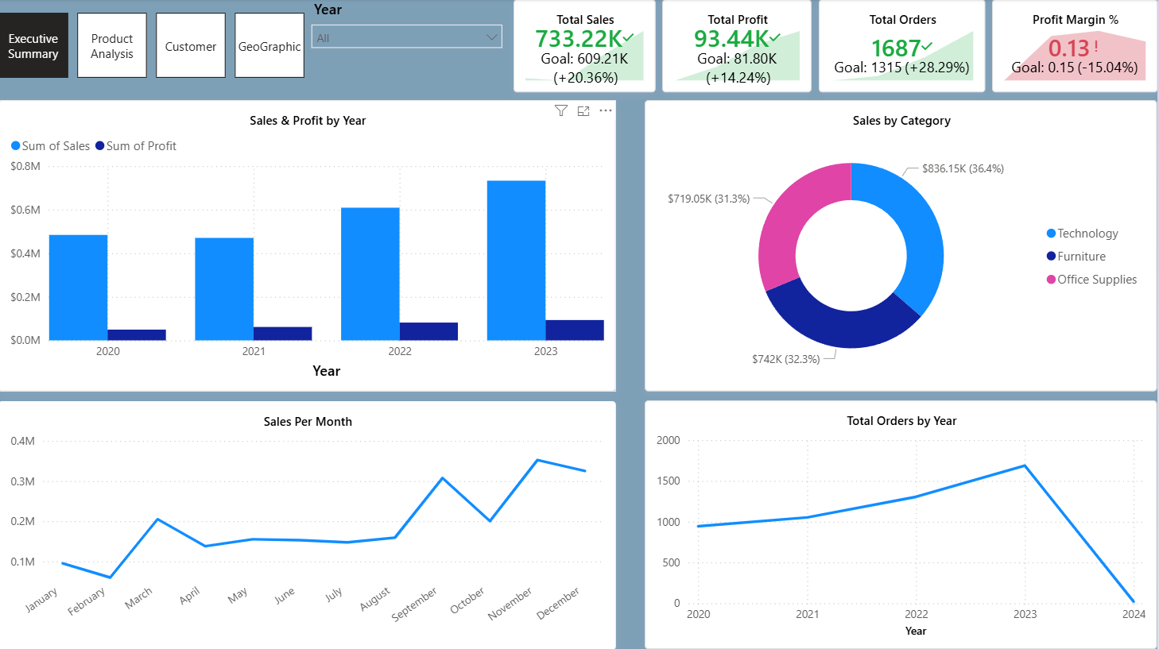
Executive Summary
This dashboard provides high-level KPIs such as Total Sales, Total Profit, Total Orders, and Profit Margin %. It includes yearly trend analysis, monthly sales
trends, category sales distribution, and order analysis. Decision makers can quickly monitor performance and compare outcomes against targets.

Slide 7
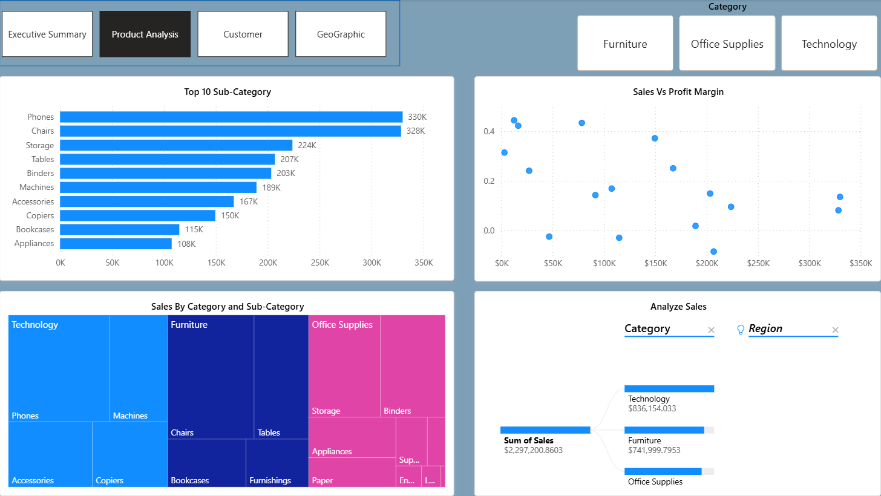
Product Analysis
This page analyzes product performance by category and sub-category. The Top 10 Sub-Categories chart highlights best-selling items such as Phones and Chairs.
Scatter plots compare sales vs profit margin while treemaps visualize category contribution. The decomposition tree helps drill down sales by category and region.

Slide 8
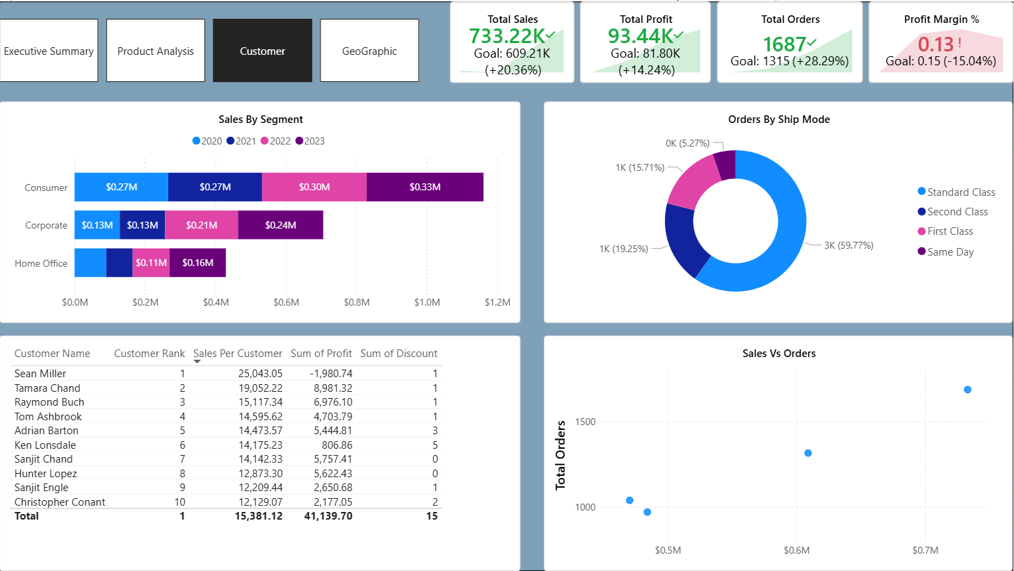
Customer Analysis
This page evaluates customer behavior and profitability. Segment analysis compares Consumer,
Corporate, and Home Office customers. Ship mode analysis helps identify logistics preferences.
Ranking tables identify top customers by sales contribution and profitability.

Slide 9
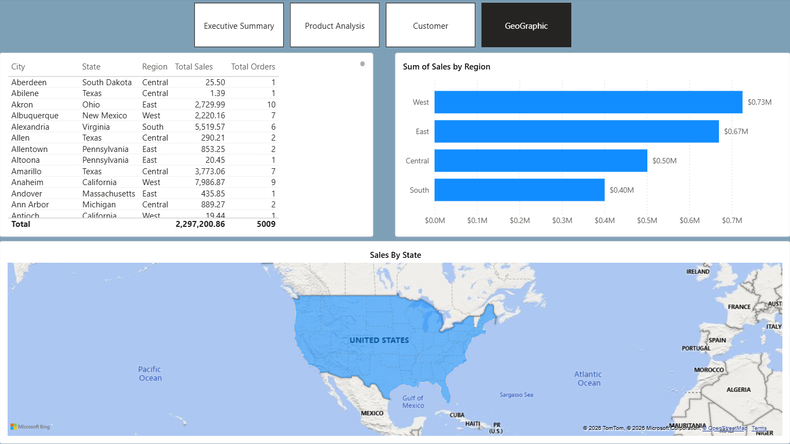
Geographic Analysis
This dashboard evaluates regional performance across the United States.
West and East regions contribute the highest sales. The geographic map helps identify state-level performance and expansion opportunities.

Slide 10
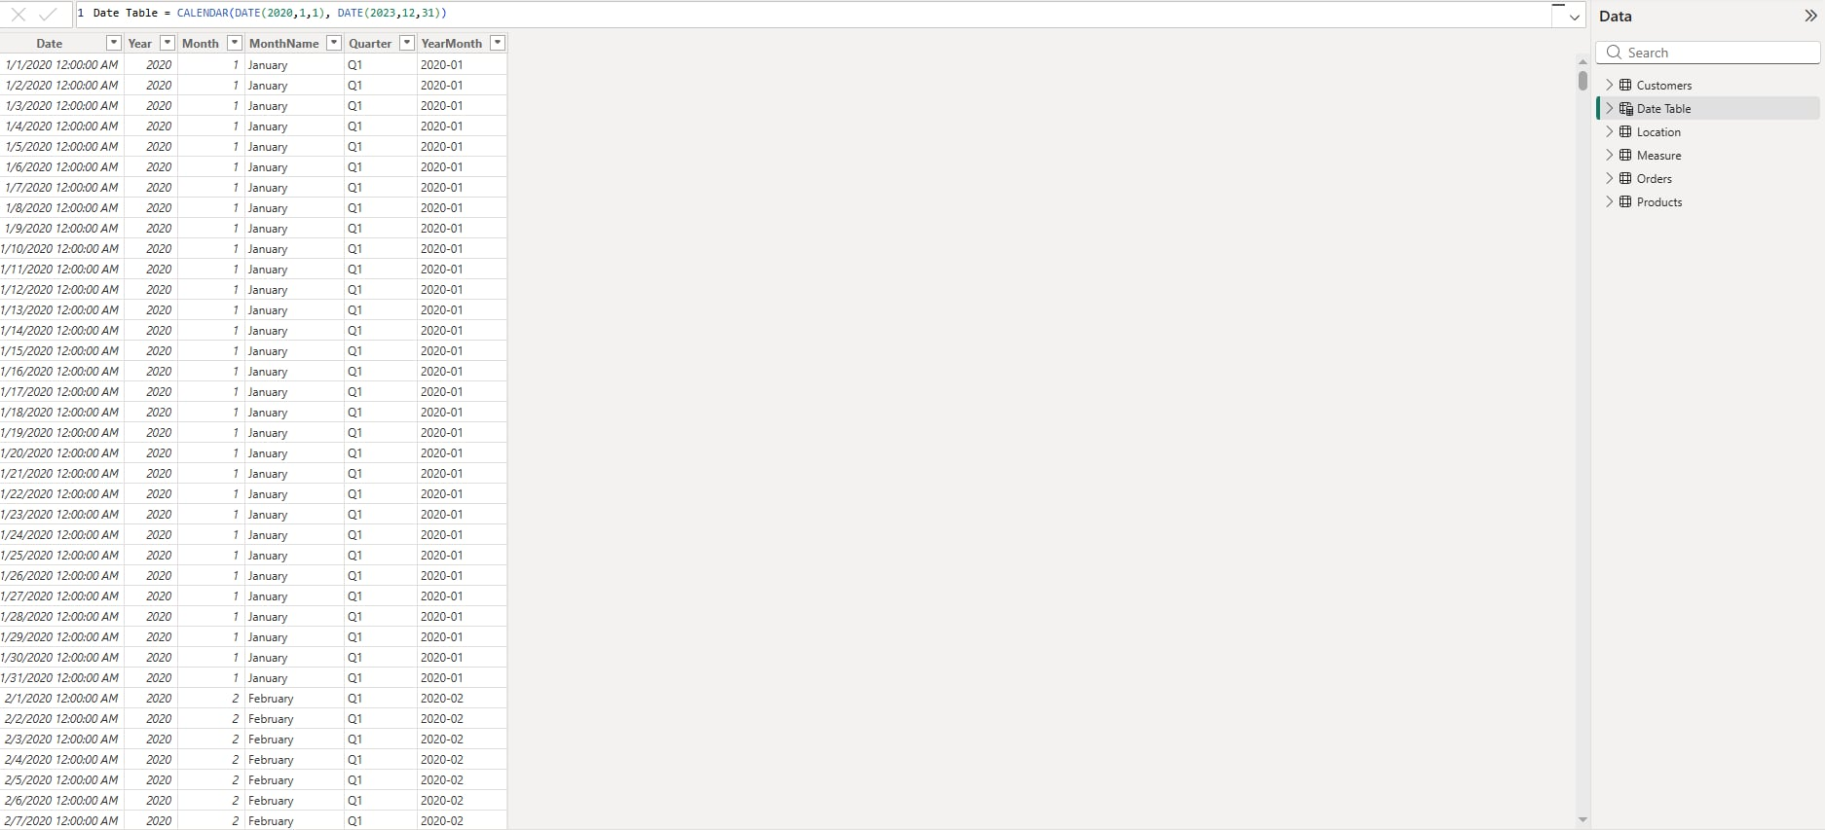
Date Table
Data Table used to compare sales , Orders from previous years

Slide 11
4. Data Relationships — Star Schema
Star Schema: Orders (Fact Table) connects to 4 dimension tables via one-to-many relationships.
Date Table
Customers
1
Orders (Fact Table)
1
M
M
M
M
Products
Location
1
1
Relationship Type: One-to-Many (1:*) from Fact to each Dimension table
• Orders → Date Table (via Order Date)
• Orders → Products (via Product ID)
• Orders → Customers (via Customer ID)
• Orders → Location (via Postal Code)

Slide 12
5. DAX Measures Documentation — Core Measures
Total Sales
Total Profit
SUM(Orders[Sales])
Calculates total revenue generated.
SUM(Orders[Profit])
Calculates total profit across all orders.
Total Orders
Total Customers
DISTINCTCOUNT(Orders[Order ID])
Counts total distinct orders.
DISTINCTCOUNT(Customers[Customer ID])
Counts unique customers.
Total Quantity
Profit Margin %
SUM(Orders[Quantity])
Calculates total quantity sold.
DIVIDE([Total Profit],[Total Sales],0)
Measures profitability ratio.
Avg Order Value
Profit Per Order
DIVIDE([Total Sales],[Total Orders],0)
Average revenue per order.
DIVIDE([Total Profit],[Total Orders],0)
Average profit per order.

Slide 13
5. DAX Measures Documentation — Time Intelligence
Sales PY
Profit PY
CALCULATE([Total Sales], SAMEPERIODLASTYEAR('Date Table'[Date]))
Previous-year sales for YoY comparison.
CALCULATE([Total Profit], SAMEPERIODLASTYEAR('Date Table'[Date]))
Previous-year profit value.
Orders PY
Sales YoY Growth
CALCULATE([Total Orders], SAMEPERIODLASTYEAR('Date Table'[Date]))
DIVIDE([Total Sales]-[Sales PY],[Sales PY],0)
Year-over-year growth rate as decimal.
Sales YoY Growth %
Sales Per Customer
FORMAT([Sales YoY Growth],"0.0")
Formatted YoY growth percentage string.
DIVIDE([Total Sales],[Total Customers],0)
Average revenue per customer.
Customer Rank
Top N Products Sales
RANKX(ALL(Customers[Customer Name]),[Total Sales],,DESC,DENSE)
Ranks customers by total sales descending.
CALCULATE([Total Sales], TOPN(10, ALL(Products[Product Name]), [Total Sales]))

Slide 14
6. Business Insights
Top Sub-Categories
Consumer Segment
Margin Challenge
Technology Leads
West Region Wins
Profit margin at 12.5% should be improved due to declining performance vs. goal.
Technology category generates the highest sales contribution across all product lines.
Phones and Chairs are the best-performing sub-categories by revenue.
Consumer segment contributes the highest sales at 51% of total revenue.
West region outperforms all other regions with $725K in revenue (32% share).

Slide 15
7. Recommendations & Advises
01
Focus Marketing
Direct campaigns toward high-performing categories like Technology and top sub-categories such as Phones and Chairs.
02
Improve Profitability
Review and improve pricing or cost structures for low-margin products to meet profitability targets.
03
Regional Expansion
Expand strategies in high-performing West/East regions and investigate root causes in low-performing South states.
04
Customer Retention
Develop targeted retention strategies for top-ranked customers who drive the highest sales contribution.

