Slide 1
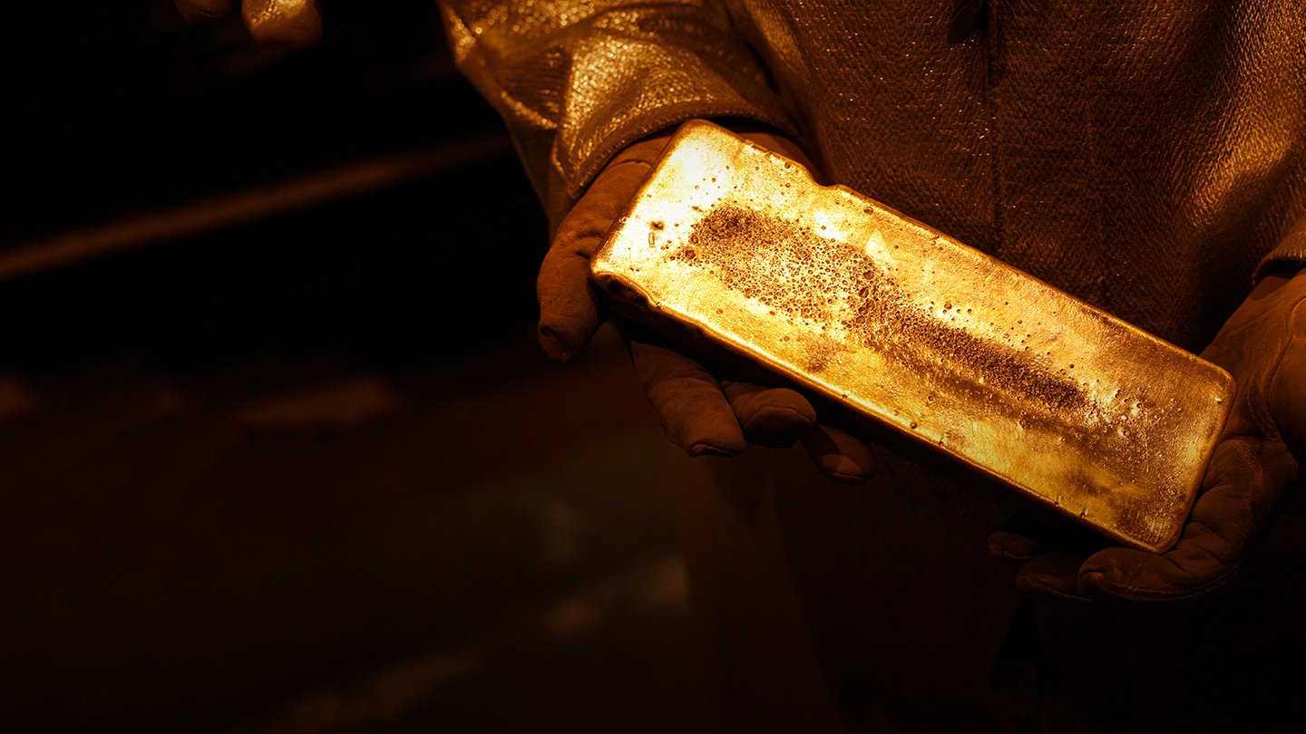
Fort Knox Heap Leach Model Remake
Data Analytics Boot Camp Final Project

Slide 2
Contents
Project Summary
Something Else
Another Thing
Last Thing

Slide 3
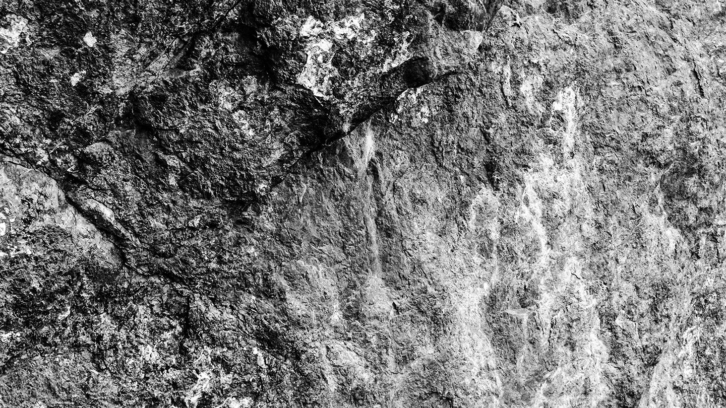
What is an astronaut’s favorite key on the keyboard?
The spacebar.

Slide 4
Background
PowerPoint Style Guide
Kinross
Fort Knox
Heap Leach
Challenges
Solve this problem

Slide 5
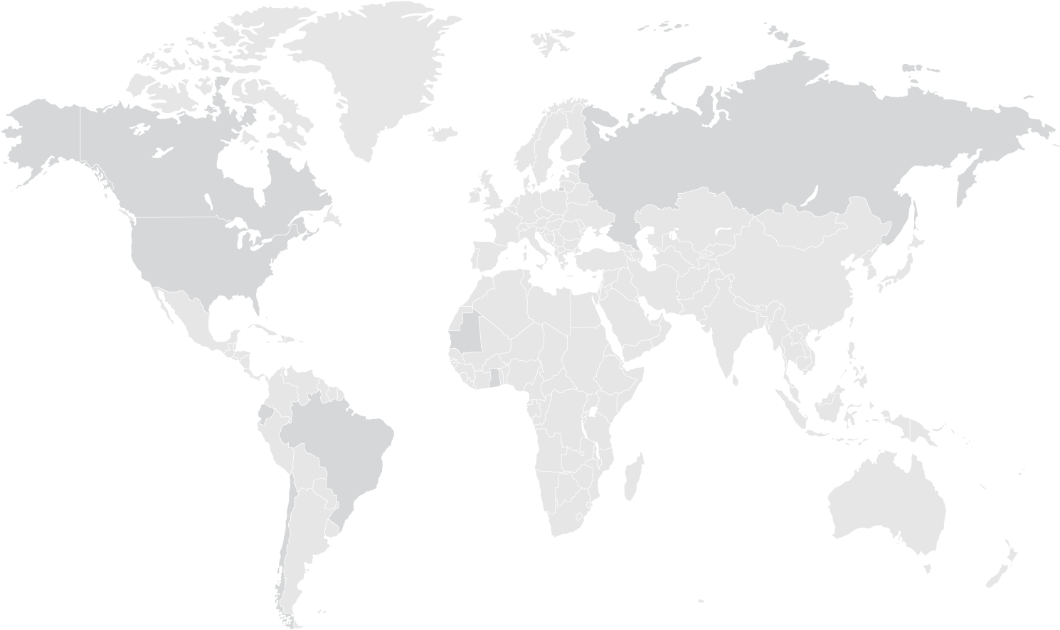
Operations Map
Kinross
Dvoinoye,Russia
Kupol, Russia
Fort Knox, USA
Toronto, Canada
Bald Mountain, USA
Round Mountain, USA
Operations
Tasiast, Mauritania
Development Projects
Chirano, Ghana
Head Office
Paracatu, Brazil
La Coipa, Chile

Slide 6
Data Sources
PowerPoint Style Guide
Praesent scelerisque ligula non pellentesque convallis. Pellentesque felis nulla, fringilla ut finibus a, consequat ut turpis
Mine technical services team – pad information
Metallurgy team – metal production

Slide 7

Project Goals
PowerPoint Style Guide
Explain the historical gold production coming out from the heap leach pad.
Create a heap leach model that can help predict future gold production given pad loading sequence, material information, and operation options.
Provide suggestions on operation options.
Sample

Slide 8

This is an alternate divider slide
Sed elementum semper consequat. Donec a quam iaculis, gravida ipsum sed, euismod arcu. Phasellus tincidunt id metus at iaculis.

