Slide 1
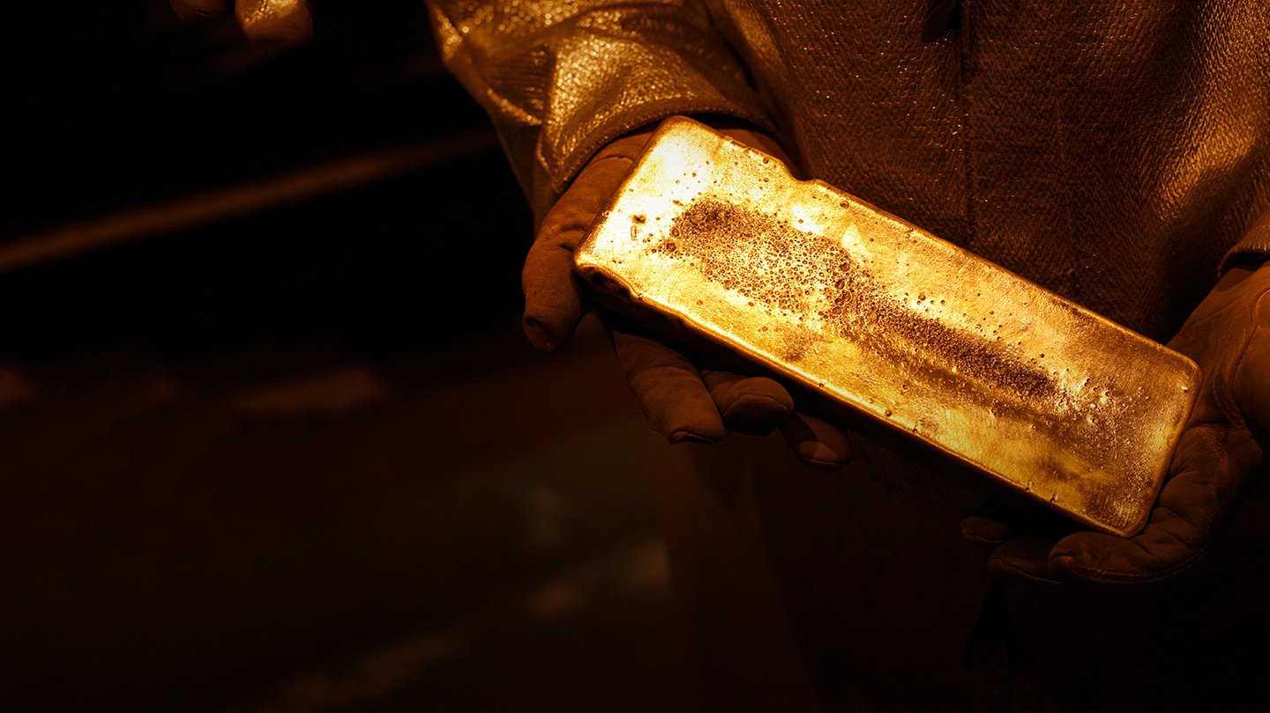
Fort Knox Heap Leach Model Remake
Data Analytics Boot Camp Final Project

Slide 2
Contents
Project Summary
Something Else
Another Thing
Last Thing

Slide 3
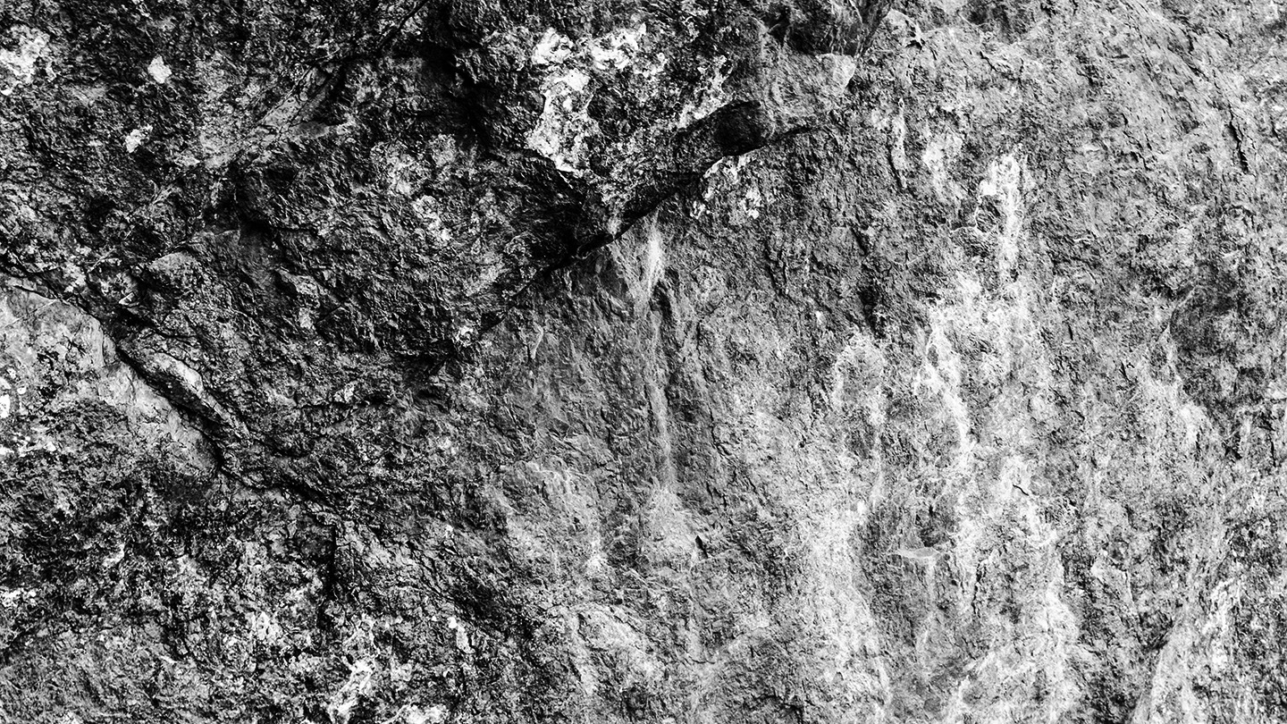
What is an astronaut’s favorite key on the keyboard?
The spacebar.

Slide 4
Background
PowerPoint Style Guide
Founded in 1993, Kinross Gold is a senior gold mining company with a diverse portfolio of mines and projects in the United States, Brazil, Chile, Ghana, Mauritania, and Russia. Headquartered in Toronto, Canada, Kinross employs approximately 9,000 people worldwide.
Fort Knox is an open-pit gold mine located near the city of Fairbanks, Alaska. It is mined by conventional open-pit methods, with ore processed at a mill and heap leach facility.
Heap Leaching is a low-cost method that is most suitable for treatment of low-grade materials that do not justify the higher costs of grinding and agitation leaching. The ores are placed on a liner, cyanide solution is dripped on the pad and percolates through the ores. Dissolved gold in the solution is extracted through adsorption, desorption and regeneration (ADR) plant.
The heap leach production acts similar to a “black box” function, where inputs are cyanide solution, gold ores, time, etc. and the output is pregnant solution (solution with gold dissolved). Understanding the heap leaching process can help the mining operation plan for the ore stacking and leaching cycle. On the financial side, a well established heap leach model can help the company foresee the upcoming challenges and opportunities.

Slide 5

Operations Map
Kinross
Dvoinoye,Russia
Kupol, Russia
Fort Knox, USA
Toronto, Canada
Bald Mountain, USA
Round Mountain, USA
Operations
Tasiast, Mauritania
Development Projects
Chirano, Ghana
Head Office
Paracatu, Brazil
La Coipa, Chile

Slide 6
Data Sources
PowerPoint Style Guide
Mine technical services team – pad information
Ores information placed on the heap leach pad. Ores tonnage, contained gold ounces, time placed and location.
Leaching information. This describes the time when leaching at a certain area started and ended.
Metallurgy team – solution information and metal production
Solution information. This records the cyanide solution strength and the gold grade in the barren and pregnant solutions. Solution information also includes the solution flowrate to the heap leach pad and the flowrate back to the ADR plant.
Metal production. This records the about of gold produced.

Slide 7

Project Goals
PowerPoint Style Guide
Explain the historical gold production coming out from the heap leach pad.
Create a heap leach model that can help predict future gold production given pad loading sequence, material information, and operation options.
Provide suggestions on operation options.
Plan to put some
Relative picture here

Slide 8

This is an alternate divider slide
Sed elementum semper consequat. Donec a quam iaculis, gravida ipsum sed, euismod arcu. Phasellus tincidunt id metus at iaculis.

