Slide 1
Disclaimer
This is proof of concept, not MVP or prototype;
Due to time constraints and the inability to negotiate deals with data sources, all presented data are randomly generated for presentation purposes;

Slide 2
Idea
The core problem:
- Find places with lots of people (◼ Hot Zones);
- Find places without people (◼ Cold Zones);
After that we can:
- Improve ◼ Hot Zones;
- Investigate why ◼ Cold Zones are so unpopular;

Slide 3
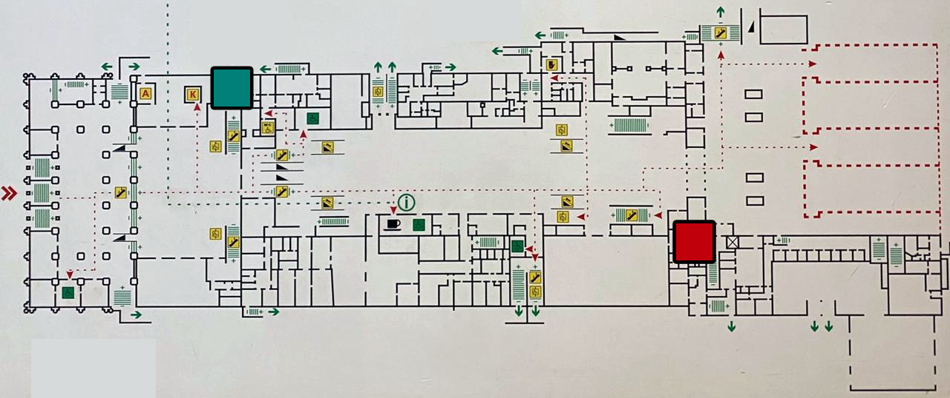
To illustrate…
“Two toilets problem”
Extremely unpopular
toilet
(cold zone);
Extremely popular
Toilet
(Hot Zone);

Slide 4
Analytics
Multi-source tracking system
Scan social networks (Twitter, Instagram, Facebook, etc);
Place QR codes at the points of interest;
Place iBeacons at places of interest;
Place public WiFi hotspots;
Place surveillance cameras at the points of interest to analyze video-feed;
Arrange a contract with mobile operators to receive data about the geo-position of the phones in the area;
Arrange a contract with hotels to collect information about the number of guests;
Arrange a contract with a taxi service to place geo-tracking devices into theirs's cars;
Arrange a contract with a car rental service to place geo-tracking devices into theirs's cars;
Etc.

Slide 5
Analytics
Scheme
Data Collector:
Mobile network operator
Heat Map
Data Collector:
Social network
Analytics
Data Collector:
Navigation website
Reports
Data Collector:
…

Slide 6
Analytics
Why so many data collectors?
We can not trust just one source;
We can identify popular, but cold spots (everyone is talking about a place, but nobody is visiting it);
Large volumes of different data from sources will help to make different analyses:
Some people are interested in bars;
Some people are interested in museums;
Some people are interested in hiking;
etc

Slide 7
Analytics
EOF
Switch presentation to the actual web app

