Slide 2
Analytics
Disclaimer
This is proof of concept, not MVP or prototype;
Due to time constraints and the inability to negotiate deals with data sources, all presented data are randomly generated for presentation purposes;

Slide 3
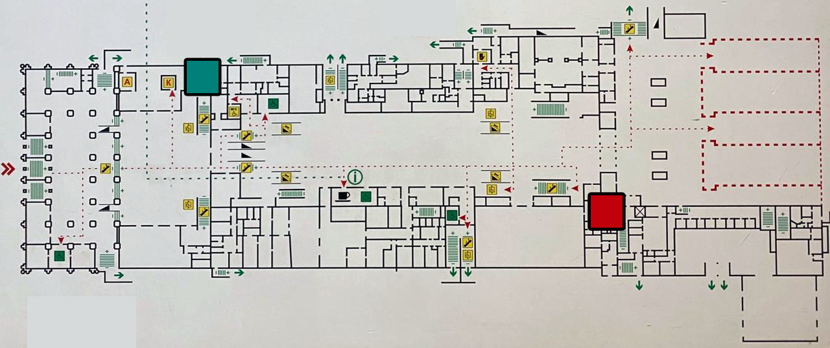
Analytics
“Two toilets problem”
1. Extremely popular toilet (hot zone);
2. Extremely unpopular (cold zone);

Slide 4
Analytics
“Two toilets problem”
Why?
People didn't know about the second restroom.
Someone forgot about the signs.

Slide 5
Analytics
Scheme
Data Collector #0
Heat Map
Data Collector #1
Analytics
Reports
Data Collector #2
Data Collector #3

Slide 6
Analytics
Data Collectors
Scan social networks (Twitter, Instagram, Facebook, etc);
Place QR codes at the points of interest;
Place iBeacons at places of interest;
Place public WiFi hotspots;
Place surveillance cameras at the points of interest to analyze video-feed;
Arrange a contract with mobile operators to receive data about the geo-position of the phones in the area;
Arrange a contract with hotels to collect information about the number of guests;
Arrange a contract with a taxi service to place geo-tracking devices into theirs's cars;
Arrange a contract with a car rental service to place geo-tracking devices into theirs's cars;
Etc.

Slide 7
Analytics
EOF
Switch to the actual app with heatmap

