Slide 1
Analytics
Disclaimer
This is proof of concept, not MVP or prototype;
Due to time constraints and the inability to negotiate deals with data sources, all presented data are randomly generated for presentation purposes;

Slide 2
Analytics
Multi-source tracking system
Data Collector:
Mobile network operator
Heat Map
Data Collector:
Social network
Analytics
Data Collector:
Navigation website
Reports
Data Collector:
…

Slide 3
Analytics
Data Collectors
Scan social networks (Twitter, Instagram, Facebook, etc);
Place QR codes at the points of interest;
Place iBeacons at places of interest;
Place public WiFi hotspots;
Place surveillance cameras at the points of interest to analyze video-feed;
Arrange a contract with mobile operators to receive data about the geo-position of the phones in the area;
Arrange a contract with hotels to collect information about the number of guests;
Arrange a contract with a taxi service to place geo-tracking devices into theirs's cars;
Arrange a contract with a car rental service to place geo-tracking devices into theirs's cars;
Etc.

Slide 4
Analytics
Why so many data collectors?
We can not trust just one source;
We can identify popular, but cold spots (everyone is talking about a place, but nobody is visiting it);
Large volumes of different data from sources will help to make different analyses:
Some people are interested in bars;
Some people are interested in museums;
Some people are interested in hiking;
…

Slide 5
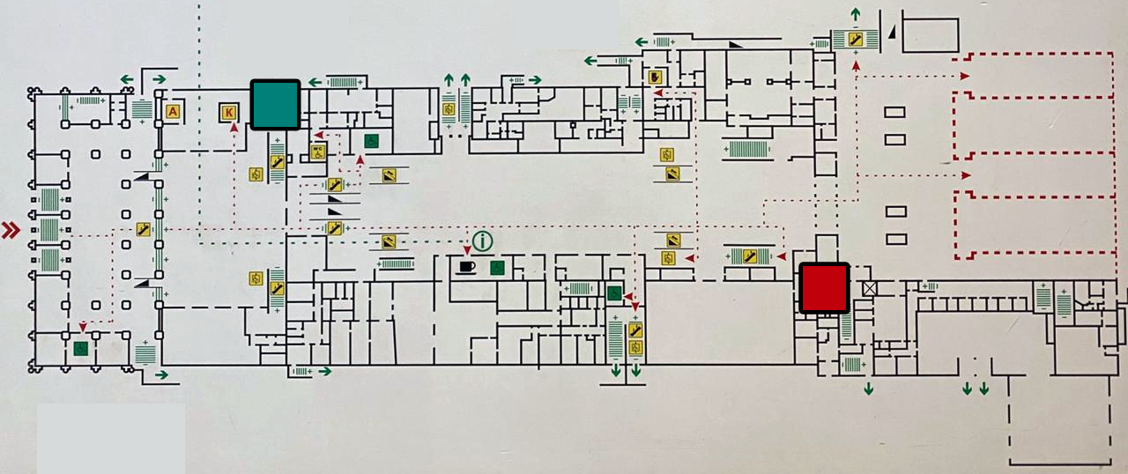
Analytics
“Two toilets problem”
1. Extremely popular toilet (hot zone);
2. Extremely unpopular (cold zone);

Slide 6
Analytics
“Two toilets problem”
Why almost nobody was visiting one of the toilets?
The cold toilet was:
New;
Bigger;
Better;

Slide 7
Analytics
EOF
Switch presentation to the actual web app

