Slide 1
SIMATS ENGINEERING
SIMATS
EXPENSE TRACKER
CSA0812 - COMPILER DESIGN FOR AI
CAPSTONE PROJECT - MAR 2024
Presented by:
1.DHANUSH.N
2.THARUN.R
3.LEELADHAR SAI
Guided by:
DR.BHAVANI

Slide 2
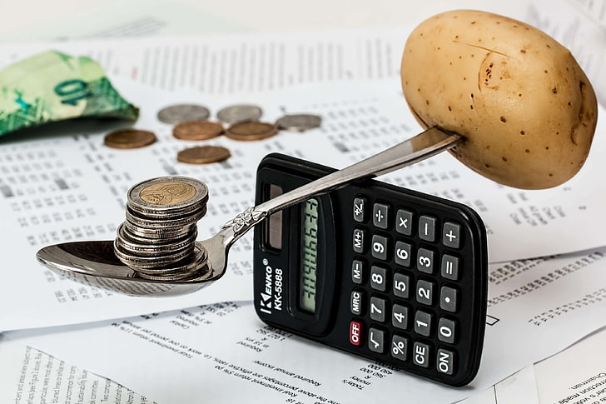

Abstract ◦The web application “Expense Tracker” is developed to manage the daily expenses in a more ◦Efficient and manageable way. By using this application we can reduce the manual calculations of the daily ◦expenses and keep track of the expenditure.

Slide 3
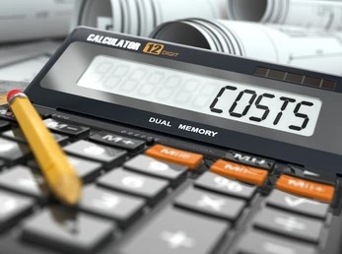
INTRODUCTION ◦Daily Expense Tracking System Will Generate Report At The End Of The Month To Show Income-expense Graph Architecture/ Algorithm/ Procedure (If Any)

Slide 4

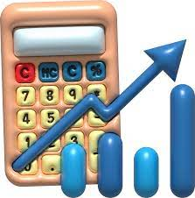
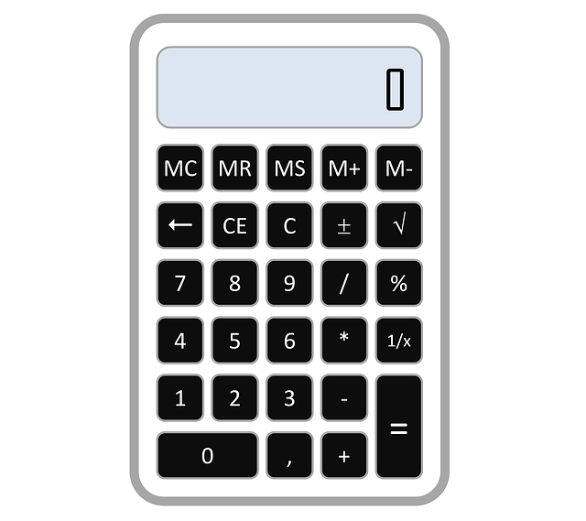
USES: Managing money is an important aspect of our daily lives. In today's fast-paced world, it's easier than ever to lose track of our spending habits, leading to financial problems.

Slide 5

One way to avoid this is by tracking our expenses. By keeping a record of what we spend, we can identify areas where we can cut back and save money

Slide 6
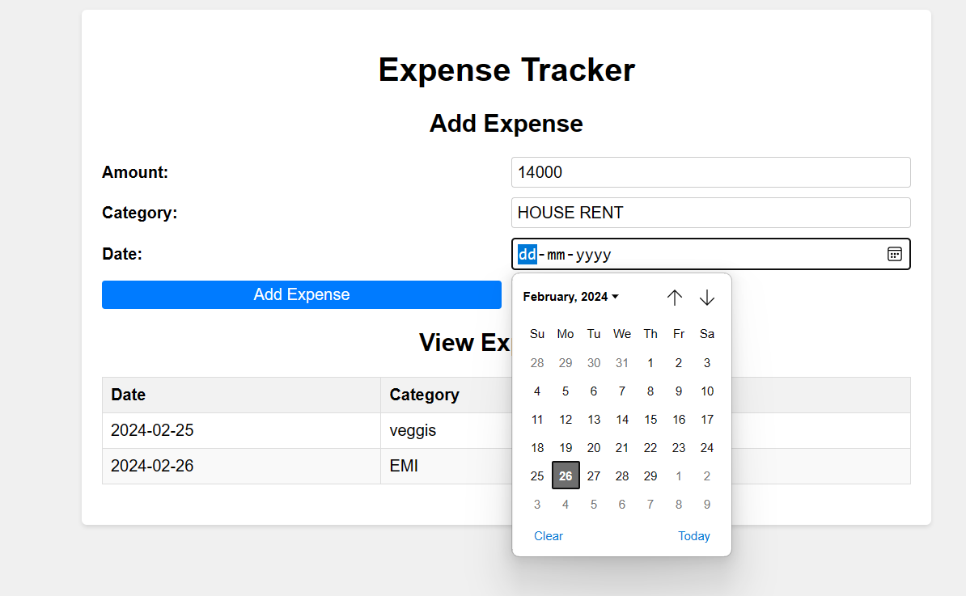

Slide 7

RESULT
HENCE THE EXPENSE CALCULATOR WORKS TO CALCULATE OUR MONTHLY EXPENSES AND FISICAL DEFICIT OF OUR FAMILY.

