Slide 1
Trends in West African Vaccination Rates
Eric Huang, Sam Konstan, Nupur Kumar, Chiemeka Nwakama

Slide 2
01
02
03
04
05
06
Introduction
Data Acquisition
Data Cleaning
Models
Results
Next Steps

Slide 3
01
Introduction

Slide 4
Problem Statement
Though Measles is often thought of a disease of the past, it remains a significant public health challenge in many parts of the world. In West Africa, vaccination coverage still often falls short of the levels needed to prevent outbreaks.

Slide 5
Quick Facts About Measles
Highly contagious disease that is most harmful in children under the age of 5
The first measles vaccine became available in 1963
West Africa started to receive vaccinations in the 1970s
Mortality rate currently close to 20% in this region of the world
An estimated 4.5 million deaths were averted by vaccination in WHO’s African Region from 2017 - 2021
According to WHO, though measles is eradicated or close to eradicated in most first world countries like the U.S., it is still common in Africa, Middle East and Asia

Slide 6
02
Data Acquisition

Slide 7
Data Acquisition
GDP Growth
Datasets Searched:
UNICEF Survey of National Immunization Coverage (WUENIC), 2023
WHO Number of Reported Cases of Measles
World Bank Open Data (GDP, Health Expensure, Poverty, Inflation, Drinkable Water, etc)
Health Cost
Poverty
Measles
Coverage
Inflation
Birth Rates
Water

Slide 8
Filtering Data
Countries of Focus:
Cameroon, Ghana, Liberia, Sierra Leone, and Nigeria
Years of Focus:
2000-2022 (years after not available)

Slide 9
Creating Custom Dataset
Ended up using the World Bank Open data and selected variables:
Immunization, measles (% of children ages 12-23 months)
Birth rate, crude (per 1,000 people)
Current health expenditure (% of GDP)
Death rate, crude (per 1,000 people)
Mortality rate, under-5 (per 1,000 live births)
Number of under-five deaths
Out-of-pocket expenditure (% of current health expenditure)
People using at least basic drinking water services (% of population)
Population, total
GDP growth (annual %)
Inflation, consumer prices (annual %)

Slide 10
03
Data Cleaning

Slide 11
Data Cleaning
Handling Missing Values
  Identified missing values denoted as .. and replaced them with NaN
  Filled missing numeric values with the mean
Standardizing Data
  Converted raw data into consistent format, ensuring all numeric values were properly represented
Pivoting Dataset
  Reshaped the data to have a combination of countries and years as rows and predictors as columns

Slide 12
04
Models

Slide 13
Models
Coded in Python using scikit-learn:
Random Forest
Regression Tree
Polynomial Regression

Slide 14
05
Results

Slide 15
Random Forest Results
Countries | MSE | R^2
Cameroon | 32.47 | 0.72
Ghana | 33.30 | -2.38
Liberia | 99.09 | -0.07
Nigeria | 50.98 | 0.55
Sierra Leone | 157.87 | 0.42

Slide 16
Regression Tree Results
Countries | MSE | R^2
Cameroon | 12.25 | 0.9
Ghana | 36.81 | -3.76
Liberia | 149.30 | -1.57
Nigeria | 21.57 | 0.81
Sierra Leone | 78.28 | 0.71

Slide 17
Predictor Importance
Predictor | Importance
Deaths(Under Age 5) | 0.919
Death rate | 0.654
Population | 0.632
Mortality Rate(Under Age 5) | 0.615
Birth Rates | 0.550
Basic Drinking Water | 0.502
OOP Expenditure | 0.472
GDP growth | 0.249
Health Expenditure | 0.222
Inflation | 0.185

Slide 18
Random Forest Results
Countries | MSE | R^2
Cameroon | 28.48 | 0.76
Ghana | 34.98 | -2.55
Liberia | 115.35 | -0.98
Nigeria | 56.30 | 0.51
Sierra Leone | 131.97 | 0.52

Slide 19
Regression Tree Results
Countries | MSE | R^2
Cameroon | 35.00 | 0.70
Ghana | 46.81 | -3.76
Liberia | 83.34 | -0.43
Nigeria | 29.57 | 0.74
Sierra Leone | 80.52 | 0.70

Slide 20
Predictor Importance
Predictor | Importance
Deaths(Under Age 5) | 1.079
Population | 1.066
Birth Rates | 0.936
Basic Drinking Water | 1.148
OOP Expenditure | 0.769

Slide 21
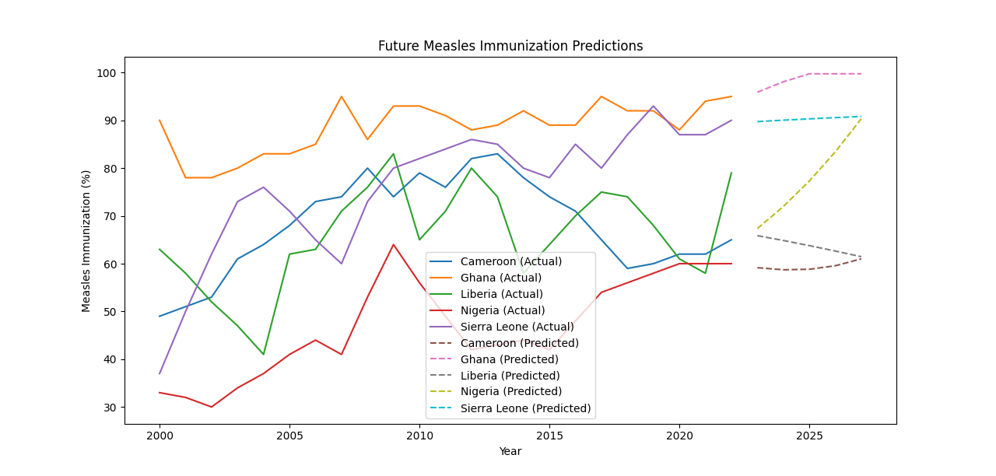

Slide 22
Predicted Rates
Countries | 2023 | 2024 | 2025 | 2026 | 2027
Cameroon | 59.15 | 58.72 | 58.82 | 59.5 | 61.00
Ghana | 95.88 | 98.07 | 99.75 | 99.75 | 99.75
Liberia | 65.86 | 64.86 | 63.78 | 62.64 | 61.46
Nigeria | 67.35 | 71.97 | 77.31 | 83.41 | 90.35
Sierra Leone | 89.74 | 90.04 | 90.31 | 90.57 | 90.83

Slide 23
Prediction Model Evaluation
Model Evaluation for Cameroon:
Mean Squared Error: 32.08
R2 Score: 0.73
Model Evaluation for Ghana:
Mean Squared Error: 79.26
R2 Score: -7.06
Model Evaluation for Liberia:
Mean Squared Error: 159.22
R2 Score: -1.74
Model Evaluation for Nigeria:
Mean Squared Error: 110.23
R2 Score: 0.03
Model Evaluation for Sierra Leone:
Mean Squared Error: 81.66
R2 Score: 0.70

Slide 24
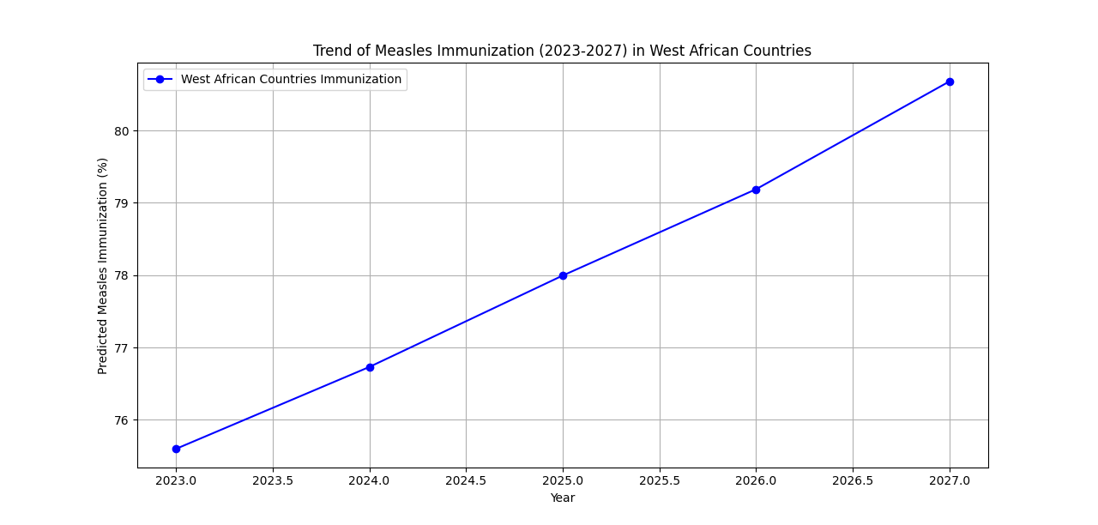

Slide 25
06
Next Steps

Slide 26
Next Steps
Research information on geographical, political, and economical factors that may play a role in affecting a country’s vaccination rates
Identify underserved areas of focus to help increase vaccination rates
Look at potential risk factors for low vaccination rates in areas with limited data

Slide 27
References
-World Bank Open Data (https://data.worldbank.org)
-WHO Immunization Data (https://www.who.int/data/gho/data/themes/immunization)
- UNICEF Immunization Data (https://data.unicef.org/topic/child-health/immunization)

Slide 28
Thank You!

