Slide 1

ASP.NET Core Middleware
Author: Chien.Do

Slide 2
Agenda
What is Middleware ?
Middleware flow
Understand Run, Use, Map method
Custom Middleware
ASP.NET Core Filter
Model Binding
Attribute
Demo

Slide 3
What is Middleware ?
Piece of code in an application pipeline that handle requests and responses, such as authentication, errors handling, etc.
There’re multiple middleware in ASP.NET Core web application (provided by framework, NuGet package or custom middleware).
Middleware component in ASP.NET core will be executed sequentially.

Slide 4
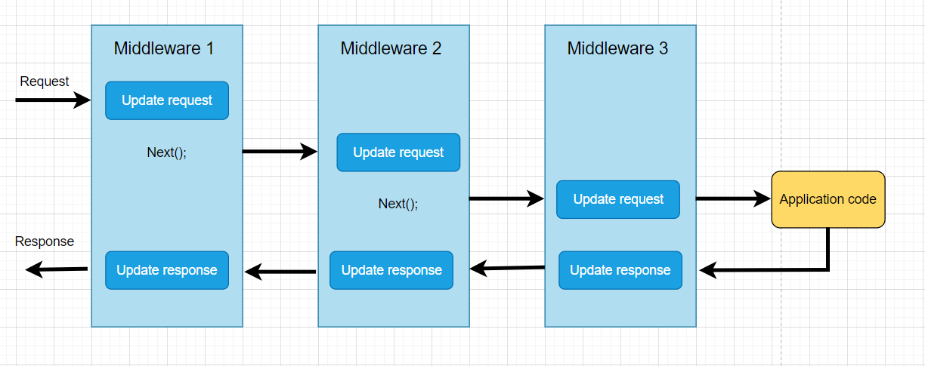
Middleware flow
Notes:
If not call next(), next middleware will not invoked

Slide 5
Understand Run, Use, Map
Run is terminate chain. No other middleware will call after this. Should be at the end of pipeline.
Use is used to configure multiple middleware. We can include next parameter which invoke the next middleware.
Map extensions are used as a convention for branching the pipeline. Map branches the request pipeline based on matches of the given request path. If the request path starts with the given path, the branch is executed.

Slide 6
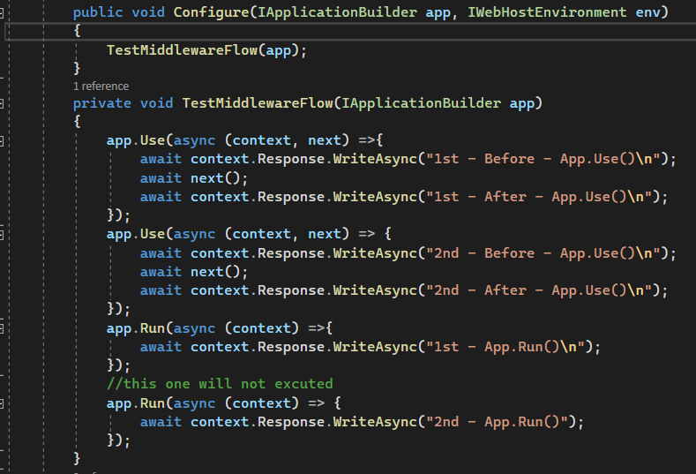
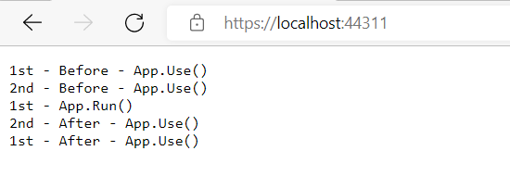
App.Use() & App.Run()

Slide 7
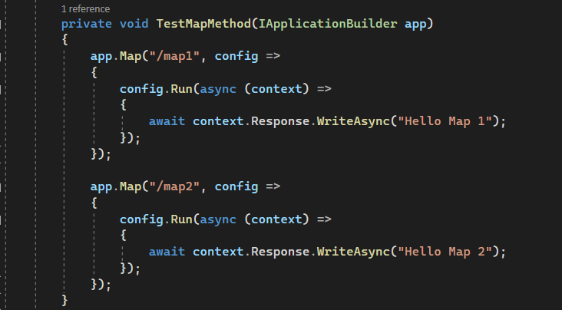
App.Map()
This method map branches the request pipeline based on matches of the given request path. If the request path starts with the given path, the branch is executed.

Slide 8
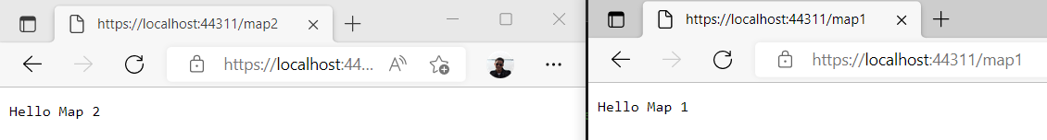
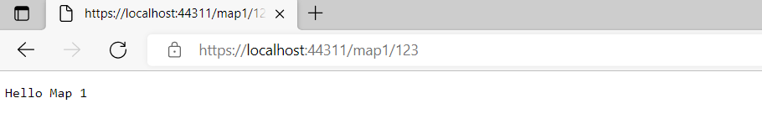
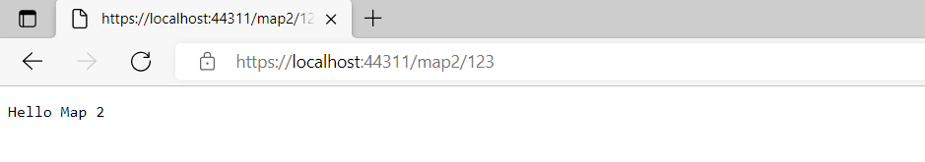
App.Map()
Notes:
Demo each path and default (/)

Slide 9
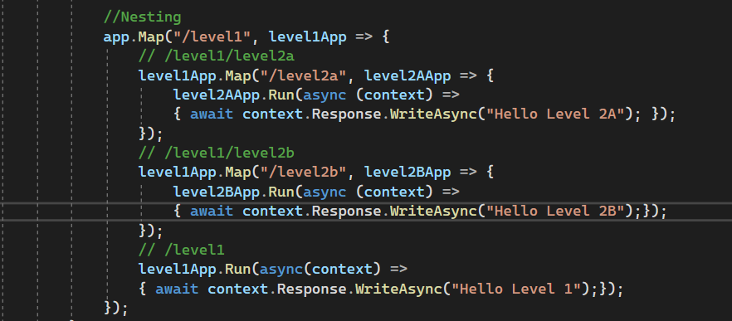
App.Map()
Map support nesting

Slide 10
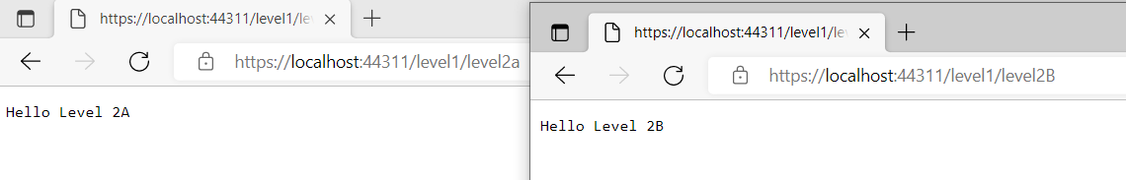
App.Map()

Slide 11
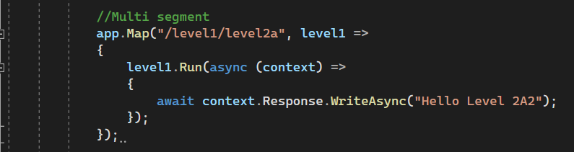
App.Map()
Map also support multi segments at once
Notes:
Demo case have nested and multi segment ( execute sequentially)

Slide 12
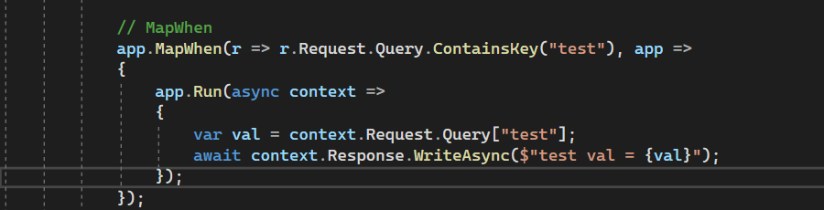
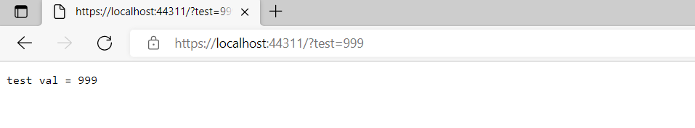
App.MapWhen()
Branch the request base on the result of given predicate.
Use “Map” when branch request based on request path only.
Use “MapWhen” when branch request based on other data from the HTTP request.
Notes:
Map could branch the request based on match of the specified request path only. MapWhen is more powerful and allows branching the request based on result of specified predicate that operates with current HttpContext object

Slide 13
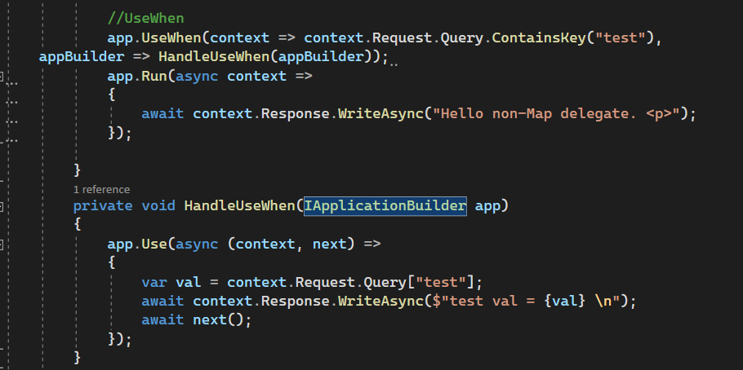
App.UseWhen()
Also branches the request pipeline based on the result of the given predicate.
Unlike “MapWhen”, this branch is rejoined to the main pipeline if it doesn't short-circuit or contain a terminal middleware.
Notes:
Mapwhen will not rejon pipeline. Demo case MapWhen & UseWhen

Slide 14
Custom Middleware
We can create custom middleware and trigger in pipeline.
Middleware class must have :
A public constructor with a parameter of type “RequestDelegate”.
A public method named Invoke or InvokeAsync. This method must return Task and Accept first parameter of type HttpContext
Notes:
Method could accept multiple parameter but HttpContext First

Slide 15
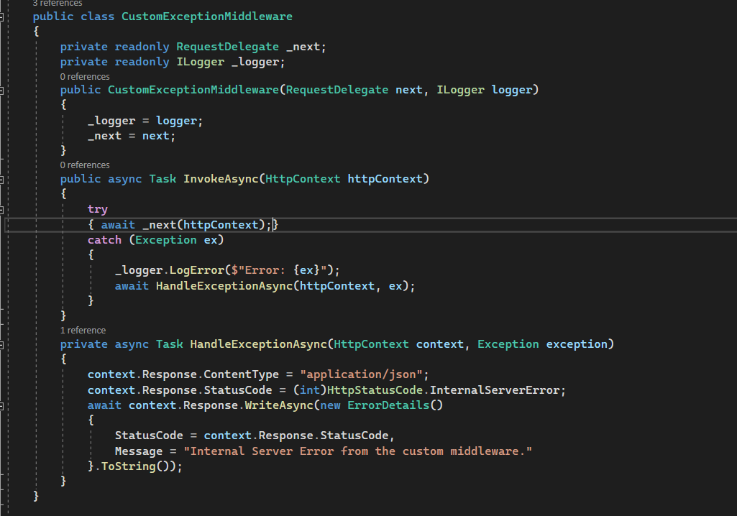
Error handling with Custom middleware

Slide 16
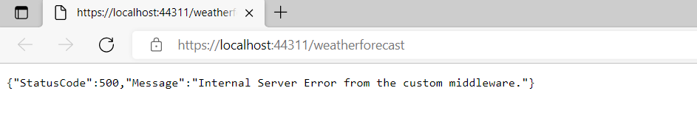
Error handling with Custom middleware

Slide 17
Filter in ASP.NET Core
Filter allow us to custom code before or after executing method.
Filters are invoked on certain stages in the request pipeline.
Filter support both synchronous and asynchronous.
Filter types:
Authorization
Resource
Action
Exception
Result

Slide 18
Filter in ASP.NET Core
Authorization Filter :runs first among all the filters, used to validate whether the user is authorized for the request.
Resource Filter :
OnResourceExecuting : Run after the authorization filter
OnResourceExecuted : Run after the rest of pipeline completed.
Action Filter:
OnActionExecuting : Run before an action method is called.
OnActionExecuted : Run after an action method is called.
Can change the arguments passed into an action.
Not supported in Razor Pages.

Slide 19
Filter in ASP.NET Core
Exception Filter: execute for the exception before they are written to response body.
Result Filter :
Runs immediately before and after the execution of method complete.
Runs only if the action method executed successfully.

Slide 20
Filter in ASP.NET Core
We can implement for multiple filters type in single class.
If we implement both synchronous & asynchronous , synchronous interface is never called.
Filter can be added to the pipeline at one of three scopes :
Action method
Controller
Globally (Apply for all controllers and actions)
We can short circuit the filter pipeline by setting “Result” Property of the Context parameter.
Notes:
Demo case implement both

Slide 21
Filter in ASP.NET Core
For the filters that are implemented as Attribute and add directly to the controller or action methods, cannot have constructor dependencies.
Solution to deal with this limitation:
ServiceFilterAttribute
TypeFilterAttribute
IFilterFactory
Notes:
Attribute limitation.

Slide 22
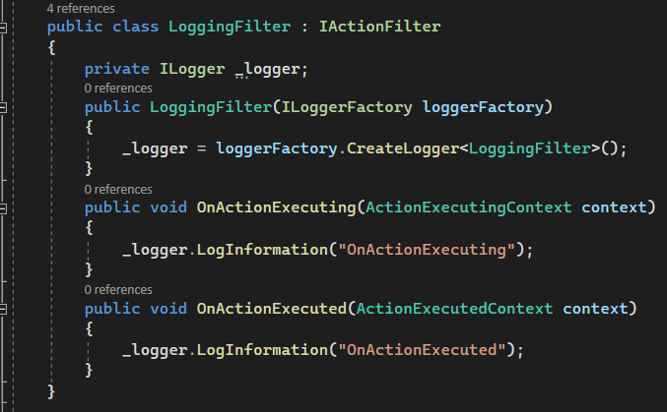
Filter in ASP.NET Core
ServiceFilterAttribute

Slide 23
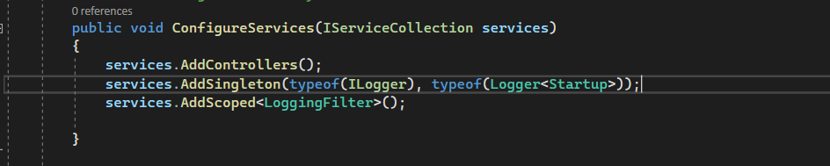
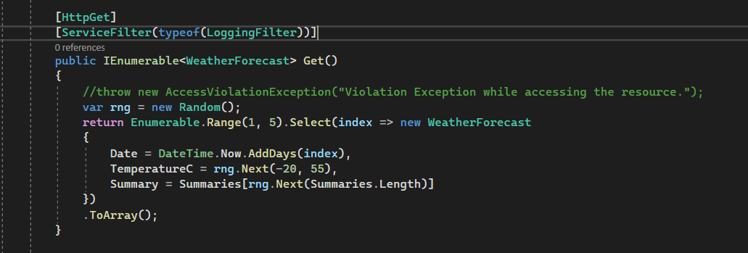
Filter in ASP.NET Core
ServiceFilterAttribute
Notes:
Show code currently use in project . Open Endpoint show HasPermissionFilter

Slide 24
Model Binding in ASP.NET Core
Model Binding is a mechanism in ASP.NET Core Application that extracts the data from an HTTP request and provides them to the controller action method parameters.
Parameters maybe simple types such as int, string, or complex like defined object.
Default model binding gets data from the following sources:
Form fields
The request body (For controller have [ApiController] atrribute.)
Route data
Query string
Uploaded files

Slide 25
Model Binding in ASP.NET Core
FromQuery : Gets values from the query string.
FromRoute : Gets values from route data.
FromForm : Gets values from posted form fields
FromBody : Gets values from the request body
FromHeader : Gets values from HTTP headers.

Slide 26
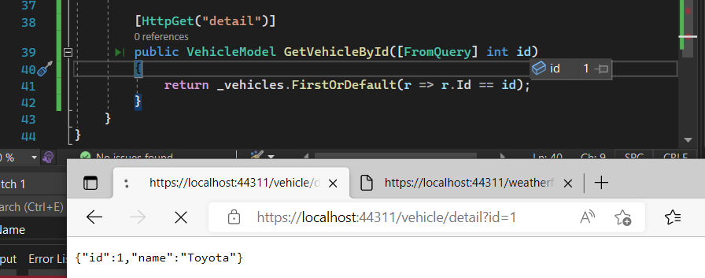
Model Binding in ASP.NET Core

Slide 27
Create Custom Model Binding in ASP.NET Core
Define “ModelBinder” that inherits from “IModelBinder”
Define “Provider” to check which model binder will be used.
Add new Provider to Configure service
Notes:
Should implement ModelBinderProvider instead of applying attributes

Slide 28
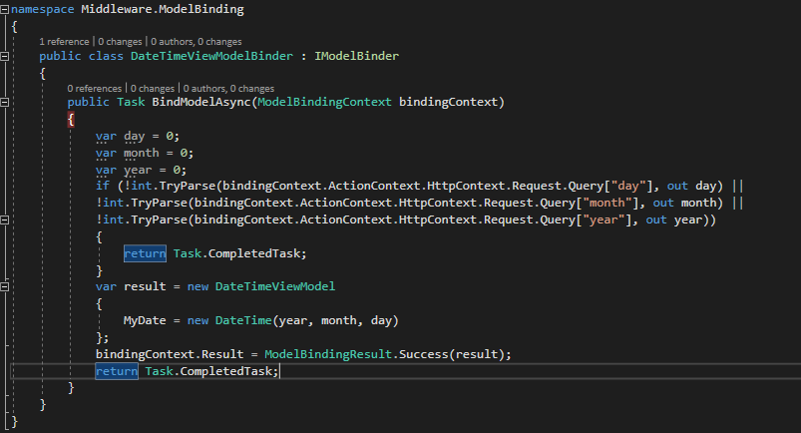
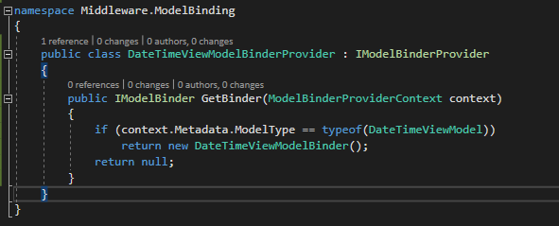
Create Custom Model Binding in ASP.NET Core
Notes:
Should implement ModelBinderProvider instead of applying attributes

Slide 29
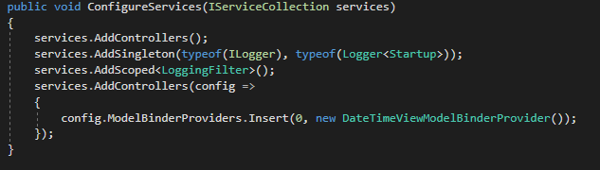
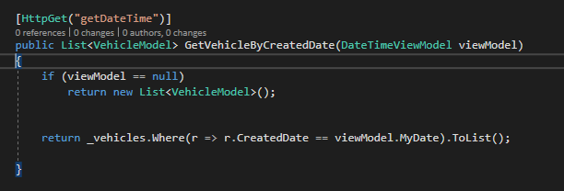
Create Custom Model Binding in ASP.NET Core
Notes:
Should implement ModelBinderProvider instead of applying attributes

Slide 30
Demo
Notes:
Show code apply custom middleware (UserPiersightSessionV3)

Slide 31
Q & A

Slide 32
THANK YOU!!!

