Slide 1
Team15 Infrastructure proposal

Slide 2


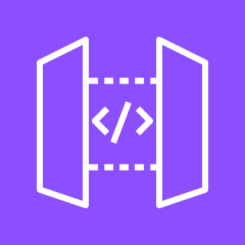




1. EMAIL SERVICE
AWS Cloud
Request
Users
Endpoint
Email
Amazon API Gateway
AWS Lambda
Amazon Simple Email Service (Amazon SES)
For approximately 10,000 email requests per month using AWS Lambda + API Gateway + Amazon SES, the estimated monthly cost would be:
Lambda: Free (within free tier – 1M requests/month)
API Gateway: Free (within free tier – 1M requests/month)
Amazon SES: ~$1.00 (charged at $0.10 per 1,000 emails)
Total estimated cost: ~$1.00/month

Slide 3







2. Database backup plan
AWS Cloud
DB instance
Database
Snapshot
Endpoint
Virtual Machine (Microsoft Azure)
Amazon API Gateway
AWS Lambda
Amazon Simple Storage Service (Amazon S3)
Amazon Simple Queue Service (Amazon SQS)
Payment Information
Lambda: Free (within free tier – 1M requests/month)
API Gateway: Free (within free tier – 1M requests/month)
Amazon SQS: Free (within free tier – 1M requests/month)
Amazon S3 ≈ $0.04/month
Storage: 1.5 GB × ~$0.023/GB-month ≈ $0.03–$0.04
PUT requests <1,000 → ~$0.005
Total estimated cost : about $0.03–$0.05 (allowing for margin, ~$0.04)

Slide 4


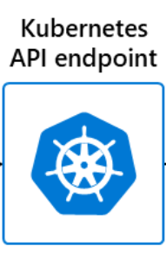


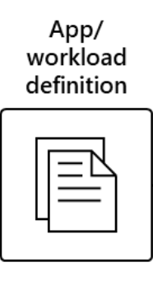
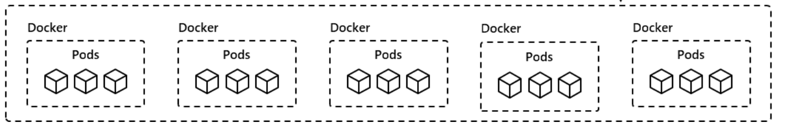
3. CI/CD, Containerisation
Mircosoft Azure
Push
Git Users
Azure DevOps
Azure Container Registry
Azure Kubernetes Service
Azure Control Plane

Slide 5
Azure DevOps → Free tier (up to 5 users, 1,800 build minutes/month, 2 GB Artifacts storage)
Azure Container Registry (ACR) → Only paid component in this setup (Basic SKU ~ $5/month, cost increases with storage usage)
AKS control plane → Free (node/VM costs excluded)
Kubernetes Service (type=LoadBalancer) creating Azure Load Balancer (L4) → Free (both Standard and Basic LB have no control plane charges; Standard SKU public IPs may incur separate charges)
Nginx Ingress Controller / Application Gateway Ingress Controller (L7) → Nginx is free; Application Gateway incurs charges (excluded here)
Kubernetes probes (health checks) → Free
Total (excluding VM/node costs): ≈ $5/month

Slide 6

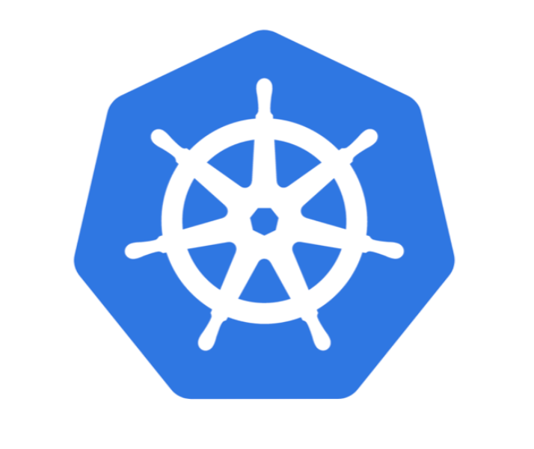








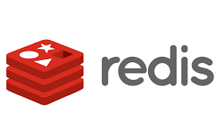
4. Infrastructure
Mircosoft Azure
Virtual Network
TLS handshake
Azure Virtual Machine
Azure Firewall
Azure Kubernetes Service
Zone 1 (proxy)
VM
Azure DNS
Load balancer (L4)
Users
Azure Virtual Machine
Zone 2 (proxy)
Load balancer (L7)
Containers
Frontend Pods
Backend Pods
Zone 3 (proxy)
PostgreSQL
Redis
Database Backup

Slide 7
Minimal Azure Architecture – Monthly Cost Estimate
Core Components:
Proxy VM (B1ms, 1 vCPU / 2 GB RAM) ×1 → $15–20
AKS Node (Standard_F2s_v2, 2 vCPU / 4 GB RAM) ×1 → ~$30
L4 Load Balancer (Standard) ×1 → $5–20
Core Subtotal: ≈ $50–70 / month
Additional Essentials:
Azure DNS → ~$1
Azure Container Registry (Basic) → ~$5
Standard SSD storage (32 GiB × 2 VMs) → $3–4
1 Static Public IP → $2–3
Additional Subtotal: ≈ $11–13 / month
Estimated Total: ≈ $61–83 / month
Notes:
Single proxy VM and single AKS node mean potential downtime during failures (SPOF).
For higher availability, consider 2 proxy VMs (+$15–20).
Costs exclude outbound traffic, backups, monitoring, and regional variations.

Slide 8
Email Service : ~$1.00/month
Database Backup : about $0.03–$0.05 (allowing for margin, ~$0.04)/month
CI/CD : $5/month
Infrastructure: ≈ $61–83 / month
Estimated Total: ≈ $67-90 / month

