Slide 1
GNN(1)
Chien-Hua, Chen
2021.03.10

Slide 2

GNN
Spatial-based
Spectral-based
Feature Aggregation | Method
Sum | NN4G
Mean | DCNN, DGC, GraphSAGE
Weighted Sum | MoNET, GAT, GIN
LSTM | GraphSAGE
Max Pooling | GraphSAGE
ChebNet → GCN → HyperGCN
Component 1
Component 4
Orthonormal
Eigen Vector
Adjacency
…
$$F$$
Features
The amount of component
C1
C2
C3
C4
SUM/MEAN/MAX
Supervised classification
Semi-supervised learning
Representation learning (embedding): Graph InfoMax
Graph Generation: GraphVAE, MolGAN, …

Slide 3
Benchmark, Tasks and Dataset
Tasks
Semi-supervised node classification: Cora, CiteSeer, Pubmed
Graph Classification: PROTEINS, D&D, COLLAB
Link Prediction: NELL
Graph Representation Learning
Regression

Slide 4

1. Node Prediction (Citation Network)
= transduction learning
AI
n.n.
prob.
GCN
algo.
pred.
AI
?
Have word 1?
to cite
Have word 1?
Chem.
Med.
Have word 2?
Have word 2?
n.n.
…
…
pred.
Article 1
Article 2
 | Cora | Citeseer | Pubmed
 | 2708 | 3327 | 19717
 | 5429 | 4732 | 44338
 | 1433 | 3703 | 500
Labels (Categories; Classes) | 7 | 6 | 3
Labeling rate | 0.052 | 0.036 | 0.003
article (node)
citation(edge)
Have word _?
word (feature; $X$)

Slide 5
1. Node Prediction (Knowledge Graph)
= transduction learning
Taiwan
???
Taipei
Canada
country
Skydome
country
City stadium
 | NELL
nodes | 65755
edges | 266144
features | 5414
Labels (Categories; Classes) | 210
Labeling rate | 0.052
Toronto
Home Town
Maple Leaf
hospital
Sunnybrook
NELL Dataset

Slide 6
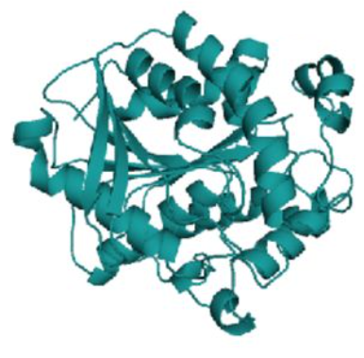
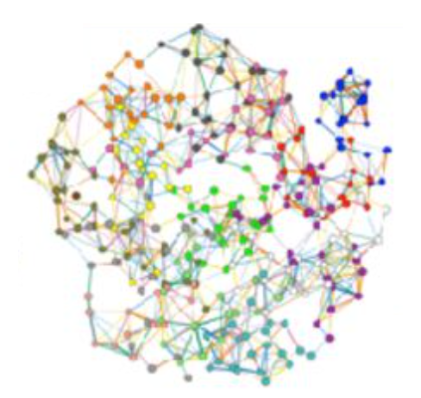
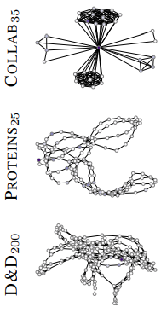
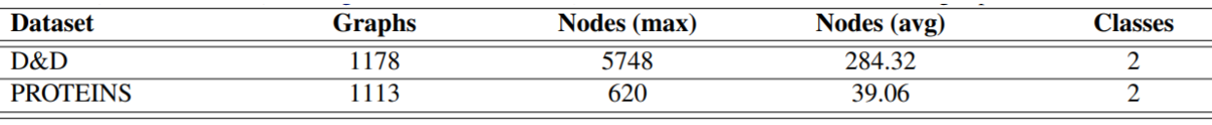
2. Graph Prediction ( Protein Structures )
= inductive learning
Graph Prediction
enzymes
non-enzymes
a.a.
????
Enzyme

Slide 7
2.Graph Prediction (Researcher’s Collaboration)
= inductive learning
Graph Prediction
1. High Energy Physics
2. Condensed Matter Physics
3. Astro Physics
researcher
collaboration

Slide 8
1. Traditional Graph Convolutional Networks
Semi-Supervised Classification with Graph Convolutional Networks (2017.9) Author: Kipf, Thomas N.; Welling, Max (University of Amsterdam)
Publication: eprint arXiv:1609.02907

Slide 9
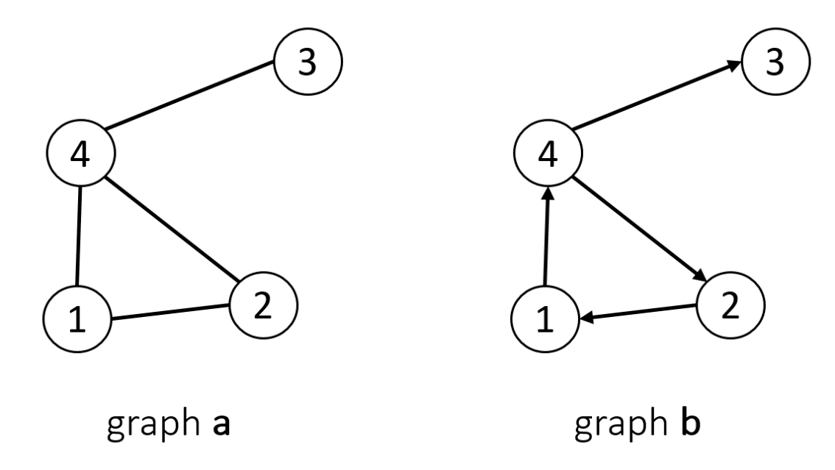
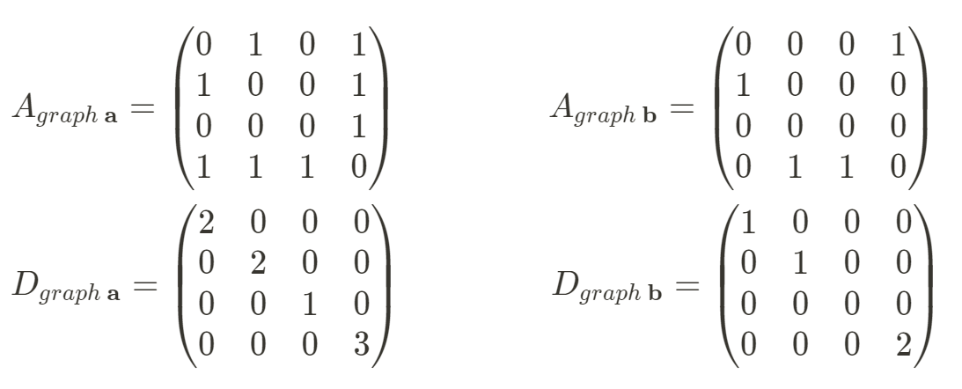
Graph
Undirected graphs
Directed graphs
Laplacian
1. Adjacency matrix (A)
2. Degree matrix (D)
(Diagonal)

Slide 10
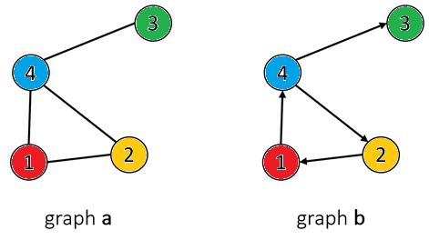
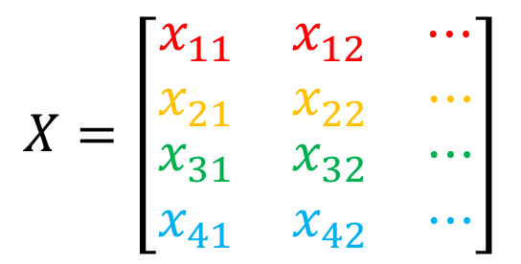
Graph
$$X=\left[\begin{matrix}\begin{matrix}x_{11} & x_{12} & ⋯\end{matrix} \\ \begin{matrix}x_{21} & x_{22} & ⋯\end{matrix} \\ \begin{matrix}\begin{matrix}x_{31} & x_{32} & ⋯\end{matrix} \\ \begin{matrix}x_{41} & x_{42} & ⋯\end{matrix}\end{matrix}\end{matrix}\right]$$
3. Feature matrix (X)
# of nodes
# of independent variables

Slide 11
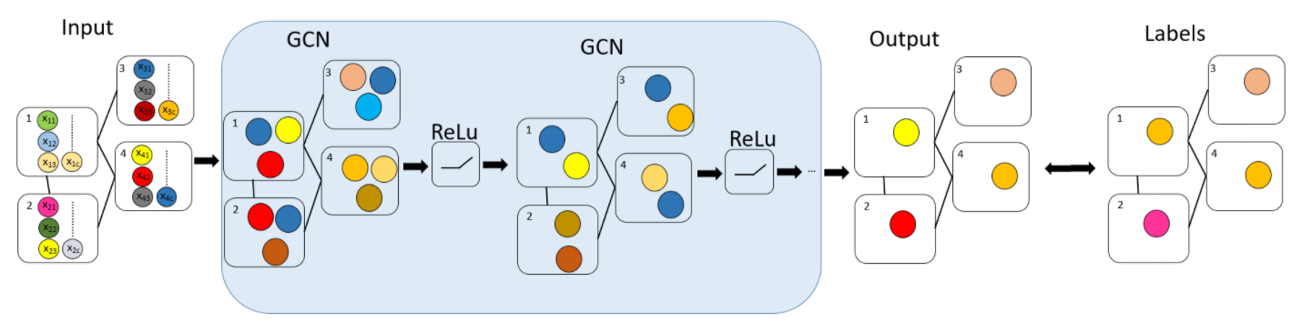


















GCN Layer
Input Layer
Hidden Layer
Output Layer
Label
$$A$$
$$A$$
$$A$$
$$⋯$$
$$A$$
$$D$$
$$D$$
$$D$$
$$⋯$$
$$D$$
$$X$$
$$H^{1}$$
$$H^{2}$$
$$⋯$$
$$F$$
$$Loss$$
$$Y$$
$$(H^{0})$$
Feature Propagation
=
Prediction

Slide 12







Feature Propagation
$$X→H^{1}$$
$$1. H^{1}←AX$$
SUM
Not concern central node itself
$$2.H^{1}←\tilde{A}X$$
SUM
Exploding Gradients
(Normalization)
$$3.H^{1}←{\tilde{D}}^{−1}\tilde{A}X$$
1
~
1
Mean
1
Not concern neighbor’s neighbor
1
3
= Regularization Laplacian
= Laplacian Smoothing
~
3
(Normalized Laplacian)
2
4
$$4. H^{1}←{\tilde{D}}^{−0.5}\tilde{A}{\tilde{D}}^{−0.5}X$$
$$(N×C)$$
$$(N×C)$$
Mean
no dimension reduction

Slide 13




Feature Propagation
$$X→H^{1}$$
$$5. H^{1}←{\tilde{D}}^{−0.5}\tilde{A}{\tilde{D}}^{−0.5}XW$$
$$W$$
Linear Combination
(Dimension Reduction)
Feature 1, Feature 2, …, Feature C
New Feature 1, …, New Feature S
(S < C)
$$6. H^{1}←σ({\tilde{D}}^{−0.5}\tilde{A}{\tilde{D}}^{−0.5}XW)$$
Nonlinearity ↑
$$σ$$
Activation Function
New Feature 1, …, New Feature S
New Feature 1, …, New Feature S

Slide 14
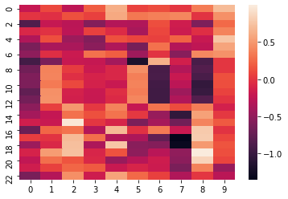
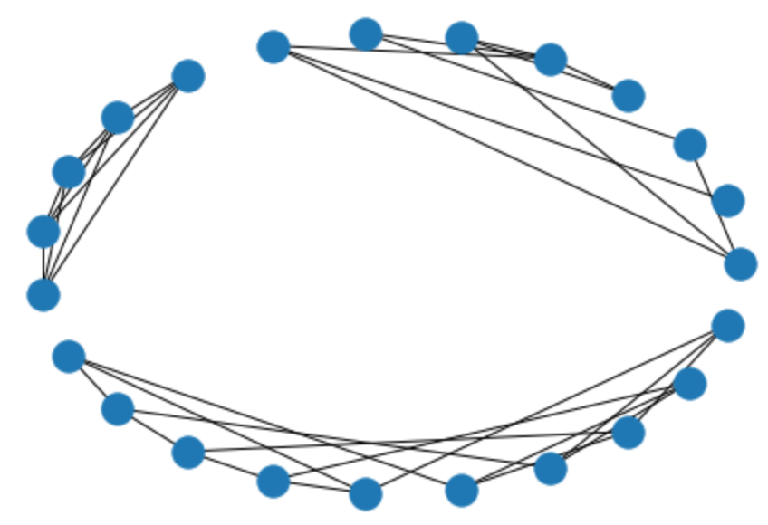
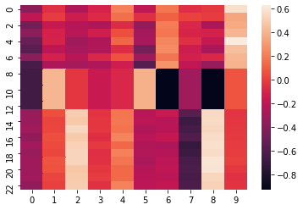
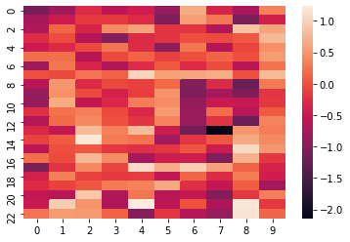
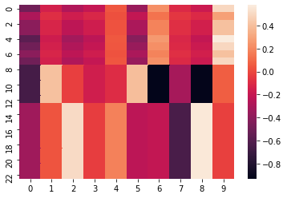
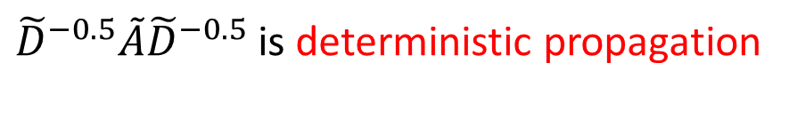
${\tilde{D}}^{−0.5}\tilde{A}{\tilde{D}}^{−0.5}$ is deterministic propagation
1 time propagation
graph
3 times propagation
nodes
6 times propagation
Over-smooth
features

Slide 15
GCN Layer
2-layer GCN in this paper! It cannot be deep.
Input Layer
Hidden Layer
Output Layer
Label
$$A$$
$$A$$
$$A$$
$$⋯$$
$$A$$
$$D$$
$$D$$
$$D$$
$$⋯$$
$$D$$
$$X$$
$$H^{1}$$
$$H^{2}$$
$$⋯$$
$$F$$
$$Y$$
=

Slide 16
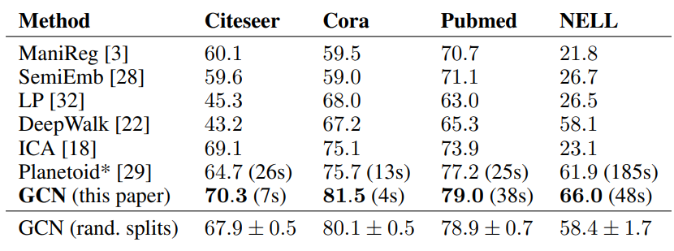
Performance
Transduction Learning

Slide 17
Restriction
Poor performance in Inductive Learning.
why? (GCN cannot be deep, so it highly depends on graph local structure.)
→Need Coarsen, GraphSAGE, LGCL, GATs
Poor performance in Direct Graph (有向圖).
→Need Learnable weight for feature propagation (LGCL , GATs)
Because of over-smooth when model is deep, it should be shallow.
→ResGCN, DenseGCN, Cluster GCN, …
Because Laplacian is deterministic propagation, GCN highly depends on neighbor and graph structure. Hence, new features are easily disturbed by potential noise such as adversarial perturbations.
→Graph-pooling (LGCL, G-U-Nets)
→Perturbation method (dropout, DropEdge, DropNode)

Slide 18





code – create GC Layer
import math
import torch
from torch.nn.parameter import Parameter
from torch.nn.modules.module import Module
torch.nn.modules.module.Module
torch.nn.parameter.Parameter
super
class GraphConvolution(Module):
def __init__(self, in_features, out_features, bias=True):
super(GraphConvolution, self).__init__()
self.in_features = in_features
self.out_features = out_features
self.weight = Parameter(torch.FloatTensor(in_features, out_features))
if bias:
self.bias = Parameter(torch.FloatTensor(out_features))
else:
self.register_parameter('bias', None)
self.reset_parameters()
def reset_parameters(self):
stdv = 1. / math.sqrt(self.weight.size(1))
self.weight.data.uniform_(-stdv, stdv)
if self.bias is not None:
self.bias.data.uniform_(-stdv, stdv)
def forward(self, input, adj):
support = torch.mm(input, self.weight)
output = torch.spmm(adj, support)
if self.bias is not None:
return output + self.bias
else:
return output
$$w$$
in_features
out_features
.reset_parameters
.forward
Hidden Layer
$$w$$
.reset_parameters
$$w$$
$$X$$
.forward
$$Xw$$

Slide 19






code – create GCN
import torch.nn as nn
import torch.nn.functional as F
class GCN(nn.Module):
def __init__(self, nfeat, nhid, nclass, dropout):
super(GCN, self).__init__()
self.gc1 = GraphConvolution(nfeat, nhid)
self.gc2 = GraphConvolution(nhid, nclass)
self.dropout = dropout
def forward(self, x, adj):
x = F.relu(self.gc1(x, adj))
x = F.dropout(x, self.dropout, training=self.training)
x = self.gc2(x, adj)
return F.log_softmax(x, dim=1)
model = GCN(nfeat=features.shape[1],
nhid=args.hidden,
nclass=labels.max().item() + 1,
dropout=args.dropout)
F.relu
F.dropout
F.log_softmax
$$w_{1}$$
ReLU
dropout
$$w_{2}$$
softmax
$$X$$
$$Xw_{1}$$
$$σ(Xw_{1})$$
$$σ\left(Xw_{1}\right)w_{2}$$
Predictions
GCN Model

Slide 20














code – Training
import torch.optim as optim
def train(epoch):
optimizer = optim.Adam(model.parameters(), lr=args.lr,
weight_decay=args.weight_decay)
model.train()
optimizer.zero_grad()
output = model(features, normalized_adj)
loss_train = F.nll_loss(output[idx_train], labels[idx_train])
def laplacian(mx):
degree = np.array(mx.sum(1))
d_hat = sp.diags(np.power(degree, -0.5).flatten())
Laplacian_mx = d_hat.dot(mx).dot(d_hat)
return laplacian_mx
loss_train.backward()
optimizer.step()
$$X$$
laplacian
F.dropout
F.nll_loss
$$∇_{w_{1}}$$
0
$$∇_{w_{2}}$$
gradient
0
$${\tilde{D}}^{−0.5}\tilde{A}{\tilde{D}}^{−0.5}X$$
$$w_{1}$$
ReLU
dropout
$$w_{2}$$
softmax
$$X$$
$$Xw_{1}$$
$$σ(Xw_{1})$$
$$σ\left(Xw_{1}\right)w_{2}$$
Predictions
labels
$$σ({\tilde{D}}^{−0.5}\tilde{A}{\tilde{D}}^{−0.5}Xw_{1})$$
$$σ({\tilde{D}}^{−0.5}\tilde{A}{\tilde{D}}^{−0.5}{Xw}_{1})w_{2}$$
$$softmax(σ\left({\tilde{D}}^{−0.5}\tilde{A}{\tilde{D}}^{−0.5}{Xw}_{1}\right)w_{2})$$
$${\tilde{D}}^{−0.5}\tilde{A}{\tilde{D}}^{−0.5}Xw_{1}$$
Loss Function
GCN Model

Slide 21







code – Testing
def accuracy(output, labels):
preds = output.max(1)[1].type_as(labels)
correct = preds.eq(labels).double()
correct = correct.sum()
return correct / len(labels)
def test():
model.eval()
output = model(features, normalized_adj)
loss_test = F.nll_loss(output[idx_test], labels[idx_test])
acc_test = accuracy(output[idx_test], labels[idx_test])
accuracy
$$X$$
F.dropout
F.nll_loss
laplacian
$$w_{1}$$
ReLU
dropout
$$w_{2}$$
softmax
$$X$$
$$Xw_{1}$$
$$σ(Xw_{1})$$
$$σ\left(Xw_{1}\right)w_{2}$$
Predictions
labels
Loss

Slide 22
1. Node Prediction (Citation Network)
= transduction learning
AI
n.n.
prob.
GCN
algo.
pred.
AI
?
Have word 1?
to cite
Have word 1?
Chem.
Med.
Have word 2?
Have word 2?
n.n.
…
…
pred.
Article 1
Article 2
 | Cora | Citeseer | Pubmed
 | 2708 | 3327 | 19717
 | 5429 | 4732 | 44338
 | 1433 | 3703 | 500
Labels (Categories; Classes) | 7 | 6 | 3
Labeling rate | 0.052 | 0.036 | 0.003
article (node)
citation(edge)
Have word _?
word (feature; $X$)

Slide 23
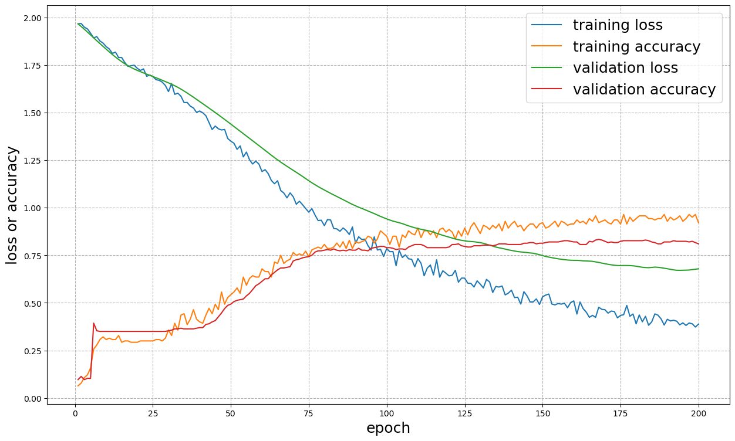
code – Results (Cora)
Training
Testing
Loss = 0.7174
accuracy = 0.836

Slide 24
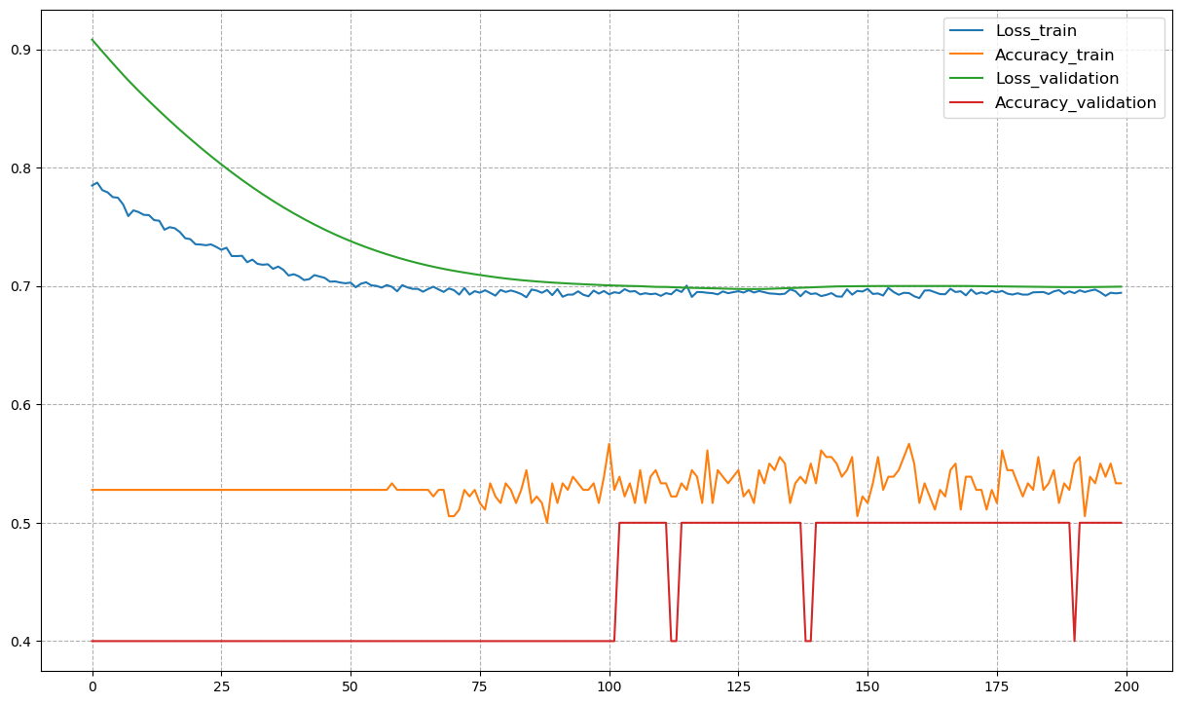
code – Results (Ours Data Set)
Training
Testing
Loss = 0.7718
accuracy = 0.4
 | dataset
Nodes | 300
edges | 11959
Feature size | 90
Labels | 2
Labeling rate | 0.333

Slide 25
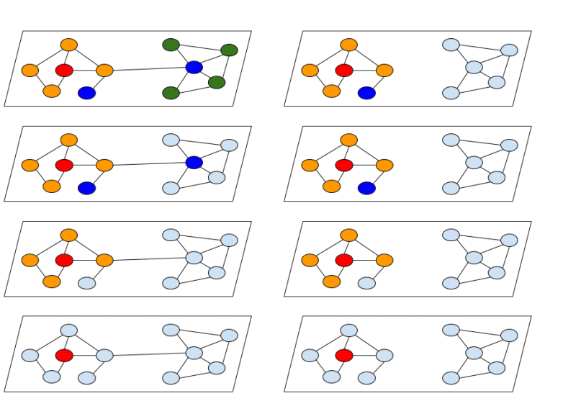

Deeper propagation
Hidden 3
Hidden 2
Hidden 1
$←$Can’t not find global information!
Input

Slide 26




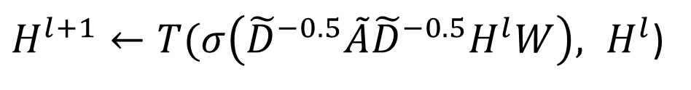

Deeper propagation
Semi-Supervised Classification with Graph Convolutional Networks (2017.9)
1. Residual connection
$$H^{l+1}←σ\left({\tilde{D}}^{−0.5}\tilde{A}{\tilde{D}}^{−0.5}H^{l}W\right)+H^{l}$$
+
$$W$$
$$σ$$
DeepGCNs: Can GCNs Go as Deep as CNNs? (2019.8)
2. Dense connection
$H^{l+1}←T(σ\left({\tilde{D}}^{−0.5}\tilde{A}{\tilde{D}}^{−0.5}H^{l}W\right), H^{l}$)
concatenate
$$W$$
$$σ$$

Slide 27
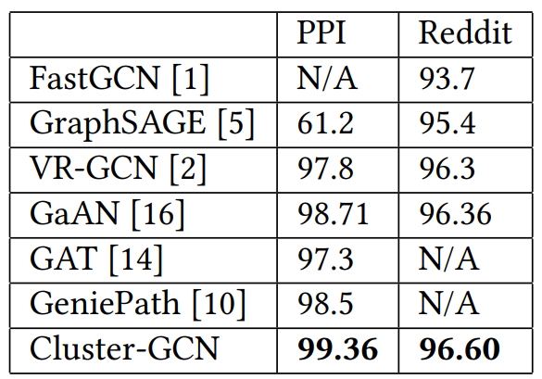



Deeper propagation
Cluster-GCN: An Efficient Algorithm for Training Deep and Large Graph Convolutional Networks
3. Cluster GCN
3-1. Enhance central node’s feature
$$H^{l+1}=σ(({\tilde{D}}^{−0.5}\tilde{A}{\tilde{D}}^{−0.5}+I)H^{l}W^{l})$$
3-2. New method for normalization
Performance in inductive learning
$$\tilde{A}={\left(D+I\right)}^{−1}(A+I)$$
$$H^{l+1}=σ((\tilde{A}+\text{λ}∙diag\left(\tilde{A}\right))H^{l}W^{l})$$

Slide 28
















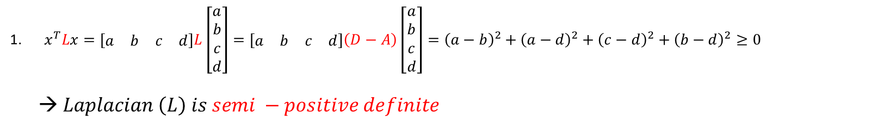












Spectral Graph Theory
$$c^{2}$$
$Laplacian \left(L\right)=D−A$
c
$$−2cd$$
2
$x^{T}Lx=\left[\begin{matrix}a & b & c & d\end{matrix}\right]L\left[\begin{matrix}a \\ b \\ c \\ d\end{matrix}\right]=\left[\begin{matrix}a & b & c & d\end{matrix}\right]\left(D−A\right)\left[\begin{matrix}a \\ b \\ c \\ d\end{matrix}\right]={\left(a−b\right)}^{2}+{\left(a−d\right)}^{2}+{\left(c−d\right)}^{2}+{\left(b−d\right)}^{2}≥0$
→ $Laplacian \left(L\right) is semi −positive definite$
$$3d^{2}$$
d
3
$$−2ad$$
$$−2bd$$
a
b
0
1
$$2b^{2}$$
$$2a^{2}$$
$$−2ab$$
2. $L=UΛU^{T} (spectral decomposition)$
$${ u}_{0}$$
$${ u}_{1}$$
$${ u}_{2}$$
$${ u}_{3}$$
$${ λ}_{0}$$
$$≥0$$
$${ u}_{0}$$
$$=$$
$${ λ}_{1}$$
$${ u}_{1}$$
$${ λ}_{2}$$
$${ u}_{2}$$
$${ λ}_{3}$$
$${ u}_{3}$$
$$L$$
$$U$$
$$Λ$$
$$U^{T}$$
Orthonormal Basis

Slide 29
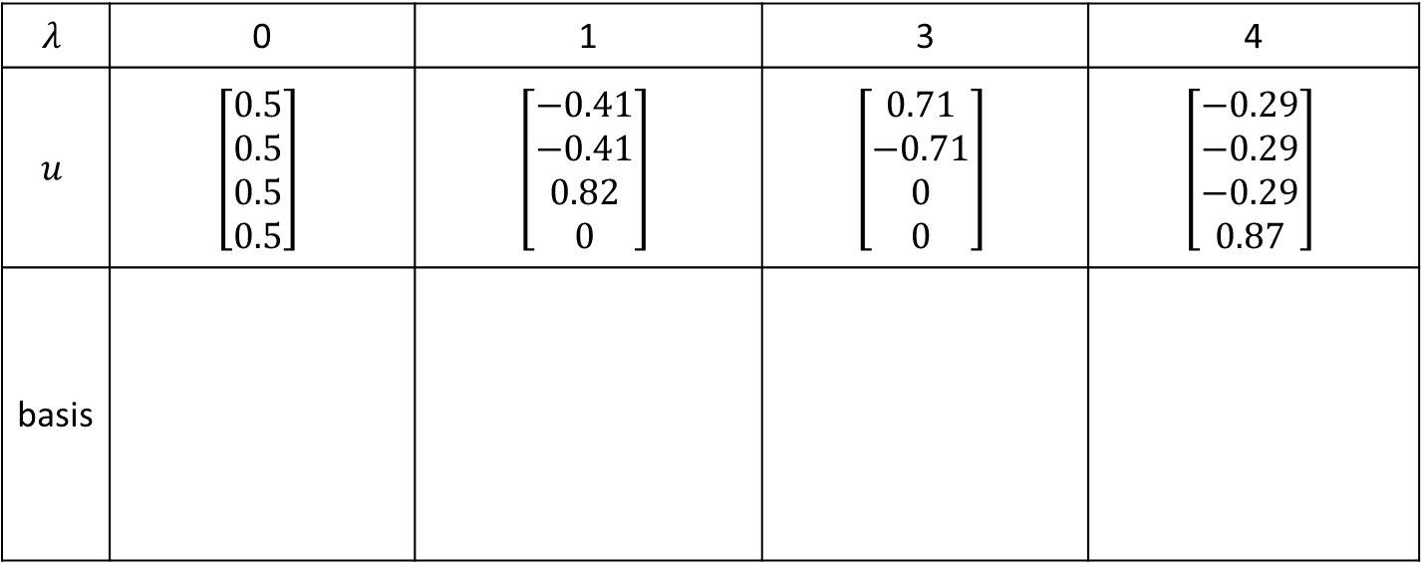

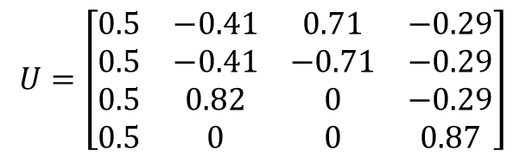
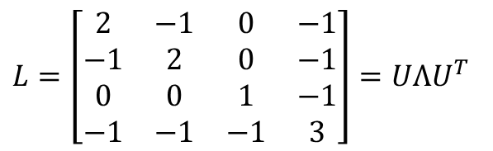
Spectral Graph Theory
$$Λ=\left[\begin{matrix}0 & 0 & 0 & 0 \\ 0 & 1 & 0 & 0 \\ 0 & 0 & 3 & 0 \\ 0 & 0 & 0 & 4\end{matrix}\right]$$
Find basis
$$L=\left[\begin{matrix}2 & −1 & 0 & −1 \\ −1 & 2 & 0 & −1 \\ 0 & 0 & 1 & −1 \\ −1 & −1 & −1 & 3\end{matrix}\right]=UΛU^{T}$$
2
3
$$U=\left[\begin{matrix}0.5 & −0.41 & 0.71 & −0.29 \\ 0.5 & −0.41 & −0.71 & −0.29 \\ 0.5 & 0.82 & 0 & −0.29 \\ 0.5 & 0 & 0 & 0.87\end{matrix}\right]$$
0
1
$$λ$$ | 0 | 1 | 3 | 4
$$u$$ | $$\left[\begin{matrix}0.5 \\ 0.5 \\ 0.5 \\ 0.5\end{matrix}\right]$$ | $$\left[\begin{matrix}−0.41 \\ −0.41 \\ 0.82 \\ 0\end{matrix}\right]$$ | $$\left[\begin{matrix}0.71 \\ −0.71 \\ 0 \\ 0\end{matrix}\right]$$ | $$\left[\begin{matrix}−0.29 \\ −0.29 \\ −0.29 \\ 0.87\end{matrix}\right]$$
basis
3
3
3
3
2
2
2
2
1
0
1
0
1
1
0
0

Slide 30




Spectral Graph Theory
Graph Fourier Transform
Orthonormal basis
$$\hat{x} = U^{T}x$$
3.5
0.5 0.5 0.5 0.5
4
-5.74
$$=$$
-0.41 -0.41 0.82 0
4
0
0.71 -0.71 0 0
-3
0.29
-0.29 -0.29 -0.29 0.87
2
Spectral Domain
Spatial Domain (Vertex Domain)
3.5
0.29
2
2
-3
0
$$Ϝ$$
3
$$λ(frequency)$$
0
1
3
4
4
4
0
1
-5.74

Slide 31
















Spectral Graph Theory
Inverse Graph Fourier Transform
$$+$$
$$+$$
$$0×0$$
$$3.5×0.5$$
$$−5.74×0$$
$$+$$
$$0.29×0.87$$
=
$$\hat{x}$$
3.5
$$x = U\hat{x}$$
2
2
0.29
0
$$inverse Ϝ$$
3
$$λ$$
0
1
3
4
0
1
-5.74
0.87
$$U$$
0.5
3
3
3
3
0
0
(Orthonormal Basis)
2
2
2
2
1
1
0
1
1
0
0
0
$$λ=0$$
$$λ=1$$
$$λ=3$$
$$λ=4$$

Slide 32




































Spectral Graph Theory
Convolution in spatial domain = Multiplication in frequency domain
$${\hat{x}}_{0}$$
$$x$$
$${\hat{x}}_{3}$$
$$Ϝ$$
$${\hat{x}}_{2}$$
$$\hat{x}=U^{T}x$$
$$λ$$
0
1
3
4
$${\hat{y}}_{0}$$
$$θ_{0}$$
$${\hat{x}}_{0}$$
$$×$$
$${\hat{y}}_{1}$$
$$=$$
$$θ_{1}$$
$${\hat{x}}_{1}$$
$$θ_{2}$$
$${\hat{y}}_{2}$$
$$θ_{2}$$
$${\hat{x}}_{2}$$
$$θ_{0}$$
$${\hat{x}}_{1}$$
$${\hat{y}}_{3}$$
$$θ_{3}$$
$${\hat{x}}_{3}$$
$$θ_{3}$$
$$θ_{1}$$
Learnable
$$filter g_{θ}(Λ)$$
$$\hat{y} = g_{θ}\left(Λ\right) \hat{x}$$
$$λ$$
0
1
3
4
Learnable
$${\hat{y}}_{0}$$
$$=$$
multiplication
(Feature Propagation)
$${\hat{y}}_{3}$$
$${\hat{y}}_{1}$$
$${\hat{y}}_{2}$$
$$λ$$
$$\hat{y}$$
0
1
3
4

Slide 33










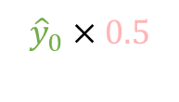



Spectral Graph Theory
Inverse Graph Fourier Transform
$$+$$
$$+$$
$${\hat{y}}_{2}×0$$
$${\hat{y}}_{0}×0.5$$
$${\hat{y}}_{1}×0$$
$$+$$
$${\hat{y}}_{3}×0.87$$
$$\hat{y}$$
=
$$y = U\hat{y}$$
$${\hat{y}}_{0}$$
2
$${\hat{y}}_{3}$$
$${\hat{y}}_{2}$$
$$inverse Ϝ$$
3
$$λ$$
0
1
3
4
$${\hat{y}}_{1}$$
0
1
0.87
$$U$$
0.5
3
3
3
3
0
0
(Orthonormal Basis)
2
2
2
2
1
1
0
1
1
0
0
0
$$λ=0$$
$$λ=1$$
$$λ=3$$
$$λ=4$$

Slide 34










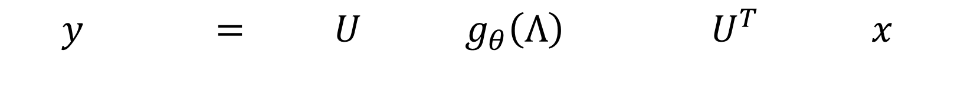













Spectral Graph Theory
Convolution in spatial domain = Multiplication in frequency domain
2
2
3
3
1
0
1
0
Learnable
$$y_{0}$$
$${ u}_{0}$$
$${ u}_{1}$$
$${ u}_{2}$$
$${ u}_{3}$$
$$θ_{0}$$
$${ u}_{0}$$
$$x_{0}$$
$$y_{1}$$
$$θ_{1}$$
$${ u}_{1}$$
$$x_{1}$$
$$y_{2}$$
$$θ_{2}$$
$${ u}_{2}$$
$$x_{2}$$
$$y_{3}$$
$$θ_{3}$$
$${ u}_{3}$$
$$x_{3}$$
$$y = U g_{θ}\left(Λ\right) { U}^{T} x$$
$$embedding$$
$$inverse F$$
Feature
Propagation
$$Ϝ$$

Slide 35






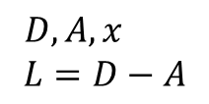


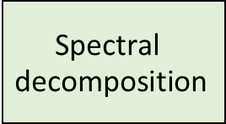



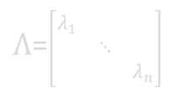
Spectral Graph Theory
2
3
Naïve Method
Propagation Method
0
1
$$y =U g_{θ}\left(Λ\right) U^{T} x$$
$D,A,x$
$$L=D−A$$
$$O(n^{3})$$
$$\text{Spectral} \text{decomposition}$$
$$U$$
$$O(n^{2})$$
$$L$$
$$O(n)$$
$$U g_{θ}\left(Λ\right) U^{T}$$
$$g_{θ}\left(Λ\right)$$
Propagation Method
Learn a filter
$Λ$=$\left[\begin{matrix}λ_{1} & & \\ & ⋱ & \\ & & λ_{n}\end{matrix}\right]$
=
Convolution Kernel
High Time Complexity
$$x$$
$$U g_{θ}\left(Λ\right) U^{T}$$
$$y$$
Propagation Method

Slide 36
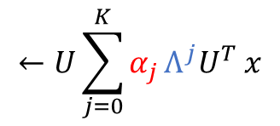


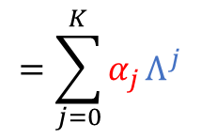
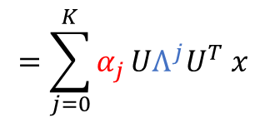

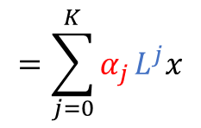
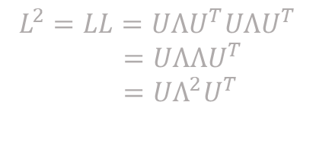
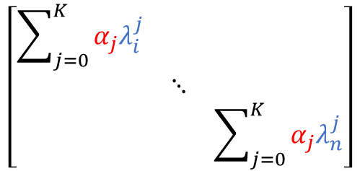


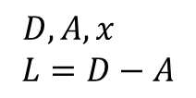
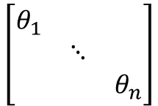


Spectral Graph Theory
1-hop
Reduce Parameter
2-hop
$$O(n)$$
estimate
known
$$g_{θ}\left(Λ\right)$$
=
$$\left[\begin{matrix}\sum_{j=0}^{K}{α_{j}λ_{i}^{j}} & & \\ & ⋱ & \\ & & \sum_{j=0}^{K}{α_{j}λ_{n}^{j}}\end{matrix}\right]$$
$$\left[\begin{matrix}θ_{1} & & \\ & ⋱ & \\ & & θ_{n}\end{matrix}\right]$$
approximate
$$=\sum_{j=0}^{K}{α_{j}}Λ^{j}$$
$D,A,x$
$$L=D−A$$
$L^{2}=LL=UΛU^{T}UΛU^{T}$
$=UΛΛU^{T}$
$=UΛ^{2}U^{T}$
$$←U\sum_{j=0}^{K}{α_{j}}Λ^{j}U^{T} x$$
$$=\sum_{j=0}^{K}{α_{j}}UΛ^{j}U^{T} x$$
$$=\sum_{j=0}^{K}{α_{j}}L^{j}x$$
$$y=U g_{θ}\left(Λ\right) U^{T} x$$
$$1. parameter estimation: O(n)$$
$O(K)$ $K≪n$
$$2. Don^{′}t need find U →save O\left(n^{3}\right) time complexity$$
$3. L^{K}: K$-$hop receptive field$
$$4. {compute L}^{j}:O(n^{3})$$

Slide 37


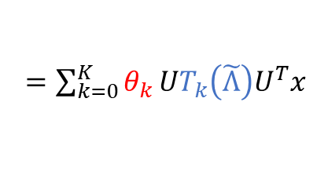



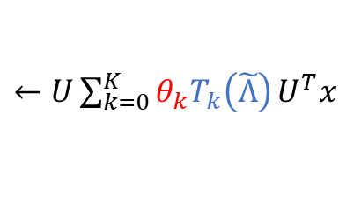

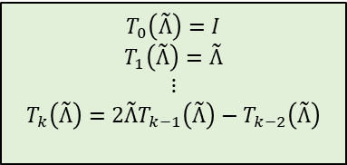



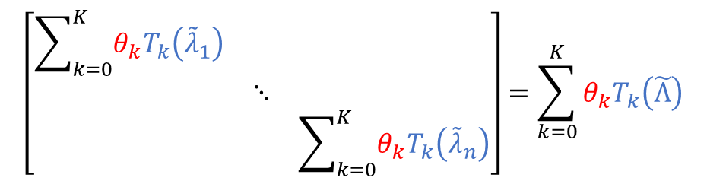
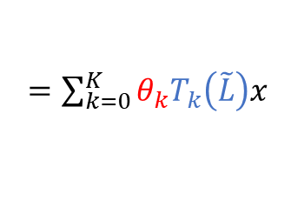
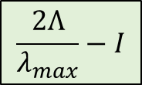
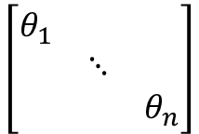
Spectral Graph Theory
ChebNet
Chebyshev Polynomial
$$T_{0}\left(\tilde{Λ}\right)=I$$
$$T_{1}\left(\tilde{Λ}\right)=\tilde{Λ}$$
$$⋮$$
$$T_{k}\left(\tilde{Λ}\right)=2\tilde{Λ}T_{k−1}\left(\tilde{Λ}\right)−T_{k−2}\left(\tilde{Λ}\right)$$
$$\frac{2Λ}{λ_{max}}−I$$
$$T_{k}\left(\tilde{Λ}\right)$$
$$Λ$$
$$\tilde{Λ} ; {\tilde{λ}}_{i}∈[−1,1]$$
$$λ_{i}^{k}$$
$$g_{θ}\left(Λ\right)$$
approx.
=
$$\left[\begin{matrix}\sum_{k=0}^{K}{θ_{k}T_{k}\left({\tilde{λ}}_{1}\right)} & & \\ & ⋱ & \\ & & \sum_{k=0}^{K}{θ_{k}T_{k}\left({\tilde{λ}}_{n}\right)}\end{matrix}\right]=\sum_{k=0}^{K}{θ_{k}T_{k}\left(\tilde{Λ}\right)}$$
$$\left[\begin{matrix}θ_{1} & & \\ & ⋱ & \\ & & θ_{n}\end{matrix}\right]$$
approximate
$$y=U g_{θ}\left(Λ\right) U^{T} x$$
$←U\sum_{k=0}^{K}{θ_{k}T_{k}\left(\tilde{Λ}\right)}U^{T}x$
$=\sum_{k=0}^{K}{θ_{k}}UT_{k}\left(\tilde{Λ}\right)U^{T}x$
$=\sum_{k=0}^{K}{θ_{k}T_{k}\left(\tilde{L}\right)x}$
$$1. parameter estimation: O(n)$$
$O(K)$ $K≪n$
$$2. Don^{′}t need find U →save O\left(n^{3}\right) time complexity$$
$$3. compute T_{k}\left(\tilde{L}\right):O({Kn}^{2})$$

Slide 38


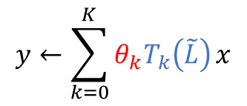



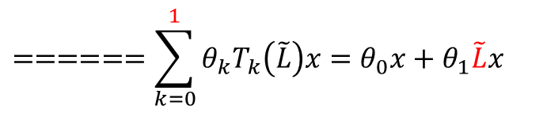









Spectral Graph Theory
Chebyshev Polynomial
$$T_{0}\left(\tilde{L}\right)=I$$
$$T_{1}\left(\tilde{L}\right)=\tilde{L}$$
$$⋮$$
$$T_{k}\left(\tilde{L}\right)=2\tilde{L}T_{k−1}\left(\tilde{L}\right)−T_{k−2}\left(\tilde{L}\right)$$
GCN
$$\frac{2L}{λ_{max}}−I$$
$$L$$
$$\tilde{L}$$
Normalized Laplacian: $L=I−D^{−\frac{1}{2}}AD^{−\frac{1}{2}}$
$$λ_{max}=2$$
$$y←\sum_{k=0}^{K}{θ_{k}T_{k}\left(\tilde{L}\right)}x$$
$$======\sum_{k=0}^{1}{θ_{k}T_{k}\left(\tilde{L}\right)x}=θ_{0}x+θ_{1}\tilde{L}x$$
Let $K=1$
$$λ_{max}=2$$
$$======θ_{0}x+θ_{1}\left(L−I\right)x$$
Gradient explode
$$θ=θ_{0}=−θ_{1}$$
Gradient vanish
$$=θ_{0}x−θ_{1}(D^{−\frac{1}{2}}AD^{−\frac{1}{2}})x$$
$==========θ\left(I−D^{−\frac{1}{2}}AD^{−\frac{1}{2}}\right)x$
renormalization
$$≈≈≈≈≈≈≈≈≈≈\left({\tilde{D}}^{−0.5}\tilde{A}{\tilde{D}}^{−0.5} \right)xθ$$
O(n)
Activation Function
$$≈≈≈≈≈≈≈≈≈≈σ\left({\tilde{D}}^{−0.5}\tilde{A}{\tilde{D}}^{−0.5}xθ \right)$$

Slide 39

Comparison of propagation models of GCN

