Slide 1
Big Data Processor GNN Model 02
Chien-Hua Chen
2021.04.14

Slide 2
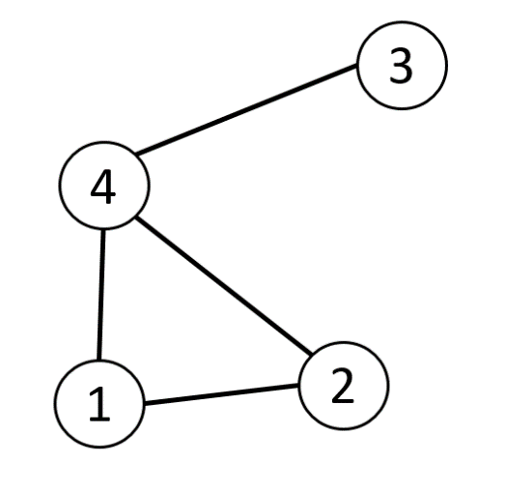
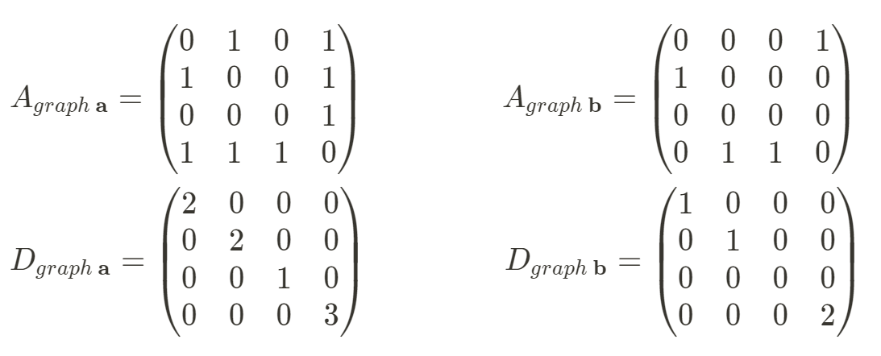



Graph
Undirected graphs
Symmetric Square Matrix
$$spectral decomposition:UΛU^{T}$$
Orthonormal Basis ($U$)
$$Fourier transform$$
~
1
1. Adjacency matrix (A)
=
1
1
1
~
3
2. Degree matrix (D)
=
3
2
4

Slide 3
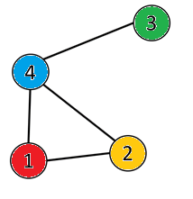
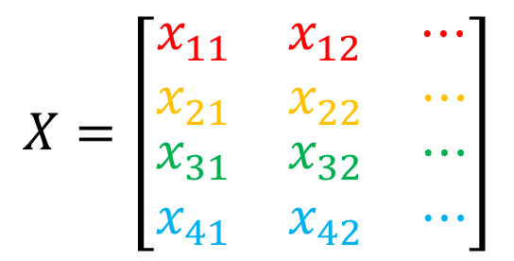
Graph
$$X=\left[\begin{matrix}\begin{matrix}x_{11} & x_{12} & ⋯\end{matrix} \\ \begin{matrix}x_{21} & x_{22} & ⋯\end{matrix} \\ \begin{matrix}\begin{matrix}x_{31} & x_{32} & ⋯\end{matrix} \\ \begin{matrix}x_{41} & x_{42} & ⋯\end{matrix}\end{matrix}\end{matrix}\right]$$
3. Feature matrix (X)
# of nodes
# of independent variables

Slide 4
1. Traditional Graph Convolutional Networks
Semi-Supervised Classification with Graph Convolutional Networks (2017.9) Author: Kipf, Thomas N.; Welling, Max (University of Amsterdam)
Publication: eprint arXiv:1609.02907

Slide 5





















GCN Layer
Input Layer
Hidden Layer
Output Layer
Label
$$A$$
$$A$$
$$A$$
$$⋯$$
$$A$$
$$D$$
$$D$$
$$D$$
$$⋯$$
$$D$$
$$X$$
$$H^{1}$$
$$H^{2}$$
$$⋯$$
$$F$$
$$Loss$$
$$Y$$
$$(H^{0})$$
Feature Propagation
Prediction
=
$$⋯$$
$$⋯$$
$$⋯$$

Slide 6


Graph Kernel (Feature Propagation)
1. Normalization
Mean
$$H^{1}←{\tilde{D}}^{−1}\tilde{A}X$$
2. Normalized Laplacian
$$H^{1}←{\tilde{D}}^{−0.5}\tilde{A}{\tilde{D}}^{−0.5}X$$
Mean

Slide 7
2. Graph U-Nets
Graph U-Nets (2019.5) Author: Gao, Hongyang; Ji, Shuiwang (Texas A&M University)
Publication: eprint arXiv:1905.05178

Slide 8
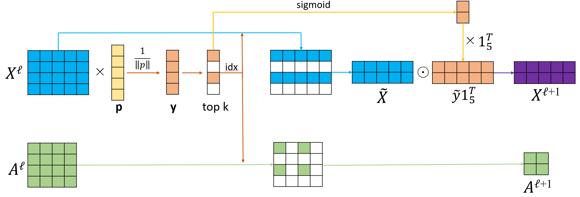
gPool
Linear Combination → Feature Conclusion
or tanh
Remain Top k nodes
Trainable

Slide 9
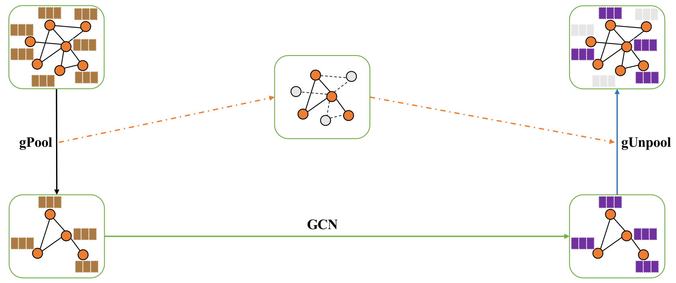
G-U-Nets
G-U-Nets = gPool + GCN + gUnpool + GCN
encoder
decoder
Select meaningful nodes
Zero-padding
Feature transfer

Slide 10
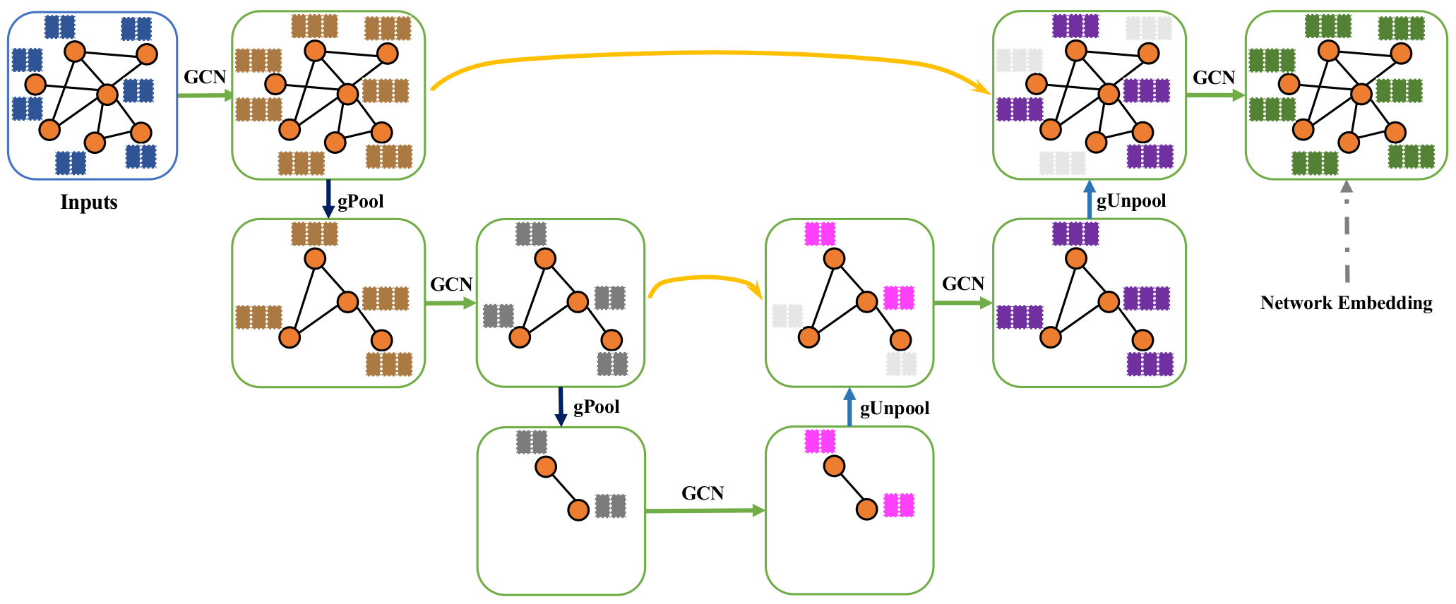
Deep G-U-Nets
Traditional GCN

Slide 11
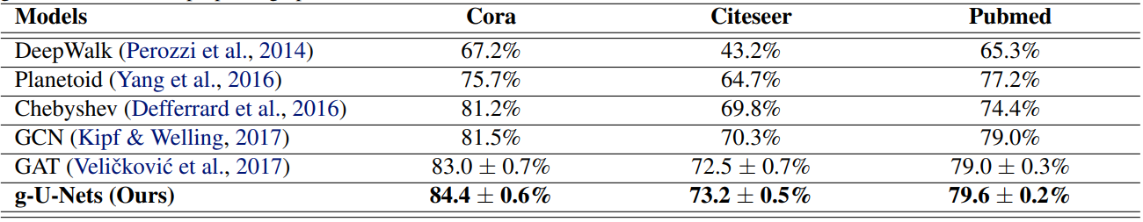
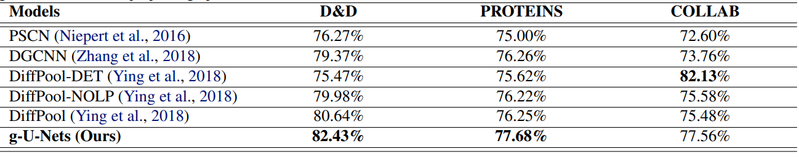



Performance
Transductive
LGCL
83.3$±$0.5%
73.0$±$0.6%
79.5$±$0.2%
Inductive

Slide 12
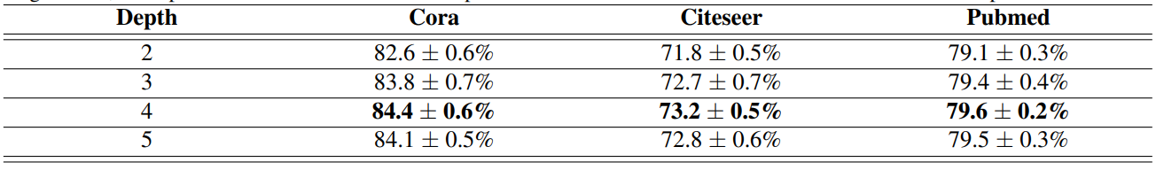
Network Depth of Graph U-Nets

