Slide 1
Big Data Processor GNN Model Package 01
Chien-Hua Chen
2021.04.14

Slide 2
Two Tasks of Graph Data
1. Transductive Learning (Node Prediction)
Class A
Class C
Class A
Class C
??????
modeling
Class A
Class B
Class A
Class B
Class A
Class B
Training
Class B
2. Inductive Learning (Graph Prediction)
Class A
Class B
Class A
Class B
??????
Class A
modeling
Class A
Class A
Training

Slide 3
10-fold Cross Validation
training
validation
Dataset
10%
90%
Mean Accuracy of Validation Set

Slide 4
Dataset of Transductive Learning
Node Prediction

Slide 5
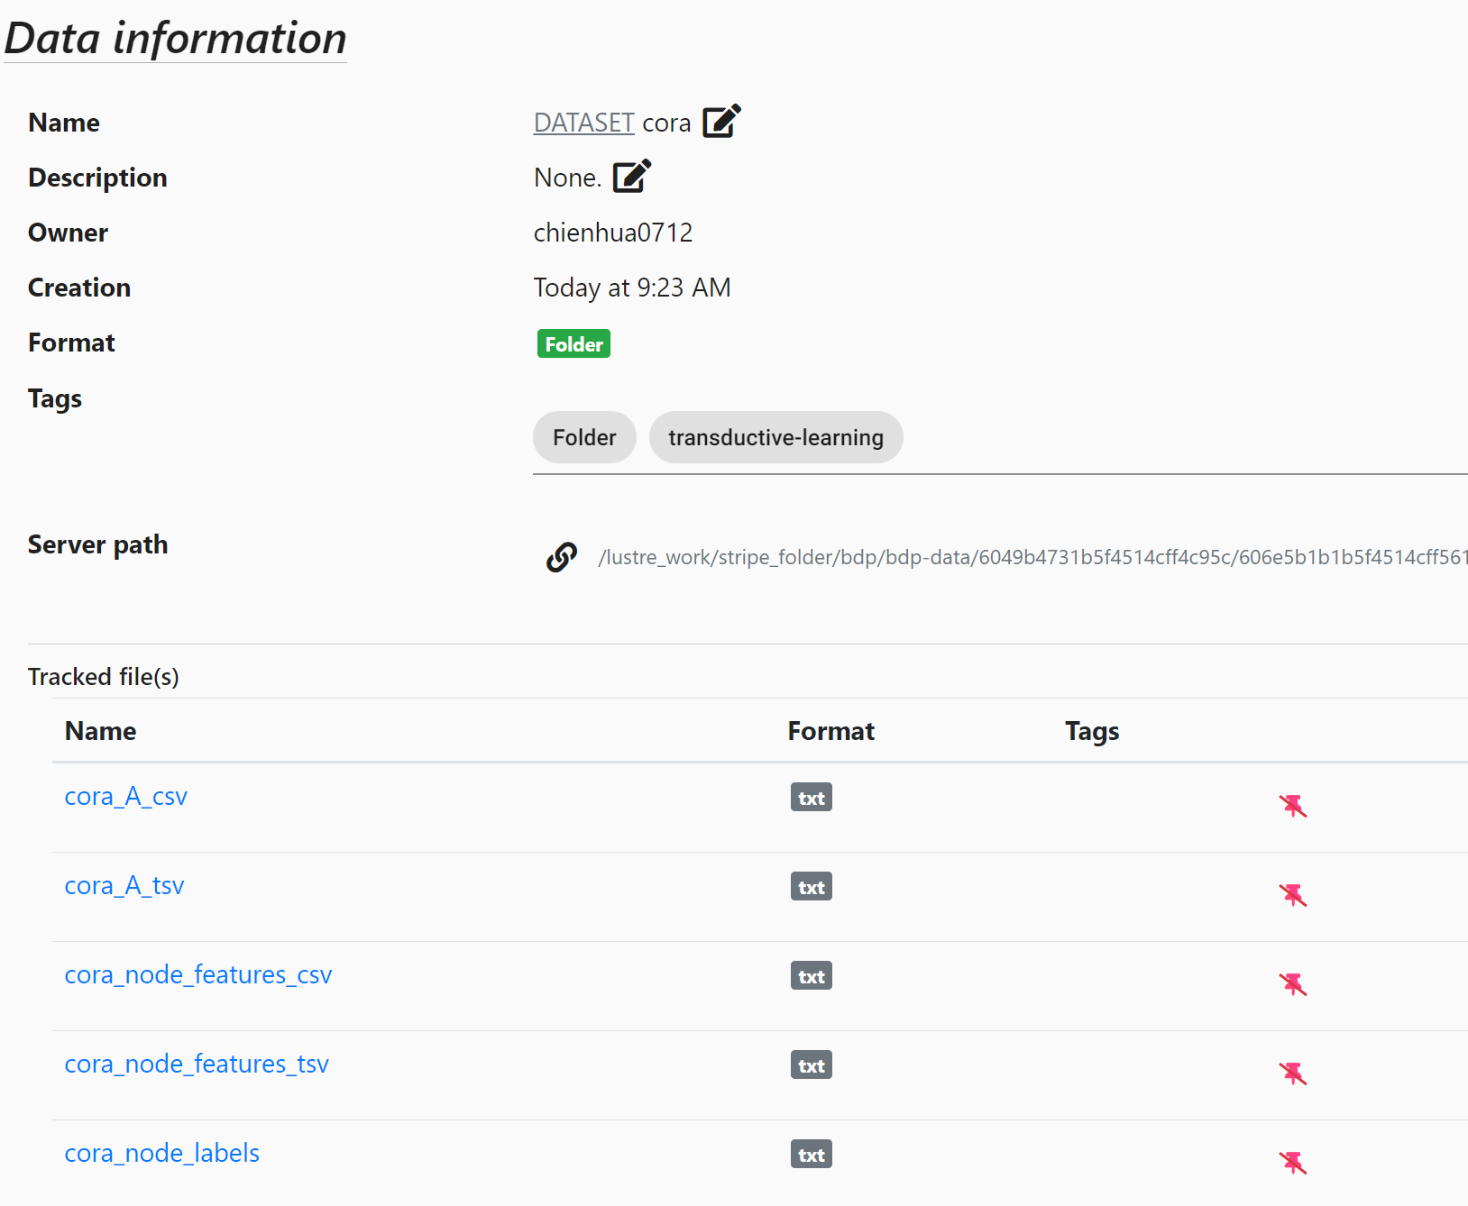
Transductive Learning – Dataset
AI
n.n.
prob.
GCN
algo.
pred.
AI
?
Chem.
Med.
n.n.
pred.
fixed file name
1.
2.
3.

Slide 6
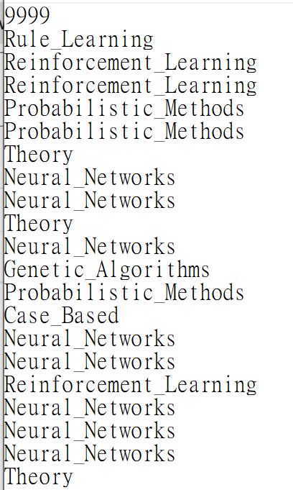
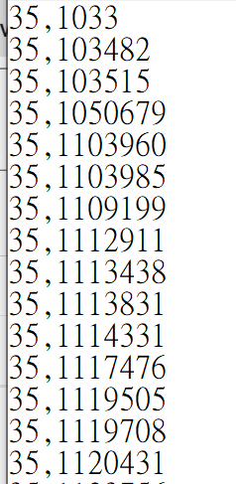
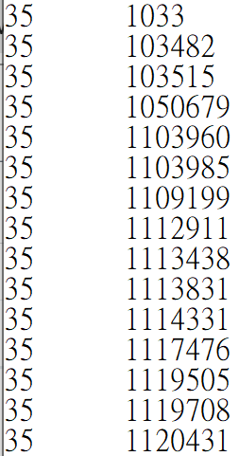
1. _A
3. _node_labels
Node Label
Unknown label
Node ID
Node ID
Node ID
Node ID
=
9999
…
…
csv
tsv
…

Slide 7
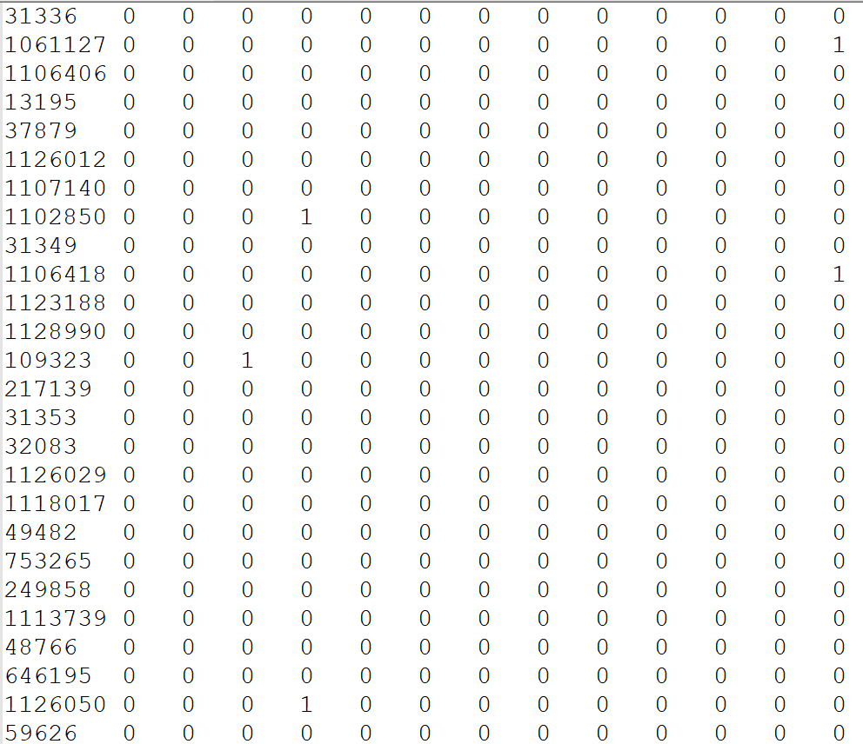
2. _node_features
Node ID
Node Features
…
tsv or csv
…

Slide 8
GCN
G
D
A
dim=1433
dim=64
dim=7
B
A
10-fold Accuracy = 88.40% (± 1.37%)
E
F
C
dim=1433
dim=64
dim=64
dim=7
88.59% (± 2.39%)
dim=1433
dim=64
dim=64
dim=64
dim=7
87.66% (± 1.91%)
88.10% (± 1.76%)
dim=64
dim=32
dim=16

Slide 9
GCN
Dropout rate = 0.3
dim=1433
dim=64
dim=64
dim=64
dim=7
87.66% (± 1.91%)
Dropout rate = 0
dim=1433
dim=64
dim=64
dim=64
dim=7
86.51% (± 3.72%)

Slide 10
G-U-Net
dim=1433
dim=64
dim=64
dim=64
dim=7
GCN
GCN
GCN
86.37% (std=2.95%)
gPool
gUnpool
dim=64
dim=64
GCN
dim=1433
dim=64
dim=32
dim=16
dim=7
87.70% (std=3.03%)
dim=64
dim=32

Slide 11
G-U-Net
Final GCN
dim=1433
dim=64
dim=64
dim=64
dim=7
GCN
GCN
GCN
86.37% (std=2.95%)
gPool
gUnpool
dim=64
dim=64
GCN
dim=1433
dim=64
dim=64
dim=7
85.15% (std=1.98%)
dim=64
dim=64

Slide 12
G-U-Net
dim=1433
dim=128
dim=7
dim=64
dim=16
78.27% (std=4.47%)
dim=32

Slide 13
Dataset of Inductive Learning
Graph Prediction

Slide 14
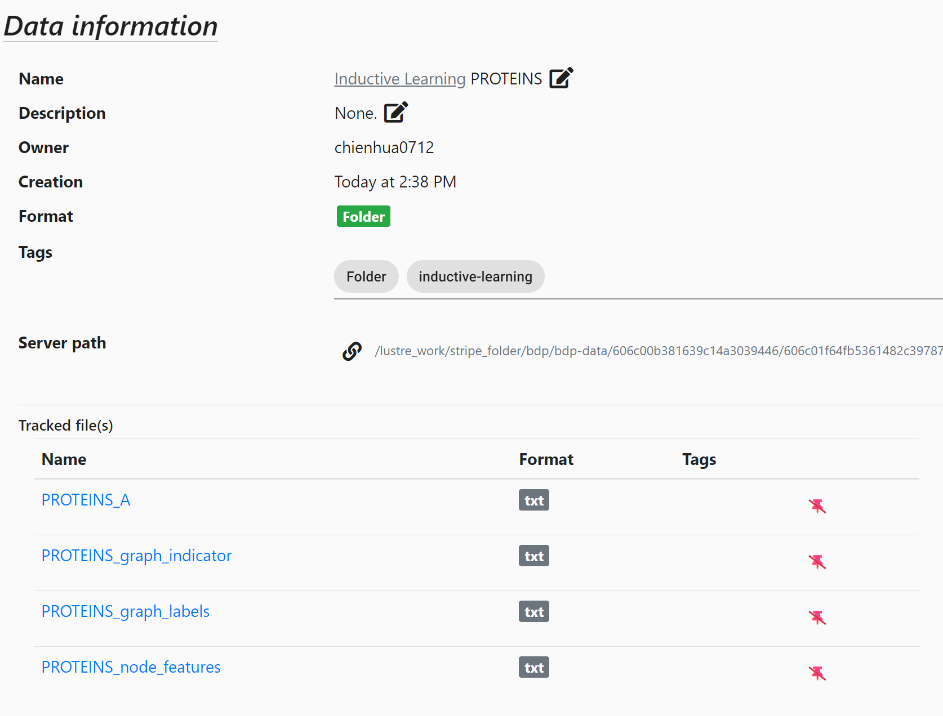
Inductive Learning – Dataset
????
Enzyme
fixed file name
1.
2.
3.
4.

Slide 15
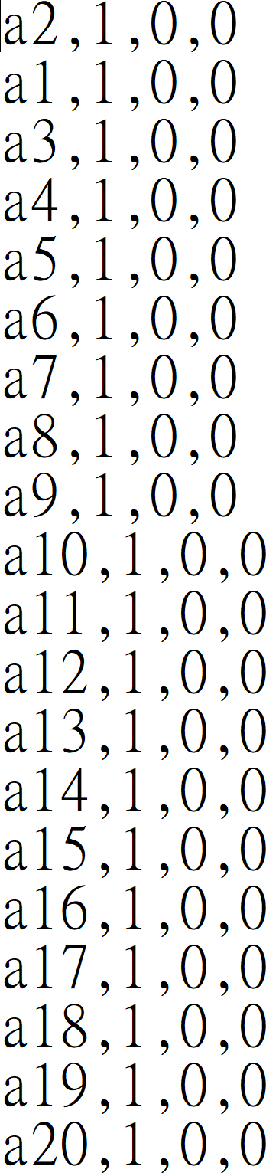
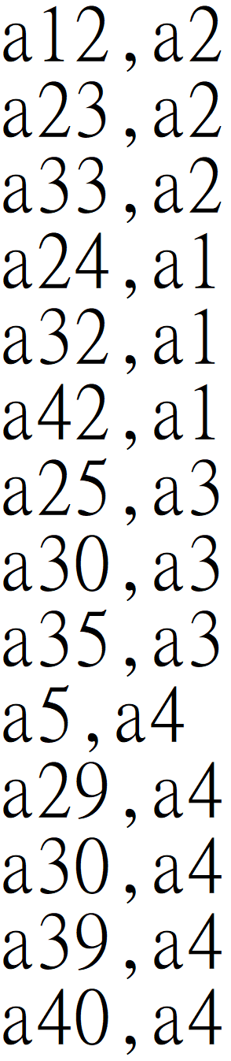
1. _A
4. _node_features
Node Features
Node ID
Node ID
Node ID
Don’t need self connection.
e.g. a1,a1
Both uni-direction and bi-direction are available.
e.g. uni-direction: a2,a3
e.g. bi-direction: a2,a3
a3,a2
All of those will be transform to undirected graph.
…
…
Do not need column name in text.
…

Slide 16
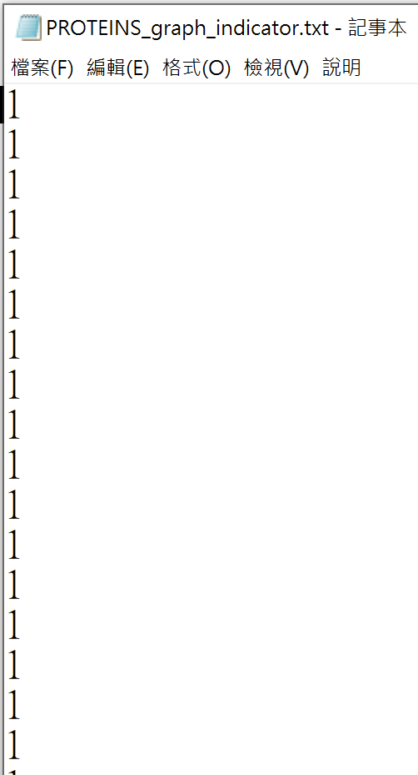
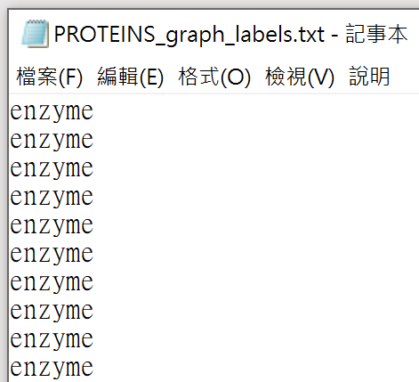
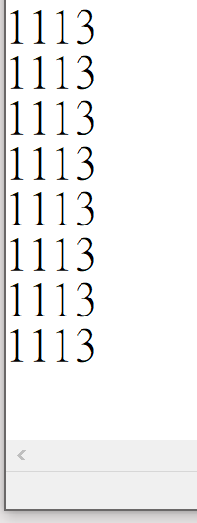
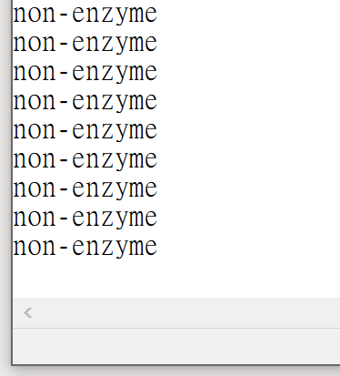
2. _graph_indicator
3. _graph_labels
Graph Label
Graph ID
Node ID
Graph ID
a2
a1
1
2
a3
3
…
…
…
…
…
…
…
…
a43469
1111
a43470
1112
a43471
1113
Don’t need this column

Slide 17
GCN
dim=64
max pooling
dim=32
dim=16
dim=3
dim=64
dim=64
dim=2
p(enzyme)
……
p(non-enzyme)
10-fold cross validation Accuracy = 67.35% (± 3.89%)

Slide 18
GCN
dim=64
Residual Connection
+
max pooling
dim=32
dim=16
dim=3
dim=64
dim=64
dim=2
p(enzyme)
……
p(non-enzyme)
10-fold cross validation Accuracy = 69.15% (± 4.59%)

Slide 19
GCN
max pooling
dim=64*3
sum pooling
mean pooling
dim=32
dim=16
dim=3
dim=64
dim=64
dim=2
p(enzyme)
……
p(non-enzyme)
10-fold cross validation Accuracy = 73.33% (± 4.07%)

Slide 20
G-U-Net
+
dim=3
dim=64
dim=52
dim=64
+
dim=426
64
64
dim=213
dim=64
dim=52
+
dim=26
dim=52
64
max
52
dim=2
Residual Connection
sum
mean
52
dim=52
dim=26
dim=13
dim=26
52
26
26
26
dim=26
dim=13
74.11% (std=2.26%)

Slide 21
G-U-Net
dim=3
dim=64
dim=52
dim=64
dim=284
64
dim=64
dim=52
dim=26
dim=52
dim=213
64
max
52
dim=2
mean
dim=52
dim=26
dim=13
dim=26
52
26
26
dim=26
dim=13

Slide 22
G-U-Net
+
dim=3
dim=64
dim=52
dim=64
max pooling
+
dim=64
dim=64
dim=52
dim=26
dim=52
dim=40
+
dim=2
Residual Connection
dim=52
dim=26
dim=13
dim=26
dim=26
dim=13

Slide 23
G-U-Net
dim=3
dim=64
max
dim=465
64
sum
mean
64
dim=200
dim=64
dim=52
64
max
52
sum
52
mean
dim=2
52
dim=52
dim=26
max
26
sum
26
mean
26
dim=26
dim=13
max
13
sum
13
mean
13
73.25% (std=3.99%)

Slide 24
G-U-Net
+
64
+
3
64
64
+
64
64
GC
GC
GC
dim=768
64
64
+
64
64
GC
GC
dim=512
64
64
64
64
GC
GC
dim=2
64
64
GC
10-fold cross validation Accuracy = 78.7 (± 4.2%)
github.com/HongyangGao/Graph-U-Nets

