Slide 1
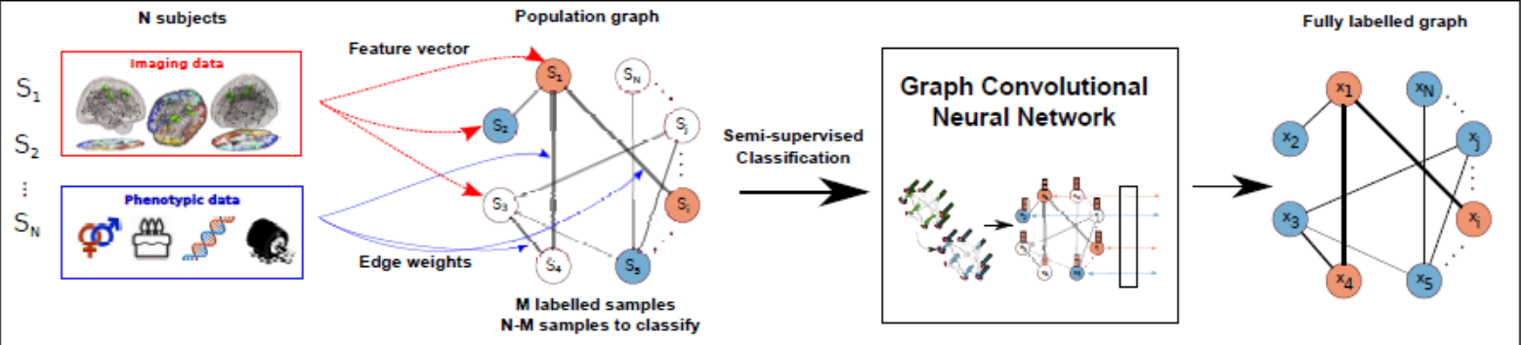
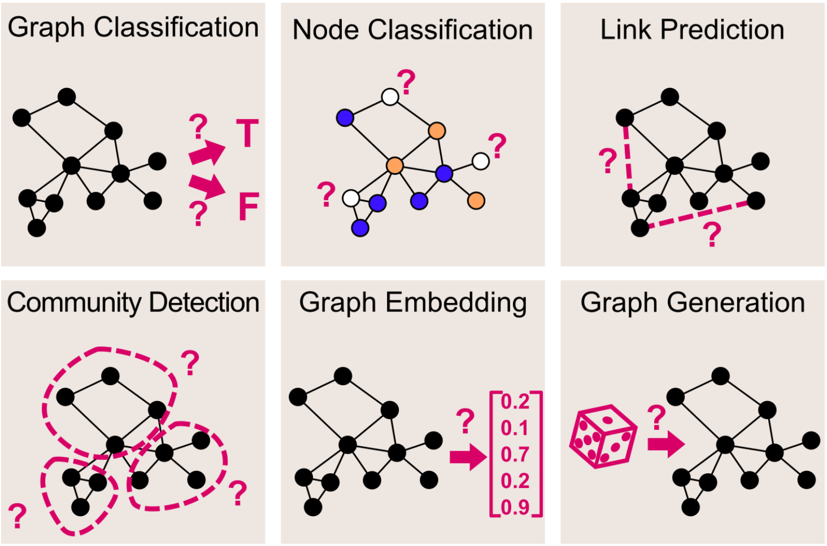
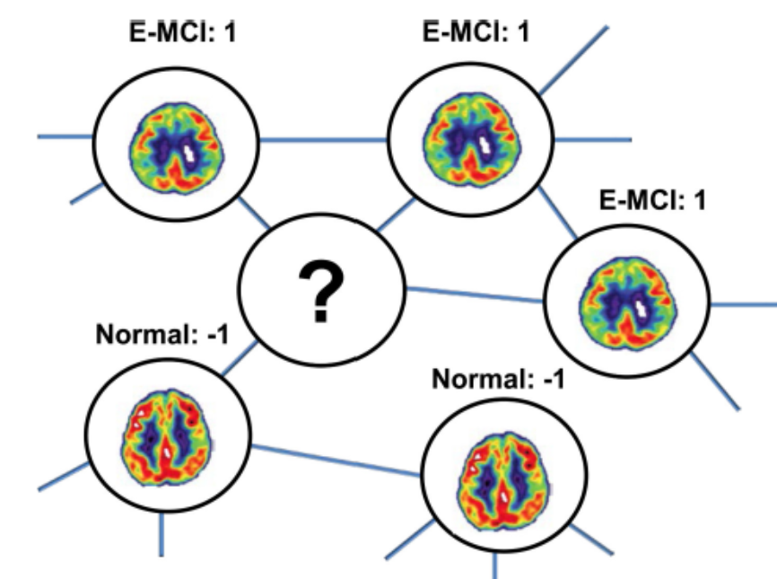
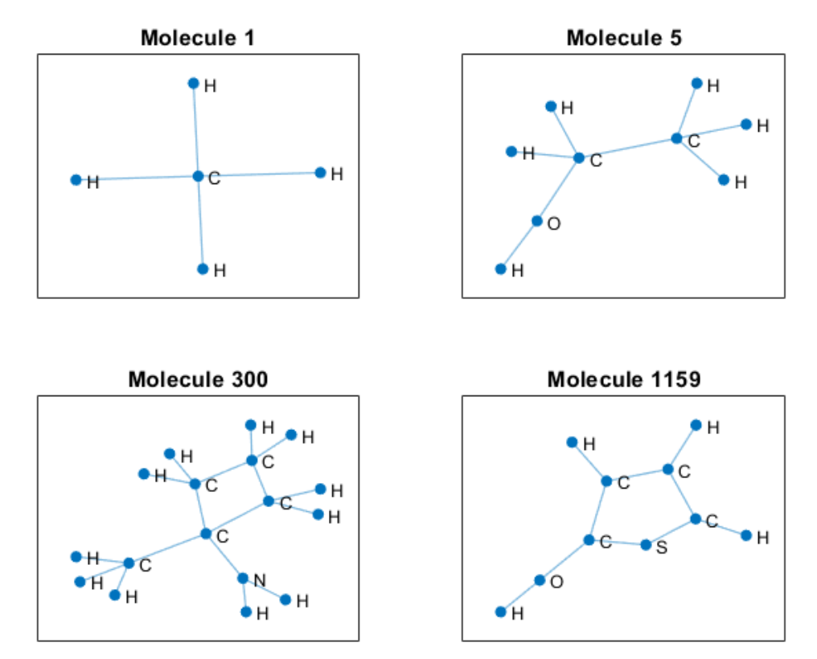
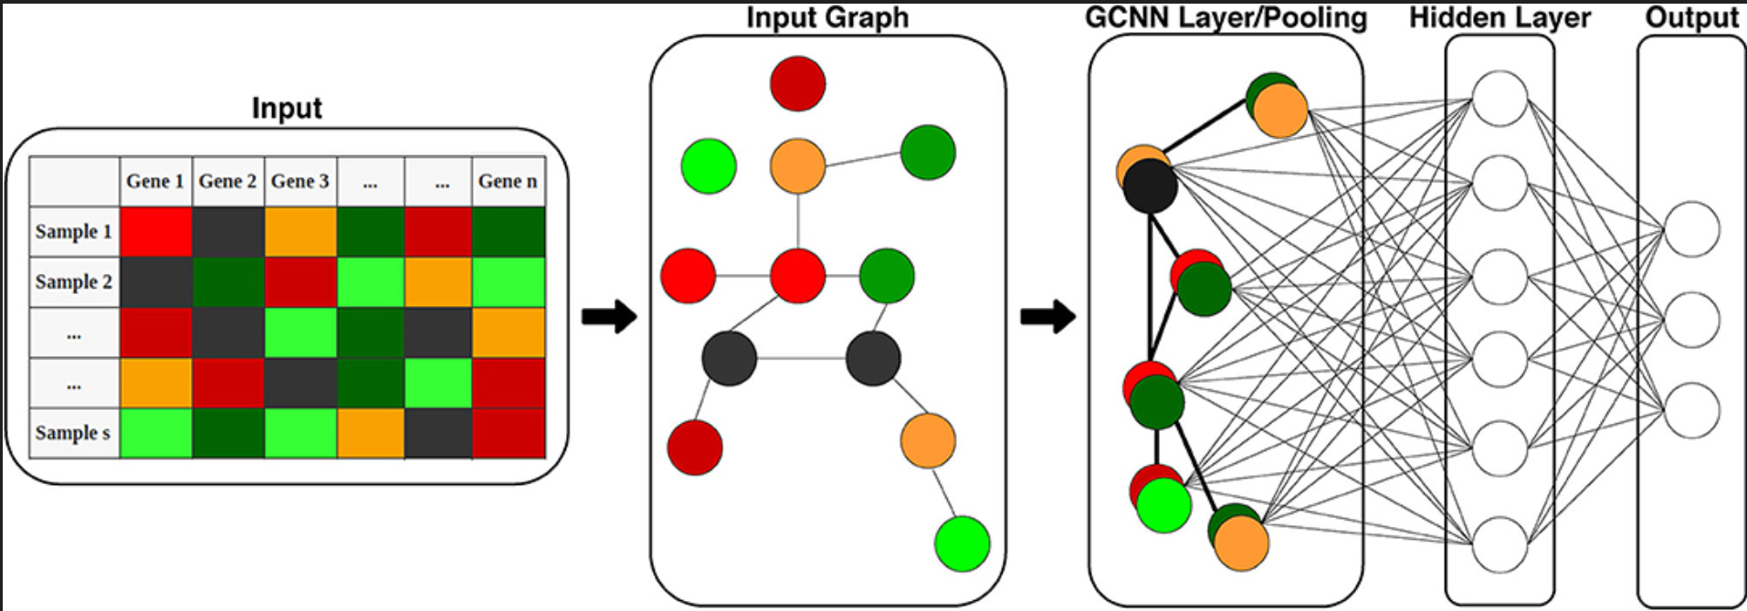
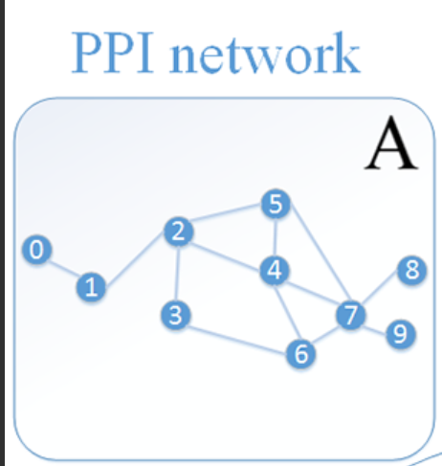
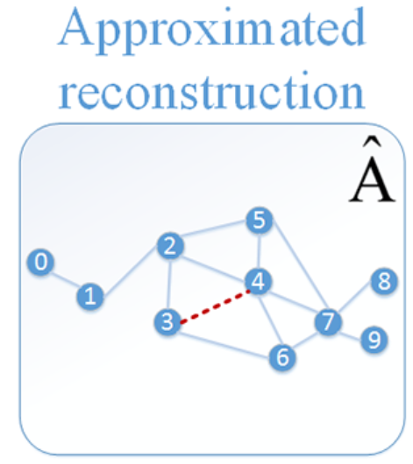
Methods
GAT
GCN
Alzheimer's disease
Cancer types
Micro-RNA & Disease
Gene expression data
人工智慧平台
Graph convolutional Neural networks
(GCN)
U-GCN
SAC-GCN
v
GCN example:
https://www.sciencedirect.com/science/article/pii/S136184152030311X
https://towardsdatascience.com/graph-convolutional-networks-deep-99d7fee5706f

