Slide 1
GCN with similarity awareness and adaptive calibration for disease-induced deterioration prediction
https://doi.org/10.1016/j.media.2020.101947
Medical Image Analysis
Volume 69, April 2021, 101947

Slide 2
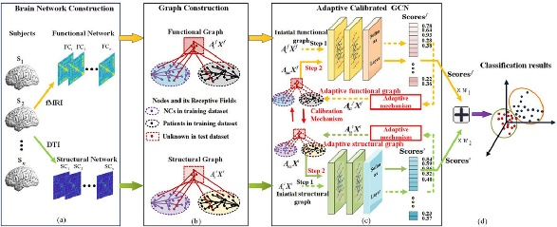
Network Structure

Slide 3



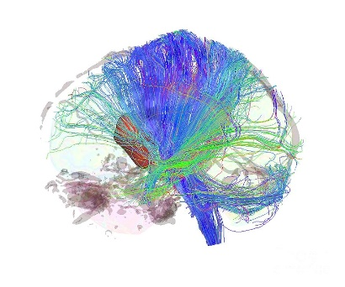












Brain Network Data
ROI: Region of Interest
$${ROI}_{1}$$
$${ROI}_{2}$$
$$…$$
$$…$$
$${ROI}_{90}$$
$${ROI}_{1}$$
$${ROI}_{2}$$
Pearson’s Corr.
DATA1
$$…$$
Feature1
90 ROIs
$$…$$
$${ROI}_{90}$$
$${ROI}_{1}$$
$${ROI}_{2}$$
$${ROI}_{90}$$
$${ROI}_{1}$$
Connection Weight
$${ROI}_{2}$$
DATA2
$$…$$
Feature2
90 ROIs
$$…$$
$${ROI}_{90}$$

Slide 4


Feature Selection
Low-Dimension
50
$$F_{v}^{1}$$
4005
Recursive Feature Elimination (RFE)
Feature 1
Hyperparameter
50
$$F_{v}^{2}$$
4005
Feature 2

Slide 5
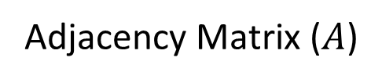
Graph Construction - Edge Connection
Unlabelled nodes
(testing set)
1 | 1 | 1 | 0 | 0 | 0 | 0 | 0 | 0
1 | 1 | 1 | 0 | 0 | 0 | 0 | 0 | 0
1 | 1 | 1 | 0 | 0 | 0 | 0 | 0 | 0
0 | 0 | 0 | 1 | 1 | 1 | 0 | 0 | 0
0 | 0 | 0 | 1 | 1 | 1 | 0 | 0 | 0
0 | 0 | 0 | 1 | 1 | 1 | 0 | 0 | 0
1 | 1 | 1 | 1 | 1 | 1 | 1 | 1 | 1
1 | 1 | 1 | 1 | 1 | 1 | 1 | 1 | 1
1 | 1 | 1 | 1 | 1 | 1 | 1 | 1 | 1
training set; NC
training set; Patient
testing set
Labelled nodes
(training set; NC)
Labelled nodes
(training set; Patient)
Adjacency Matrix ($A$)

Slide 6
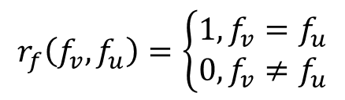
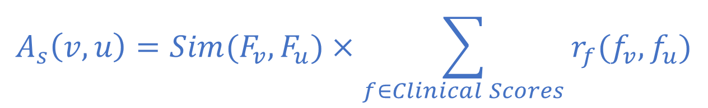


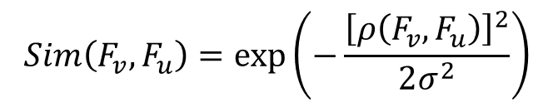
Edge Weights Initialization
$$A_{s}\left(v,u\right)=Sim(F_{v},F_{u})×\sum_{f∈Clinical Scores}{r_{f}(f_{v},f_{u})}$$
$$ρ\left(F_{v},F_{u}\right)=1−corr(F_{v},F_{u})$$
$$r_{f}\left(f_{v},f_{u}\right)=\left\{\begin{aligned}1, f_{v}=f_{u} \\ 0,f_{v}≠f_{u}\end{aligned}\right.$$
$$Sim\left(F_{v},F_{u}\right)=exp\left(−\frac{{\left[ρ\left(F_{v},F_{u}\right)\right]}^{2}}{2σ^{2}}\right)$$
$$σ=mean(ρ)$$

Slide 7
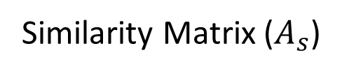
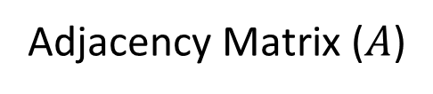

Initialized Adjacency Matrix
1 | 1 | 1 | 0 | 0 | 0 | 0 | 0 | 0
1 | 1 | 1 | 0 | 0 | 0 | 0 | 0 | 0
1 | 1 | 1 | 0 | 0 | 0 | 0 | 0 | 0
0 | 0 | 0 | 1 | 1 | 1 | 0 | 0 | 0
0 | 0 | 0 | 1 | 1 | 1 | 0 | 0 | 0
0 | 0 | 0 | 1 | 1 | 1 | 0 | 0 | 0
1 | 1 | 1 | 1 | 1 | 1 | 1 | 1 | 1
1 | 1 | 1 | 1 | 1 | 1 | 1 | 1 | 1
1 | 1 | 1 | 1 | 1 | 1 | 1 | 1 | 1
sim | sim | sim | sim | sim | sim | sim | sim | sim
sim | sim | sim | sim | sim | sim | sim | sim | sim
sim | sim | sim | sim | sim | sim | sim | sim | sim
sim | sim | sim | sim | sim | sim | sim | sim | sim
sim | sim | sim | sim | sim | sim | sim | sim | sim
sim | sim | sim | sim | sim | sim | sim | sim | sim
sim | sim | sim | sim | sim | sim | sim | sim | sim
sim | sim | sim | sim | sim | sim | sim | sim | sim
sim | sim | sim | sim | sim | sim | sim | sim | sim
$$A_{init}=$$
Adjacency Matrix ($A$)
Similarity Matrix ($A_{s}$)
element-wise (Hadamard product)

Slide 8
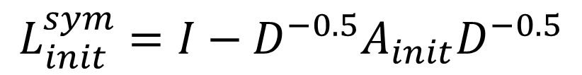
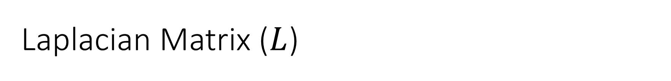
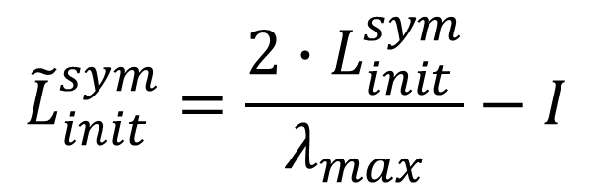
Laplacian Matrix ($L$)
Symmetric Normalized Laplacian
$$L_{init}^{sym}=I−D^{−0.5}A_{init}D^{−0.5}$$
Rescaled Symmetric Normalized Laplacian
$${\tilde{L}}_{init}^{sym}=\frac{2∙L_{init}^{sym}}{λ_{max}}−I$$
$\tilde{L}$ represents a rescaling of the graph Laplacian that maps the eigenvalues from $\left[0, λ_{max}\right]$ to $\left[−1, 1\right]$ since Chebyshev polynomial forms an orthogonal basis in $\left[−1, 1\right]$.

Slide 9

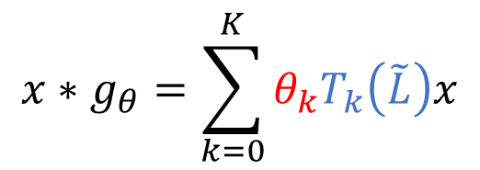
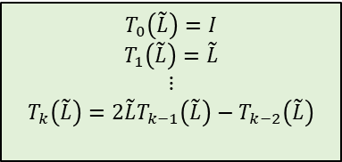
Graph Convolution Layer - ChebNet
$$T_{0}\left(\tilde{L}\right)=I$$
$$T_{1}\left(\tilde{L}\right)=\tilde{L}$$
$$⋮$$
$$T_{k}\left(\tilde{L}\right)=2\tilde{L}T_{k−1}\left(\tilde{L}\right)−T_{k−2}\left(\tilde{L}\right)$$
hyperparameter
Chebyshev Polynomial
$$x∗g_{θ}=\sum_{k=0}^{K}{θ_{k}T_{k}\left(\tilde{L}\right)x}$$
$F$(feature matrix)
parameter

Slide 10
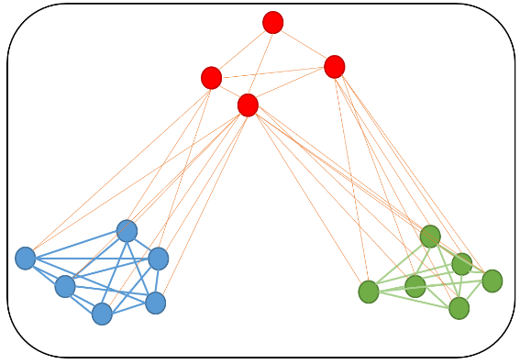

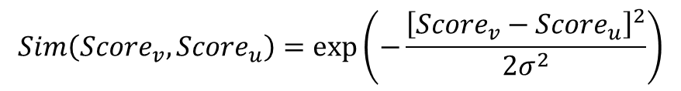
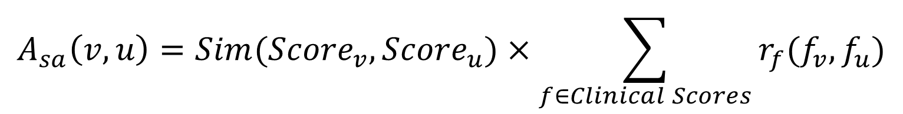

Pretrain Scores & Adaptive Adjacency Matrix
Pretrain Scores
Hyperparameter
$$F$$
50
25
score$∈\left[0, 1\right]$
Adaptive Mechanism
$$A_{sa}\left(v,u\right)=Sim({Score}_{v},{Score}_{u})×\sum_{f∈Clinical Scores}{r_{f}(f_{v},f_{u})}$$
$$Sim\left({Score}_{v},{Score}_{u}\right)=exp\left(−\frac{{\left[{Score}_{v}−{Score}_{u}\right]}^{2}}{2σ^{2}}\right)$$

Slide 11


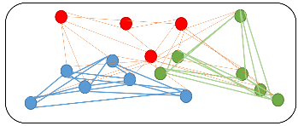



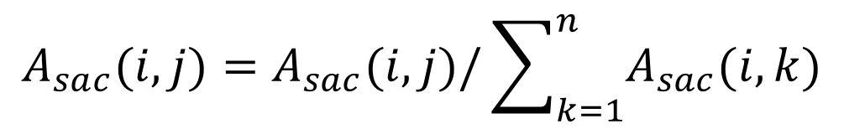



Dual Pretrain Scores & Calibration Mechanism
Dual Pretrain Scores
$$F^{1}$$
$${score}^{1}$$
$$A_{sa}^{1}$$
$$F^{2}$$
$${score}^{2}$$
$$A_{sa}^{2}$$
Calibration Mechanism
$$A_{sac}=A_{sa}^{1}∘A_{sa}^{2}∘A$$
Normalization by sum of row
$$A_{sac}(i, j)=A_{sac}(i, j)/\sum_{k=1}^{n}{A_{sac}(i, k)}$$

Slide 12













Full Model - pretrain
ChebNet
$$F^{1}$$
Feature1
$$F^{1}$$
$${\tilde{L}}_{init}^{1}$$
$${score}^{1}$$
SVM-RFE
sim()
$$A_{init}^{1}$$
$${\tilde{L}}_{init}^{1}$$
Feature2
$$F^{2}$$
$$A_{init}^{2}$$
Laplacian
$${\tilde{L}}_{init}^{2}$$
Data Loader
Clinical Score
$$r_{f}()$$
$$F^{2}$$
$${score}^{2}$$
$${\tilde{L}}_{init}^{2}$$
fold1
fold2
fold3
Training set idx
Testing set idx
A

Slide 13




Full Model
ChebNet
$$F^{1}$$
Feature1
$$F^{1}$$
$$A_{sac}$$
$${\tilde{L}}_{sac}$$
$${score}^{1}$$
$${score}^{1}$$
SVM-RFE
sim()
$$A_{init}^{1}$$
$${\tilde{L}}_{init}^{1}$$
Feature2
$$F^{2}$$
$$A_{init}^{2}$$
Laplacian
$${\tilde{L}}_{init}^{2}$$
+
Data Loader
Clinical Score
weighted
$$r_{f}()$$
$$F^{2}$$
$${score}^{2}$$
$${score}^{2}$$
fold1
fold2
fold3
p(disease)
Training set idx
Testing set idx
A

Slide 14
Experiment by Tuning Hyperparameters
SVM-RFE
50 100 200 300 400 500 600 700 800
epoch
Dimension of hidden layer
Weights between feature1 and featuere2
0.1, 0.2, 0.3 , 0.4 , 0.5 , 0.6 , 0.7 , 0.8 , 0.9 , 1.0
GCN model structure
GCN, S-GCN, SA-GCN, SAC-GCN

