Slide 1
SR-GNN

Slide 2

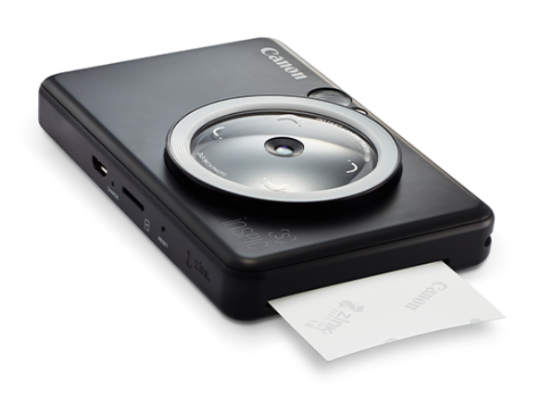

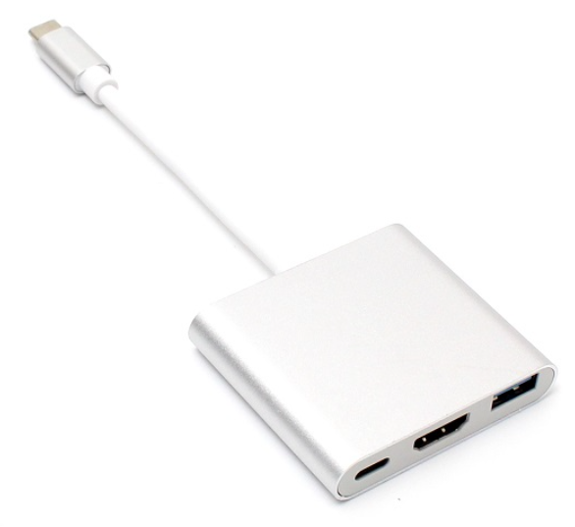








embedding
Embedding space
$$v_{1}$$
$$\left[\begin{matrix}0.34 & −0.74 & 0.25 & ⋯\end{matrix}\right]$$
$$v_{2}$$
$$\left[\begin{matrix}−0.41 & 0.57 & 0.12 & ⋯\end{matrix}\right]$$
$$v_{3}$$
$$\left[\begin{matrix}0.25 & 0.98 & −0.56 & ⋯\end{matrix}\right]$$
$$v_{4}$$
$$\left[\begin{matrix}0.55 & −0.18 & 0.66 & ⋯\end{matrix}\right]$$
…

Slide 3

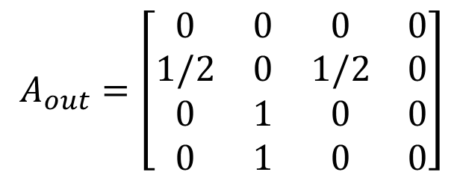










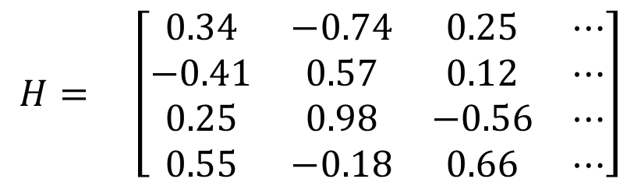




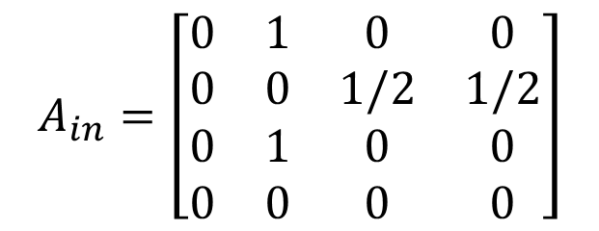
$$v_{1}$$
$$v_{2}$$
$$v_{3}$$
$$v_{2}$$
$$v_{4}$$
$$v_{5}$$
$$A_{in}=\left[\begin{matrix}0 & 1 & 0 & 0 \\ 0 & 0 & 1/2 & 1/2 \\ 0 & 1 & 0 & 0 \\ 0 & 0 & 0 & 0\end{matrix}\right]$$
$$H= \left[\begin{matrix}0.34 & −0.74 & 0.25 & ⋯ \\ −0.41 & 0.57 & 0.12 & ⋯ \\ 0.25 & 0.98 & −0.56 & ⋯ \\ 0.55 & −0.18 & 0.66 & ⋯\end{matrix}\right]$$
$$v_{4}$$
$$v_{1}$$
$$v_{2}$$
input
$$v_{1}$$
$$v_{2}$$
$$v_{3}$$
$$v_{3}$$
$$A_{out}=\left[\begin{matrix}0 & 0 & 0 & 0 \\ 1/2 & 0 & 1/2 & 0 \\ 0 & 1 & 0 & 0 \\ 0 & 1 & 0 & 0\end{matrix}\right]$$
$$v_{4}$$
target
$$v_{5}$$

Slide 4
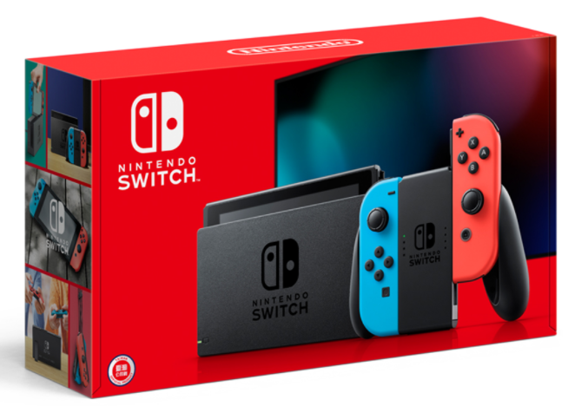


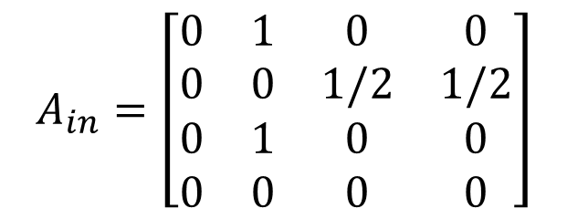


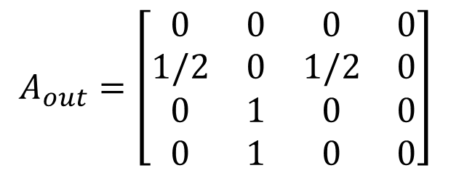







Session data
$$v_{1}$$
$$v_{2}$$
$$v_{3}$$
$$v_{2}$$
$$v_{4}$$
$$v_{5}$$
Graph data
$$A_{in}=\left[\begin{matrix}0 & 1 & 0 & 0 \\ 0 & 0 & 1/2 & 1/2 \\ 0 & 1 & 0 & 0 \\ 0 & 0 & 0 & 0\end{matrix}\right]$$
$$A_{out}=\left[\begin{matrix}0 & 0 & 0 & 0 \\ 1/2 & 0 & 1/2 & 0 \\ 0 & 1 & 0 & 0 \\ 0 & 1 & 0 & 0\end{matrix}\right]$$
$$v_{4}$$
target
input
$$v_{5}$$
$$v_{1}$$
$$v_{2}$$
$$v_{3}$$

Slide 5



























































$$H_{in}$$
$$H_{in}$$
$$v_{1}$$
$$v_{1}$$
包含item的input跟output資訊
Linear_{in}
Input和output資訊
$$v_{2}$$
$$v_{2}$$
$$H$$
$$A_{in}H_{in}$$
$$v_{3}$$
$$v_{3}$$
Linear
$$v_{1}$$
$$v_{1}$$
$$v_{1}$$
$$v_{1}$$
$$v_{1}$$
$$v_{1}$$
$$v_{4}$$
$$v_{4}$$
$$v_{2}$$
$$v_{2}$$
$$v_{2}$$
$$v_{2}$$
$$v_{2}$$
$$v_{2}$$
cat
$$v_{3}$$
$$v_{3}$$
$$v_{3}$$
$$v_{3}$$
$$v_{3}$$
$$v_{3}$$
$$H_{out}$$
$$H_{out}$$
$$v_{4}$$
$$v_{4}$$
$$v_{4}$$
$$v_{4}$$
$$v_{4}$$
$$v_{4}$$
$$v_{1}$$
$$v_{1}$$
a
b
c
a: 建立reset gate
→ 控制item的資訊記憶程度
b: 建立input gate
$$v_{2}$$
$$v_{2}$$
$$A_{out}H_{out}$$
Linear_{out}
$$v_{3}$$
$$v_{3}$$
$$v_{1}$$
$$v_{1}$$
$$v_{1}$$
$$v_{4}$$
$$v_{4}$$
$$v_{2}$$
$$v_{2}$$
$$v_{2}$$
Item的資訊
Linear
$$v_{3}$$
$$v_{3}$$
$$v_{3}$$
包含item的資訊
$$v_{4}$$
$$v_{4}$$
$$v_{4}$$
a
b
c

Slide 6




































b
a
c
$$v_{1}$$
$$v_{1}$$
$$v_{1}$$
$$v_{2}$$
$$v_{2}$$
$$v_{2}$$
$$v_{3}$$
$$v_{3}$$
$$v_{3}$$
Input Gate
Reset Gate
New Gate
$$v_{4}$$
$$v_{1}$$
$$v_{4}$$
$$v_{1}$$
$$v_{4}$$
$$v_{1}$$
$$v_{2}$$
.
+
$$v_{2}$$
+
$$v_{2}$$
+
$$v_{3}$$
sigmoid
$$v_{3}$$
tanh
$$v_{3}$$
sigmoid
$$v_{4}$$
$$v_{4}$$
$$v_{1}$$
$$v_{4}$$
$$v_{1}$$
$$v_{1}$$
$$v_{2}$$
$$v_{2}$$
$$v_{2}$$
$$v_{3}$$
$$v_{3}$$
$$v_{3}$$
$$v_{4}$$
$$v_{4}$$
$$v_{4}$$

Slide 7

















$$H$$
New Gate
$$v_{1}$$
$$v_{1}$$
$$v_{2}$$
$$v_{2}$$
$$v_{3}$$
$$v_{3}$$
$$v_{4}$$
$$v_{4}$$
Output
$$v_{1}$$
-
+
.
+
$$v_{2}$$
$$v_{3}$$
Input Gate
$$v_{4}$$
$$v_{1}$$
$$v_{2}$$
$$v_{3}$$
決定item的資訊是否輸入
$$v_{4}$$

Slide 8
Imitation of LSTM

Slide 9















$$y^{t}$$
.
$$x_{o}^{t}$$
sigmoid
Memory
cell
$$c^{t−1}$$
.
$$x_{f}^{t}$$
+
sigmoid
$$x_{i}^{t}$$
.
sigmoid
sigmoid
$$x^{t}$$
+
$${bias}_{o}$$
+
$$bias$$
+
+
$${bias}_{i}$$
.
$${bias}_{f}$$
.
$$w_{o;(n×1)}$$
$$x_{(1×n)}^{t}$$
$$w_{(n×1)}$$
.
.
$$w_{i;(n×1)}$$
$$w_{f;(n×1)}$$
A word

