Slide 1
TargetedMSQC
Project MRM-QC
Paper: Quality assessment and interference detection in targeted mass spectrometry data using machine learning
https://pubmed.ncbi.nlm.nih.gov/30323719
Chien-Hua Chen

Slide 2
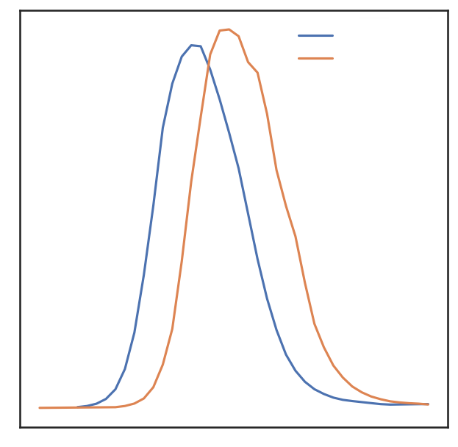
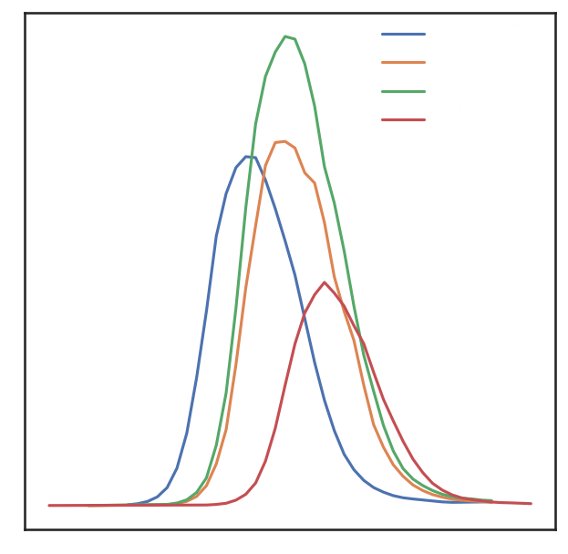
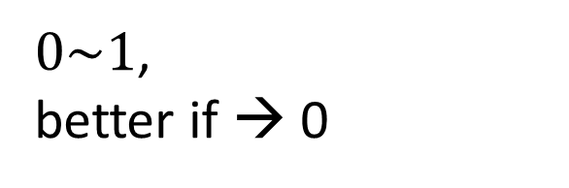
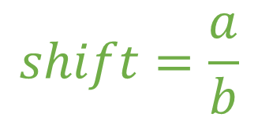
Shift (4)
TransitionShift
IsotopeShift
PeakGroupShift
PairShift
median time of max(intensity)
y4.1.light
y4.1.light
y4.1.heavy
y4.1.heavy
boundary
y6.1.light
max(intensity)
y6.1.heavy
Intensity
Intensity
$$shift=\frac{a}{b}$$
$0\sim 1$,
better if → 0
a
a
b
b
Retention Time
Retention Time

Slide 3
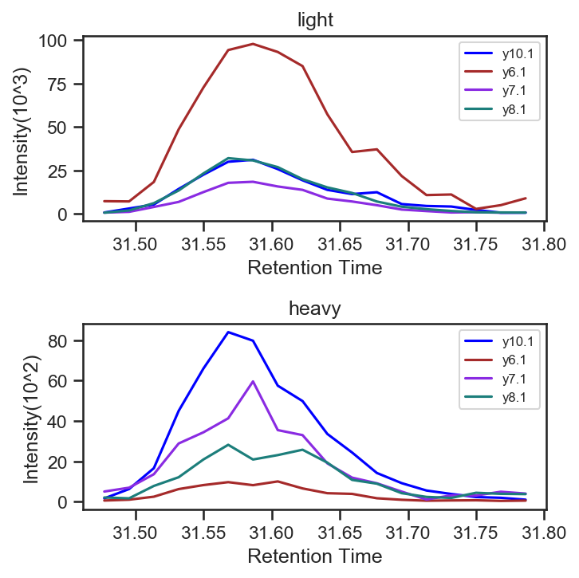
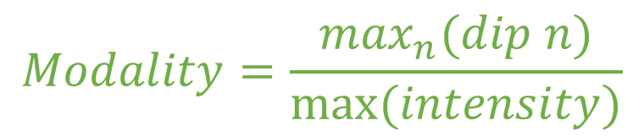
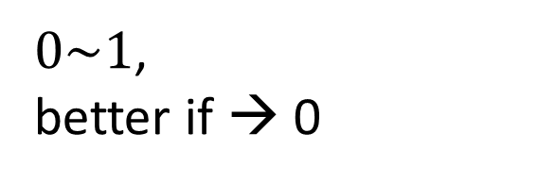
Modality (3)
TransitionModality
IsotopeModality
PeakGroupModality
$$Modality=\frac{\max_{n}{(dip n)}}{max⁡(intensity)}$$
$0\sim 1$,
better if → 0
dip1
dip2
Max(intensity)

Slide 4
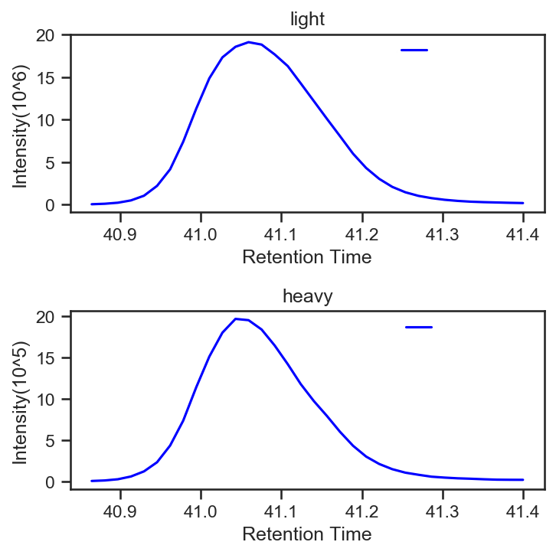

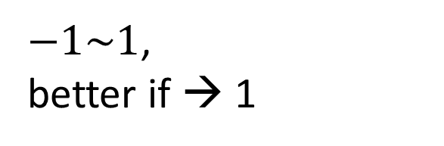
Similarity (3)
y4.1.light
PairSimilarity
IsotopeSimilarity
PeakGroupSimilarity
$$modality=corr(light, heavy)$$
$−1\sim 1$,
better if → 1
y4.1.heavy

Slide 5
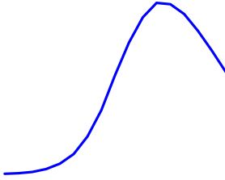
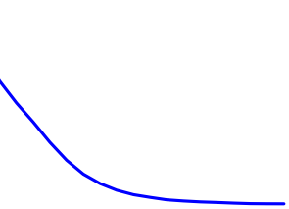
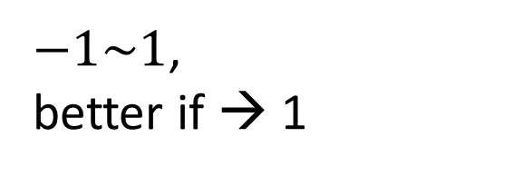
Symmetry (3)
Center
y4.1.light
TransitionSymmetry
IsotopeSymmetry
PeakGroupSymmetry
$$symmetry=corr(left, reverse\left(right\right))$$
$−1\sim 1$,
better if → 1
Reverse
Pearson
Correlation

Slide 6
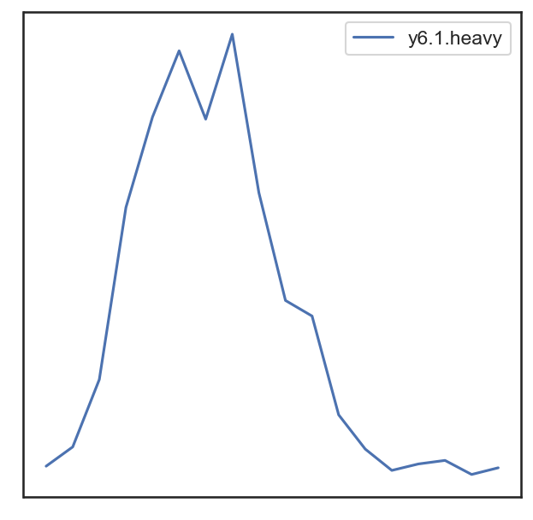
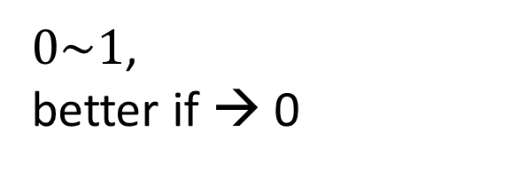
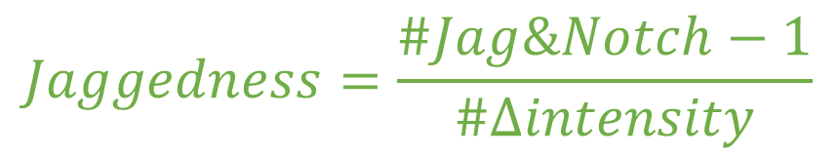
Jaggedness (3)
TransitionJaggedness
IsotopeJaggedness
PeakGroupJaggedness
Jag
Jag
Steep Ascent/Descent：
$$∆intensity>flatness.factor∗max(intensity)$$
Notch
Jag & Notch：
Jag: steep ascent → steep descent
Notch: steep descent → steep ascent
$$Jaggedness=\frac{\#Jag\&Notch−1}{\#∆intensity}$$
flat
$0\sim 1$,
better if → 0
Notes:
-1: one-peak perfect transition curve

Slide 7
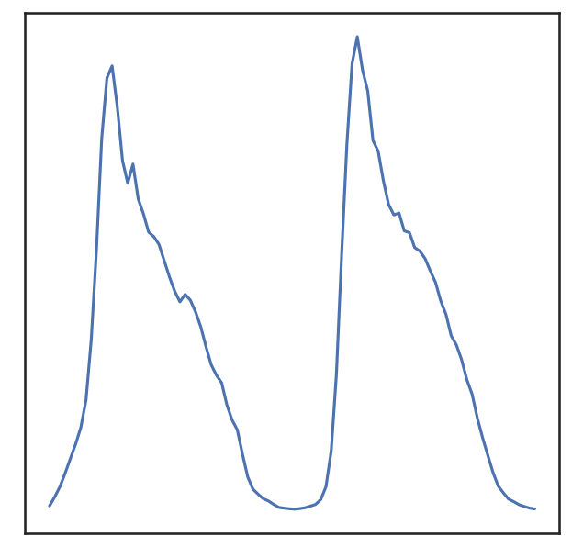
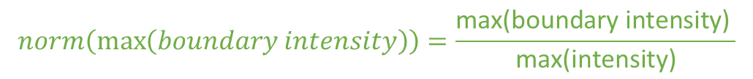
Intensity (3)
max(boundary intensity)
max(intensity)
TransitionMaxIntenstiy
TransitionMaxBoundaryIntenstiy
TransitionMaxBoundaryIntenstiyNormalized
$$norm\left(\max\left(boundary intensity\right)\right)=\frac{\text{max}\text{(}\text{boundary} \text{intensity}\text{)} }{\text{max}\text{(}\text{intensity}\text{)}}$$

Slide 8
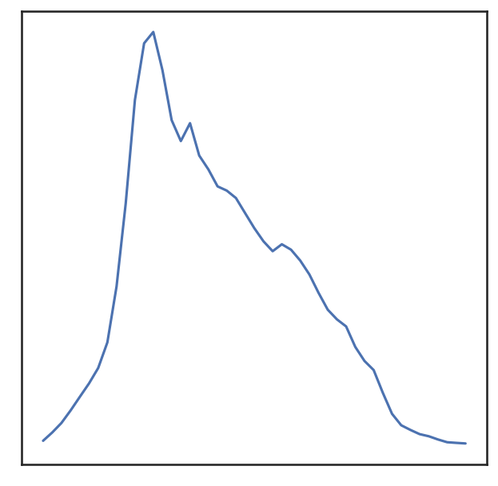
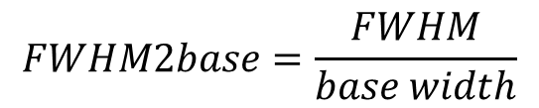
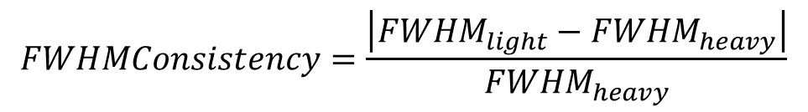
FWHM (8)
*Full width at half maximum (半高寬)
FWHM
TransitionFWHM
IsotopeFWHM
PeakGroupFWHM
TransitionFWHM2base
IsotopeFWHM2base
PeakGroupFWHM2base
PairFWHMConsistency
MeanIsotopeFWHMConsistency
FWHM
FWHM2base
Base width
Consistency
$$FWHM2base=\frac{FWHM}{base width}$$
$$FWHMConsistency=\frac{\left|{FWHM}_{light}−{FWHM}_{heavy}\right|}{{FWHM}_{heavy}}$$

Slide 9
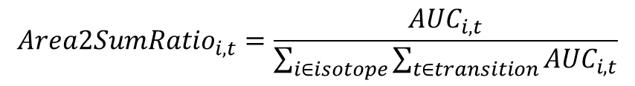
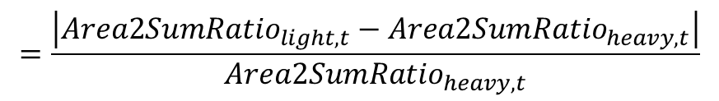
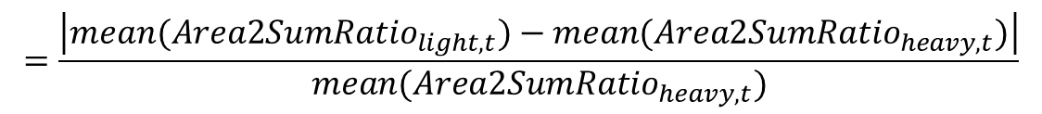
Area Ratio (4)
Area2SumRatioCV
PeakGroupRatioCorr
PairRatioConsistency
MeanIsotopeRatioConsistency
$${Area2SumRatio}_{i,t}=\frac{{AUC}_{i,t}}{\sum_{i∈isotope}{\sum_{t∈transition}{{AUC}_{i,t}}}}$$
$$=Corr({Area2SumRatio}_{light,t},{Area2SumRatio}_{heavy,t})$$
$$=\frac{\left|{Area2SumRatio}_{light,t}−{Area2SumRatio}_{heavy,t}\right|}{{Area2SumRatio}_{heavy,t}}$$
$$=\frac{\left|{mean(Area2SumRatio}_{light,t})−{mean(Area2SumRatio}_{heavy,t})\right|}{{mean(Area2SumRatio}_{heavy,t})}$$

