Slide 1
Autonomy at work

Slide 2
Table of contents
01
04
What is the autonomy at work ?
Things to avoid to form the habit of autonomy at work
02
05
Why do we need automony at work
Build Trust in work place
03
06
How to practice autonomy ?
Example about autonomy at work

Slide 3

01 What is the Autonomy at work
Autonomy at work is how freedom employees do their jobs, including pace, order without micromanaged.
Allows individuals to freely choose their work approach, provided they meet set objectives, deadlines, and quality standards.
Manage time
Work automation
Personal responsibility
Work independently
Decision-making
Sign for Autonomy

Slide 4
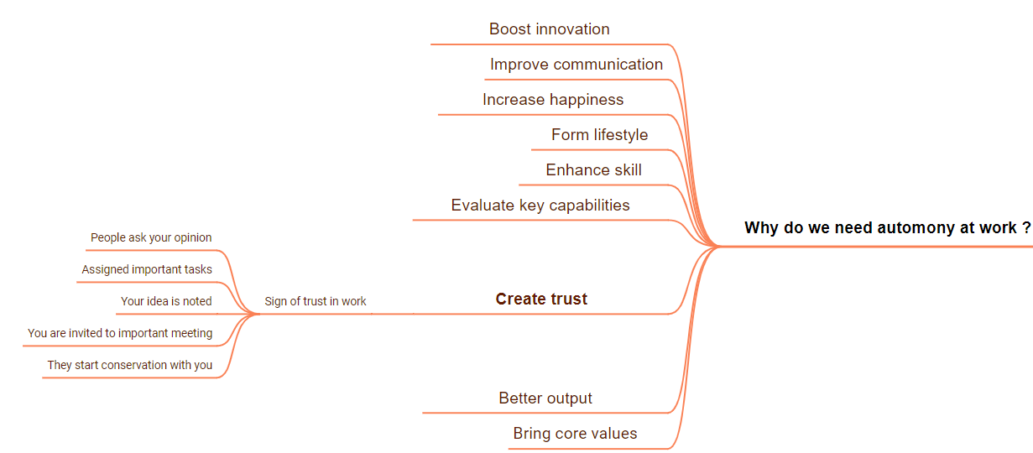
02 Why do we need Automony at work ?

Slide 5




03 How to practice Autonomy at work ?
Build confidence
Proactively build a career plan
Practice handle and solve problem
Prepare before working
Keep learning

Slide 6
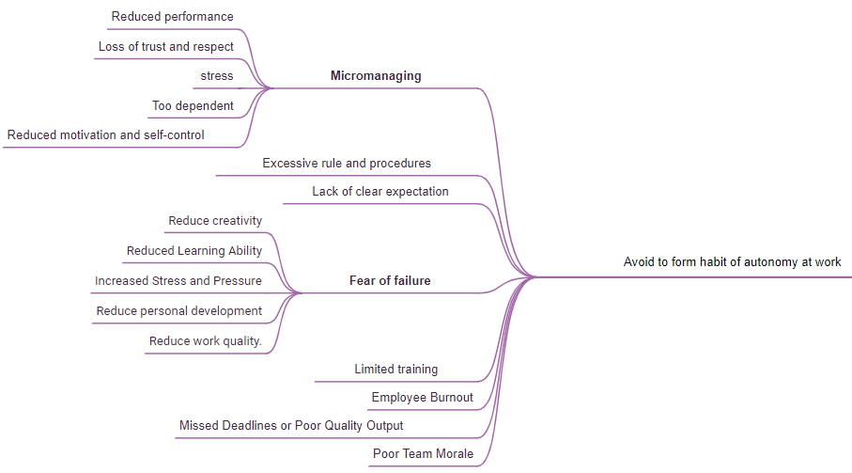
04 Things to avoid to form the habit of Autonomy at work

Slide 7
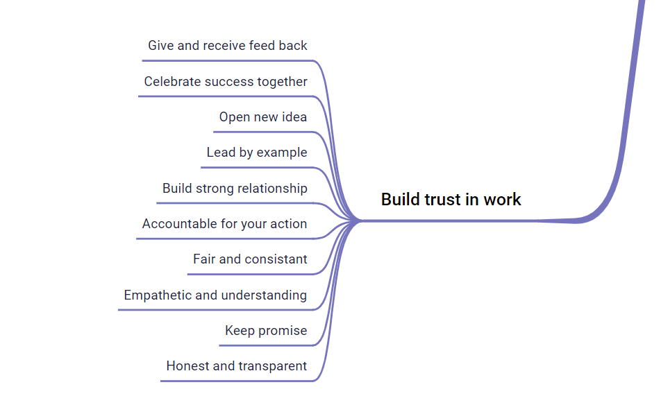
05 Build Trust in work place

Slide 8
06 Example about Autonomy at work
Let employees make decisions about work
Set own goal
Let they choose where to work
Let they set their begin and end time
Let they decide how they will finish tasks

Slide 9
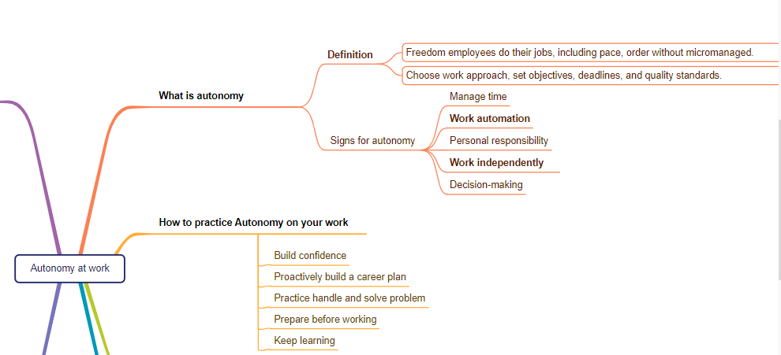
Conclusion

Slide 10
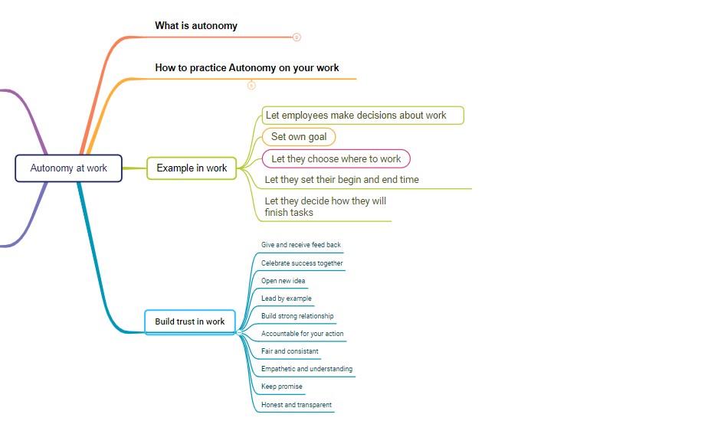
Conclusion

Slide 11
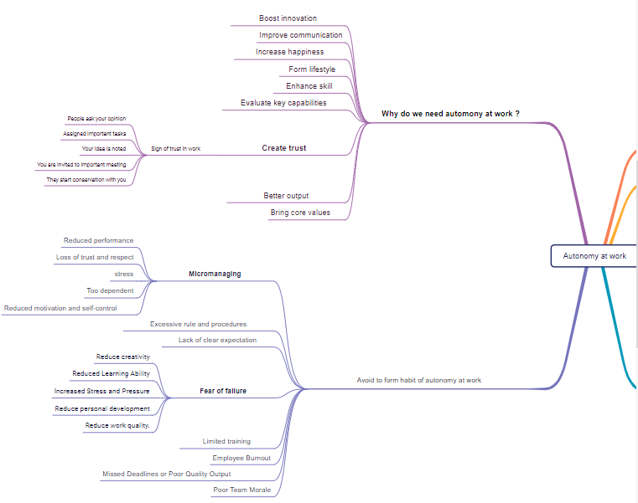
Conclusion

Slide 12



Thanks!
CREDITS: This presentation template was created by Slidesgo, and includes icons by Flaticon, and infographics & images by Freepik
Please keep this slide for attribution

