Slide 1
Optimization Code

Slide 2

Flow chart
Prof. Ching Chun Huang
Team members: Duong Duy Chien
Ding-Zhi Guo Wang
Hung Sheng

Slide 3
Overview Flow Chart
Load the data and Build the Quantization table
Initial Point and Linear Line model
Group the point to line- Update model
Build the CAD file

Slide 4
Load the data and Build the Quantization table
Initial Point and Linear Line model
Group the point to line- Update model
Build the CAD file
Terminology: Cell: each block of quantization (size: 0.01x0.01)
cell | cell

Slide 5
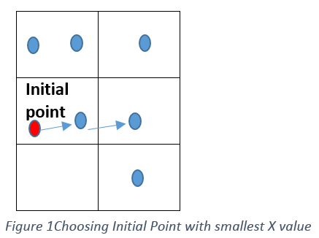
Load the data and Build the Quantization table
Initial Point and Linear Line model
Group the point to line- Update model
Build the CAD file
Initial Point
Find the 5 points
Constraints(CT):
Closest point in right side, 0.055<distance<0.065
The next points, and the current point should make the vector quite similar to the line below. (we use this constraint if we had the reference model below)
Make a Line from 5 points by optimization projection errors
Build linear line model
Projection error

Slide 6
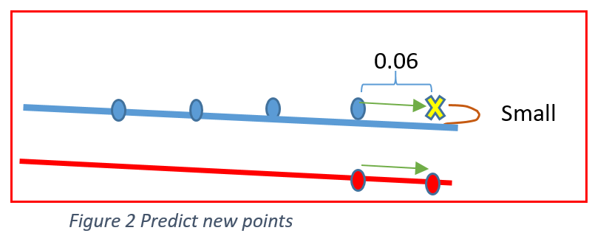
Constraints1(CT1):
Closest point in right side, 0.055<distance<0.065
Base on current linear line model, projection distance < Threshold
Has the same direction with reference model.
Load the data and Build the Quantization table
Initial Point and Linear Line model
Group the point to line- Update model
Build the CAD file
Start new Initial points in next Line(previous step)
Linear Line model
Yes
Find next Points (CT1)
End Line?
NO
NO
Print the warning message and pause “Outliner(X,Y) “
Constraints (CT2):
The prediction points satisfy these constraints:
Distance with previous point =~0.06
Distance with current linear line model is small. (threshold)
Has the same direction with reference model.
Yes
Update the model
Predict next points
(CT2)
Update next points to line model
Contain 10 points?
NO
Yes
Remove the first and of date the last points to model
Note: when we update new points to current model. We also need to move the reference model to next points vector
Notes:
OUtliner

Slide 7
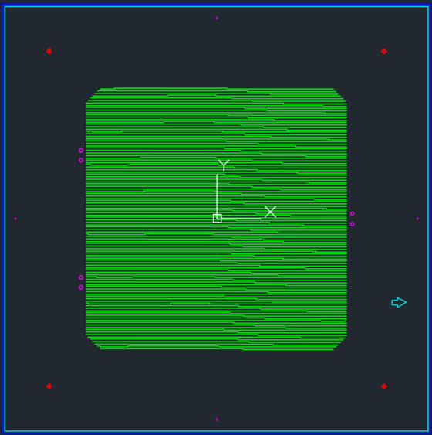
Load the data and Build the Quantization table
Initial Point and Linear Line model
Group the point to line- Update model
Build the CAD file
Draw CAD by applying Holography
Result

Slide 8
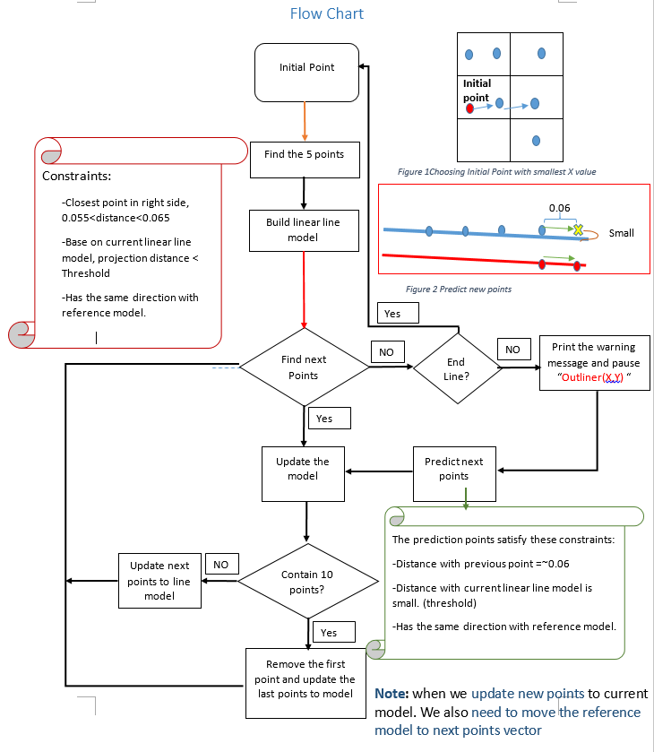

Slide 9
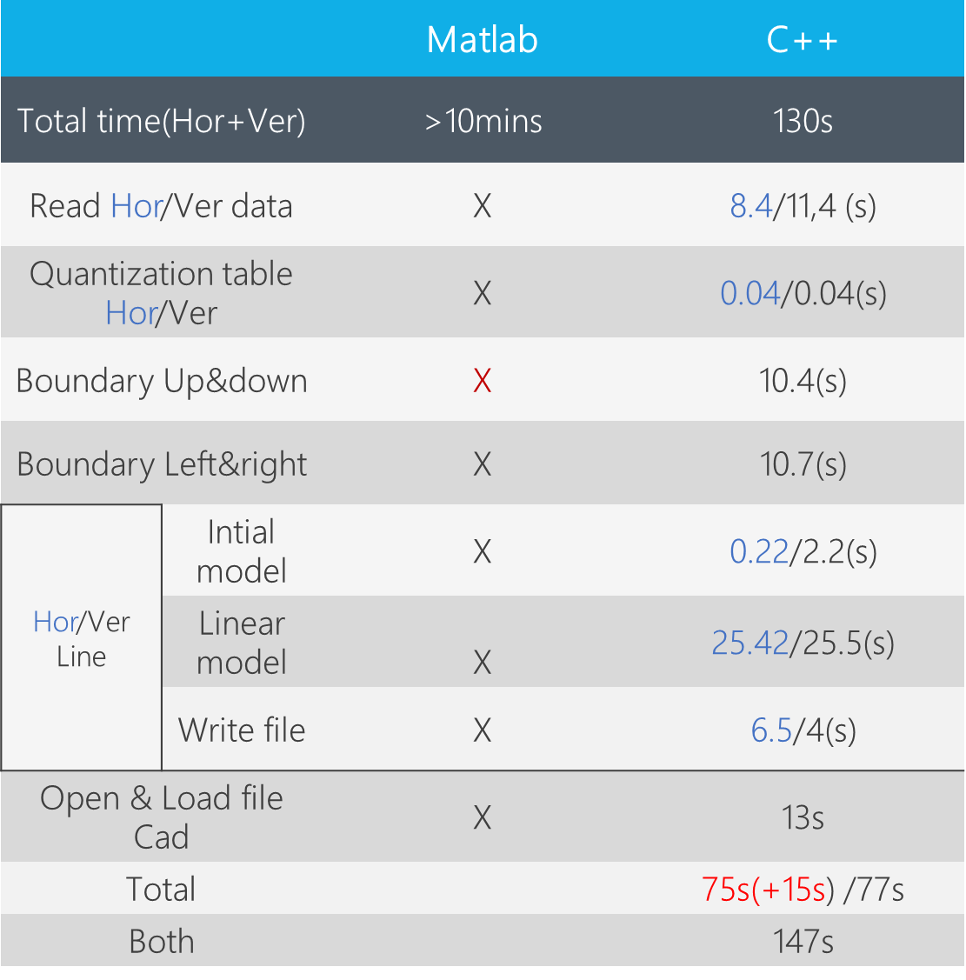
Code Processing
Read data
Quantaization table
Boundary
Initial model
Linear model
Write file
Open Autocad

Slide 10
Code processing
Quantization table (504 - 536) : 0.04s
-2 for loop to store the variable ()
0d | 105 | 210 | 315 | 420
1 | 106 | 211 | 316 | 421
. | . | . | . | .
. | . | . | . | .
104 | 209 | 314 | 419 | 524

Slide 11

Summary
Read data
Predict points
Output file
Find Polyfit line.
Find Distance points to points & points to line
Predict points base on Ref_model
Write output points to txt file to draw in Matlab.
Apply homography to convert scan points into CAD file -> automatic draw it
Read 4 corresponding homography points.
Read data in txt file
Read data
Check outlier
Predict points
Output to txt file
-1st time, know the number of rows and columns.
-2nd time, creat the vector to store all points.
-Outlier in a first line, stop then initial in next line.
- Homography by using open-cv.

Slide 12
 |  | Hor: 105Lines/3129 points Ver: 105 Lines | Hor: 105Lines/5429 points Ver: 205 Lines | Hor: Ver: 315 Lines | Compare
Total time (Hor+Ver) 105 Lines |  | 106.7s | 187.2s | 292s | 1.75 2.73
Read Hor/Ver data |  | 7.85s/10.6s | 15.75s/18.6s | 26.375/23.75 | 2/1.75 3.36/2.24
Quantization table Hor/Ver |  | 0.04/0.05(s) | 0.059/0.067 | 0.075/0.092 | X
Boundary Up&down |  | 3,047s | 3.753s | 4.735 | 1.23 1.55
Boundary Left&right |  | 2.74s | 4.712s | 6.515 | 1.72 2.38
Hor/Ver Line | Intial model | 0.214/6.8 | 0.467/11 | 0.884/16.09 | X
 | Linear model | 41.573/25.363 | 66.53/48.498 | 107.251/80.146 | 1.6/1.912 2.58/3.16
 | Write file | 3.769/3.716 | 8.876/7.483 | 11.69/12.619 | 2.36/2.0 3.1/3.39
Open & Load file Cad |  | 13s | 13s
Evaluate:
Increasing number of lines spend more time than increase number of points
Processing time = times of expand *0.9
To do:
- Fix Initial model

Slide 13
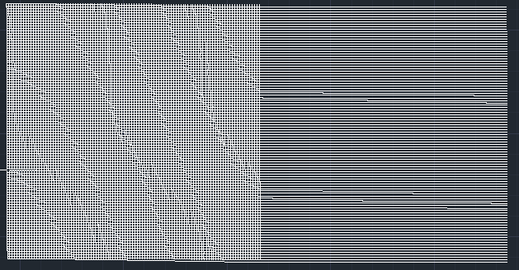
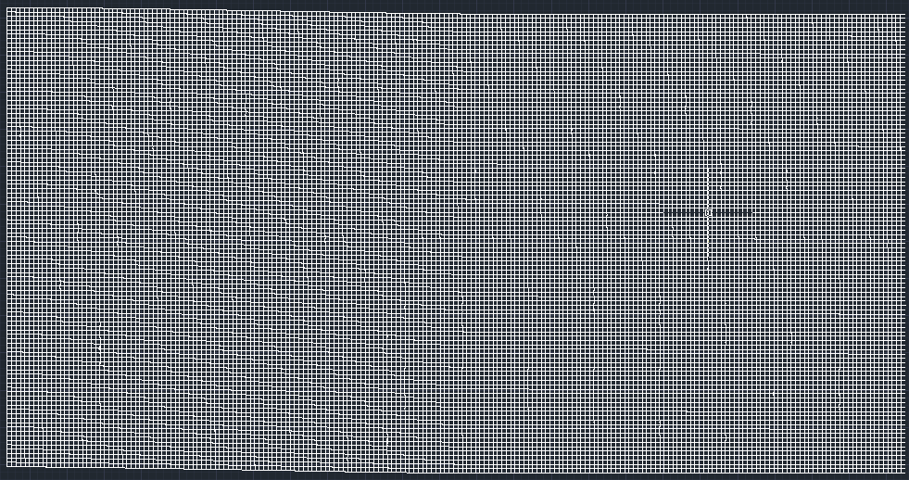
Create dataset

Slide 14
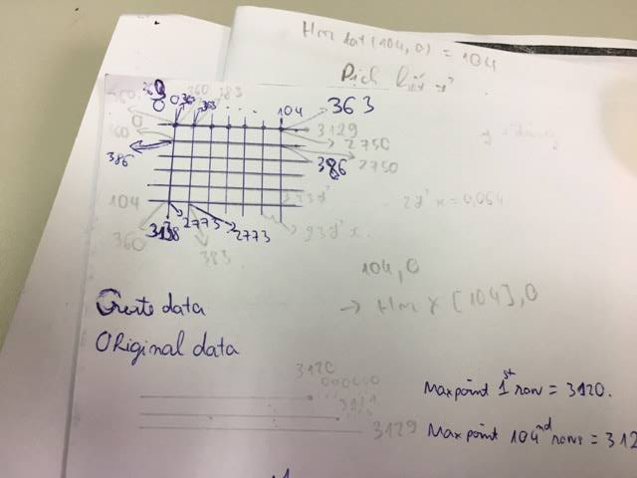
Horizontal- Creat data
X: temp = 0.064 (consider points in rows)
X<2750: keep the same
2750<X<2750+23*expand: X[2750] +temp* (X-2750)
2750+23*expand<X< HorX[0].size +23*expand:
Consider: X- 2750-23*expand
0 => add 0 (riêng điểm 0 dời đi 2300 vẫn là 0)
!=0: X [(X- 2750-23*expand)+2750 ]+temp*23*expand (dời đi 2300 điểm)
Y: temp = 0.064
Y<2750: keep the same
2750<X<2750+23*expand: Y[2750] equal to Y[2750]
2750+23*expand<X< HorX[0].size +23*expand:
Y [(X- 2750+23*expand)+2750 ] (Horizoltal y is the same, 0 still 0, don’t need to consider)

Slide 15
Vertical-Creat data
X: temp = 0.064*23 (consider numbers of columns)
X>104: X[104] +temp
Test: 104 va 105 phải y chang
Y: temp = 0.064*23
Y>104 : Y=Y[104]
Mở rộng theo chiều ngang

