Slide 1
October 28, 2025
Retrieval-Augmented Generation

Slide 2
Outline
Background
Challenges & Possible improvement ideas
Hands-on with RAG
References:
UCB EECS CS 288. Natural Language Processing
Sharma, C. "Retrieval-Augmented Generation: A Comprehensive Survey of Architectures, Enhancements, and Robustness Frontiers." in arXiv preprint arXiv:2506.00054, 2025.

Slide 3
Outline
Background
Challenges & Possible improvement ideas
Hands-on with RAG

Slide 4
Background
<responds>
Generator
reference
user query
<factual context>
Knowledge Base
Retriever
<retrieved context>
<retrieval query>
user query
<user query>
1

Slide 5
Background
<responds>
Generation
Generator
reference
user query
Retrieval
<factual context>
Knowledge Base
Retriever
<retrieved context>
<retrieval query>
user query
<user query>
1

Slide 6
Outline
Background
Challenges & Possible improvement ideas
Hands-on with RAG

Slide 7
Challenges & Possible improvement ideas
2

Slide 8
Challenges & Possible improvement ideas – (Question Answering in specific domain)
2

Slide 9
Challenges & Possible improvement ideas – (Question Answering in specific domain)
Challenges
Retrieval quality, Grounding fidelity, Pipeline efficiency, Robustness
Possible improvement ideas
Chunking
What should be the retrieval unit? Document? Passage?
Retrieval method
Sparse retrieval (BM25) or dense retrieval? Or hybrid?
Retrieval query
Is user input suitable for direct use as a query?
Rewriting
make passages more comprehensible & include relevant info only
Reranking/adaptive adoption
use only relevant retrieved passages
Pipeline & Framework design
Deciding when to use retrieval? Multiple rounds of retrieval?
<responds>
Generator
reference
user query
<factual context>
Knowledge Base
Retriever
<retrieved context>
<retrieval query>
user query
<user query>
2

Slide 10
Challenges & Possible improvement ideas – (Question Answering in specific domain)
Challenges
Retrieval quality, Grounding fidelity, Pipeline efficiency, Robustness
Possible improvement ideas
Chunking
What should be the retrieval unit? Document? Passage?
Retrieval method
Sparse retrieval (BM25) or dense retrieval? Or hybrid?
Retrieval query
Is user input suitable for direct use as a query?
Rewriting
make passages more comprehensible & include relevant info only
Reranking/adaptive adoption
use only relevant retrieved passages
Pipeline & Framework design
Deciding when to use retrieval? Multiple rounds of retrieval?
<responds>
Generator
reference
user query
<factual context>
Knowledge Base
Retriever
<retrieved context>
<retrieval query>
user query
<user query>
2

Slide 11
Challenges & Possible improvement ideas – (Question Answering in specific domain)
Challenges
Retrieval quality, Grounding fidelity, Pipeline efficiency, Robustness
Possible improvement ideas
Chunking
What should be the retrieval unit? Document? Passage?
Retrieval method
Sparse retrieval (BM25) or dense retrieval? Or hybrid?
Retrieval query
Is user input suitable for direct use as a query?
Rewriting
make passages more comprehensible & include relevant info only
Reranking/adaptive adoption
use only relevant retrieved passages
Pipeline & Framework design
Deciding when to use retrieval? Multiple rounds of retrieval?
<responds>
Generator
reference
user query
<factual context>
Knowledge Base
Retriever
<retrieved context>
<retrieval query>
user query
<user query>
2

Slide 12
Challenges & Possible improvement ideas – (Question Answering in specific domain)
Challenges
Retrieval quality, Grounding fidelity, Pipeline efficiency, Robustness
Possible improvement ideas
Chunking
What should be the retrieval unit? Document? Passage?
Retrieval method
Sparse retrieval (BM25) or dense retrieval? Or hybrid?
Retrieval query
Is user input suitable for direct use as a query?
Rewriting
make passages more comprehensible & include relevant info only
Reranking/adaptive adoption
use only relevant retrieved passages
Pipeline & Framework design
Deciding when to use retrieval? Multiple rounds of retrieval?
<responds>
Generator
reference
user query
<factual context>
Knowledge Base
Retriever
<retrieved context>
<retrieval query>
user query
<user query>
2

Slide 13
Challenges & Possible improvement ideas – (Question Answering in specific domain)
Challenges
Retrieval quality, Grounding fidelity, Pipeline efficiency, Robustness
Possible improvement ideas
Chunking
What should be the retrieval unit? Document? Passage?
Retrieval method
Sparse retrieval (BM25) or dense retrieval? Or hybrid?
Retrieval query
Is user input suitable for direct use as a query?
Rewriting
make passages more comprehensible & include relevant info only
Reranking/adaptive adoption
use only relevant retrieved passages
Pipeline & Framework design
Deciding when to use retrieval? Multiple rounds of retrieval?
<responds>
Generator
reference
user query
<factual context>
Knowledge Base
Retriever
<retrieved context>
<retrieval query>
user query
<user query>
2

Slide 14
Challenges & Possible improvement ideas – (Question Answering in specific domain)
Challenges
Retrieval quality, Grounding fidelity, Pipeline efficiency, Robustness
Possible improvement ideas
Chunking
What should be the retrieval unit? Document? Passage?
Retrieval method
Sparse retrieval (BM25) or dense retrieval? Or hybrid?
Retrieval query
Is user input suitable for direct use as a query?
Rewriting
make passages more comprehensible & include relevant info only
Reranking/adaptive adoption
use only relevant retrieved passages
Pipeline & Framework design
Deciding when to use retrieval? Multiple rounds of retrieval?
<responds>
Generator
reference
user query
<factual context>
Knowledge Base
Retriever
<retrieved context>
<retrieval query>
user query
<user query>
2

Slide 15
Challenges & Possible improvement ideas – (Question Answering in specific domain)
Challenges
Retrieval quality, Grounding fidelity, Pipeline efficiency, Robustness
Possible improvement ideas
Chunking
What should be the retrieval unit? Document? Passage?
Retrieval method
Sparse retrieval (BM25) or dense retrieval? Or hybrid?
Retrieval query
Is user input suitable for direct use as a query?
Rewriting
make passages more comprehensible & include relevant info only
Reranking/adaptive adoption
use only relevant retrieved passages
Pipeline & Framework design
Deciding when to use retrieval? Multiple rounds of retrieval?
<responds>
Generator
reference
user query
<factual context>
Knowledge Base
Retriever
<retrieved context>
<retrieval query>
user query
<user query>
2

Slide 16
Challenges & Possible improvement ideas – (Question Answering in specific domain)
Challenges
Retrieval quality, Grounding fidelity, Pipeline efficiency, Robustness
Possible improvement ideas
Chunking
What should be the retrieval unit? Document? Passage?
Retrieval method
Sparse retrieval (BM25) or dense retrieval? Or hybrid?
Retrieval query
Is user input suitable for direct use as a query?
Rewriting
make passages more comprehensible & include relevant info only
Reranking/adaptive adoption
use only relevant retrieved passages
Pipeline & Framework design
Deciding when to use retrieval? Multiple rounds of retrieval?
<responds>
Generator
reference
user query
<factual context>
Knowledge Base
Retriever
<retrieved context>
<retrieval query>
user query
<user query>
2

Slide 17
Challenges & Possible improvement ideas – (Question Answering in specific domain)
Challenges
Retrieval quality, Grounding fidelity, Pipeline efficiency, Robustness
Possible improvement ideas
Chunking
What should be the retrieval unit? Document? Passage?
Retrieval method
Sparse retrieval (BM25) or dense retrieval? Or hybrid?
Retrieval query
Is user input suitable for direct use as a query?
Rewriting
make passages more comprehensible & include relevant info only
Reranking/adaptive adoption
use only relevant retrieved passages
Pipeline & Framework design
Deciding when to use retrieval? Multiple rounds of retrieval?
<responds>
Generator
reference
user query
<factual context>
Knowledge Base
Retriever
<retrieved context>
<retrieval query>
user query
<user query>
2

Slide 18
Challenges & Possible improvement ideas – (Question Answering in specific domain)
Challenges
Retrieval quality, Grounding fidelity, Pipeline efficiency, Robustness
Possible improvement ideas
Chunking
What should be the retrieval unit? Document? Passage?
Retrieval method
Sparse retrieval (BM25) or dense retrieval? Or hybrid?
Retrieval query
Is user input suitable for direct use as a query?
Rewriting
make passages more comprehensible & include relevant info only
Reranking/adaptive adoption
use only relevant retrieved passages
Pipeline & Framework design
Deciding when to use retrieval? Multiple rounds of retrieval?
<responds>
Generator
reference
user query
<factual context>
Knowledge Base
Retriever
<retrieved context>
<retrieval query>
user query
<user query>
2

Slide 19
Challenges & Possible improvement ideas – (Question Answering in specific domain)
Challenges
Retrieval quality, Grounding fidelity, Pipeline efficiency, Robustness
Possible improvement ideas
Chunking
What should be the retrieval unit? Document? Passage?
Retrieval method
Sparse retrieval (BM25) or dense retrieval? Or hybrid?
Retrieval query
Is user input suitable for direct use as a query?
Rewriting
make passages more comprehensible & include relevant info only
Reranking/adaptive adoption
use only relevant retrieved passages
Pipeline & Framework design
Deciding when to use retrieval? Multiple rounds of retrieval?
<responds>
Generator
reference
user query
<factual context>
Knowledge Base
Retriever
<retrieved context>
<retrieval query>
user query
<user query>
2

Slide 20
Challenges & Possible improvement ideas – (Question Answering in specific domain)
Challenges
Retrieval quality, Grounding fidelity, Pipeline efficiency, Robustness
Possible improvement ideas
Chunking
What should be the retrieval unit? Document? Passage?
Retrieval method
Sparse retrieval (BM25) or dense retrieval? Or hybrid?
Retrieval query
Is user input suitable for direct use as a query?
Rewriting
make passages more comprehensible & include relevant info only
Reranking/adaptive adoption
use only relevant retrieved passages
Pipeline & Framework design
Deciding when to use retrieval? Multiple rounds of retrieval?
<responds>
Generator
reference
user query
<factual context>
Knowledge Base
Retriever
<retrieved context>
<retrieval query>
user query
<user query>
2

Slide 21
Outline
Background
Challenges & Possible improvement ideas
Hands-on with RAG

Slide 22
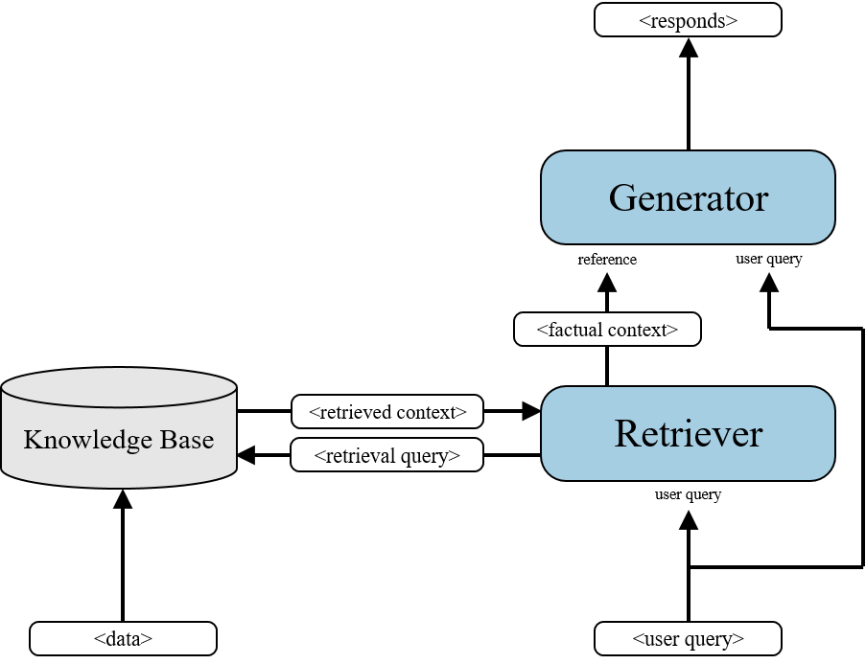
Hands-on with RAG
4

Slide 23
Hands-on with RAG
create_model()
create_embedding_model()
preprocess_pages2chunks()
load_doc_from_path()
4

Slide 24
Hands-on with RAG
generate()
create_model()
lm_template()
create_embedding_model()
preprocess_pages2chunks()
load_doc_from_path()
4

Slide 25
Hands-on with RAG
generate()
create_model()
lm_template()
prompt_template()
create_embedding_model()
retrieve_relevant_docs()
query_template()
preprocess_pages2chunks()
load_doc_from_path()
rag_ask()
4

Slide 26
HW4 LLM

Slide 27
Requirements
1. At least compare result with and without RAG
- Must have evaluation metrics: BLEU, ROUGE, BERTScore...
- Prepare your own dataset
2. Bonus: compare different models
3. Bonus: try different RAG pipeline

Slide 28
Submit and Grading
1. Jupyter notebook / code
2. Report
- Describe your dataset - 20% (notebook example)
- Result without RAG - 20%
- Result with RAG - 20%
- Compare the result (w/o RAG) - 20%
- Bonus: Different model comparison - 10%
- Bonus: Describe your own RAG pipeline / Compare with sample notebook - 10%

Slide 29
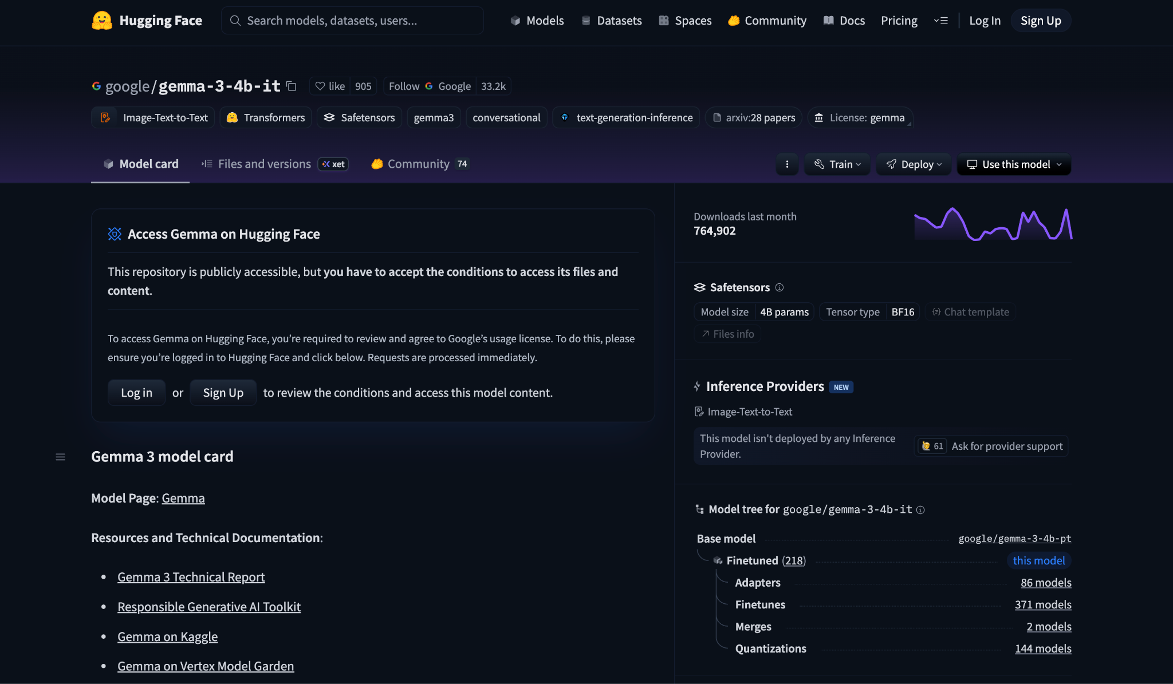
Access model weight

Slide 30
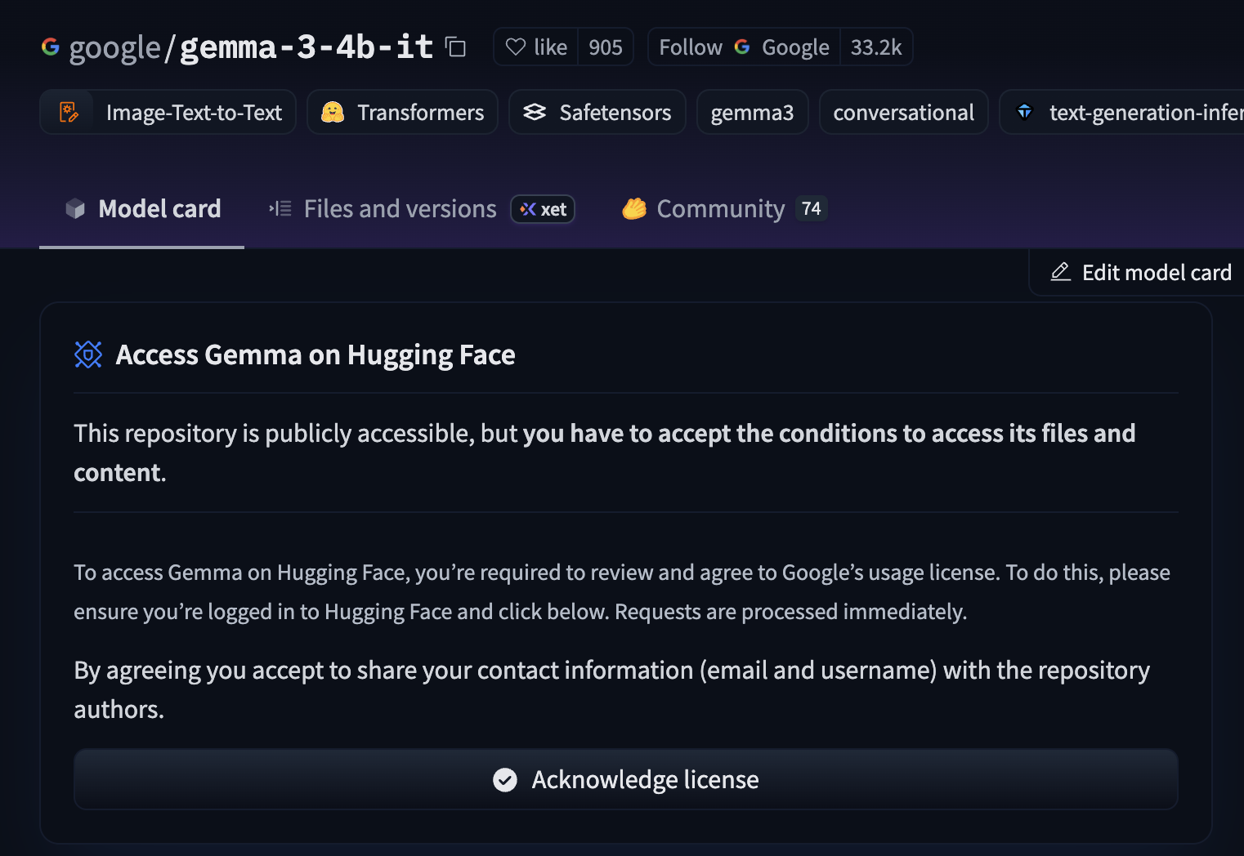
Access model weight

Slide 31
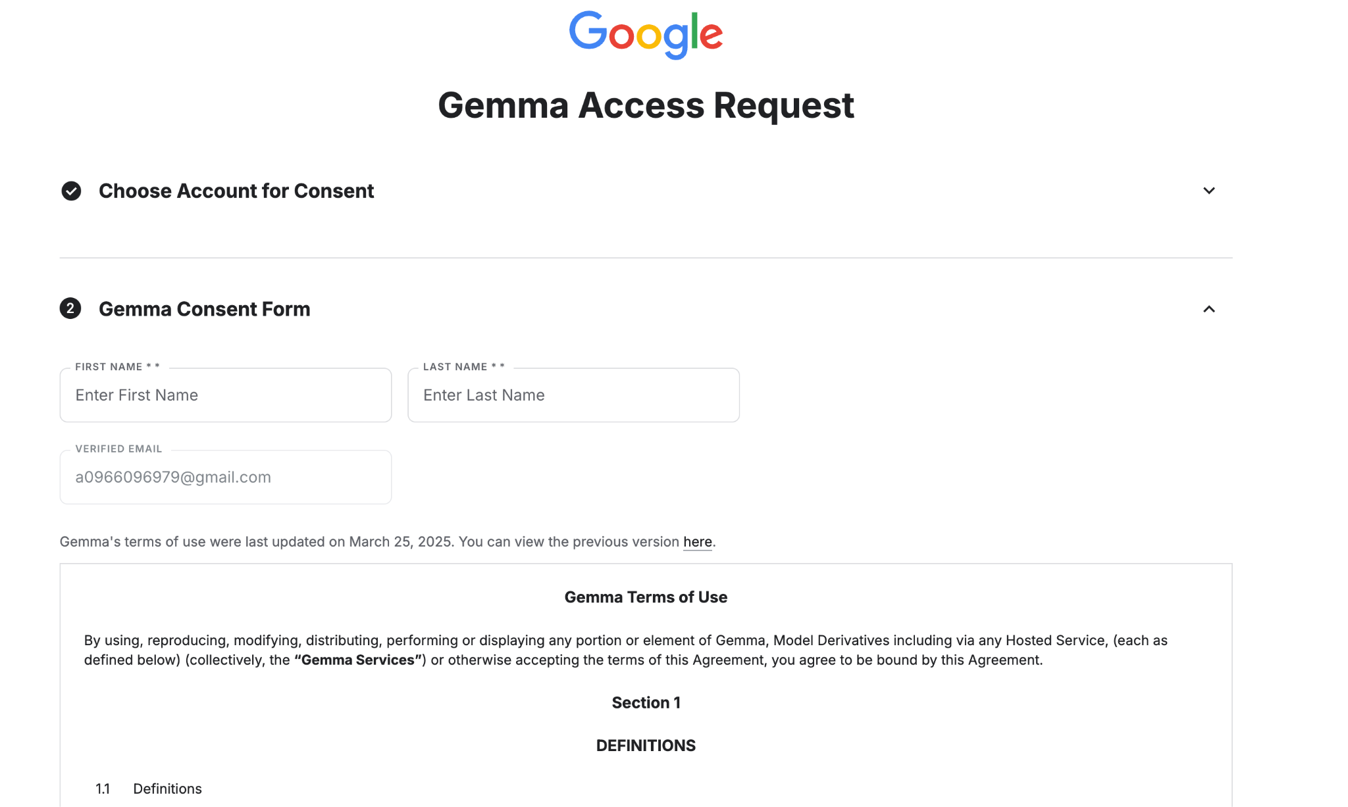
Access request

Slide 32
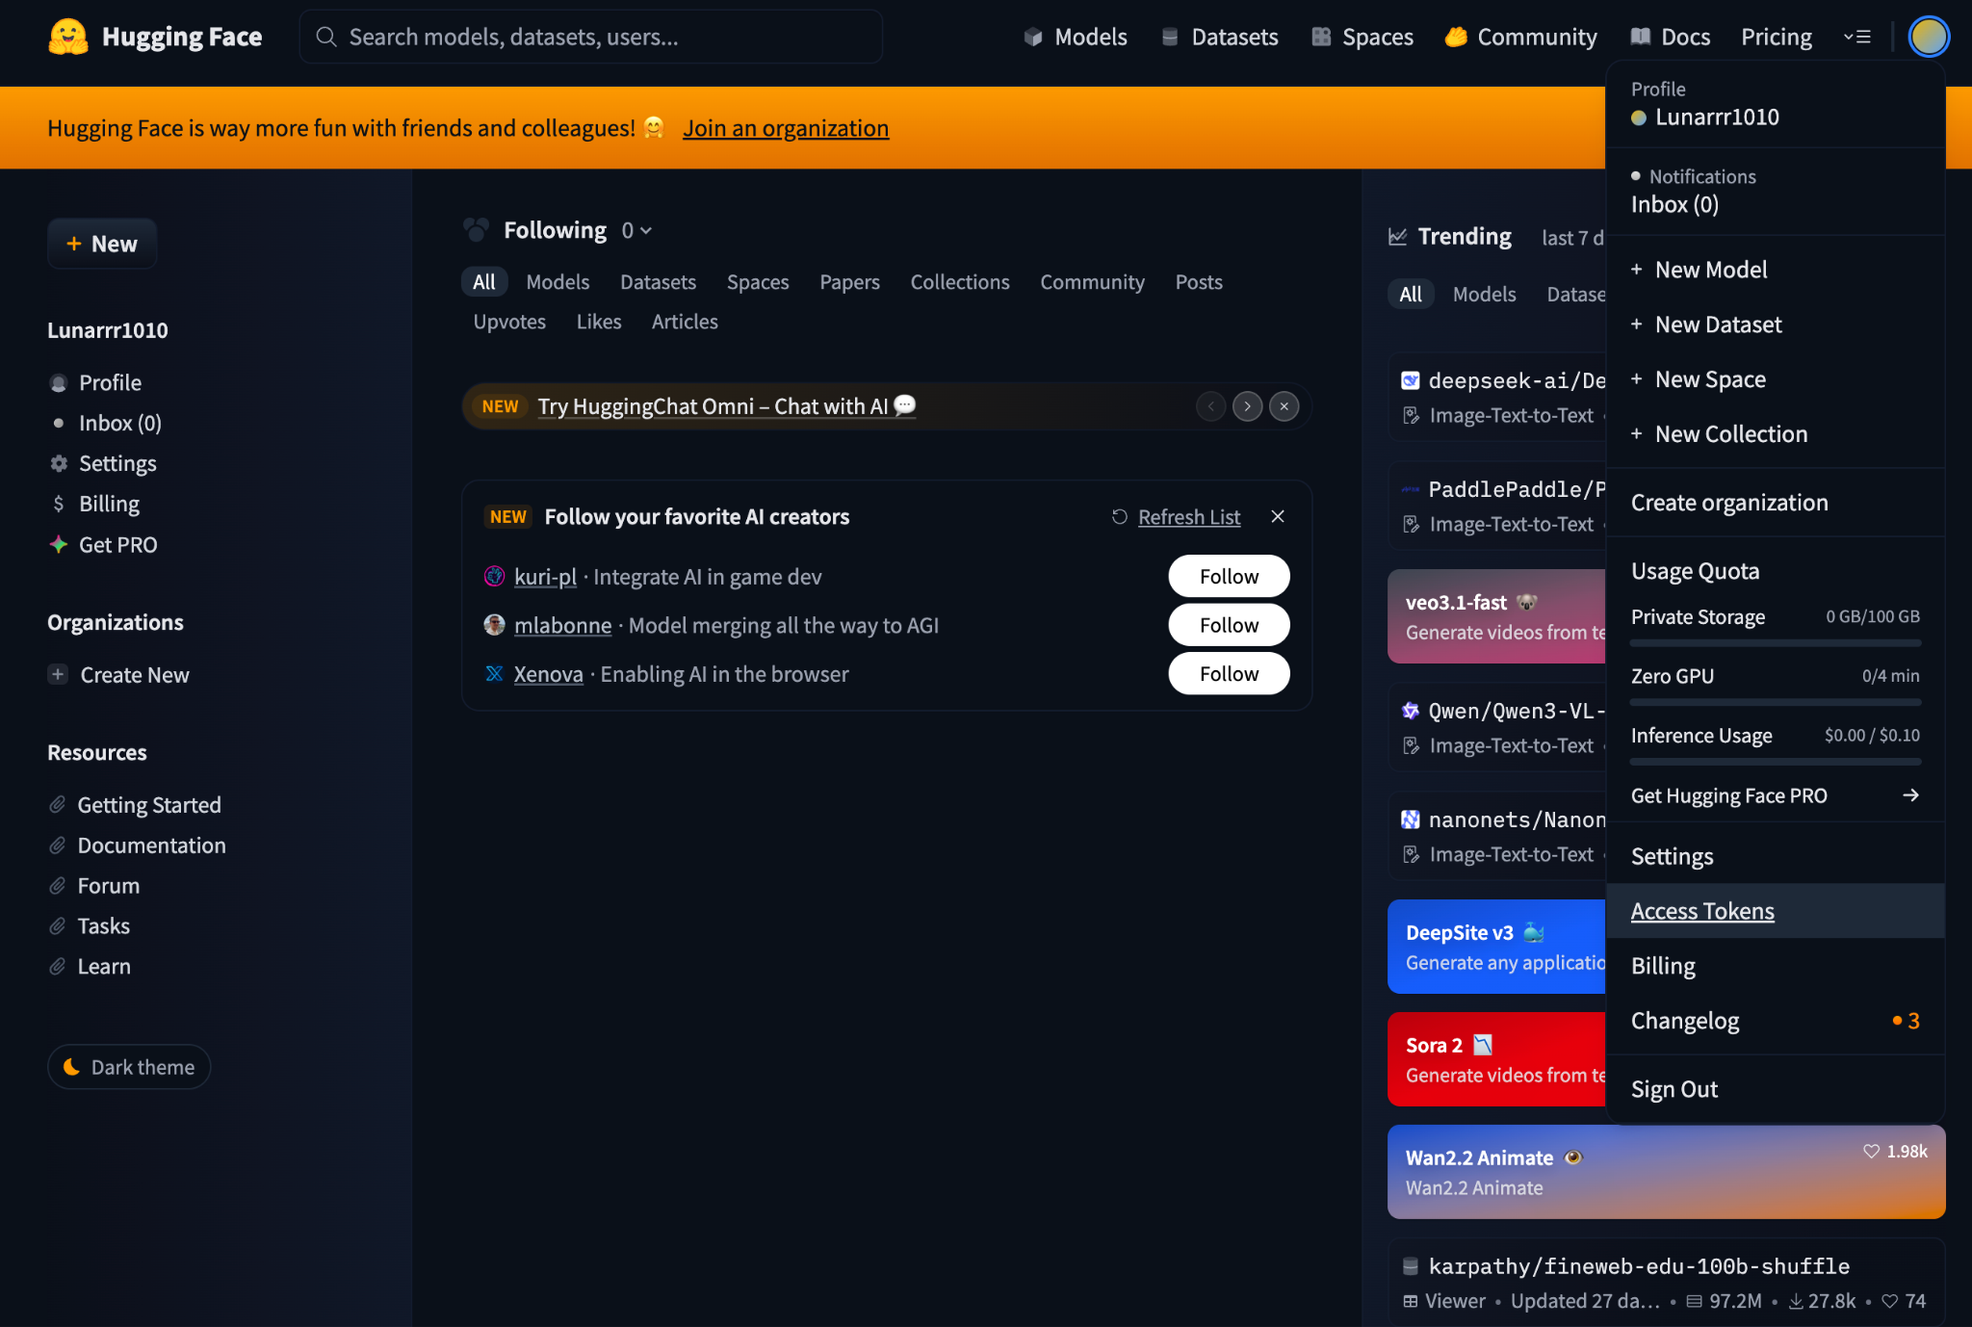
Run on colab

Slide 33


Slide 34


Slide 35
Referencies
Sentence transformers
LLM Models

