Slide 1
Morphing
M10509109 陸建綱
Notes:
Hello every one, good morning
my final project is about morphing

Slide 2
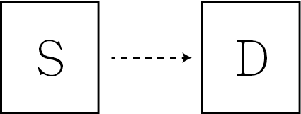
What is morphing
Morphing is an image processing technique typically used as an animation tool for metamorphosis from one image to another.
Notes:
We have a source image and a destination image
We want make source image to destination image smoothly

Slide 3
How does morphing do?
Wrap first image into second image
Wrap second image into first
Let the first one fade out
Let the second one fade in
Notes:
What is wrapping?
Wrapping means that make two image have the same shape
Then The two image will have the similar shape

Slide 4
What is Morphing clearly?
Wrapping
(shape)
+
Cross dissolving
(color)
Notes:
cross dissolving is easy(let an image fade out and the other fade in)
Wrapping is used for the shape
Cross dissolving is used for the color

Slide 5
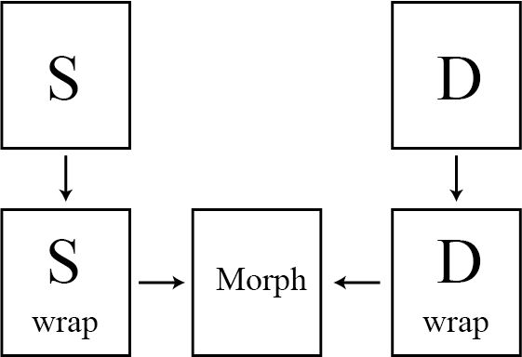

Slide 6
Wrapping is the most important
Because we want make their shape similar
We have to draw the feature lines on both two images
Then use them to wrap image
Notes:
Because we want make their shape similar

Slide 7
Algorithm
Notes:
Let’s talk about this algorithm

Slide 8
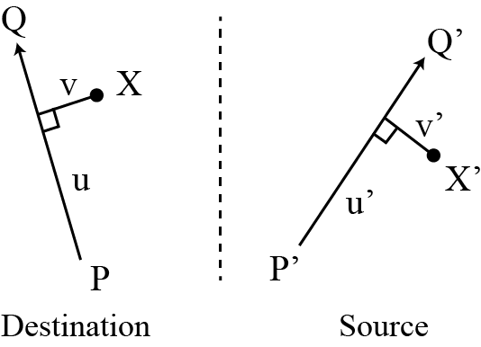
Single line pair
Notes:
Typically we will have a lot of feature line on both image
But at beginning , we first talk about one pair line algorithm
Out purpose is let the corresponding point move to the correct position
So we have to draw line on both image to find the position
Draw line PQ P’Q’
Calculate the u and v values on destination
And we can use u and v to find u’ and v’ on the source image
Then use u’ and v’ to find X’
What we do now is make source image shape more likely to the destination image shape by finding particular position

Slide 9
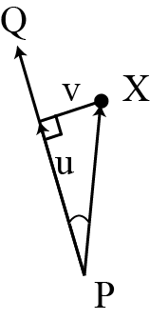
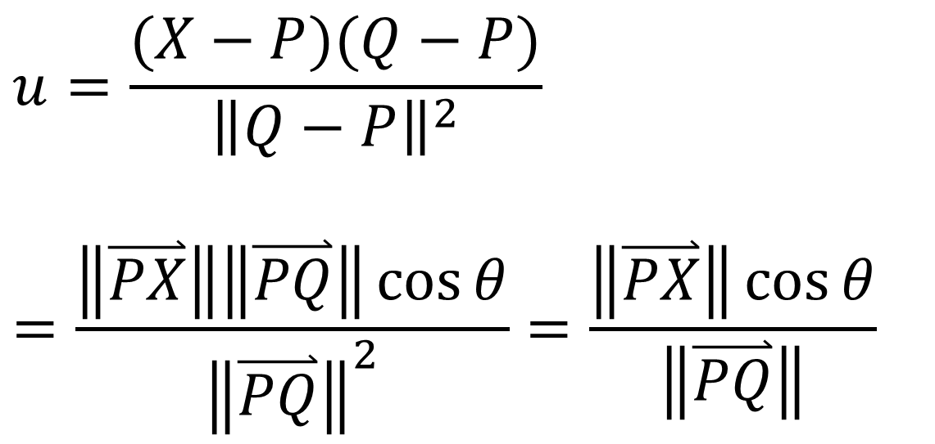
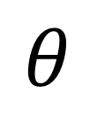
Calculate u
$$u=\frac{(X−P)(Q−P)}{{\left\|Q−P\right\|}^{2}}$$
$$=\frac{\left\|\overset{⃑}{PX}\right\|\left\|\overset{⃑}{PQ}\right\|\cos{θ}}{{\left\|\overset{⃑}{PQ}\right\|}^{2}}=\frac{\left\|\overset{⃑}{PX}\right\|\cos{θ}}{\left\|\overset{⃑}{PQ}\right\|}$$
$$θ$$
u is a ratio!
Notes:
We can use this formula to calculate u
After simplication ,we can see that
This formula is used to find the projection of PX on PQ
Then find the ratio of the projection and PQ line
So u is a ratio

Slide 10
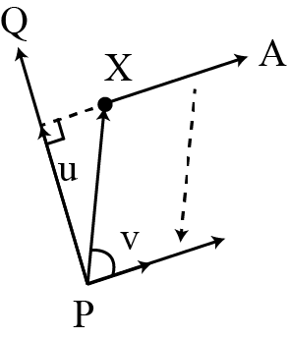
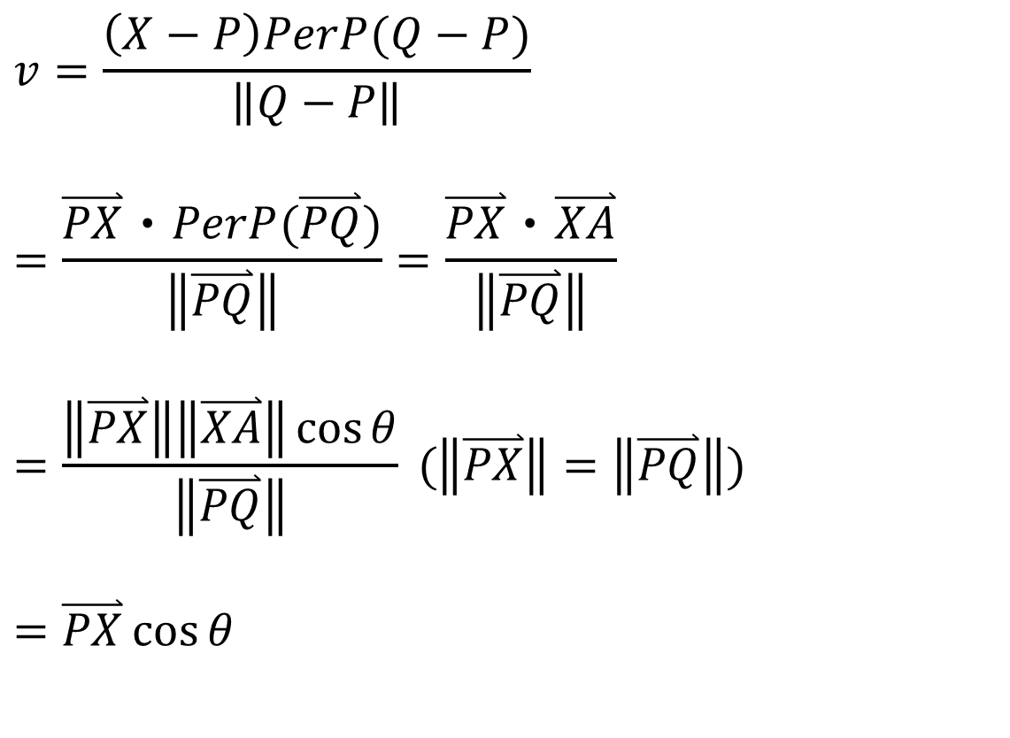

Calculate v
$$v=\frac{\left(X−P\right)PerP(Q−P)}{\left\|Q−P\right\|}$$
$$=\frac{\overset{⃑}{PX}‧PerP(\overset{⃑}{PQ})}{\left\|\overset{⃑}{PQ}\right\|}=\frac{\overset{⃑}{PX}‧\overset{⃑}{XA}}{\left\|\overset{⃑}{PQ}\right\|}$$
$$=\frac{\left\|\overset{⃑}{PX}\right\|\left\|\overset{⃑}{XA}\right\|\cos{θ}}{\left\|\overset{⃑}{PQ}\right\|} (\left\|\overset{⃑}{PX}\right\|=\left\|\overset{⃑}{PQ}\right\|)$$
$$=\overset{⃑}{PX}\cos{θ}$$
v is a distance!
$$θ$$
Notes:
We can use this formula to calculate v
After simplification , we can find v is the distance of point x to the line PQ

Slide 11
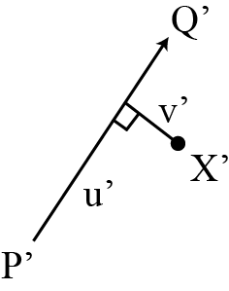
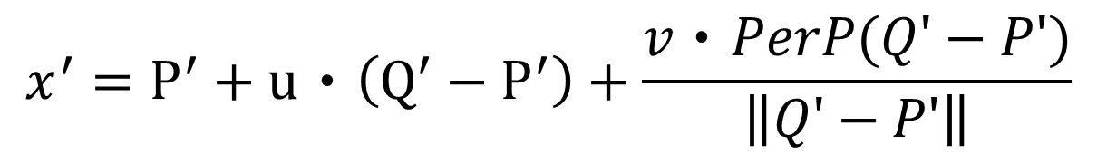
Use u and v to find X’
$$x^{′}=P^{′}+u‧\left(Q^{′}−P^{′}\right)+\frac{v‧PerP(Q'−P')}{\left\|Q'−P'\right\|}$$
`
Notes:
Then we can use u v to find x’
As we can see , we just move from P’ along this vecter then we arrive the intersection point
Then use the distance v to find X’
Prep is means Perpendicular

Slide 12
Multiple line pair
Q2
Q1’
Q1
Q2’
X
v1
v1
v2
D1
X1’
u2
D2
u1
u1
P2
X’
v2
u2
X2’
P2’
P1
P1’
Destination image
Source image
Notes:
Until now we know how to use Single line pair to find the corresponding point
Let’s talk about the multiple line pair
At destination image we draw the feature line
Calcuate the u1 v1 and u2 v2 of the two feature line
The we also have the corresponding feature line on the source image
Then we use the u1 v1 u2 v2 to find the x1’ and x2’
Now we will give weight to each new x to find the x’

Slide 13
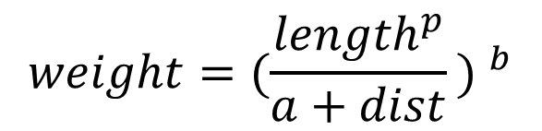
How to decide the weight for each point
$$weight={(\frac{{length}^{p}}{a+dist}\text{)} }^{b}$$
(1)
(1) 0 < u < 1 → dist is v
(2)
(3)
v
(2) 0 > u → dist is x’ to P’
u
(3) 1 < u → dist is x’ to Q’
P’
Q’
Notes:
We can use this formula to calculate weight for each point
The length means feature line’s length
Dist means the distance of x’ to the feature line, according to the value of u , we can find 3 situations
If u is greater than 0 and smaller than 1 , the value of dist is the value v
If u is smaller than 0, the value of dist is the distance between x’ and P’
If u is greater than 1, the value of dist is the distance between x’ and Q’
A b p are constants that can be used to change the relative effect of the lines
a we set 1(A=1),a is used to avoid weight becomes infinite
b determines how the relative strength of different lines falls off distance(b=2)
p determines strength of line length (P=0 )

Slide 14
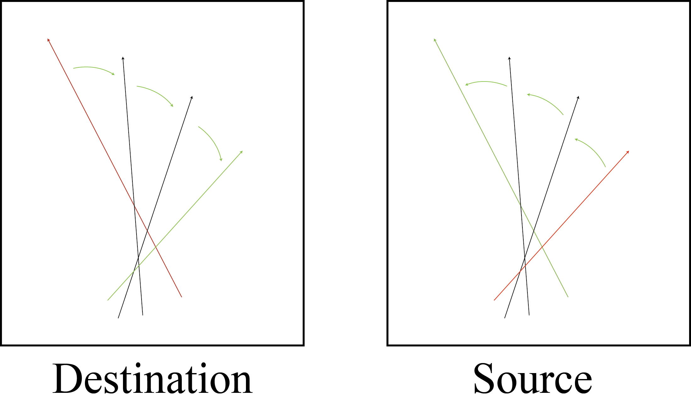
Rotate the wrap line
Notes:
Now we have to rotate our feature line.
Because every middle frame has to have different shape according to different feature line
The red line is the feature line and the black is the middle line
The feature line on the destination image will rotate to the other feature line on the source image line
if we don’t rotate the line , out middle frame will the same . And can not change the shape of every middle frame

Slide 15


Calculate middle line
Middle point =[(1-ratio)*S.x+ratio*D.x , (1-ratio)*S.y+ratio*D.y ]
length =(1-ratio)*S.length+ratio*D.length
Degree= =(1-ratio)*S.degree+ratio*D.degree
$$θ$$
$$θ$$
Notes:
On source image and destination image we have a lot of pair lines
And we can calculate their middle point , length and degree
Then use interpolation to calculate the middle line

Slide 16


X is not exit
Use bilinear interpolation to find the x
a
b
$$β$$
$$α$$
x
c
d

Slide 17
Demo
Notes:
Let’s talk about this algorithm

Slide 18
Platform
OS: Windows7
Progaming language: Java
Java IDE: ECLIPSE
Jre: 1.8.0_65
GUI library : javaFx
Image library : opencv

Slide 19
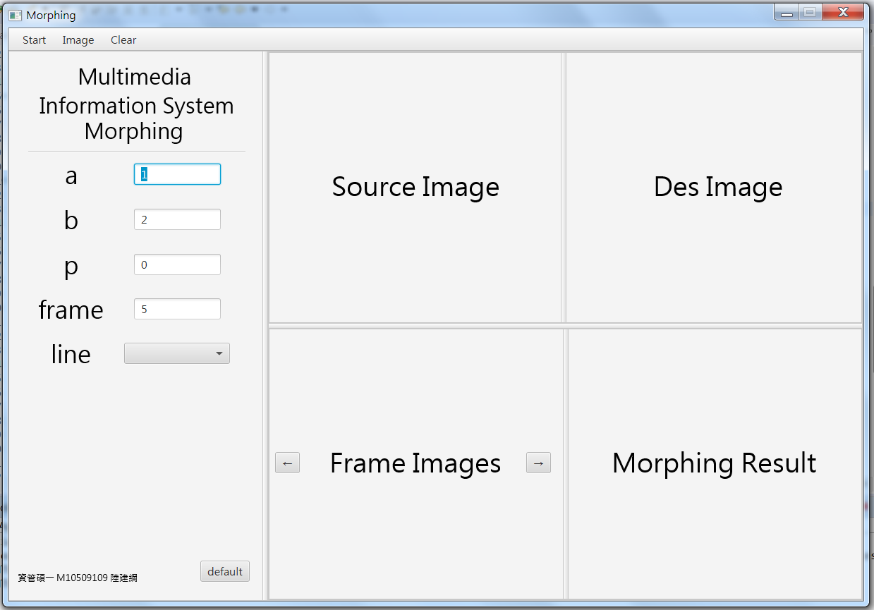
Morphing demo

Slide 20
Thanks for your listening
Notes:
Let’s talk about this algorithm

