Slide 1
Java Automation with Selenium
Maven and Page Object Model
09e-BM/DT/FSOFT - @FPT SOFTWARE - FPT Software Academy - Internal Use

Slide 2
Agenda
What is Maven?
Why Maven?
Install Maven
What is Page Object Model
Advantages of Page Object Model

Slide 3
Lesson Objectives
Understand what is Maven
Able to use Maven to install and manage versions
Understand Page Object Model
Able to apply Page Object Model to projects

Slide 4
Section 1 – Maven

Slide 5
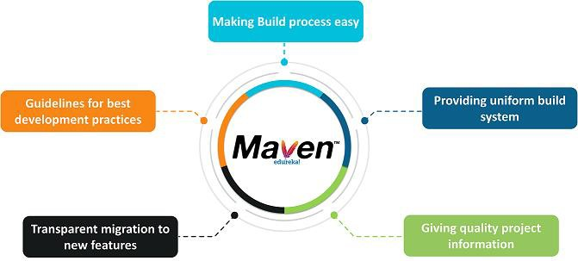
What is Maven?
Maven is a popular open-source build tool developed by the Apache Group to build, publish, and deploy several projects at once for better project management. The tool provides allows developers to build and document the lifecycle framework.
Maven’s purpose is to provide developers with:
A comprehensive, maintainable, reusable, and simple model for projects.
A set of tools and plug-ins that can interact with the declarative model.

Slide 6
Why Maven?
Advantages of Maven:
Helps manage all the processes, such as building, documentation, releasing, and distribution in project management
Simplifies the process of project building
Increases the performance of the project and the building process
The task of downloading Jar files and other dependencies is done automatically
Provides easy access to all the required information
Makes it easy for the developer to build a project in different environments without worrying about the dependencies, processes, etc.
In Maven, it’s easy to add new dependencies by writing the dependency code in the pom file

Slide 7
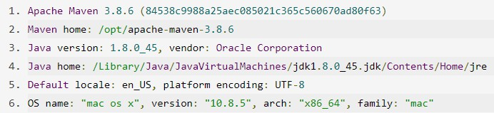
Install Maven
Download Maven: https://maven.apache.org/download.cgi
Configure Maven
The installation of Apache Maven is a simple process of extracting the archive and adding the bin folder with the mvn command to the PATH. Detailed steps are:
Have a JDK installation on your system. Either set the JAVA_HOME environment variable pointing to your JDK installation or have the java executable on your PATH.
Extract distribution archive in any directory: unzip apache-maven-3.8.6-bin.zip
Add the bin directory of the created directory apache-maven-3.8.6 to the PATH environment variable
Confirm with mvn -v in a new shell. The result should look similar to

Slide 8
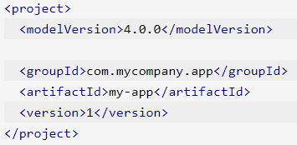
pom.xml of Maven
What is a POM?
A Project Object Model or POM is the fundamental unit of work in Maven. It is an XML file that contains information about the project and configuration details used by Maven to build the project. It contains default values for most projects.
Minimal POM
The minimum requirement for a POM are the following:
project - root
modelVersion - should be set to 4.0.0
groupId - the id of the project's group.
artifactId - the id of the artifact (project)
version - the version of the artifact under the specified group
A POM requires that its groupId, artifactId, and version be configured. These three values form the project's fully qualified artifact name. This is in the form of <groupId>:<artifactId>:<version>. As for the example above, its fully qualified artifact name is "com.mycompany.app:my-app:1".

Slide 9
Section 2 – Page Object Model

Slide 10
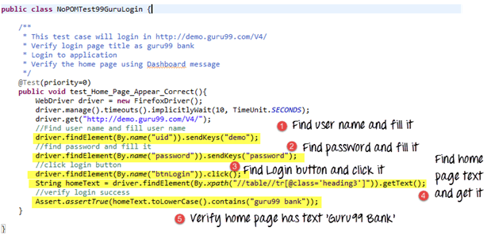
Page Object Model
Why ?

Slide 11
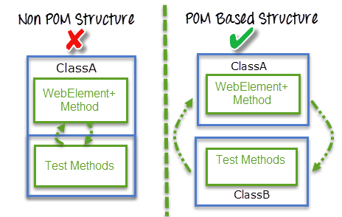
Page Object Model
Page Object Model is a design pattern to create Object Repository for web UI elements. Under this model, for each web page in the application, there should be corresponding page class. This Page class will find the WebElements of that web page and also contains Page methods which perform operations on those WebElements.
Advantages:
Reduces the duplication of code
UI changes only affect to a single Page Object, not to the actual test codes
Makes tests more readable
Improves the maintainability of tests
Notes:
Developing a maintainable automation code is one of the keys to a successful test-automation project. Test-automation code needs to be treated as production code and similar standards and patterns should to be applied while developing this code.

Slide 12
Page Object Model
Without POM Implementation
With POM Implementation
Test scripts
Test scripts
User defined keywords
User defined keywords
WebElement Locators
Page Objects
Login Page
Home Page
Checkout Page
Cart Page
WebElement
Locators

Slide 13
Page Object Model – Page class
public class LoginPage {
public By TXT_USERNAME = By.id("username");
public By TXT_PASSWORD = By.id("j_password");
public By BTN_LOGIN = By.xpath(".//*[@class='BUTTON']");
WebDriver driver;
public LoginPage(WebDriver driver){ this.driver = driver;
}
public HomePage clickLogin(){ driver.findElement(TXT_USERNAME).sendKeys("hainh2"); driver.findElement(TXT_PASSWORD).sendKeys(“password");
driver.findElement(BTN_LOGIN).click();
return new HomePage(driver);
}
}
public class HomePage extends Common {
public By BTN_ADDQUERY = By.xpath(".//*[@class='BUTTON']");
WebDriver driver;
public HomePage(WebDriver driver){
this.driver = driver;
}
public AddQueryPage clickAddNewQuery(){ driver.findElement(BTN_ADDQUERY).click();
return new AddQueryPage(driver);
}
}

Slide 14
Page Object Model – Testcase
public void testLogin(){
LoginPage loginPage = new LoginPage(driver);
HomePage homepage = loginPage .clickLogin();
AddQueryPage newQueryPage = homepage.clickAddNewQuery();
homepage = newQueryPage.createQuery("Error Message");
assert(homepage.isElementPresent(By.linkText("Error Message")));
}
Practise 1: Rewrite previous test using Page Object Model Pattern

Slide 15
Lesson Summary
Highlight points:
Maven
Page Object Model
Advantages of Maven
Advantages of Page Object Model

Slide 16

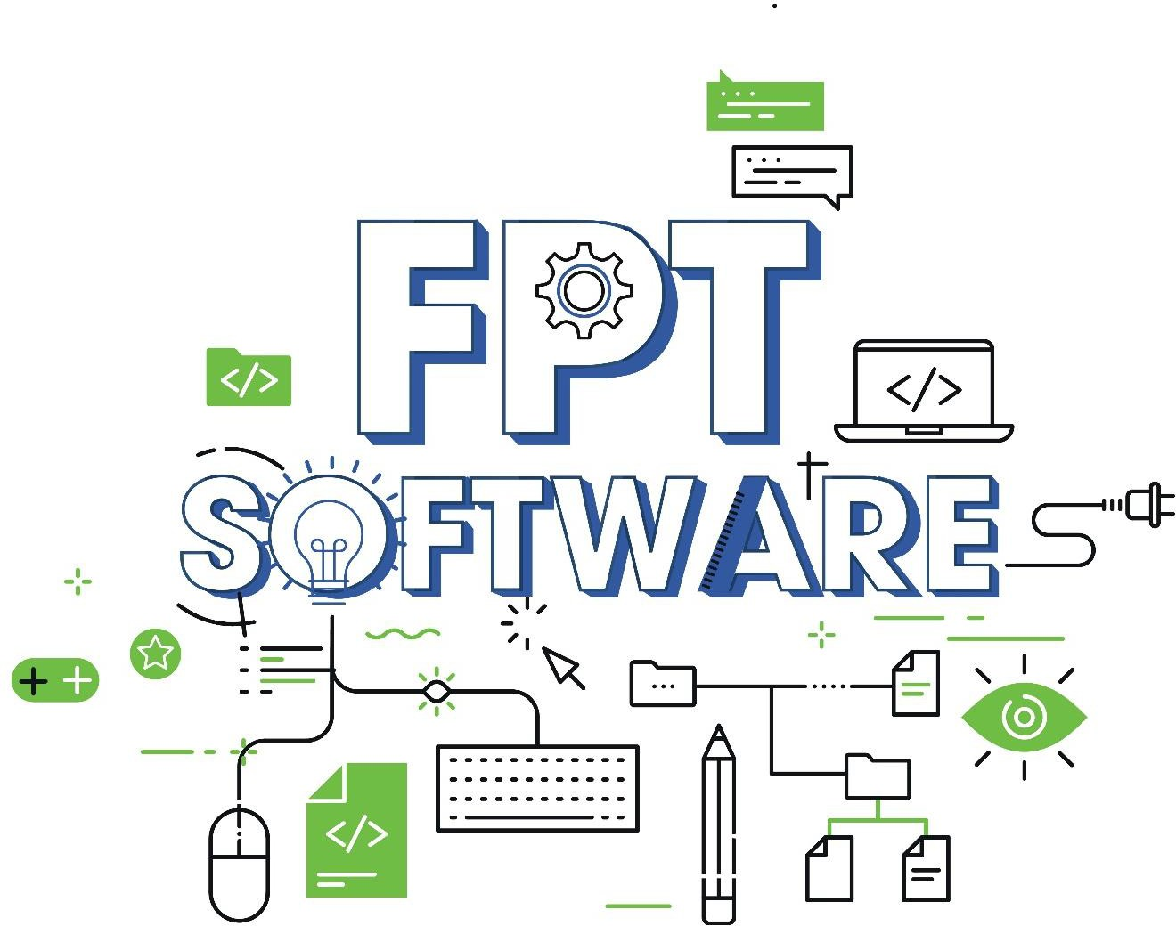

THANK YOU!

