Slide 1
Java Automation with Selenium
TestNG in Java Automation
09e-BM/DT/FSOFT - @FPT SOFTWARE - FPT Software Academy - Internal Use

Slide 2
Agenda
What is TestNG?
Why TestNG?
Assertion of TestNG
Annotations of TestNG

Slide 3
Lesson Objectives
Understand what is TestNG
Know advantages of TestNG
Able to use annotations of TestNG
Able to create test suites, test groups by TestNG
Able to apply TestNG in real projects

Slide 4
Section 1 – What is TestNG?

Slide 5
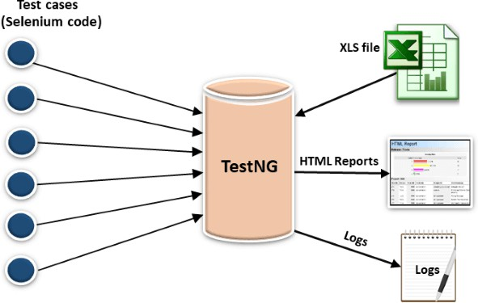
What is TestNG?
TestNG is a testing framework designed to simplify a broad range of testing needs, from unit testing (testing a class in isolation of the others) to integration testing (testing entire systems made of several classes, several packages and even several external frameworks, such as application servers).
Writing a test is typically a three-step process:
Write the business logic of your test and insert TestNG annotations in your code.
Add the information about your test (e.g. the class name, the groups you wish to run, etc...) in a testng.xml file or in build.xml.
Run TestNG.

Slide 6
Section 2 – Why TestNG?

Slide 7
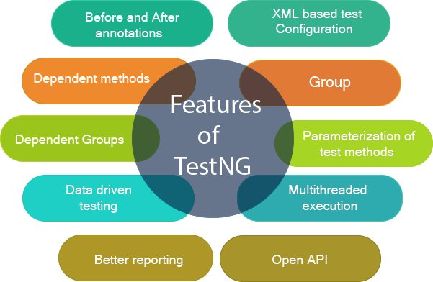
Why TestNG?
TestNG is a testing framework inspired from JUnit and NUnit but introducing some new functionalities that make it more powerful and easier to use, such as:
Annotations.
Run your tests in arbitrarily big thread pools with various policies available (all
methods in their own thread, one thread per test class, etc...).
Test that your code is multithread safe.
Flexible test configuration.
Support for data-driven testing (with @DataProvider).
Support for parameters.
Powerful execution model (no more TestSuite).
Supported by a variety of tools and plug-ins (Eclipse, IDEA, Maven, etc...).
TestNG is designed to cover all categories of tests: unit, functional, end-to-end, integration, etc...

Slide 8
Section 3 – Assertion of TestNG

Slide 9
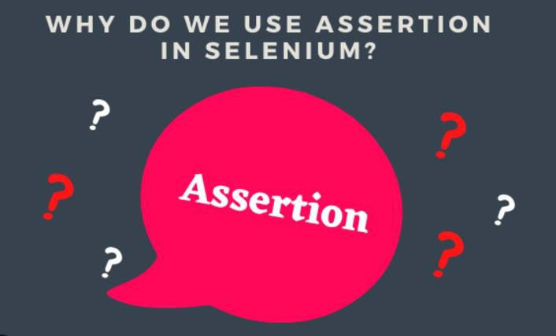
Assertion of TestNG
Assertions in TestNG are a way to verify that the expected result and the actual result matched or not.
There are two types of assertions in Selenium and the categorization depends on how the assertion behaves after a condition is pass or fail.
Here, we would discuss two types of assertions in Selenium:
Hard Assertions
Soft Assertions

Slide 10
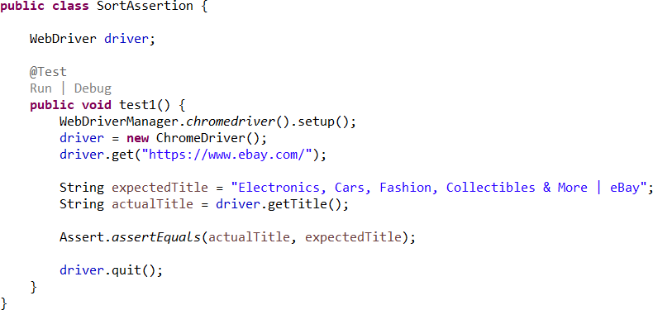
Assertion of TestNG
Hard Assertions: A hard assertion does not continue with execution until the assertion condition is met.
Hard assertions usually throw an Assertion Error whenever an assertion condition has not been met. The test case will be immediately marked as Failed when a hard assertion condition fails.

Slide 11
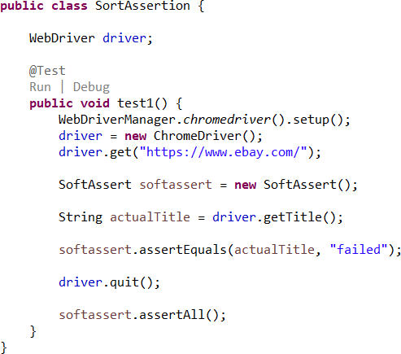
Assertion of TestNG
Sort Assertions: A soft assertion continues with the next step of the test execution even if the assertion condition is not met.
Soft Assertions are the type of assertions that do not throw an exception automatically when an assertion
fails unless it is asked for. This is useful if you are doing multiple validations in a form, out of which only a few validations directly have an impact on deciding the test case status.

Slide 12
Section 4 – Annotations of TestNG

Slide 13
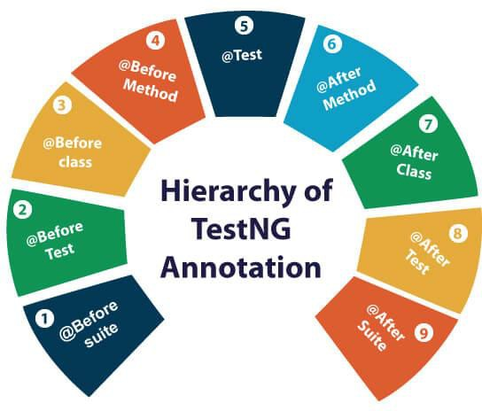
Annotations of testNG
TestNG Annotation is a piece of code which is inserted inside a program or business logic used to control the flow of execution of test methods.
@Listeners: Defines listeners on a test class.
@Parameters: Describes how to pass parameters to a @Test method.
@Test: Marks a class or a method as part of the test.
@DataProvider: Marks a method as supplying data for a test method. The annotated method must return an Object[][] where each Object[] can be assigned the parameter list of the test method. The @Test method that wants to receive data from this DataProvider needs to use a dataProvider name equals to the name of this annotation.

Slide 14
Annotations of testNG
TestNG Annotation is a piece of code which is inserted inside a program or business logic used to control the flow of execution of test methods.
@BeforeSuite: The annotated method will be run before all tests in this suite have run.
@AfterSuite: The annotated method will be run after all tests in this suite have run.
@BeforeTest: The annotated method will be run before any test method belonging to the classes inside the
<test> tag is run.
@AfterTest: The annotated method will be run after all the test methods belonging to the classes inside the
<test> tag have run.
@BeforeGroups: The list of groups that this configuration method will run before. This method is guaranteed t
run shortly before the first test method that belongs to any of these groups is invoked.
@AfterGroups: The list of groups that this configuration method will run after. This method is guaranteed to ru shortly after the last test method that belongs to any of these groups is invoked.
@BeforeClass: The annotated method will be run before the first test method in the current class is invoked.
@AfterClass: The annotated method will be run after all the test methods in the current class have been run.
@BeforeMethod: The annotated method will be run before each test method.
@AfterMethod: The annotated method will be run after each test method.
o
n

Slide 15
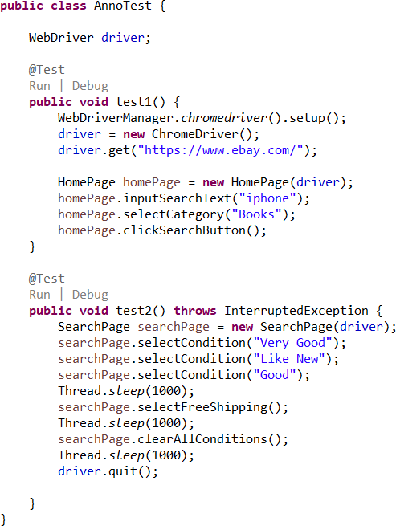
Annotations
@Test: Marks a class or a method as part of the test.

Slide 16
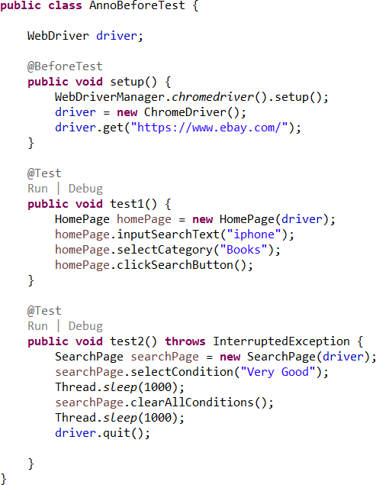
Annotations
@BeforeTest: The annotated method will be run before any test method belonging to the classes inside the <test> tag is run.

Slide 17
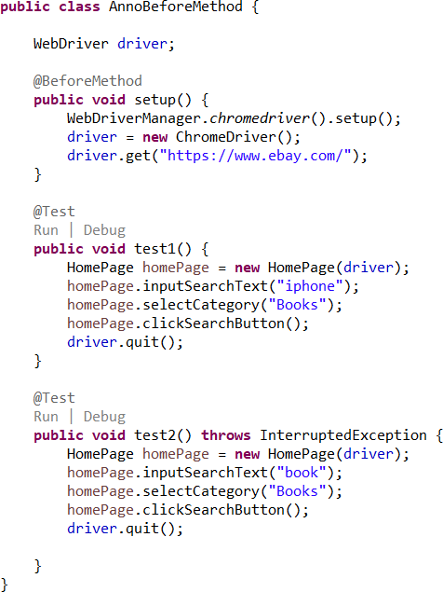
Annotations
@BeforeMethod: The annotated method will be run before each test method.

Slide 18
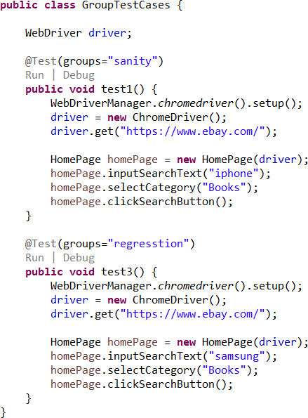
Annotations
Group test cases: As the name indicates, grouping in TestNG lets you group multiple test methods in named groups. Through groups in TestNG, you have the provision to run a particular set of tests that belong to a group or multiple groups.

Slide 19
Annotations
Group test cases: As the name indicates, grouping in TestNG lets you group multiple test methods in named groups. Through groups in TestNG, you have the provision to run a particular set of tests that belong to a group or multiple groups.

Slide 20
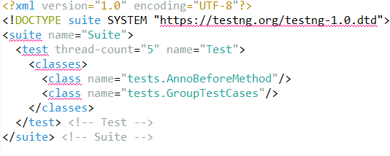
Annotations
Test suite is a container that has a set of tests which helps testers in executing and reporting the test execution status

Slide 21
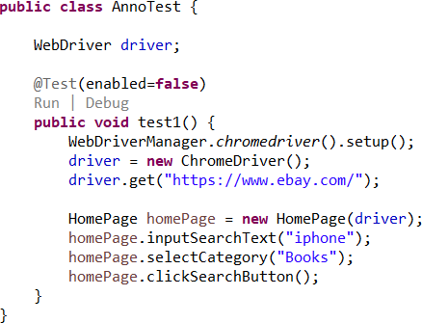
Annotations
How to skip test cases?

Slide 22
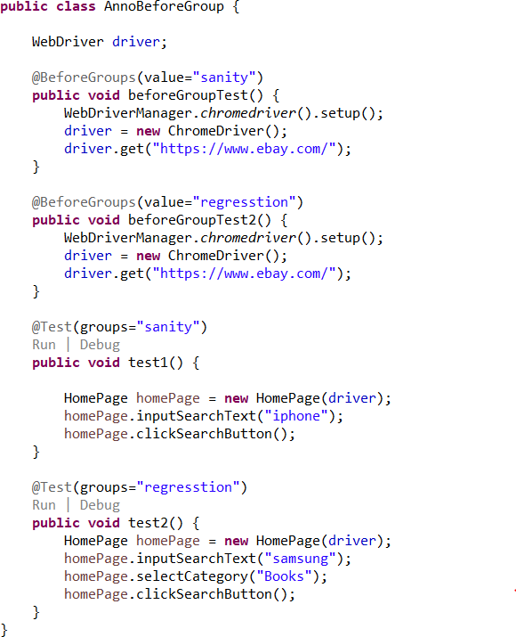
Annotations
@BeforeGroups: The list of groups that this configuration method will run before. This method is guaranteed to run shortly before the first test method that belongs to any of these groups is invoked.

Slide 23
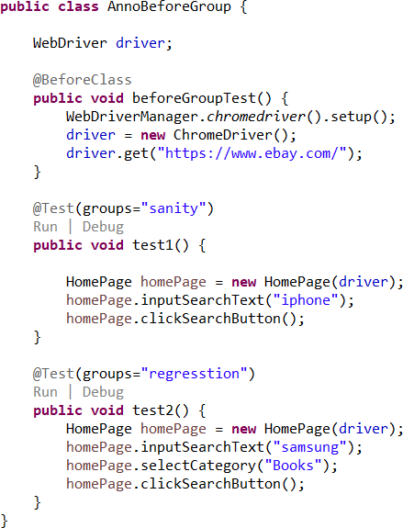
Annotations
@BeforeClass: The annotated method will be run before the first test method in the current class is invoked

Slide 24
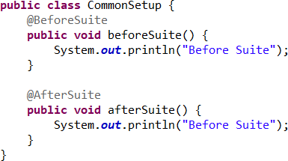
Annotations
@BeforeSuite: The annotated method will be run before all tests in this suite have run.
@AfterSuite: The annotated method will be run after all tests in this suite have run.

Slide 25
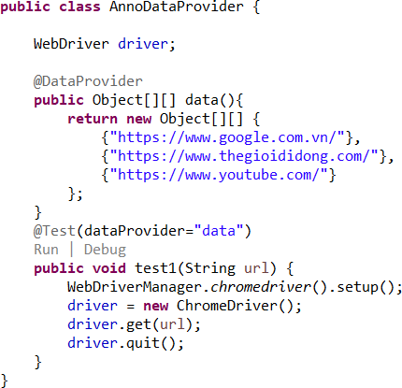
Annotations
@DataProvider: Marks a method as supplying data for a test method. The annotated method must return an Object[][] where each Object[] can be assigned the parameter list of the test method. The @Test method that wants to receive data from this DataProvider needs to use a dataProvider name equals to the name of this annotation.

Slide 26
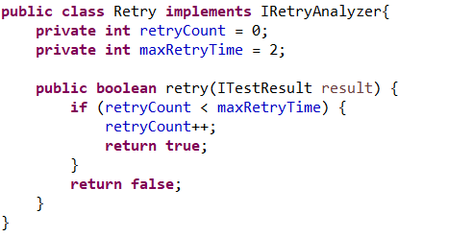
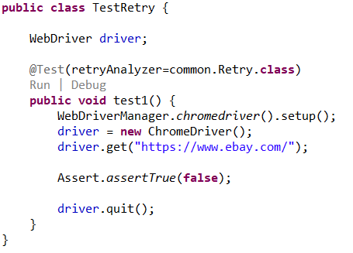
Retry running test cases
Sometimes, you might want TestNG to automatically retry a test whenever it fails. In those situations, you can use a retry analyzer. When you bind a retry analyzer to a test, TestNG automatically invokes the retry analyzer to determine if TestNG can retry a test case again in an attempt to see if the test that just fails now passes. Here is how you use a retry analyzer:
Build an implementation of the interface
org.testng.IRetryAnalyzer
Bind this implementation to the @Test annotation for e.g., @Test(retryAnalyzer = LocalRetry.class)

Slide 27
Lesson Summary
Highlight points:
Understand TestNG
Sotf Assertion and hard Assertion
@Test
Create groups in TestNG
Create suites in TestNG
Beforexx and Afterxxx

Slide 28



THANK YOU!

