Slide 1
Java Automation with Selenium
Data Driven and Selenium Grid
09e-BM/DT/FSOFT - @FPT SOFTWARE - FPT Software Academy - Internal Use

Slide 2
Agenda
Data Driven
Selenium Grid

Slide 3
Lesson Objectives
Understand what is Selenium Grid
Able to configure/setup Selenium Grid in the real project
Understand Data driven approach
Able to apply Data driven in real projects

Slide 4
Section 1 – What is Data driven?

Slide 5
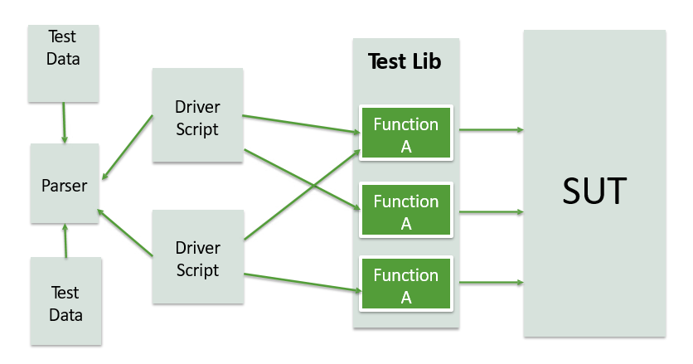
Data Driven
Test data taken out of test scripts
One driver script can execute multiple similar tests

Slide 6
Data Driven
TestNG provides the DataProvider feature to create data-driven test
Define Data table
@DataProvider(name=“testData”)
public Object[][] testData() { return new Object[][] { new Object[] “test data"}, new Object[] “test data"}, new Object[] “test data"}, new Object[] “test data"},
};
}
Add data to the test:
@Test(dataProvider = "testData")
public void testBMICalculator(Object A, Object B)
Practise 2: Rewrite previous test using data driven to test with different data test

Slide 7

Data Driven Framework with Apache POI – Excel
Reading data from the Excel
We need a way to open this Excel sheet and read data from it within our Selenium test script. For this purpose, we use the Apache POI library, which allows you to read, create and edit Microsoft Office-documents using Java.

Slide 8
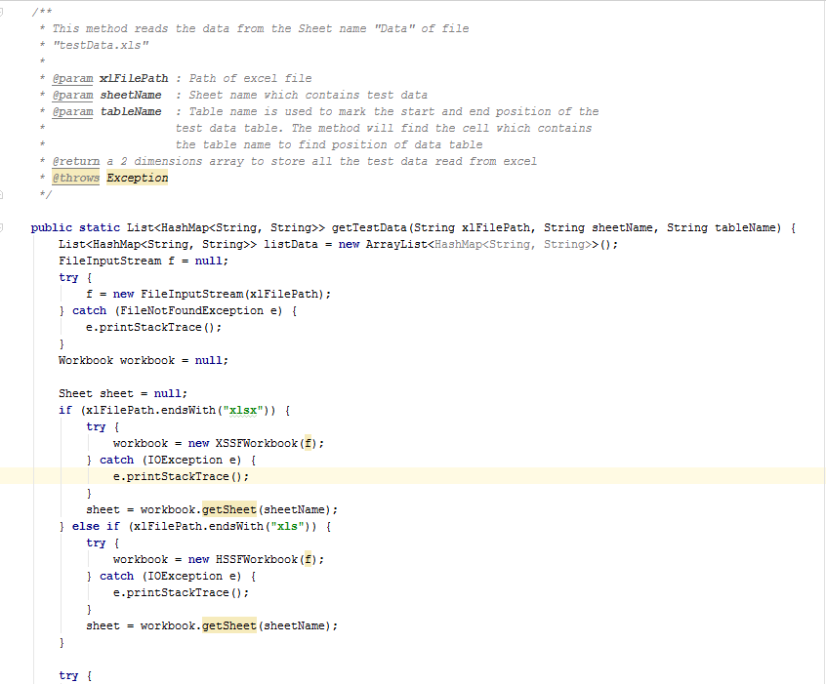
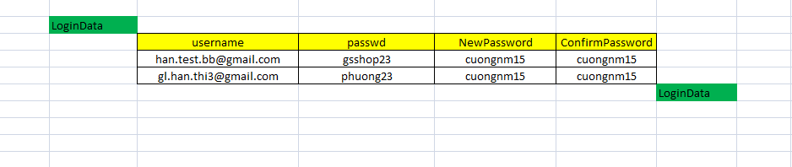
Example

Slide 9
Section 2 – Selenium Grid

Slide 10
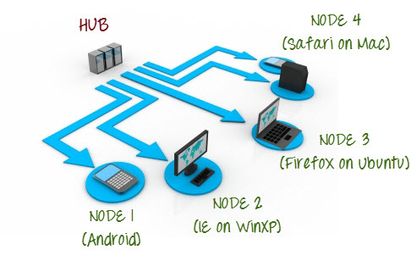
What is Selenium Grid?
Selenium Grid is a part of the Selenium Suite that specializes in running multiple tests across different browsers, operating systems, and machines in parallel.
Selenium Grid uses a hub-node concept where you only run the test on a single machine called a hub, but the execution will be done by different machines called nodes.

Slide 11
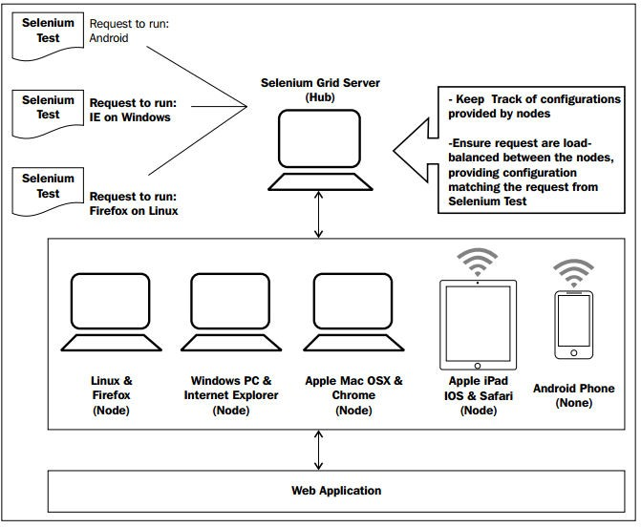
Selenium Grid

Slide 12
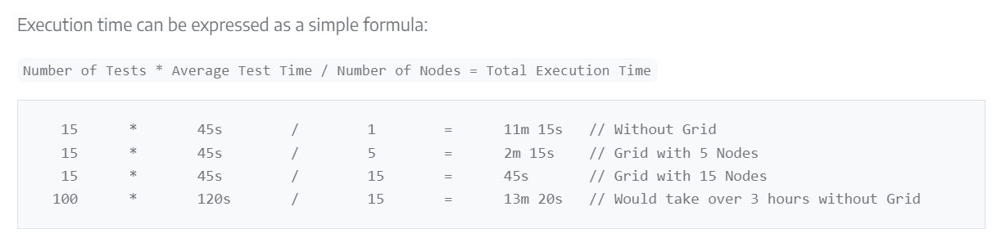
When to Use Grid?
When would you use a Selenium Grid?
To run your tests in parallel, against different browser types, browser versions, operating systems
To reduce the time needed to execute a test suite
Selenium Grid runs test suites in parallel against multiple machines (called Nodes). For large and long-running test suites, this can save minutes, hours, or perhaps days. This shortens the turnaround time for test results as your application under test (AUT) changes.

Slide 13
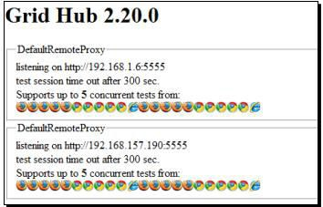
How to Set Up Selenium Grid? Using Command Line
For Selenium Grid 3:
Launching Hub
java -jar selenium-server-standalone-x.xx.xx.jar -role hub
Register a node to Hub
java -jar selenium-server-standalone-x.xx.xx.jar –role node –hub http://localhost:4444/grid/register
Notes:
https://www.selenium.dev/downloads/

Slide 14
Selenium Grid
Write test against the Grid
DesiredCapabilities capability = DesiredCapabilities.firefox(); capability.setBrowserName("firefox");
// Set the platform we want our tests to run on
capability.setPlatform("LINUX");
driver = new RemoteWebDriver(new URL( "http://<grid hub>:4444/wd/hub"), capability); driver.get(<site URL>)
Practise 3: Rewrite previous test using Grid to run test in parallel on Firefox and Chrome
Notes:
https://www.selenium.dev/documentation/grid/getting_started/

Slide 15

Lesson Summary
Highlight points:
Data driven approach
Selenium Grid

Slide 16



THANK YOU!

