Slide 1
Custom View in Android
Jaden Lin

Slide 2
3 Common Types of Custom View
Compound Components
Custom ViewGroup
Custom View

Slide 3

Outline
Introduction of View
Scenario of 3 types of custom view
Drawing procedure of View
Measure
Layout
Draw
Example of Custom ViewGroup: FlowLayout

Slide 4
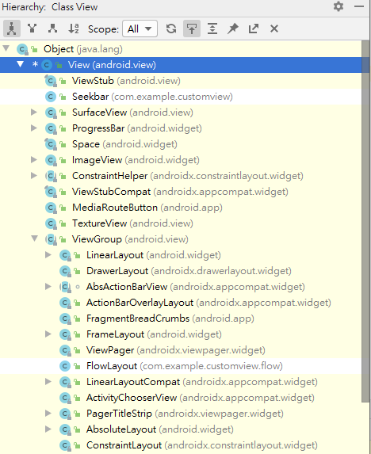
Introduction of View
View : a rectangular area on the screen and, responsible for drawing and event handling.
View is the base class for widgets (ImageView, Buttons, EditText).
ViewGroup: subclass of view, a special view that can contain other views (called children.)
ViewGroup is the base class for layouts and views containers.
Notes:
大家都知道， 你講的那麼官腔 這些我也知道，很簡單。
可是我還是要講

Slide 5
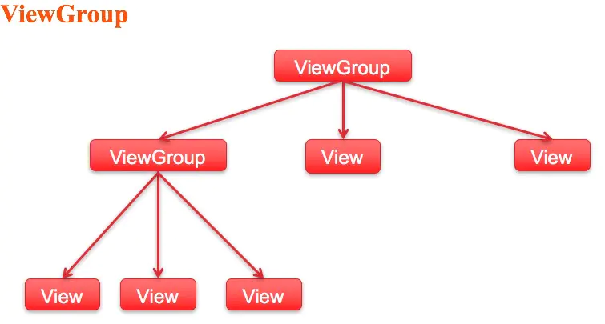
ViewGroup (Parent View)
Looks familiar?
Notes:
Viewgroup他有很多Children, 他相對於這些
所以ViewGroup 會包含View 也包含ViewGroup
有沒有人覺得很孰悉? 我們之後再來看一下

Slide 6
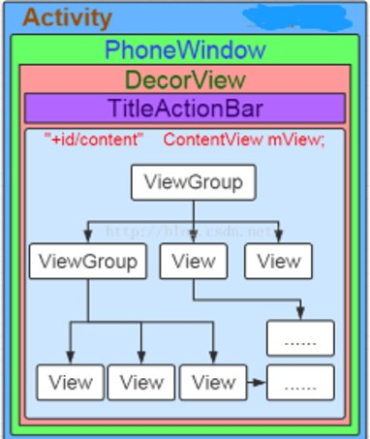
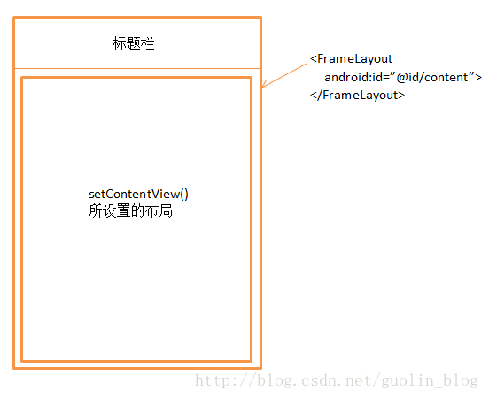
View in Activity
從Class的角度來看:
從Layout的角度來看:

Slide 7
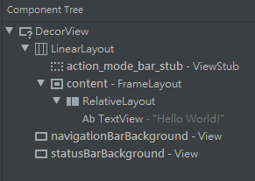
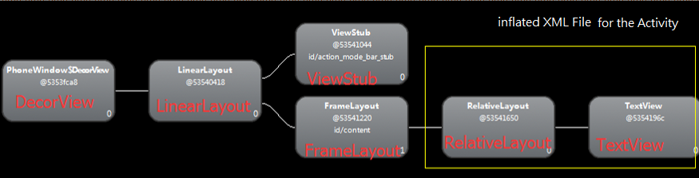
View in Activity
從Hierarchy (Component Tree)的角度來看:
Notes:
其他各位前輩有講過Layout Inspector，自己之前沒用過，我們新建一個簡單的project 打開來看一下好了。我們會看到甚麼? DecorView其實繼承自Framelayout,也是一個Viewgroup..在最上層 所以它是我們的root View

Slide 8
When to use for each Type?
Compound Components
Custom
ViewGroup
Custom
View
Encapsulates
existing android widgets.
Responsible for laying and manage Child Views
Has customized graphics and style

Slide 9
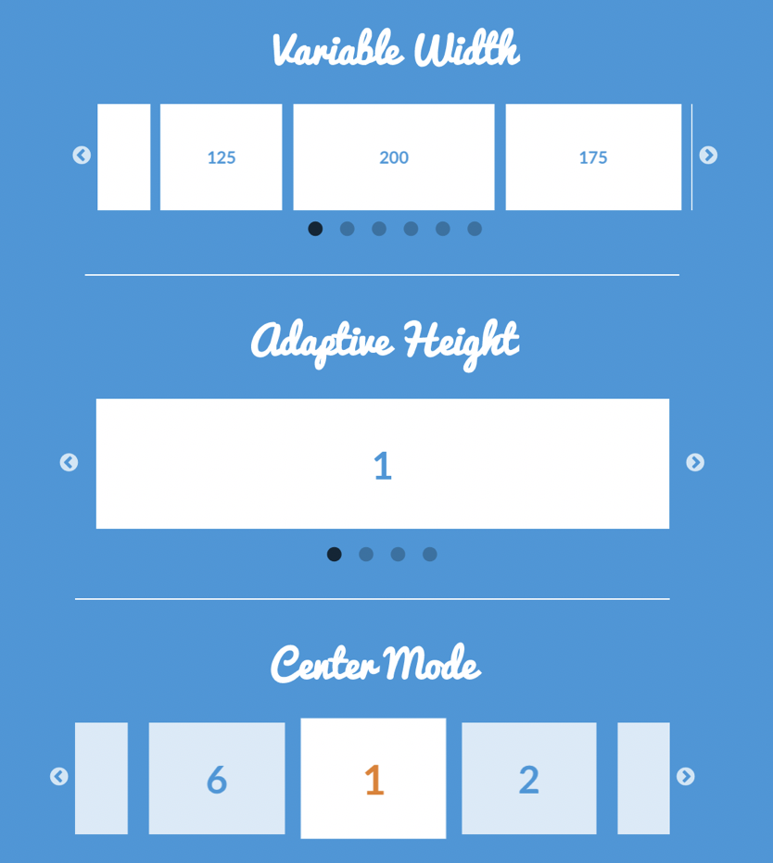

Compound Components (controls)
Compound Components
Custom
ViewGroup
Custom
View
Scenario:
Comprised of multiple existing components
Encapsulate these components into a single class

Slide 10

Custom ViewGroup
Compound Components
Custom
ViewGroup
Custom
View
Scenario:
Multiple Items, Dynamic Loading…..
There might be different number of items with different custom attributes.
We wish to lay our items in our own way based on these custom attributes.
Notes:
右邊這張圖 上傳照片

Slide 11
Custom View
Compound Components
Custom
ViewGroup
Custom
View
Scenario:
An atomic view that may need complicated drawing and animation
There might be customized attribute and touch event that may affect view’s style or graphics
Notes:
需要複雜的動畫和繪圖. 可能有一些動態的attribute去影響View的樣式和圖形

Slide 12

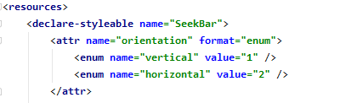
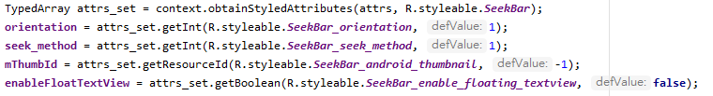



Procedure of Creating a Compound Components
Start
Layout
Extends
a layout , ex: LinearLayout, RelativeLayout
Define/ Retrieve Attributes
Inflate Compound
Views
Initialize UI and Data based on
Attributes
Define Interface,
Expose Interface Method
Handle TouchEvent

Slide 13
View的繪製流程
View
繪製流程
而我們的Custom View / ViewGroup就是override onMeasure(), onLayout(),onDraw()這三個方法.
這三個方法分別在measure(),layout(),draw()被呼叫
最複雜的就是Measure的過程, 既要測量View, 也要測量View Group
Measure
Layout
Draw
End

Slide 14
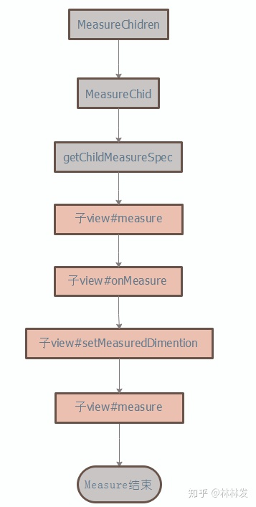
Measure()
測量甚麼?! 誰來測量?! 如何測量?!
View
繪製流程
A: 測量高度和寬度!!
A: Parent View給 Child View測量, Child view sets its final measured width and height
Measure
A: umm.. It’s a little complicated.
Layout
Draw
End
Notes:
第一步是

Slide 15


onMeasure()
View
繪製流程
Measure
onMeasure() receives the its own MeasureSpec calculated by and passed from its parent ViewGroup
Android自己定義的測量規格： MeasureSpec (包含Mode 跟Size)
Layout
Mode Size
Int MeasureSpec:
What is Mode?
Why do we need the Mode?
How Many Modes are there?
Draw
A MeasureSpec is comprised of a mode(2bits) and a size(30 bits) .
End
Notes:
有一天下班很晚，晚上11点 你离开公司的时候在门口被警察拦住， 警察问你Integer几个byte 你如果答对了他就放你走， 因为你是工程师，答不出来就是小偷
講到這裡 大家可能會充滿了疑惑， 什麼是模式?

Slide 16
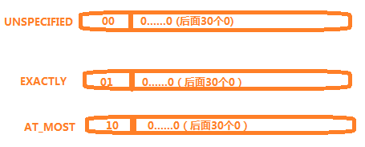
Mode of MeasureSpec
View
繪製流程
MeasureSpec其實是Parent ViewGroup 傳遞給Child view的佈局要求
3 types of modes:
Measure
未指定尺寸模式。父佈局沒有對子view強加任何限制。它可以是任意想要的尺寸。
Layout
精確值模式。父佈局決定了子view的準確尺寸。子view無論想設定多大的值，都將限定在那個邊界內。
Draw
最大值模式。子view可以一直大到指定的值。
End

Slide 17
Mode of MeasureSpec
Example:
Suppose there is a Parent ViewGroup , its width and height are fixed: 300dp* 300 dp
Consider it may have one of three child views below:
<!--View 1-->
android:layout_width="match_parent"
android:layout_height="match_parent"
<!--View 2-->
android:layout_width=“100dp"
android:layout_height=“100dp"
<!--View 3--> android:layout_width="wrap_content"
android:layout_height="wrap_content"
我們預期Child View會是:300dp*300dp
我們預期Child View會是100dp*100dp
我們預期Child View會自己設定長寬, 但它最多不會超過
300dp*300dp

Slide 18
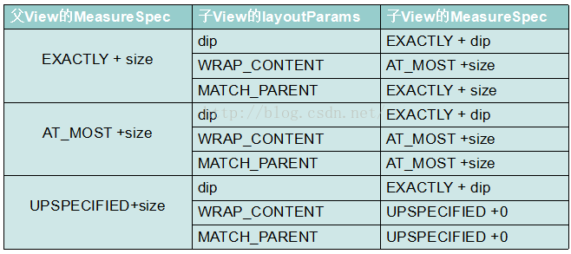
Purpose of MeasureSpec
Child View的大小受限於Parent ViewGroup的大小, Parent ViewGroup會將自己的限制傳遞下去
ParentViewGroup 根據自己的MeasureSpec和Child View的Layour Parameters 算出子View的MeasureSpec。

Slide 19
Mode of MeasureSpec
Example:
Suppose there is a Parent ViewGroup , its width and height are fixed: 300dp* 300 dp
Consider it may have one of three child views below:
→ Exactly + 300dp
<!--View 1-->
android:layout_width="match_parent"
android:layout_height="match_parent"
<!--View 2-->
android:layout_width=“100dp"
android:layout_height=“100dp"
<!--View 3-->
android:layout_width=“wrap_content"
android:layout_height=“wrap_content"
我們預期Child View會是:300dp*300dp
→ Exactly + 300dp
我們預期Child View會是100dp*100dp
→ Exactly + 100dp
我們預期Child View會自己設定長寬, 但它最多不會超過
300dp*300dp
→ At_most + 300dp

Slide 20
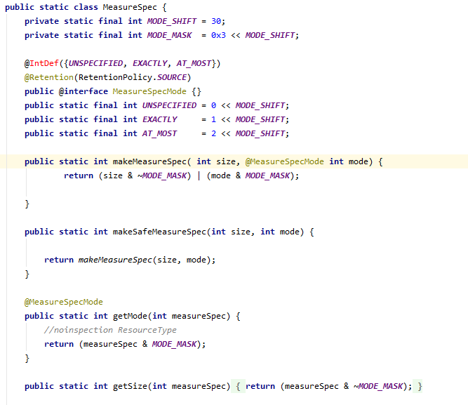
MeasureSpec
View
繪製流程
A Utility Class
Help us compose and
decompose the
MeasureSpec we use in
onMeasure()
The value of
MeasureSpec is still
an Integer
SpecMode
Measure
Layout
Draw
End

Slide 21
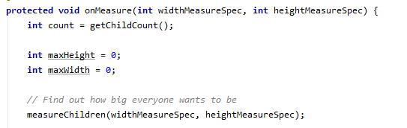
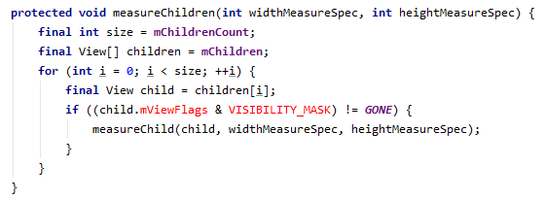
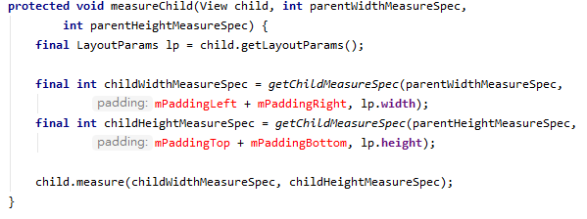
父View#OnMeasure
View
繪製流程
Measure
Layout
真正為Child View 算出MeasureSpec的地方!!!!
Draw
End
Notes:
好 講完剛剛那個例子做為一個工程師， 我們會希望會知道它具體的運作原理嘛!我們接著來看一下Measure 的Stack call

Slide 22
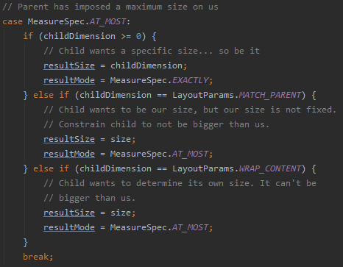
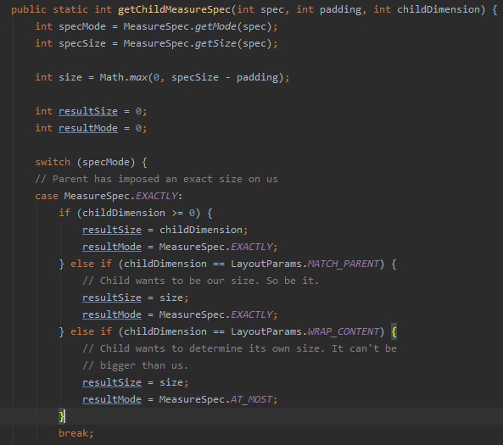
真正為Child 算出MeasureSpec的地方!

Slide 23
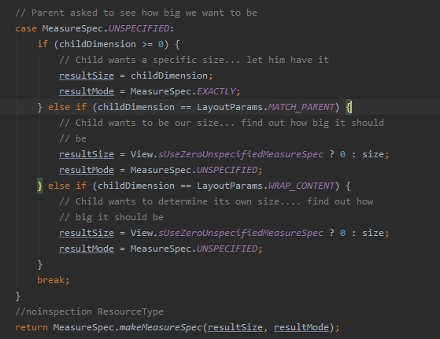
父View#OnMeasure

Slide 24

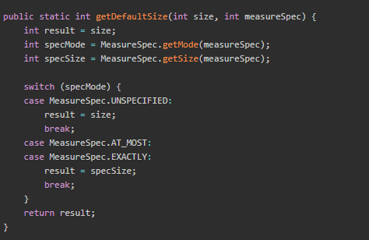
Child View set its own height and width by passing MeasureSpec Measured by Parent View
MeasureSpec of Child View
父View#OnMeasure
After ChildView gets its own MeasureSpec measured by ParentView, it calls OnMeasure().

Slide 25
Mode of MeasureSpec
Suppose there is a Parent ViewGroup , its width and height are fixed: 300dp* 300 dp
Consider it may have one of three child views below:
→ Exactly + 300dp
→ 設定測量後的MeaureSpec: 300dp
<!--View 1-->
android:layout_width="match_parent"
android:layout_height="match_parent"
<!--View 2-->
android:layout_width=“100dp"
android:layout_height=“100dp"
<!--View 3-->
android:layout_width=“wrap_content"
android:layout_height=“wrap_content"
我們預期Child View會是:300dp*300dp
→ Exactly + 300dp
→ 設定測量後的MeaureSpec: 300dp
我們預期hild View會是100dp*100dp
→ Exactly + 100dp
→ 設定測量後的MeaureSpec: 100dp
Seems Strange?
我們預期Child View會自己設定長寬, 但它最多不會超過
300dp*300dp
→ At_most + 300dp
→ 設定測量後的MeaureSpec: 300dp

Slide 26
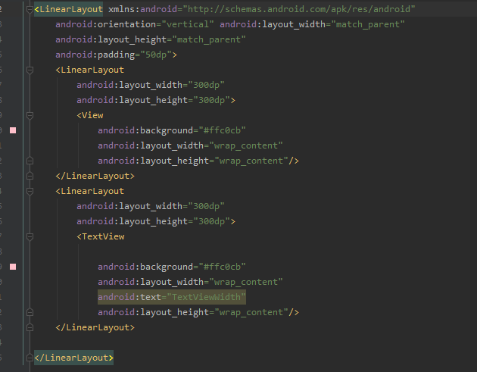
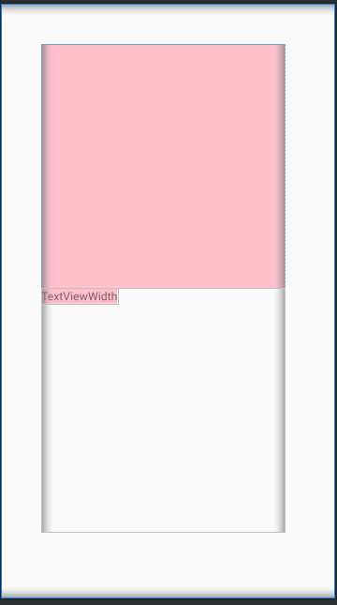
Child View set its own height and width by measureSpec measured by Parent View
Textview class overrides
onMeasure() method!!​

Slide 27
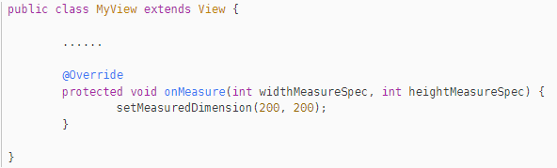
MeasureSpec calculated by Parent View is only a reference
View
Measure
The final width and height is set by calling setMeasuredDimension.
Layout
Draw
It’s OK to define whatever width and height you want!! If you did not call this function, an Exception will be thrown later.
End

Slide 28
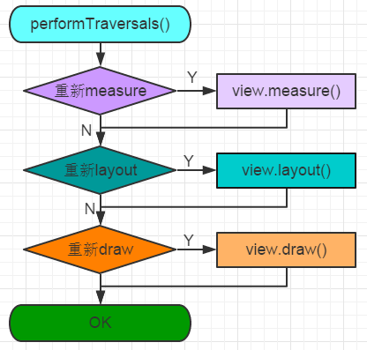
What is the Root View? How is its MeasureSpec is measured?
DecorView! performTraversals()!!
private void performTraversals() {
......
int childWidthMeasureSpec = getRootMeasureSpec(mWidth, lp.width);
int childHeightMeasureSpec = getRootMeasureSpec(mHeight, lp.height);
......
mView.measure(childWidthMeasureSpec, childHeightMeasureSpec);
......
mView.layout(0, 0, mView.getMeasuredWidth(),mView.getMeasuredHeight());
......
mView.draw(canvas);
......
}
Notes:
我們現在講了父親可以測量小孩了….. 那父親的父親是誰測量呢? 一直追溯上去?

Slide 29
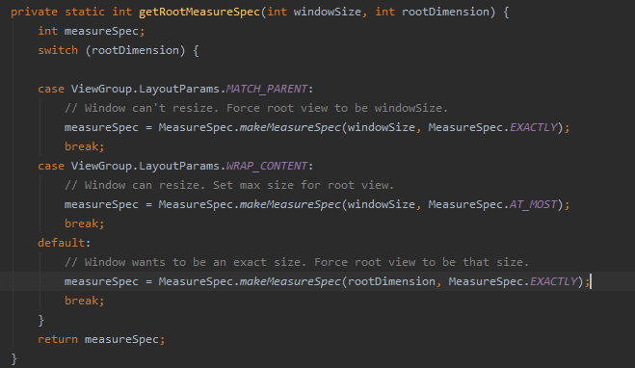
What is the Root View? How is its MeasureSpec is measured?
View
繪製流程
MeasureSpec of The RootView
Measure
Layout
Draw
End

Slide 30
Recap: Stack call and FlowChart of Measure
Perform
Traversal()
HasNext
Child View?
View
Group
onMeasure
Measure
Children
SetMeasuredDimension
getRoot
MeasureSpec()
Measure
Child
Measure()
NextView:
View or ViewGroup?
Layout()
SetMeasuredDimension
onMeasure
View
View
Draw()
ViewGroup

Slide 31

Now We Know How onMeasure() works!!!!!
View
繪製流程
Once we have measured the height and width of the Child Views, the next step is to lay the Child Views in ViewGroup.
It’s important to remember the flowchart if we wish to create our own Custom ViewGroup.
Is Layout() called similar to Measure()?
Measure
Layout
Draw
End

Slide 32
Recap: Stack call and FlowChart of Measure
Perform
Traversal()
HasNext
Child View?
View
Group
onMeasure
Measure
Children
End
getRoot
MeasureSpec()
Measure
Child
Measure()
NextView:
View or ViewGroup?
Layout()
SetMeasuredDimension
onMeasure
View
View
Draw()
ViewGroup

Slide 33
onMeasure in ViewTree
onMeasure is called from ViewRoot to Leaf node recursively.
Every node is a subclass of either View or ViewGroup.
Which Design Pattern is applied here?
!!!!
Composite Pattern​

Slide 34
Step 2: Layout
View
繪製流程
Same as onMeasure. This method will be called from root view recursively!(DFS)
Measure
Layout
Draw
End

Slide 35
Layout() is called in performTraversal()
View
繪製流程
Same as onMeasure. This method will be called from root view recursively!(DFS)
Measure
private void performTraversals() {
......
int childWidthMeasureSpec = getRootMeasureSpec(mWidth, lp.width);
int childHeightMeasureSpec = getRootMeasureSpec(mHeight, lp.height);
......
mView.measure(childWidthMeasureSpec, childHeightMeasureSpec);
......
mView.layout(0, 0, mView.getMeasuredWidth(),mView.getMeasuredHeight());
......
mView.draw(canvas);
......
}
Layout
Draw
layout() method receives 4 parameters, and they represent left, top, right and bottom coordinate of the view respectively. All these coordinates are relative to its current Parent View.
End

Slide 36
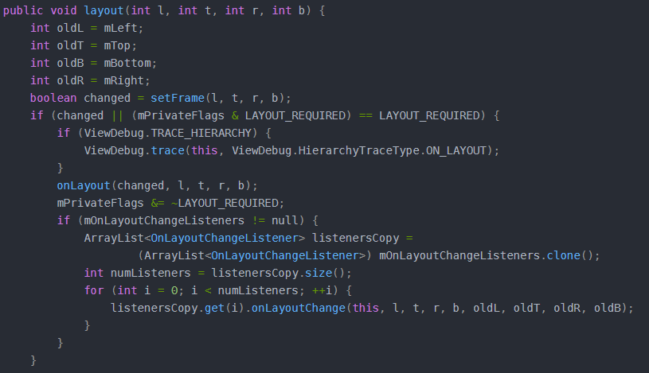
layout(), onLayout()
首先會用setFrame()來判斷View的大小是否發生過變化，以確定有沒有必要對當前的視圖進行重繪，同時還會在這裡把傳遞過來的四個參數分別賦值給mLeft、mTop、mRight和mBottom這幾個變數。
接下來會在第11行調用onLayout()方法，正如onMeasure()方法中的預設行為一樣，也許你已經迫不及待地想知道onLayout()中的默認行為是什麼樣的了。
View
繪製流程
Set where the child view should lay in the Parent View
Measure
Layout
Draw
End

Slide 37
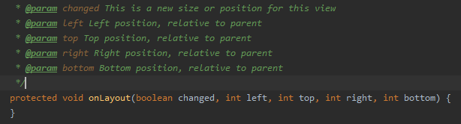
onLayout()
View
繪製流程
Let’s see what are there in onLayout() of View!
Measure
Layout
onLayout () method of View class is EMPTY!!!!!
Draw
End

Slide 38

onLayout()
onLayout () method of View class is empty because it does not need to lay its children and View does not even have a child view.
View
繪製流程
Measure
Layout
How about onlayout() in ViewGroup.java?
Draw
onLayout() method of ViewGroup class is an abstract class., which means We must define our own way to lay children
End
Let’s take a look at how LinearLayout implements its way of layouts

Slide 39
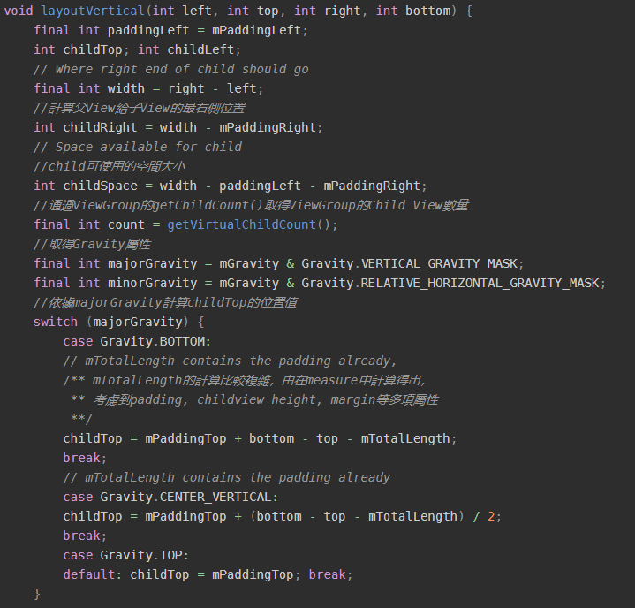
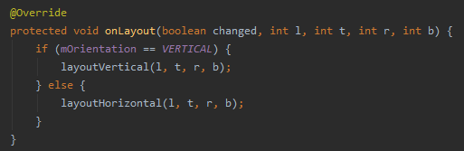
onLayout() in LinearLayout
View
繪製流程
Measure
大致上分為5步:
計算第一個Child 開始的Top座標
Iterate over all child views
通過Child View的measure後的寬高，margin和direction等attribute計算每一個Child相對於的上下左右 座標值
呼叫childView的layout() 設定他們的座標
通過margin,child高度累加child top值, 使其成為下一個View的起始座標
Layout
Draw
End
LinearLayout: https://android.googlesource.com/platform/frameworks/base/+/master/core/java/android/widget/LinearLayout.java

Slide 40
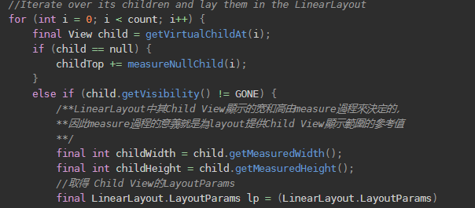
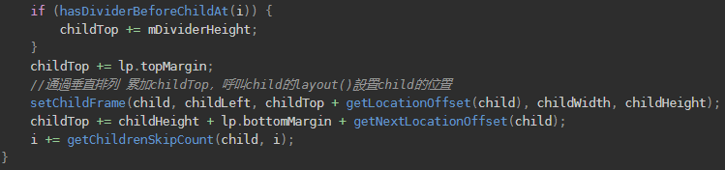
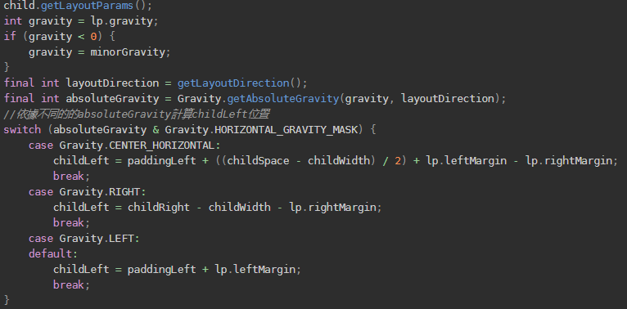

2nd step:
Iterate over Child Views
4th step: set child view coordinate
3th step:
Compute coordinates
5th step: update child top

Slide 41
Recap: Stack call and FlowChart of layout()
Perform
Traversal()
View
Group
layout
setFrame
onLayout
Measure()
HasNext
Child View?
End
getMeasured
Width/Height()
NextView:
View or ViewGroup?
Layout()
setFrame
Layout
View
View
Draw()
ViewGroup

Slide 42
Now, we know How layout of a ViewGroup works
View
繪製流程
Set in a certain place, (r,l,b,t), given by ParentViewGroup
Given measured height and width of each Child views,
We can Compute (r,l,b,t) for every Child Views
Once we have laid child views, the next step is to draw views
inside the rectangular area bounded by (r,l,b,t)
Measure
Layout
Draw
YES! onDraw is also executed in a same way.
End

Slide 43
Step 3: Draw
Measure() measures the height and width of a view, Layout() sets a view in a certain place on the screen, while onDraw() is the real place where the content of a view is drawed on the screen
View
繪製流程
Measure
Same as onMeasure and onLayout,
This method will be called from root view recursively!
Layout
Draw
End

Slide 44
What is the Root View? How is its MeasureSpec is measured?
DecorView! performTraversals()!!
private void performTraversals() {
......
int childWidthMeasureSpec = getRootMeasureSpec(mWidth, lp.width);
int childHeightMeasureSpec = getRootMeasureSpec(mHeight, lp.height);
......
mView.measure(childWidthMeasureSpec, childHeightMeasureSpec);
......
mView.layout(0, 0, mView.getMeasuredWidth(),mView.getMeasuredHeight());
......
mView.draw(canvas);
......
}
Notes:
我們現在講了父親可以測量小孩了….. 那父親的父親是誰測量呢? 一直追溯上去?

Slide 45
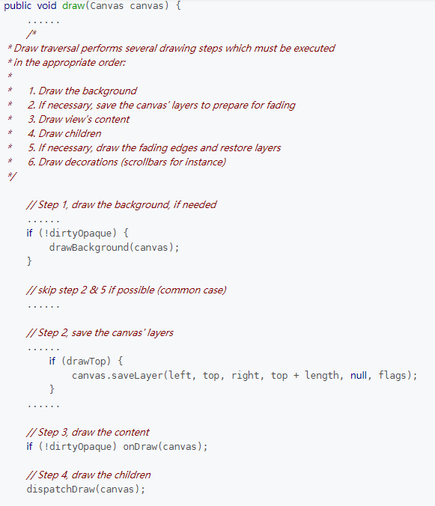
Steps of drawing
ViewGroup does not override draw(),
let’s take a look how View class implements this method
1. Draw the background : drawBackGround()
2. If necessary, save the canvas' layers to prepare for fading
3. Draw view's content : onDraw()
4. Draw children : dispatchDraw()
5. If necessary, draw the fading edges and restore layers
6. Draw decorations (scrollbars for instance)
Notes:
官方的source code裡面說: 第二步和第五步不重要，而第6步是畫scrollbar 我們節約時間這邊只會講1 3 4 ， 也是我們必須要知道的
大家想看Source Code嗎? 我們大概看一下 才知道怎樣去Custom 我們的onDraw()

Slide 46
Draw
BackGround
onDraw
Dispatch
Draw
View
繪製流程
private void drawBackground(Canvas canvas) {
//取得xml中透過android:background設定的attribute
或者程式中setBackgroundColor()、setBackgroundResource()
等設定的背景Drawable
final Drawable background = mBackground;
......
//依據layout過程確定的View 位置(rlbt)来設定背景的繪製區塊
if (mBackgroundSizeChanged) {
background.setBounds(0, 0, mRight - mLeft, mBottom - mTop); mBackgroundSizeChanged = false;
rebuildOutline();
}
......
background.draw(canvas);
......
}
Measure
Layout
Draw
End

Slide 47
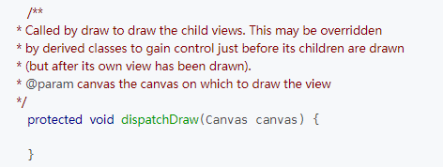
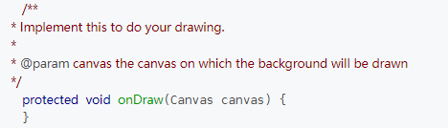
Draw
BackGround
onDraw
Dispatch
Draw
View
繪製流程
onDraw(): draw View’s Content
dispatchDraw(): draw children
Let’s think about it. What are there inside these 2 methods of a View?
Measure
!!!!
Layout
They are both Empty​
Draw
Because the native View class does not have any content and it does not have any child neither.
End
Notes:
我們先猜一下View 裡面的onDraw 跟 DispatchDraw會有什麼內容。
他們都是空的!
View是基本的顯示內容，因為沒有content.. 沒有需要顯示的內容所以是空方法\
而且他沒有Child，所以這邊會是空的
ViewGroup是有

Slide 48
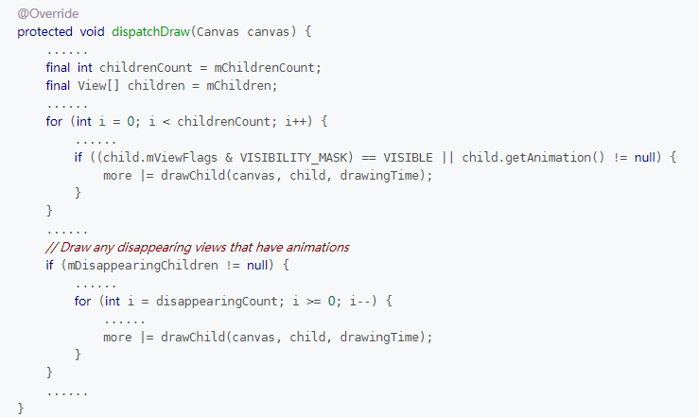
Draw
BackGround
onDraw
Dispatch
Draw
View
繪製流程
dispatchDraw() in ViewGroup:
Iterate over all children and call ondraw() of every child.
Measure
What we need to do is to override ondraw()!
Layout
Draw
End

Slide 49
Recap: Stack call and FlowChart of Draw
Perform
Traversal()
View
Group
draw
ondraw
dispatch
Draw
Measure()
HasNext
Child View?
End
getMeasured
Width/Height()
NextView:
View or ViewGroup?
Layout()
onDraw
draw
View
View
Draw()
ViewGroup

Slide 50
Now, we know the entire drawing procedure of View and ViewGroup
View
繪製流程
Measure: Given Layout parameters and parent MesureSpec, measure height and width of a View
Layout: Given measured height and width of itself and children, put children in a customized way by setting its (r,l,b,t).
Draw: Given a rectangular area bounded by (r,l,b,t), draw view’s content
Measure
Layout
Draw
End

Slide 51
Recap: Stack call and FlowChart of Measure
Perform
Traversal()
HasNext
Child View?
View
Group
onMeasure
Measure
Children
setMeasuredDimension
getRoot
MeasureSpec()
Measure
Child
Measure()
NextView:
View or ViewGroup?
Layout()
SetMeasuredDimension
onMeasure
View
View
Draw()
ViewGroup

Slide 52
Recap: Stack call and FlowChart of layout()
Perform
Traversal()
View
Group
layout
setFrame
onLayout
Measure()
HasNext
Child View?
End
getMeasured
Width/Height()
NextView:
View or ViewGroup?
Layout()
setFrame
Layout
View
View
Draw()
ViewGroup

Slide 53
Recap: Stack call and FlowChart of Draw
Perform
Traversal()
View
Group
draw
ondraw
dispatch
Draw
Measure()
HasNext
Child View?
End
getMeasured
Width/Height()
NextView:
View or ViewGroup?
Layout()
onDraw
draw
View
View
Draw()
ViewGroup

Slide 54
How to use each Type?
Compound Components
Custom
ViewGroup
Custom
View
Encapsulate
existing android widgets.
Override Touch Event.
Expose interface
to outside
Mostly override onlayout() ,onMeasure().
Override TouchEvent
The key point is to override onMeasure() and onDraw().
Override TouchEvent

Slide 55
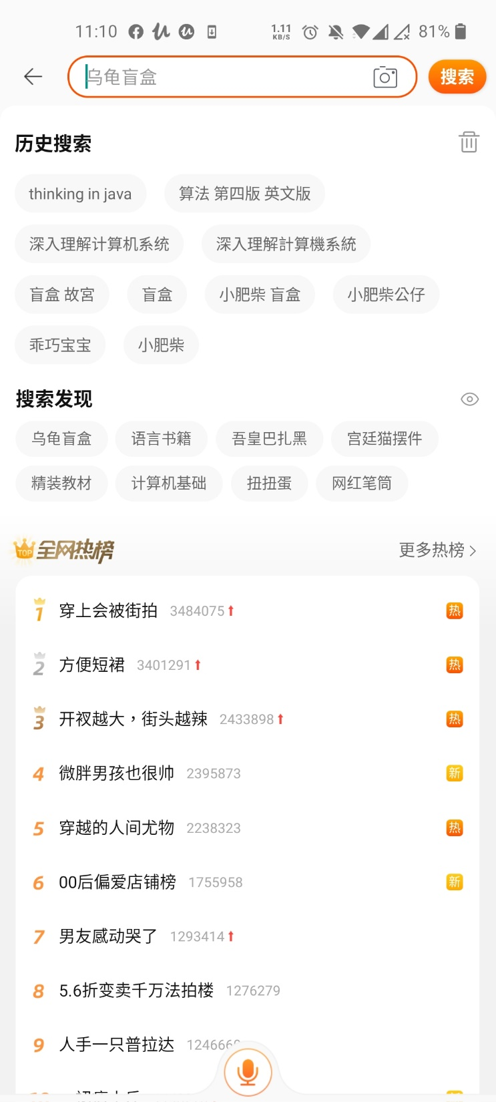
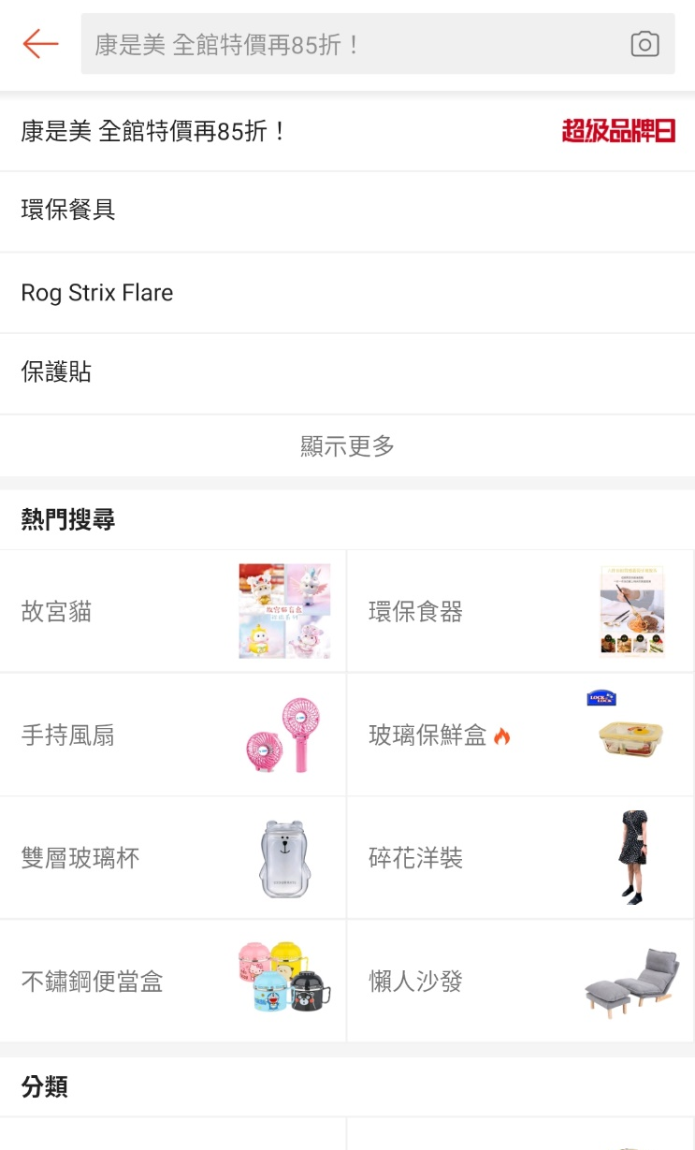
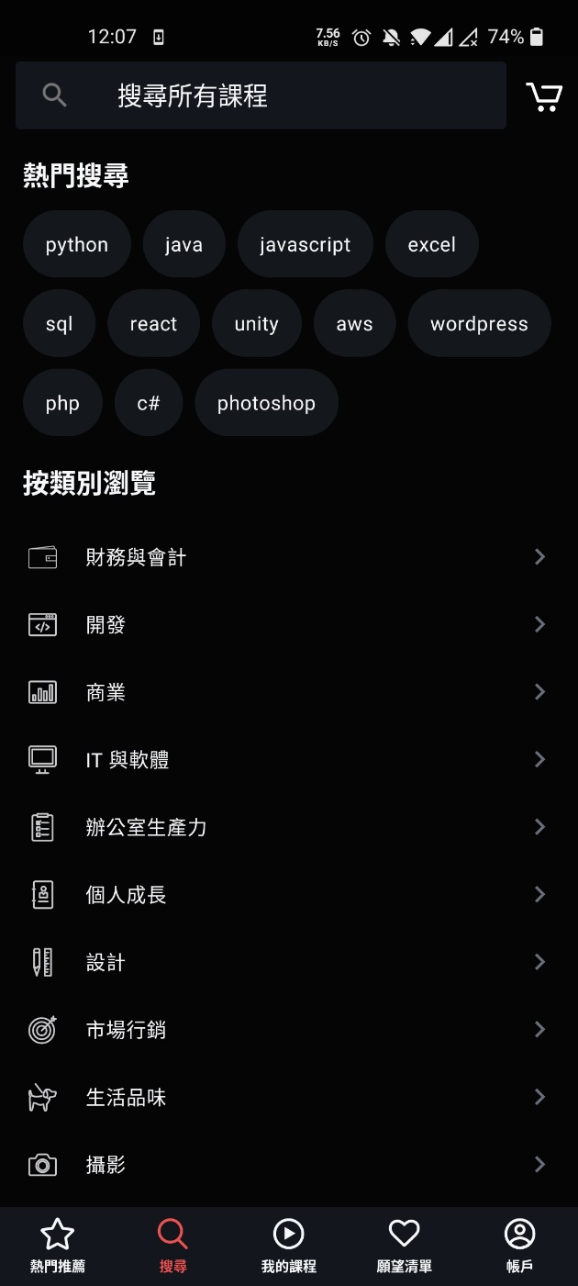
Example of Custom ViewGroup: FlowLayout

Slide 56
Implementing Procedure
開始
1. Set up Adapter
2. Pass Data set or Create inside
3.Wrap Data set in .XML
Extends
ViewGroup
Define/Retrieve
Attributes
The Key Point of Laying Children: Dynamically Compute Coordinates and Height and Width. It is prone to make bugs.
Add Child Views
Measure
Self/
Children
LayChildren
Define Interface
Handle TouchEvent

