Slide 1
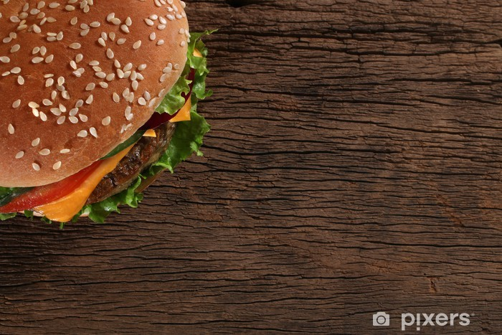
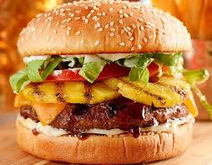
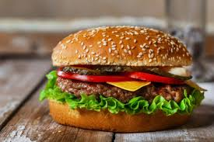
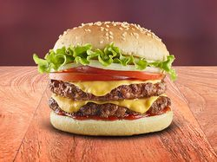
Delicious
Burger

Slide 2
Products
According to the last survey conducted
during the first week of January 2024,
95% of our customers are satisfied with
the services provided, where 50% prefer
the cheeseburger with fried egg,
and the other 50% prefer the Hawaiian
burger with bacon.

Slide 3
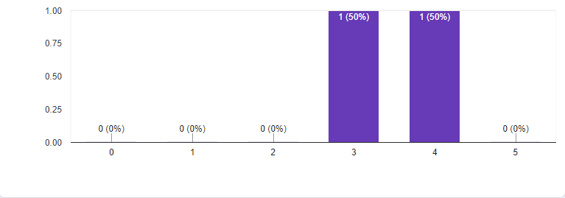
At the beginning of 2020, we started with a simple hamburger that thanks to the customer service we were able to improve based on their preferences and suggestions to improve the service provided so that the following graph shows how satisfied they are with the products offered.

Slide 4
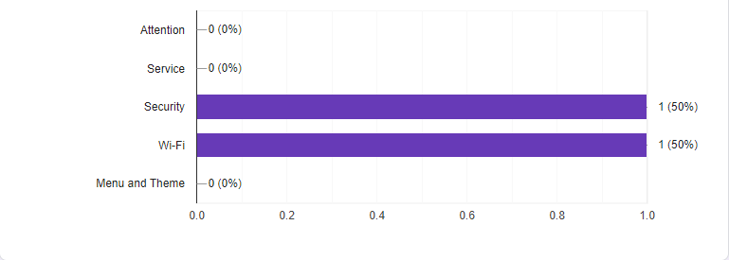
Thanks to this, we can objectively focus on the following areas of opportunity for improvement and implementation, such as the equipment of the playground or children's area, and the points for improvement shown in the following graph, like security and Wi-Fi service.

Slide 5
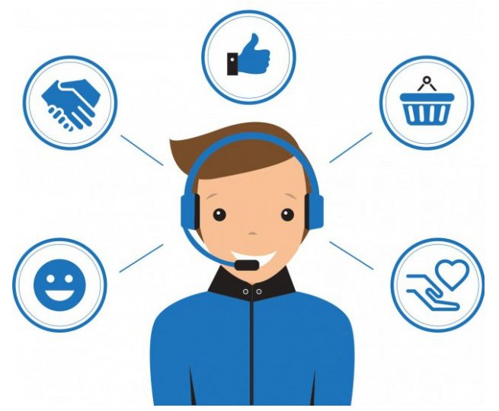
Customer Service
Most customers are satisfied with the
service that is provided as a plus to their
consumption, by delivering at the door of
their home, allowing them to place their
order by WhatsApp and receive it in the
comfort of their home.

Slide 6
Comparative
Business | Product | Price
Delicious burger | Cheez burger with fried egg | $65.00 – $80.00
Cheez burger | Cheez burger with fries | $159.00 - $180.00
La Wa-Wa | Cheez burger with house chilli | $95.00 – $120.00
Our price is the most accessible to
the competition, making home delivery
at no extra charge as a plus to the
purchases made even if they do not
have much virtual presence, and our
customers automatically recommend us
to their family and friends personally.

Slide 7
Our Plan
To continue providing the service
expected by our customers, we must
make the expected improvements to
their suggestions, we will inform them
that since we started we have maintained
the same price and due to inflationary
changes we can no longer maintain it
and in exchange, we will continue giving
the same plus of delivering it to their
homes at no extra charge.

Slide 8
Action Plan
With these changes, we will be able to increase our profits by 50% in the initial part and later we will offer new offers and promotions that will allow us to be at the forefront and public preference, doubling our net profits compared to previous years.

Slide 9

Keep going!
We will continue to work on the surveys to obtain automatic feedback on the customer service provided to our clients, supported by the 4 P's, to find the areas of opportunity and reinforce those already implemented.

Slide 10
Thanks for your attention and dedication to obtain the expected results. Let´s make the things happen!
Delicious
Burger

