Slide 1







GROUP 3
Strategy and Strategic Planning &
Security Plans and Policies

Slide 2



A. Strategy
B. Strategic Planning and Security Strategy
C. The information Security Lifecycle
D. Architecting the Enterprise
E. Levels of Planning
F. Planning Misalignment
G. System Security Plan (SSP)
H. Policy Development and Implementation

Slide 3
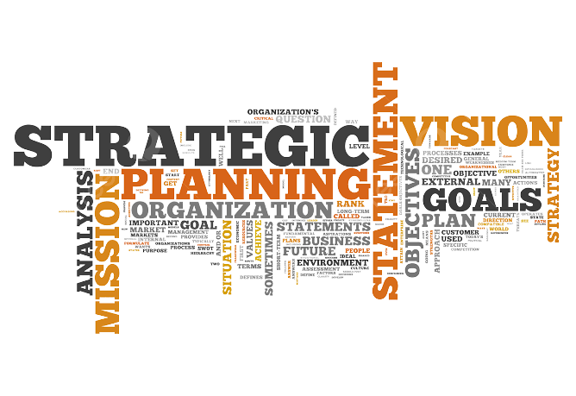
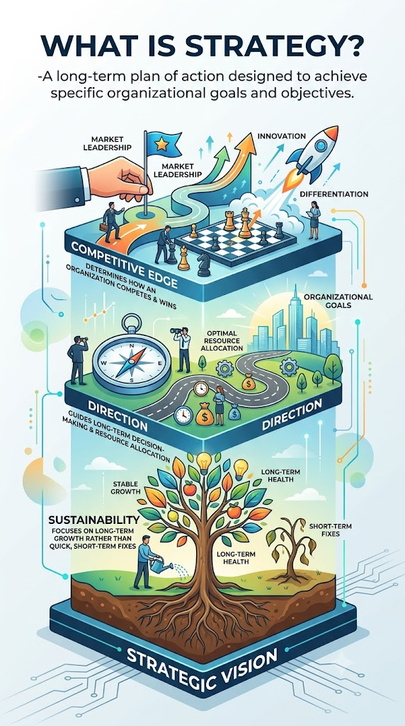



Strategy
What is Strategy?
-A long-term plan of action designed to achieve specific organizational goals and objectives.
Core Focus
  Competitive Edge: Determines how an organization competes and wins in the market.
  Direction: Guides long-term decision-making and optimal resource allocation.
  Sustainability: Focuses on long-term growth rather than quick, short-term fixes.
Crueta

Slide 4
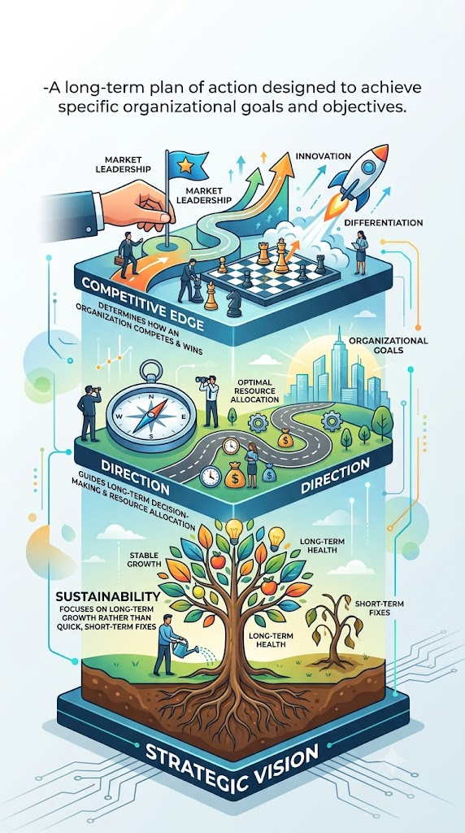
Strategy
Importance of Strategy
  Clear Direction: Provides a clear roadmap so everyone works toward the same goals.
  Better Decision-Making: Helps leaders make consistent, informed, and proactive choices.
  Resource Optimization: Ensures money, human talent, and technology are used efficiently.
  Competitive Advantage: Keeps the organization ahead of its competitors.
  Adaptability: Prepares the business to navigate market changes and uncertainties.
Crueta

Slide 5
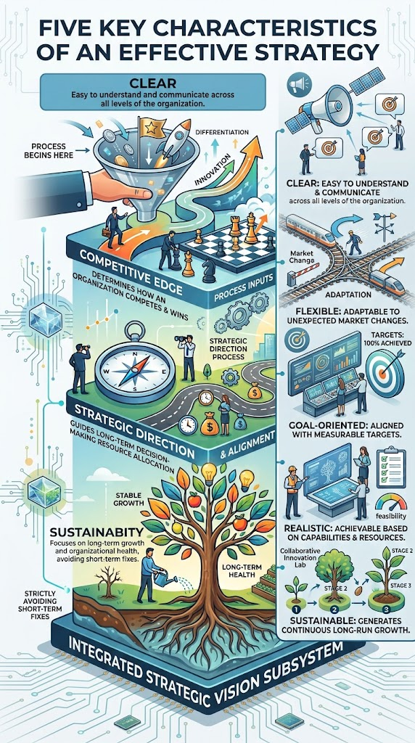
Strategy
Characteristics of an Effective Strategy
  Clear: Easy to understand and communicate across all levels of the organization.
  Flexible: Dynamic enough to adapt to unexpected market changes.
  Goal-Oriented: Directly aligned with reaching measurable targets.
  Realistic: Achievable based on available capabilities and resources.
  Sustainable: Capable of generating continuous growth over the long run.
Crueta

Slide 6
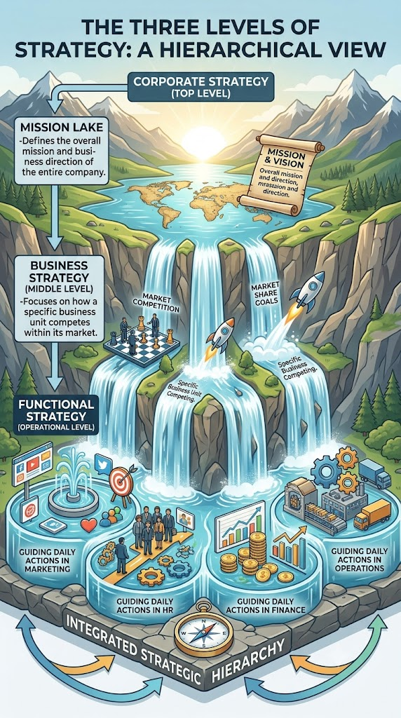
Strategy
Levels of Strategy
  Corporate Strategy (Top Level)
    Defines the overall mission and business direction of the entire company.
  Business Strategy (Middle Level)
    Focuses on how a specific business unit competes within its market.
  Functional Strategy (Operational Level)
    Guides daily actions in individual departments (e.g., Marketing, HR, Finance, Operations).
Crueta

Slide 7
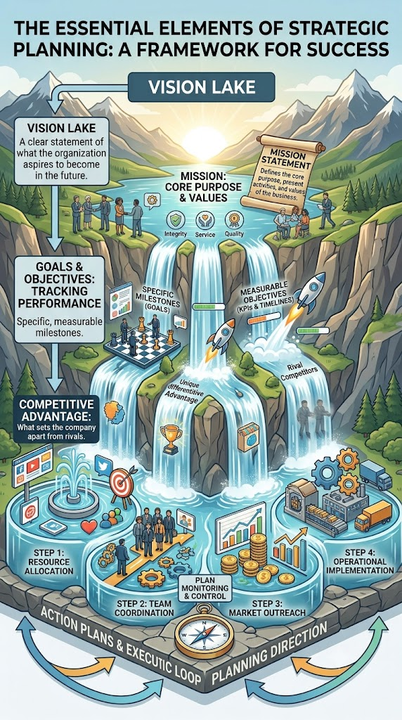
Components of Strategy
The Essential Elements of Strategic Planning
    Vision: A clear statement of what the organization aspires to become in the future.
    Mission: Defines the core purpose, present activities, and values of the business.
    Goals & Objectives: Specific, measurable milestones to track performance.
    Competitive Advantage: What sets the company apart from rivals.
    Action Plans: Detailed step-by-step procedures to execute strategy effectively.
Crueta

Slide 8
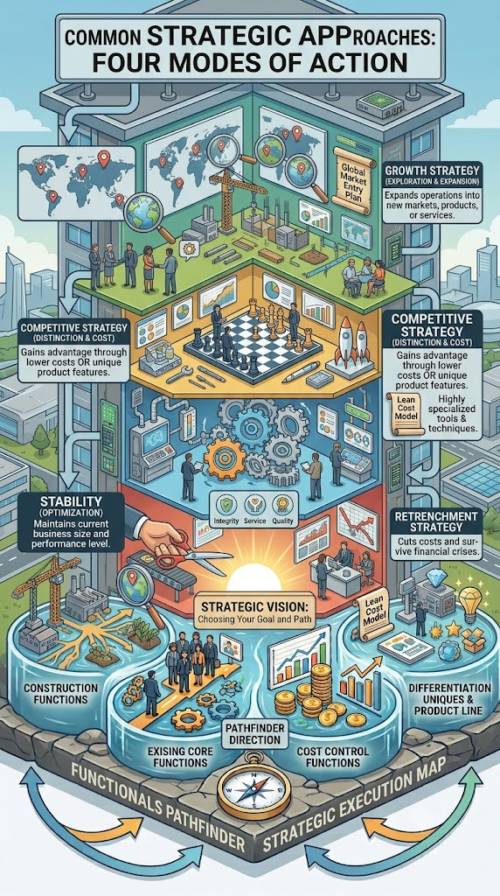
Types of Strategy
Common Strategic Approaches
  Growth Strategy: Expands operations into new markets, products, or services.
  Stability Strategy: Maintains current business size and performance level.
  Retrenchment Strategy: Cuts costs and reduces operations to survive financial crises.
  Competitive Strategy: Focuses on gaining advantage through lower costs or unique product features.
Crueta

Slide 9

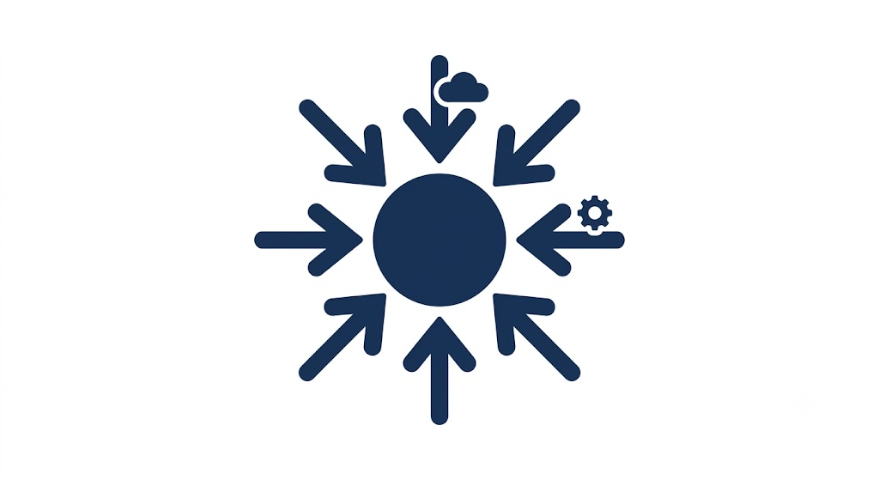
Factors Affecting Strategy
crueta
Internal Influences
External Influences
  Internal Factors (Inside Control)
  Resources: Financial & physical capital
  Employees: Skills, talent, and leadership
  Technology: Technical tools & systems
  Culture: Shared values & workplace norms
  External Factors (Outside Control)
  Competition: Market rivals & threat of entry
  Economy: Inflation, interest rates, & growth
  Government: Laws, policies, & taxes
  Customer Needs: Changing demands & trends

Slide 10
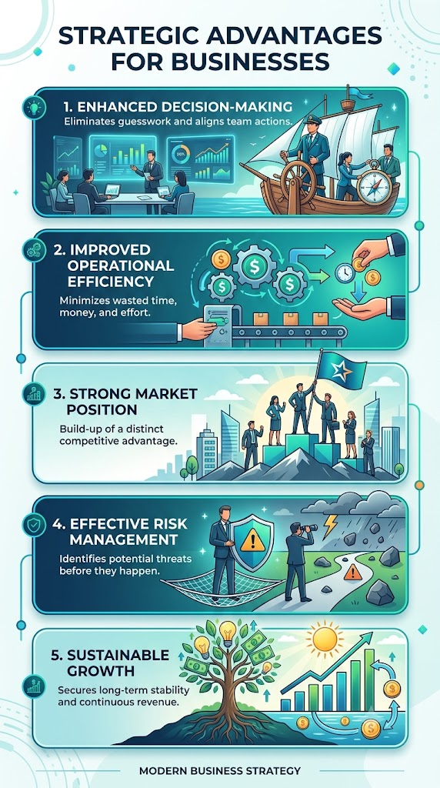
Benefits of Strategy
Strategic Advantages for Businesses
  Enhanced Decision-Making: Eliminates guesswork and aligns team actions.
  Improved Operational Efficiency: Minimizes wasted time, money, and effort.
  Strong Market Position: Build-up of a distinct competitive advantage.
  Effective Risk Management: Identifies potential threats before they happen.
  Sustainable Growth: Secures long-term stability and continuous revenue.
Crueta

Slide 11
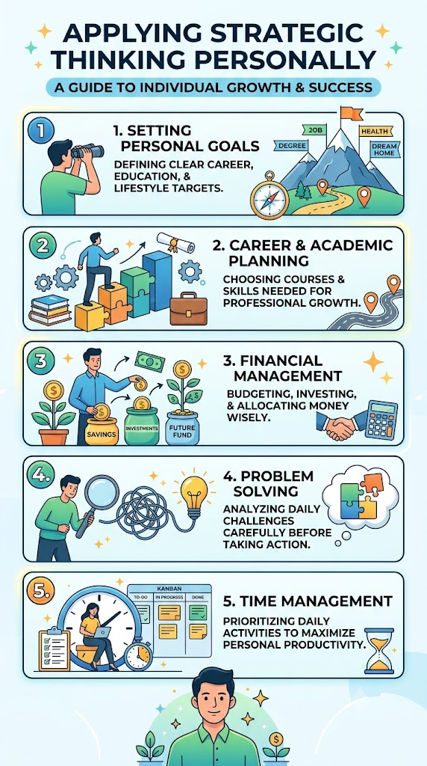
Strategy in Everyday Life
Applying Strategic Thinking Personally
  Setting Personal Goals: Defining clear career, education, and lifestyle targets.
  Career & Academic Planning: Choosing courses and skills needed for professional growth.
  Financial Management: Budgeting, investing, and allocating money wisely.
  Problem Solving: Analyzing daily challenges carefully before taking action.
  Time Management: Prioritizing daily activities to maximize personal productivity.
Crueta

Slide 12
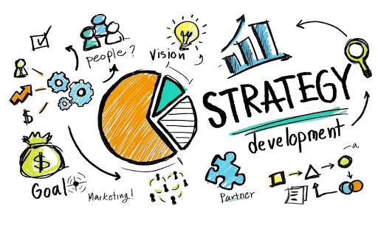




Strategic Planning and Security Strategy
"Information technology and business are becoming inextricably interwoven. I don't think anybody can talk meaningfully about one without talking about the other."— Bill Gates
EGO

Slide 13
Strategic Planning and Security Strategy
Definition and Importance of Strategic Planning
  Strategic Planning is the roadmap: it is the process of aligning IT investments with the overarching goals of the business to create value, drive innovation, and ensure long-term growth.
  Security Strategy is the shield: it is the framework of policies, risk management, and governance that protects the organization's assets, ensuring that as the business grows, it remains resilient against evolving threats.
EGO

Slide 14
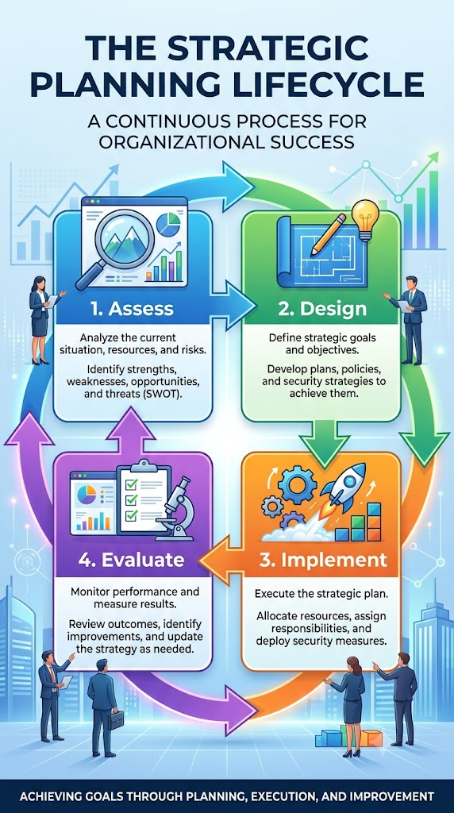
IT STRATEGIC PLANNING
Strategic planning is the process of setting an organization's long-term goals and creating a roadmap to achieve them. In IT, it ensures that technology and cybersecurity initiatives support the organization's overall business objectives.
Importance of Strategic Planning
  Provides Direction – Establishes clear goals and priorities.
  Aligns IT with Business Goals – Ensures technology supports organizational success.
  Improves Resource Allocation – Helps prioritize budgets, people, and technology.
  Manages Risks – Identifies and prepares for potential security threats.
  Supports Business Continuity – Keeps operations running during disruptions.
  Enhances Security – Strengthens protection of systems, data, and networks.
EGO

Slide 15
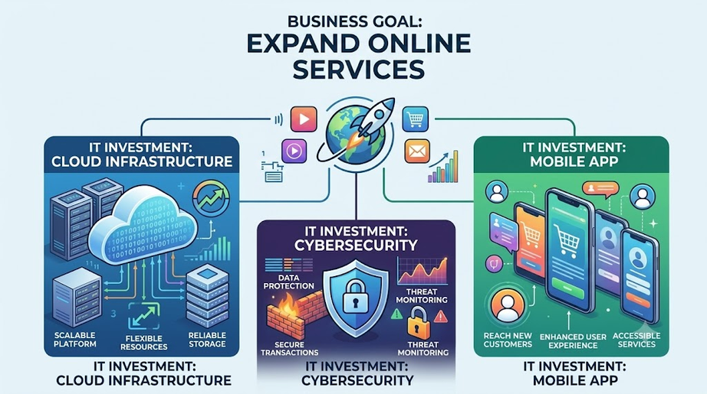
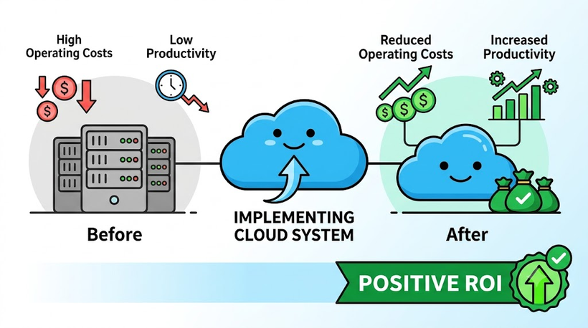
IT STRATEGIC PLANNING
EGO
Aligning IT investments with overarching business goals
Measuring IT value and return on investment (ROI)
Definition
Ensuring IT investments support the organization's goals and long-term strategy.
Importance
  Supports business objectives
  Maximizes ROI
  Improves efficiency
  Prioritizes high-value projects
Definition
Measuring IT value and ROI evaluates whether technology investments deliver benefits that justify their costs.
Importance
  Measures investment effectiveness
  Supports better decision-making
  Identifies high-value projects
  Optimizes IT spending

Slide 16
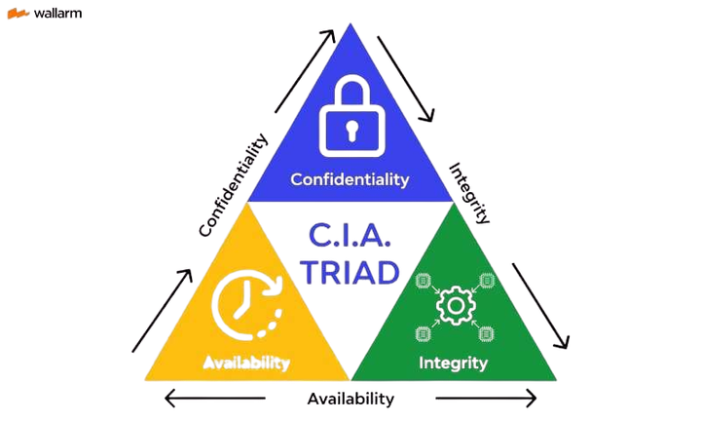
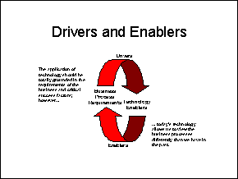
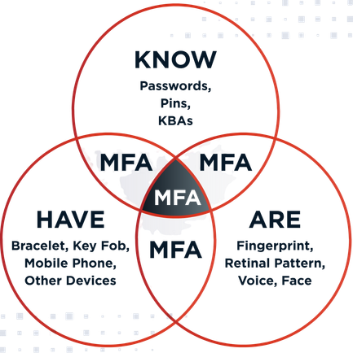
EGO
Foundations of Security Strategy
Business Enabler vs. an IT Roadblock
Balancing Usability, Budget, and Security Controls
C.I.A. TRIAD
The Core principle of information security used to protect organizational data and systems.
  Confidentiality – Prevents unauthorized access to information.
  Integrity – Ensures data is accurate and unaltered.
  Availability – Ensures systems and data are accessible when needed.
Business Enabler
  Protects data and customer trust
  Supports compliance
  Enables safe innovation
IIT Roadblock
  Overly restrictive controls
  Reduced productivity
  User frustration
Organizations must balance security, user convenience, and cost when implementing security measures.
Considerations
  Usability – Easy for users to follow.
  Budget – Cost-effective security investments.
  Security Controls – Appropriate protection against risks.

Slide 17
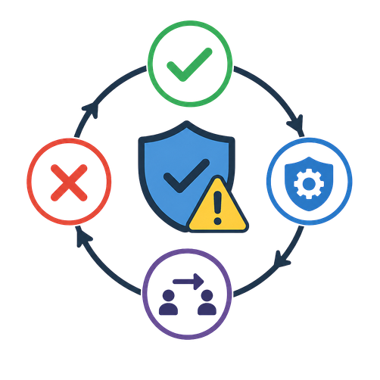
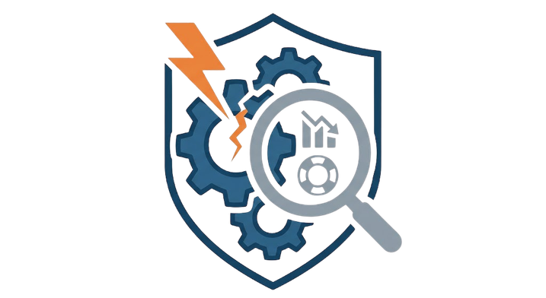
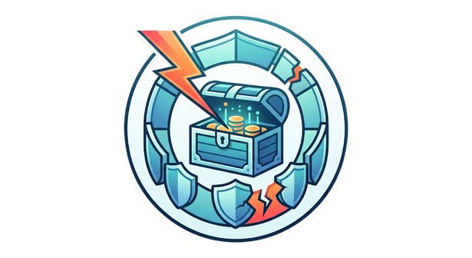
IT Risk Management
Risk Assessment: Identifying Assets, Threats, and Vulnerabilities
Risk Treatment Strategies
Conducting a Business Impact Analysis (BIA)
Risk treatment determines how an organization responds to identified risks.
  Accept – Tolerate the risk.
  Mitigate – Reduce the risk with security controls.
  Transfer – Shift the risk (e.g., insurance or outsourcing).
  Avoid – Eliminate the activity causing the risk.
A Business Impact Analysis (BIA) identifies critical business functions and evaluates the impact of disruptions.
Importance
  Identifies critical operations
  Estimates financial and operational impact
  Supports disaster recovery planning
Risk assessment identifies what needs protection, what could cause harm, and the weaknesses that attackers can exploit.
  Assets – Valuable resources (data, systems, hardware)
  Threats – Potential dangers (hackers, malware, disasters)
  Vulnerabilities – Weaknesses that threats can exploit

Slide 18
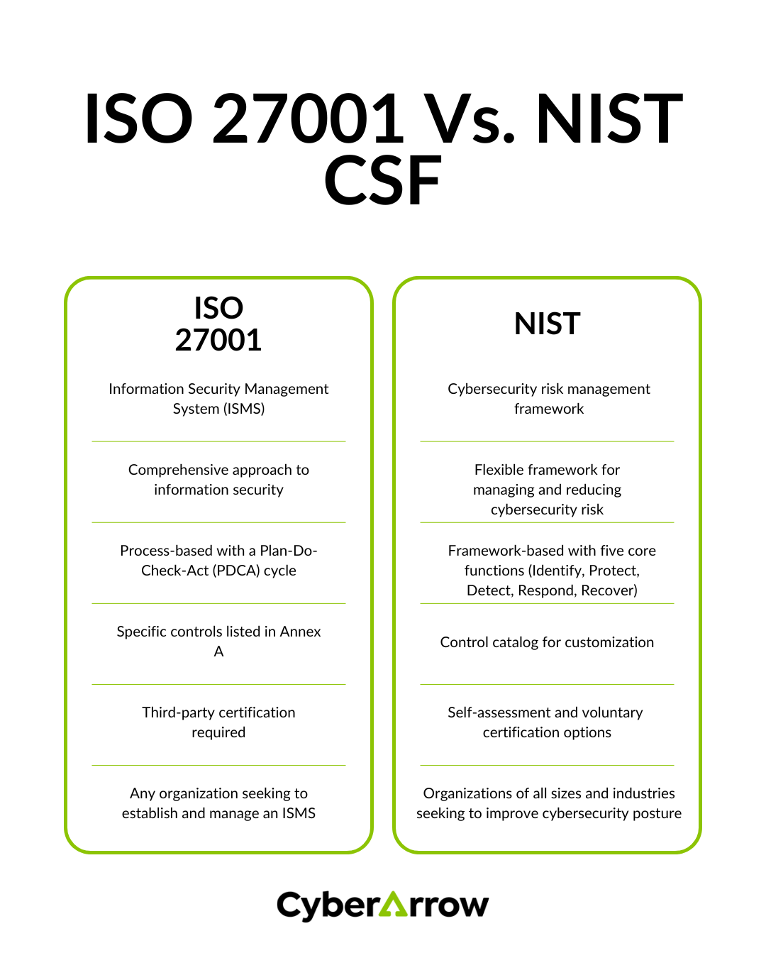
EGO
Security Governance and Frameworks
Security Frameworks (NIST CSF & ISO 27001)
Security frameworks provide best practices and guidelines for managing cybersecurity risks and protecting information.
  NIST Cybersecurity Framework (CSF) – Focuses on Identify, Protect, Detect, Respond, and Recover.
  ISO 27001 – An international standard for establishing and managing an Information Security Management System (ISMS).

Slide 19
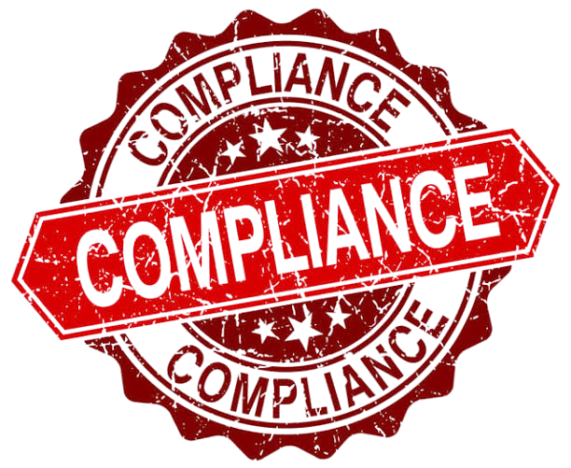
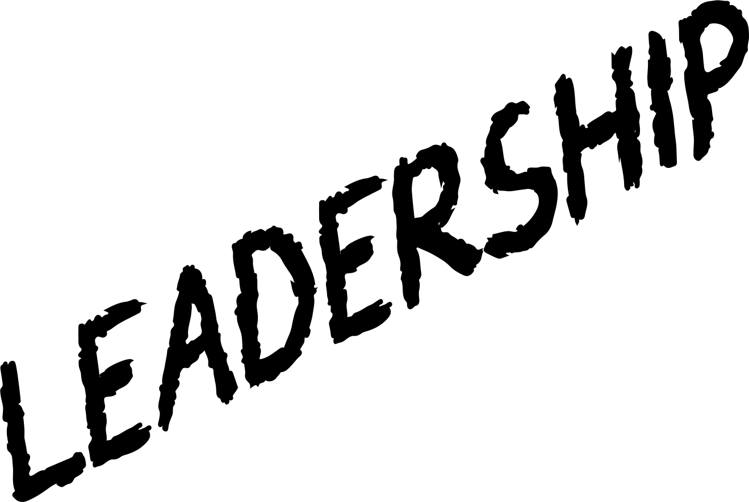
EGO
Security Governance and Frameworks
Regulatory Compliance and Data Privacy Laws
Role of Leadership and Security Governance Boards
Organizations must comply with laws and regulations that protect personal and sensitive information.
Importance
  Protects customer data
  Avoids legal penalties
  Builds trust and reputation
  Ensures regulatory compliance
Leadership and governance boards oversee cybersecurity strategy, policies, and risk management to ensure security aligns with business goals.
Responsibilities
  Set security policies and objectives
  Allocate security budgets and resources
  Manage organizational risks
  Ensure compliance with regulations

Slide 20
Security Plans and Policies
EGO
Hierarchy of Governance
Essential Enterprise Policies
The Policy Lifecycle
Security governance is organized into different levels to ensure consistent implementation.
  Policies – High-level security rules and objectives.
  Standards – Mandatory requirements that support policies.
  Guidelines – Recommended best practices (optional).
  Procedures – Step-by-step instructions for completing tasks.
Enterprise policies establish rules to protect organizational information and resources.
  Acceptable Use Policy (AUP) – Defines proper use of company IT resources.
  Access Control Policy – Specifies who can access systems and data.
  Data Classification Policy – Categorizes data based on sensitivity (e.g., Public, Internal, Confidential).
The policy lifecycle ensures security policies remain effective and up to date.
  Creation – Develop the policy.
  Enforcement – Implement and apply the policy.
  Training – Educate employees on compliance.
  Review – Update the policy as risks and business needs change.

Slide 21
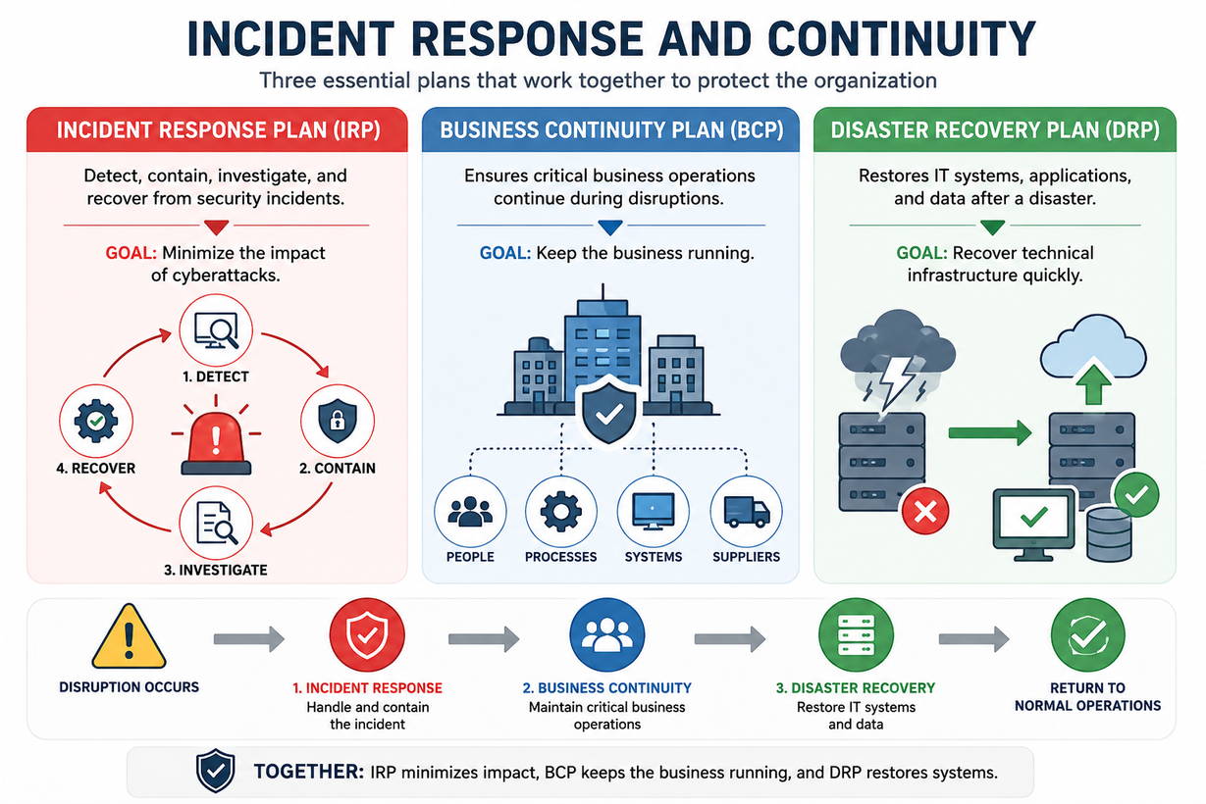
EGO
Incident Response and Continuity
Incident Response Plan (IRP)
  Detect, contain, investigate, and recover from security incidents.
  Goal: Minimize the impact of cyberattacks.
Business Continuity Plan (BCP)
  Ensures critical business operations continue during disruptions.
  Goal: Keep the business running.
Disaster Recovery Plan (DRP)
  Restores IT systems, applications, and data after a disaster.
  Goal: Recover technical infrastructure quickly.

Slide 22



Andaya
The information security lifecycle
The information security lifecycle
The Information Security Lifecycle is a continuous and systematic process used by organizations to protect information assets throughout their entire lifecycle. It involves planning, implementing, operating, monitoring, reviewing, and continuously improving security controls to ensure information remains secure against evolving cyber threats and business changes. Unlike a one-time security project, the Information Security Lifecycle is an ongoing cycle that adapts to new technologies, regulations, and security risks.

Slide 23
Andaya
The Six Phases of the Information Security Lifecycle
Planning
Implementation
Planning is the first phase of the Information Security Lifecycle where an organization identifies its valuable information assets, evaluates potential threats and vulnerabilities, assesses risks, and develops security goals, policies, and strategies. This phase establishes the foundation for protecting information by determining what needs to be secured and how security measures will be implemented.
Implementation is the phase of the Information Security Lifecycle where the planned security measures and controls are put into action. Organizations deploy technologies, configure security settings, enforce policies, and provide user training to protect information systems from threats and unauthorized access.
Operation
Monitoring
Operation is the phase of the Information Security Lifecycle where implemented security controls are used, managed, and maintained during daily business operations. Organizations ensure that systems remain secure by performing routine maintenance, managing user accounts, creating backups, and responding to security incidents.
Monitoring is the phase where organizations continuously observe their networks, systems, and applications to detect suspicious activities, security threats, or policy violations. This helps identify potential attacks early and enables a quick response to minimize damage.

Slide 24
Andaya
The Six Phases of the Information Security Lifecycle
Review
Continuous Improvement
Review is the phase where organizations evaluate the effectiveness of their information security controls, policies, and procedures. Regular audits, vulnerability assessments, and penetration testing help identify weaknesses and ensure compliance with security standards.
Continuous Improvement is the final phase of the Information Security Lifecycle where organizations enhance their security practices based on lessons learned, new technologies, and emerging cyber threats. This ensures that information security remains effective over time.

Slide 25
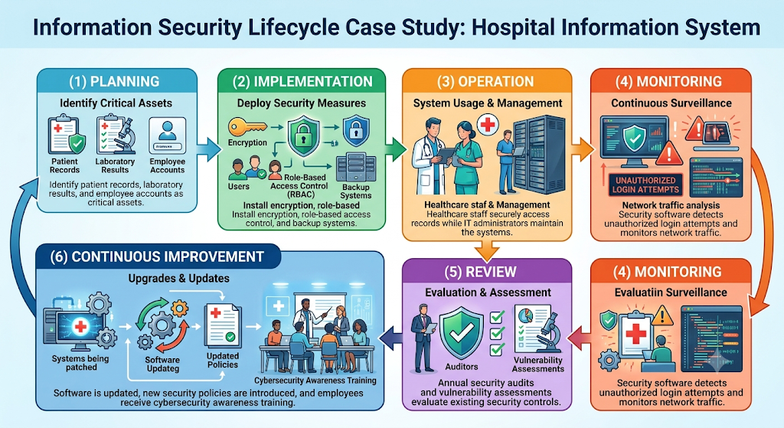
Applying the Information Security Lifecycle
Andaya
Notes:
(1) Planning – Identify Critical Assets
Sa Planning phase, dito muna ina-identify ng hospital kung ano ang mga pinakamahalagang assets na kailangang protektahan. Kasama rito ang patient records, laboratory results, at employee accounts dahil lahat ng ito ay may sensitive at confidential information.
Pagkatapos, nagsasagawa sila ng risk assessment para malaman kung anu-anong cyber threats o vulnerabilities ang puwedeng makaapekto sa system. Base sa resulta nito, gumagawa sila ng security policies at objectives na magiging guide sa buong security process.
Key idea: Alamin muna kung ano ang kailangang protektahan bago mag-implement ng security measures.
(2) Implementation – Deploy Security Measures
Pagkatapos ng planning, ina-apply na ng hospital ang mga security controls para maprotektahan ang kanilang information system.
Kasama rito ang:
* Encryption, para maging unreadable ang patient data kapag may unauthorized access.
* Role-Based Access Control (RBAC), para ang bawat employee ay makaka-access lang ng data na kailangan nila sa trabaho nila.
* Backup systems, para may copy ng important files kung sakaling magkaroon ng system failure o cyberattack.
Key idea: I-implement ang tamang security technologies at policies para maprotektahan ang hospital data.
(3) Operation – System Usage and Management
Sa Operation phase, ginagamit na ng hospital ang system sa kanilang araw-araw na operations.
Ang mga doctors, nurses, at laboratory staff ay secure na nakakakita ng patient records ayon sa kanilang assigned roles. Samantala, ang IT administrators ang responsible sa pag-maintain ng system, pag-manage ng user accounts, pag-install ng updates, at pagtiyak na laging secure ang buong network.
Key idea: Habang ginagamit ang system araw-araw, tuloy-tuloy pa rin ang pagpapanatili ng security.
(4) Monitoring – Continuous Surveillance
Hindi sapat na naka-install lang ang security controls. Kaya sa Monitoring phase, tuloy-tuloy na mino-monitor ng hospital ang kanilang network at systems.
Gumagamit sila ng security software para makita kung may:
unauthorized login attempts,
suspicious activities,
o unusual network traffic.
Kapag may na-detect na possible attack, agad itong ina-alert sa IT security team para mabilis nilang maimbestigahan at ma-stop ang problema bago ito lumala.
Key idea: Ma-detect agad ang cyber threats bago sila makapag-cause ng malaking damage.
(5) Review – Evaluation and Assessment
Sa Review phase, chine-check ng hospital kung effective pa ba ang kanilang security controls.
Ginagawa ito sa pamamagitan ng:
Security audits
Vulnerability assessments
Penetration testing
Dito nila nakikita kung saan pa may weaknesses ang system at kung ano ang dapat pang i-improve para mas maging secure.
Key idea: Regular na i-evaluate ang security para malaman kung may kailangang baguhin o i-improve.
(6) Continuous Improvement – Upgrades and Updates
Dahil mabilis mag-evolve ang cyber threats, kailangan ding continuous ang improvement ng security.
Regular na:
nag-u-update ng software,
nagpa-patch ng vulnerabilities,
nagdadagdag ng bagong security policies,
at nagco-conduct ng cybersecurity awareness training para sa mga employees.
Ginagamit din nila ang lessons learned mula sa previous incidents para lalo pang mapalakas ang security ng hospital.
Key idea: Laging i-update at i-improve ang security para makasabay sa mga bagong cyber threats.
Overall Explanation
Mapapansin sa diagram na paikot ang proseso, ibig sabihin continuous cycle siya. Pagkatapos ng Continuous Improvement, babalik ulit ang hospital sa Planning phase para mag-identify ng mga bagong risks at gumawa ng panibagong security strategy.
Ang cycle na ito ang tumutulong para mapanatili ang tatlong pangunahing goals ng Information Security:
Confidentiality – Tanging authorized personnel lang ang puwedeng makakita ng patient information.
Integrity – Siguradong accurate at hindi nababago ang medical records nang walang authorization.
Availability – Available ang system at patient records anumang oras na kailangan ng healthcare staff.
Conclusion
Sa pamamagitan ng Planning, Implementation, Operation, Monitoring, Review, at Continuous Improvement, napoprotektahan ng hospital ang confidential patient information, nababawasan ang cybersecurity risks, at napapanatiling secure at reliable ang kanilang information system. Dahil continuous ang Information Security Lifecycle, laging handa ang hospital sa mga bagong cyber threats at mas napapanatili ang tiwala ng mga pasyente sa kanilang healthcare services.

Slide 26


Andaya
2/2
Best Practices and Common Challenges
01
02
Best Practices
  Conduct regular risk assessments.
  Keep systems updated.
  Train employees regularly.
  Implement Multi-Factor Authentication (MFA).
  Perform regular backups.
  Develop an incident response plan.
  Monitor systems continuously.
Common Challenges
  Rapidly evolving cyber threats
  Human error
  Insider attacks
  Budget limitations
  Legacy systems
  Regulatory compliance

Slide 27
Andaya
Architecting the Enterprise
Architecting the Enterprise
Enterprise Architecture (EA) is the process of designing and organizing an organization's business processes, information systems, data, applications, and technology infrastructure into a unified framework that supports its strategic goals. Enterprise Architecture acts as the organization's blueprint, ensuring that technology investments align with business objectives while improving efficiency, security, scalability, and decision-making.

Slide 28

Andaya
4/4
Components of Enterprise Architecture
Key Components to Understand
Defines business goals, organizational structure, and business processes.
Example: Customer Service Process
Defines how software applications interact.
Example: Payroll System connected to the Human Resource System
BUSINESS ARCHITECTURE
APPLICATION ARCHITECTURE
01
03
Defines how organizational data is collected, stored, managed, and protected.
Example: Student Information Database
Defines hardware, servers, cloud services, operating systems, and networking infrastructure.
Example: Cloud Computing, Firewalls, Routers, and Virtual Machines
DATA ARCHITECTURE
TECHNOLOGY ARCHITECTURE
02
04

Slide 29



Andaya
Enterprise Architecture Frameworks
TOGAF (The Open Group Architecture Framework)
Zachman Framework
FEAF (Federal Enterprise Architecture Framework)
Provides a structured methodology for designing, implementing, and managing Enterprise Architecture.
Organizes Enterprise Architecture using different stakeholder perspectives, making complex systems easier to understand.
Developed for government agencies to standardize IT systems and improve interoperability between organizations.
Benefits
  Better decision-making
  Improved system integration
  Reduced IT costs
  Easier scalability
  Enhanced information security

Slide 30

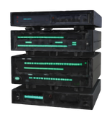


Andaya
Enterprise Architecture and Information Security
4/4
Enterprise Architecture strengthens information security by integrating security into every layer of the organization.
Business Layer
Data Layer
Application Layer
Technology Layer
  Security governance
  Policies
  Risk management
  Data encryption
  Data classification
  Backup and recovery
  Authentication
  Authorization
  Secure software development
  Firewalls
  Intrusion Detection Systems (IDS)
  Cloud security
  Network segmentation

Slide 31

Summary and Conclusion
Andaya
Information Security Lifecycle
  A continuous process for protecting information assets.
  Includes planning, implementation, operation, monitoring, review, and continuous improvement.
  Helps organizations manage risks and maintain business continuity.
Enterprise Architecture
  Serves as the organization's blueprint.
  Aligns business goals with IT resources.
  Improves efficiency, scalability, and security.
  Supports strategic decision-making.
Conclusion
An organization can achieve effective information security only when the Information Security Lifecycle and Enterprise Architecture work together. The lifecycle provides a continuous process for protecting information, while Enterprise Architecture ensures that business processes, technology, and security are aligned to support organizational goals, manage risks, and adapt to evolving cybersecurity challenges.

Slide 32
The Role of Planning in Security
Planning — the process of setting objectives and determining, in advance, the actions required to achieve them.
Planning is the management function that turns security intent into structured, executable work. Without it, even well-funded security programs tend to become reactive: responding to incidents instead of preventing them, and spending resources inconsistently across the organization.
Security planning happens simultaneously at three organizational levels — each with its own scope, audience, and time horizon. The effectiveness of a security program depends heavily on how well those three levels connect to one another.
tapit

Slide 33
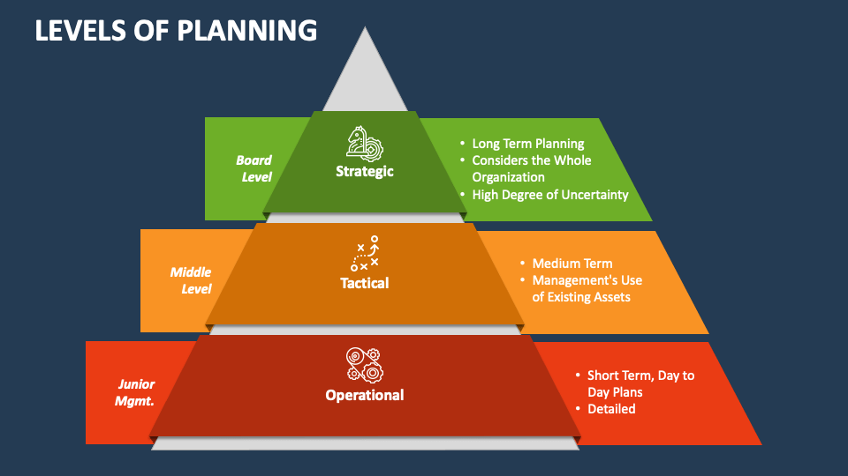
The Planning Hierarchy
Each level adds detail, specificity, and a shorter timeline to the one above. A strategic goal is broad; at the operational level, it becomes a concrete task with an owner and deadline.
If any level is built in isolation, the chain breaks—resulting in strategic goals no one pursues or daily tasks that serve no larger purpose.
tapit

Slide 34
Strategic-Level Planning
Strategic-level plans set the outer boundary within which every tactical and operational plan must fit. They rarely specify how something will be done, only what the organization is committing to and why.
Example: The organization commits to migrating to a zero-trust security architecture over the next five years.
Time horizon | 3–5+ years
Owned by | Executive leadership, CISO
Focus | Organization-wide direction, major resource commitments
Output | Broad goals and priorities — not task lists
tapit

Slide 35
Tactical-Level Planning
Tactical planning is where "why" becomes "how." A department manager takes a strategic direction and works out the specific initiatives, staffing, and budget needed to move toward it within a realistic time frame.
Example: The IT department plans and budgets the rollout of multi-factor authentication across all systems within the next 18 months, as one step toward the zero-trust goal.
Time horizon | 1–3 years
Owned by | Department / mid-level managers
Focus | Translating strategic goals into concrete projects and initiatives
Output | Project plans, budgets, timelines, milestones
tapit

Slide 36
Operational-Level Planning
This is planning at its most concrete — the actual work that keeps systems secure day to day. It rarely involves setting new direction; instead, it's about scheduling and completing the tasks that tactical plans call for.
Examples: Weekly patch deployment schedule · quarterly security awareness training sessions · monthly access-log audits.
Time horizon | Days to weeks
Owned by | Supervisors and front-line staff
Focus | Daily execution of tactical initiatives and real‑time coordination
Output | Task lists, schedules, checklists
tapit

Slide 37
Documents and Deliverables Across Planning Levels
Each planning level doesn't just differ in scope — it produces a different kind of document, aimed at a different audience.
STRATEGIC
TACTICAL
OPERATIONAL
The strategic security plan is the document that answers "where are we headed, and why?"
  Reads more like a vision statement than a task list
  Rarely mentions specific tools, vendors, or dates beyond the year
  Gets revisited only every few years, not monthly
The project or program plan answers "what are we actually going to build or roll out?"
  Names specific initiatives, budgets, and deadlines
  Usually lives in a project tracker rather than a static document
  Gets reviewed and adjusted quarterly as work progresses
Task lists, checklists, and SOPs answer "what do I do today?"
  Written for someone to follow without needing extra context
  Focused on a single action or shift, not a multi-month effort
  Updated constantly as procedures change
A common failure point is an organization having a polished strategic plan and detailed operational checklists, but nothing connecting them at the tactical level — leaving no clear path from executive intent to daily execution. This gap is often where misalignment first takes root.

Slide 38
Planning and the CISO
If the three planning levels are a chain, the CISO (Chief information security officer) is the link that keeps it from breaking. This role sits at the intersection of executive strategy and operational reality, translating in both directions.
Core responsibilities in the planning process:
  Represents security's interests and constraints in executive-level strategic discussions
  Reviews tactical plans from different departments to confirm they stay consistent with strategic intent
  Monitors operational activity to verify it reflects what was actually planned upstream
  Surfaces misalignment early, before it becomes wasted work or a security gap
A CISO who is disconnected from any one of the three levels is usually the first sign that an organization's planning is starting to drift out of alignment.
tapit

Slide 39
Top-Down vs. Bottom-Up Planning
 | Top-Down | Bottom-Up
Origin | Senior management sets direction, flows downward | Operational/technical staff identify needs, pass findings upward
Strength | Strong cross-department coordination, consistent resourcing, clear authority | Draws on deep technical expertise of the people closest to the systems
Weakness | Can drift from day-to-day operational reality | Weak coordination with senior management; harder to align with overall strategy
Best suited for | Organization-wide initiatives requiring consistency | Identifying practical gaps and technical requirements
tapit

Slide 40
Causes of Planning Misalignment
Planning misalignment happens when the strategic, tactical, and operational levels stop moving in the same direction. It's rarely caused by one big failure — usually it's several small gaps compounding over time.
People & communication
  Breakdowns in communication between executive, management, and operational levels
  No single owner (e.g., CISO) coordinating across all three levels
Structure
  Departmental silos — units planning in isolation, without cross-functional input
  Mismatched timelines, or a missing tactical layer connecting strategy to daily tasks
Approach
  Pure top-down planning that ignores operational realities
  Pure bottom-up planning that ignores organizational direction
tapit

Slide 41
Consequences and Fixes for Misalignment
The cost of misalignment:
Wasted budget and staff time · unaddressed security gaps · low buy-in from the teams expected to execute the plan · plans that look good on paper but are never actually completed.
The fix — Hybrid (Countercurrent) Planning:
  Leadership initiates — sets overall direction and goals (top-down)
  Teams refine — operational and tactical staff build out detailed, practical plans grounded in real constraints (bottom-up)
  Iterative review — plans move back up for adjustment and reconciliation
  Final approval — leadership signs off once strategic and operational realities are reconciled
The goal isn't to pick top-down or bottom-up — it's to build a deliberate feedback loop between them, so strategic ambition and operational feasibility inform each other instead of working in isolation.
tapit

Slide 42


SYSTEM SECURITY PLAN
SSP Fundamentals & System Scoping
What is System Security Plan?
An SSP acts as a master blueprint outlining how an organization secures its information systems and enforces continuous monitoring protocols.
Boundary Delineation
Explicitly defines what hardware, software, data flows, and network connections reside within the operational scope of authorization.
Impact Categorization
Classifies information types (e.g., CUI, FCI) based on FIPS 199 standards to align security categorization levels appropriately.
Catuera

Slide 43


System Security Plan
Security Control Implementation
Framework Mapping: Aligning security controls directly with recognized frameworks such as NIST SP 800-171 or NIST SP 800-53 requirements.
Implementation Statements: Detailing the exact technologies, configurations, and administrative processes utilized to meet each control objective.
Roles & Responsibilities: Assigning operational ownership to key personnel including System Owners, Information Owners, and Security Officers.
Evidence Linking: Documenting the artifacts, technical logs, and existing policies that validate active control enforcement.
Catuera

Slide 44



System Security Plan
SSP Maintenance & POA&M Tracking
Living Document Lifecycle
An SSP must not remain static. It requires periodic reviews, adjustments following IT infrastructure changes, and continuous configuration updates to remain accurate against modern threat landscapes.
Plan of Action & Milestones
When compliance gaps or unfulfilled controls are discovered, they are captured via a POA&M roadmap detailing specific remediation actions, target completion milestones, and responsible parties.
Catuera

Slide 45

System Security Plan
Access Control & Network Boundaries
Logical Access
Perimeter Defense
Account Management
Enforcing least privilege principles, robust password parameters, and multi-factor authentication across all user tiers.
Configuring internal segments, firewalls, and gateways to restrict lateral movement and insulate core assets.
Managing the full lifecycle of provisioning, auditing permissions, and immediate revocation for terminated users.
Catuera

Slide 46

System Security Plan
Continuous Monitoring & Audit Readiness
Ongoing Log Collection
Artifact Repository
Centralizing system audit logs and security event records for real-time anomaly detection
Maintaining an updated, organized repository of evidence to streamline annual compliance audits.
Automated Scans
Reporting Cadence
Providing structured security health summaries to executive leadership and authorization officials.
Scheduling routine vulnerability and configuration assessments to catch drift before major reviews.
Catuera

Slide 47
Policy Development & Implementation
Risk Assessment & Policy Objectives
Asset Discovery
Goal Alignment
Regulatory Mapping
Identifying vital information assets, evaluating internal/external threat landscapes, and mapping vulnerabilities prior to drafting text
Defining organizational security targets to safeguard data confidentiality, integrity, and availability while matching strategic business goals.
Integrating applicable legal frameworks and compliance standards (e.g., GDPR, HIPAA, PCI DSS) directly into foundational policy scope.
Catuera

Slide 48

Policy Development & Implementation
Drafting Core Security Directives
Acceptable Use Policies (AUP)
Access Control & Authentication
Governing resource usage, internet habits, and prohibited user actions across corporate networks.
Establishing robust password parameters, multi-factor authentication (MFA), and least-privilege principles.
Device & Endpoint Security
Data Privacy & Handling
Implementing uniform security requirements for company-issued gear, BYOD configurations, and remote login protocols.
Outlining explicit rules for classification, encryption at rest/transit, and secure data disposal pathways.
Catuera

Slide 49

Policy Development & Implementation
Communication & Employee Education
System Security Plan
Top-Down Endorsement
Successful policy adoption requires vocal leadership support. Executive backing sets a culture of security accountability where rules are perceived as organizational priorities rather than bureaucratic roadblocks.
Continuous Security Training
Equipping employees through targeted awareness campaigns, phishing simulations, and clear guidelines ensures that human error is minimized at the front line of defense.
Catuera

Slide 50
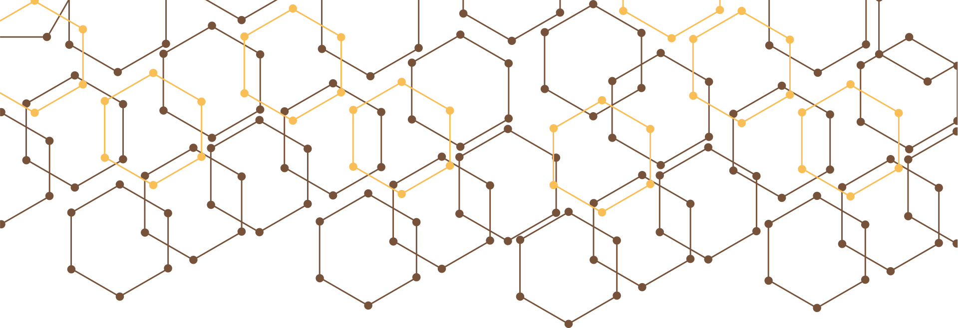


Policy Development & Implementation
Device Security & Remote Access
System Security Plan
Endpoint Protection
Mandating anti-malware, host-based firewalls, and full-disk encryption across all corporate and connected devices.
BYOD Governance
Enforcing containerization and remote-wipe capabilities for personal devices handling organizational data assets
Secure Remote Links
Requiring encrypted virtual private networks (VPNs) and zero-trust verification channels for off-site connections
Catuera

Slide 51


Policy Development & Implementation
Review, Audit & Incident Readiness
SYSTEM SECURITY PLAN
Audit Policies
Regularly review rule effectiveness against evolving cyber threats and system updates
Incident Planning
Develop structured response playbooks to contain, eradicate, and recover from breaches
Simulate Drills
Test team reaction times and operational readiness through realistic tabletop exercises
Refine Posture
Incorporate lessons learned from security reviews into revised policy guidelines
Catuera

Slide 52



Thank You!

