Slide 1


IT Professional Elective 3
SECURITY METRICS AND KEY PERFORMANCE INDICATORS
GROUP 5
August 10, 2026

Slide 2
Report Highlights
01
Challenge of security metrics
04
Metrics and FISMA
02
What makes a goodmetric
05
Physical Security and Environmental Events
03
06
Approaches to securitymetrics
Physical and environmental threats and control
ITPE 3 I GROUP 5

Slide 3
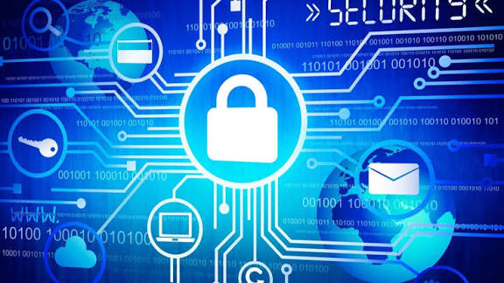
What is the Core Challenge?
Security metrics often fail to truly reflect an organization's security posture. They can create a dangerous illusion of progress while real risk remains unaddressed or even increases
PENAVERDE

Slide 4
Activity vs. Outcome
  The Problem: Traditional metrics measure the volume of activity (e.g., scans run, alerts generated) rather than the actual reduction of risk .
  The Illusion: Boards see rising numbers and assume protection is improving, but this often means security teams are generating "noise," not reducing exposure .
  A Critical Flaw: Metrics like "number of incidents handled" are the most common but are misleading; a low incident count might mean strong defenses—or inadequate monitoring .
PENAVERDE

Slide 5

Common Pitfalls of Bad Metrics
Bad metrics can mislead organizations and fail to show real security performance.
1. Perverse Incentives
  A Security Operations Center (SOC) measured on "tickets processed" is incentivized to quickly close tickets as false positives rather than investigate them. This does not measure real security effectiveness .
2. The "Vanity" Problem
  Focusing on metrics like the number of detection rules can inflate false positives. A higher number of rules does not mean better detection; it can mean more noise .
  Metrics must be SMART: Specific, Measurable, Attainable, Repeatable, and Time-dependent .
PENAVERDE

Slide 6
Why Security Metrics Often Fail: Three Fundamental Barriers
Barrier 1: The Immeasurable Nature of Risk
  The core components of risk—Asset Value, Threat, and Vulnerability—resist precise quantification:
    Asset Value: Intangible assets like institutional reputation and customer trust have no fixed monetary equivalent.
    Threat: A potential for harm is inherently hypothetical and defies numerical capture.
    Vulnerability: While technical vulnerabilities are measurable, human factors like "user awareness" remain highly subjective.
PENAVERDE

Slide 7
Barrier 2: The Context Deficit
  Metrics lack situational context. A high patch rate may look impressive, but if the most critical vulnerabilities remain unpatched, the organization is still exposed.
  Metrics are reductive—they simplify complex realities into numbers that can easily be misinterpreted by leadership.
Barrier 3: A Static Mindset in a Dynamic World
  Traditional vs. Modern: Most metrics were designed for static IT infrastructure, but today's environment is fluid—spanning cloud, AI, and CI/CD pipelines.
  AI as a Disruptor: AI introduces adaptive and autonomous risks. Traditional metrics fail to capture visibility over AI usage, non-human identities, and model behavior, creating a false sense of security.
PENAVERDE

Slide 8
Turning Challenges into Action
Turning security metric challenges into clear actions helps improve overall security performance.
From Activity to Outcomes
Add Context to Every Number
  Measure risk reduction, not just work done.
  Ask: "Are we safer?" not "Were we busy?"
  A metric without context is misleading.
  Always pair data with: Asset Criticality + Severity + Trend.
Evolve with the Environment
  Traditional metrics fail in dynamic systems (Cloud, AI, CI/CD).
  Must now track: AI usage, non-human identities, and real-time changes.
PENAVERDE

Slide 9
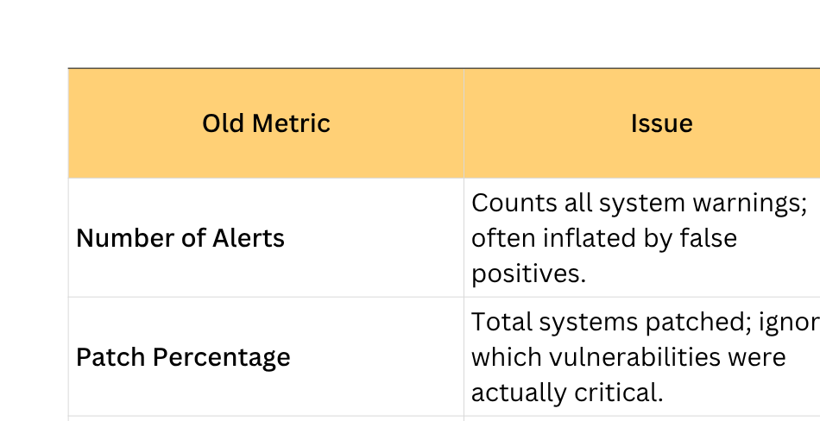
Rethinking Security Metrics
PENAVERDE

Slide 10
What is a Metric?
A metric is meaningful information derived from measurement.
Measurement
Metric
The process of collecting or determining a value about an object, activity, condition, or outcome.
Example: counting the number of unresolved vulnerabilities.
A metric gives a measure context and meaning so it can be interpreted, compared, monitored, or used for a decision.
Example: percentage of critical vulnerabilities resolved within the required timeframe.
ELUMBA

Slide 11
What makes a “good” metric?
  Allows accurate and detailed comparisons
  Leads to correct conclusions
  Is well understood by everyone
  Has a quantitative basis
  A good metric helps avoid erroneous conclusions
ELUMBA

Slide 12

Why Does the Quality of a
Metric Matter?
Poor metrics can create misleading conclusions and poor decisions.
  Security decisions often involve limited time, resources, and incomplete information.
  A poorly designed metric may measure activity without showing whether security actually improved.
  Metrics can be misunderstood when definitions, targets, data sources, or calculation methods are unclear.
  Organizations may unintentionally optimize for the metric instead of the security objective.
  High-quality metrics make security performance visible, support accountability, reveal trends, and guide corrective action.
  The purpose of a metric is therefore not simply measurement—it is better-informed security decision-making.
ELUMBA

Slide 13
Characteristics of a Good Metric
A strong metric should satisfy several complementary qualities.
Relevant
Valid
A strong metric should satisfy several complementary qualities.
Actually measures the property or outcome it claims to represent.
Reliable
Actionable
Produces consistent results when conditions and methods are comparable.
Provides information that can lead to a decision or improvement.
ELUMBA

Slide 14
Characteristics of a Good Metric
A strong metric should satisfy several complementary qualities.
Timely
Understandable
Available when the information is needed for the decision.
Clearly defined and easy for intended users to interpret.
Comparable
Cost-effective
Allows meaningful comparison across time, targets, systems, or groups.
The value of the information justifies the effort and resources required.
ELUMBA

Slide 15


Good Metric vs. Weak Metric
The quality of a metric is demonstrated by what it tells the decision-maker.
Weak: “Number of security incidents”
A higher number may indicate worse security—but it may also reflect better reporting, improved detection, increased monitoring, or a change in system exposure.
Without context, interpretation is uncertain.
Stronger: “Rate of confirmed security incidents per 1,000 monitored assets”
Adds normalization and context, making comparison more meaningful. Still, it should be interpreted with detection coverage, severity, and reporting changes.
LESSON: Good metrics reduce ambiguity, but even strong metrics should not be interpreted in isolation. Context and supporting measures matter.
ELUMBA

Slide 16


Validity and Reliability
A metric should measure the intended concept and do so consistently.
Validity — “Are we measuring the right thing?”
Example: using the percentage of critical vulnerabilities fixed within the SLA is more valid for remediation timeliness than simply counting patches installed.
Validity concerns whether the metric represents the intended property.
Reliability — “Can we trust the measurement?”
If the same data and method are used under comparable conditions, the result should be consistent.
Reliable metrics depend on stable definitions, controlled calculations, and dependable data sources.
REMEMBER: A metric can be reliable but not valid: a system may consistently count the wrong thing. Good measurement requires both.
ELUMBA

Slide 17
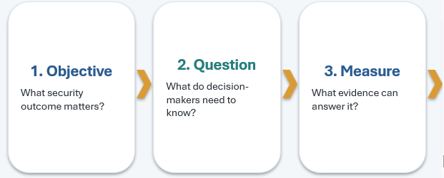
Designing a Good Metric: The Decision Chain
Start with the objective—not with whatever data happens to be available.
ELUMBA

Slide 18
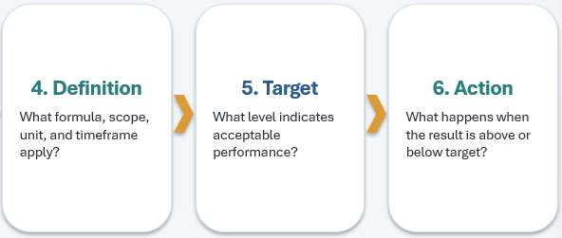
Designing a Good Metric: The Decision Chain
ELUMBA

Slide 19
CONCLUSION
What makes a good metric?
  A good security metric is relevant, valid, reliable, actionable, timely, understandable, comparable, and cost-effective. Most importantly, it should provide trustworthy information that helps an organization make better security decisions.
ELUMBA

Slide 20

SECURITY METRICS & FISMA
Measuring, Managing, and Reporting Information Security Performance
9.3 Approaches to Security Metrics
9.4 Metrics and FISMA
CORTEZ

Slide 21
What Are Security Metrics?
Quantifiable measurements used to gauge the performance, effectiveness, and maturity of an organization's information security program — turning technical activity into evidence decision-makers can act on.
Why They Matter
  Justify security spending with evidence
  Reveal gaps between policy and practice
  Support compliance reporting (e.g., FISMA)
  Track progress toward risk-reduction goals
  Enable benchmarking across time and peers
■
Objective
Based on data, not opinion or intuition
▲
Quantifiable
Expressed in numbers, percentages, or ratios
✓
Actionable
Drive decisions on budget, staffing, and controls
↻
Repeatable
Collected consistently over time for trend analysis
CORTEZ

Slide 22
9.3
Approaches to Security Metrics
Three widely used frameworks help organizations decide what to measure and why.
1
2
3
Goal-Question-
Metric (GQM)
Balanced
Scorecard
NIST SP 800-55
Three-Tier Model
Start from business goals, derive questions, then define metrics that answer them.
View security across four lenses: financial, customer, internal process, and learning/growth.
Measure at the implementation, effectiveness/efficiency, and mission-impact levels.
CORTEZ

Slide 23
Approach 1
Goal-Question-Metric (GQM) Method
1
GOAL
“Reduce unauthorized access incidents.”
Define what the organization wants to achieve
2
QUESTION
“How many access attempts were blocked vs. successful?”
Ask what you need to know to tell if the goal is met
3
METRIC
“Nnumber of unauthorized access attempts per month.”
Define the measurable data that answers the question
Strength: keeps metrics tied to business objectives instead of collecting data for its own sake.
CORTEZ

Slide 24
Approach 2
The Balanced Scorecard Approach
Adapted from business strategy, it balances security metrics across four perspectives so no single view dominates decision-making.
$
Financial
♥
Customer / Stakeholder
Cost of controls vs. cost of incidents avoided
Trust, compliance status, breach exposure
⚙
Internal Process
↑
Learning & Growth
Patch cycle time, audit findings closed
Staff training completion, awareness scores
CORTEZ

Slide 25
Approach 3
NIST SP 800-55: Three Metric Types
NIST's Performance Measurement Guide for Information Security groups metrics by organizational maturity.
1
2
3
Implementation
Effectiveness / Efficiency
Impact
Is the control in place?
Is the control working well?
What business result did it produce?
EXAMPLE METRIC
EXAMPLE METRIC
EXAMPLE METRIC
% of systems with firewalls configured per policy
Average time to patch critical vulnerabilities
Estimated cost avoided from incidents prevented
CORTEZ

Slide 26
Metrics and FISMA
9.4
The Federal Information Security Modernization Act (FISMA) requires U.S. federal agencies to develop, document, and implement an information security program — and to report measurably on its performance.
Why Metrics Matter Under FISMA
  Turns compliance from a one-time checklist into continuous monitoring
  Gives OMB & Congress visibility into agency cyber posture
  Identifies systemic weaknesses across government
  Supports risk-based budget and resource decisions
ORIGIN
Enacted 2002, modernized 2014
APPLIES TO
Federal agencies & their contractors
OVERSIGHT
OMB policy — NIST standards — DHS operational support
BASIS
NIST Risk Management Framework (SP 800-37, 800-53)
CORTEZ

Slide 27
FISMA Reporting Metric Categories
Annual FISMA metrics (developed with OMB, DHS, and the CIGIE) are organized around the NIST Cybersecurity Framework functions.
IDENTIFY
Risk management, asset & system inventory maturity
PROTECT
Access control, security training, configuration management
DETECT
Continuous monitoring, anomaly & event detection capability
RESPOND
Incident response planning, communications, mitigation
RECOVER
Recovery planning, improvements, contingency testing
CORTEZ

Slide 28
FISMA Metrics in Practice
How the reporting cycle actually runs, year over year.
1
2
3
4
Agencies collect data
Submit via CyberScope
Independent audit
Public accountability
CIOs & CISOs gather metrics from security tools and processes
Data reported to OMB/DHS through the CyberScope reporting portal
Inspectors General (IG) independently assess agency maturity
OMB publishes an annual report to Congress
Agencies receive a maturity rating on a 5-level scale — Ad Hoc, Defined, Consistently Implemented, Managed & Measurable, and Optimized — mirroring how program maturity models score capability.
CORTEZ

Slide 29
Key Takeaways
1
Metrics need a method
2
Maturity drives metric type
GQM, Balanced Scorecard, and NIST SP 800-55 each give structure to what you measure and why.
Move from implementation → effectiveness → impact metrics as a program matures.
3
FISMA formalizes accountability
4
Metrics are strategic, not just technical
Federal agencies must measure, report, and be independently audited on security posture.
Good metrics connect security work directly to risk, cost, and mission outcomes.
CORTEZ

Slide 30
Objectives
As we delve into the SDGs Progress Report, I want to express my gratitude for the unwavering commitment each of you has shown toward advancing sustainable development. Our collective efforts are not just about meeting goals; they are a testament to our shared responsibility in shaping a better future.
INGOUDE COMPANY
SDG Progress Report 2025

Slide 31
Key
Highlights
Our progress in advancing the Sustainable Development Goals (SDGs) is marked by measurable positive impact, strategic collaborations with key partners, innovative approaches utilizing technology, and community empowerment initiatives. Achievements include notable improvements in clean sanitation, reflecting our commitment to creating positive change. These milestones reinforce our dedication to shaping a sustainable and equitable future, with ongoing efforts aligned with the SDGs agenda.
INGOUDE COMPANY
SDG Progress Report 2025

Slide 32
Priority of SDGs
Interconnected Global Agenda
The SDGs represent a holistic and interconnected approach to addressing pressing global challenges. Ranging from poverty eradication and health to climate action and gender equality, the goals recognize the interdependence of social, economic, and environmental aspects in achieving sustainable development.
Inclusivity and Leave No One Behind
Central to the SDGs is the commitment to inclusivity, ensuring that development benefits reach all people, leaving no one behind. The goals emphasize addressing inequalities and disparities across various dimensions.
INGOUDE COMPANY
SDG Progress Report 2025

Slide 33
Measuring Progress
Measuring progress towards Sustainable Development Goals (SDGs) involves defining clear indicators for each goal, collecting relevant data, and establishing baselines. Regular monitoring and evaluation against these indicators help track trends and assess the effectiveness of implemented policies.
Key Indicator
Your Key Performance Indicator goes here
Your Key Performance Indicator goes here
Your Key Performance Indicator goes here
Activity
Add a few details describing the related activities
Add a few details describing the related activities
Add a few details describing the related activities
Outcome
  What results did you obtain from your projects?
  Write them here
  What results did you obtain from your projects?
  Write them here
  What results did you obtain from your projects?
  Write them here

Slide 34
Metrics and FISMA
BORJA

Slide 35
The Federal Information Security Modernization Act (FISMA) is a United States federal law that requires agencies and contractors to establish comprehensive cybersecurity programs. Under FISMA, information security cannot remain a passive policy document; it must exist as an active, operational process. Security metrics serve as the essential quantitative evidence required by FISMA. They transform subjective assumptions about an organization's security posture into objective, measurable data that demonstrates whether security controls are actually functioning as intended to protect critical information systems.
Overview of FISMA
& The Role of Security Metrics

Slide 36
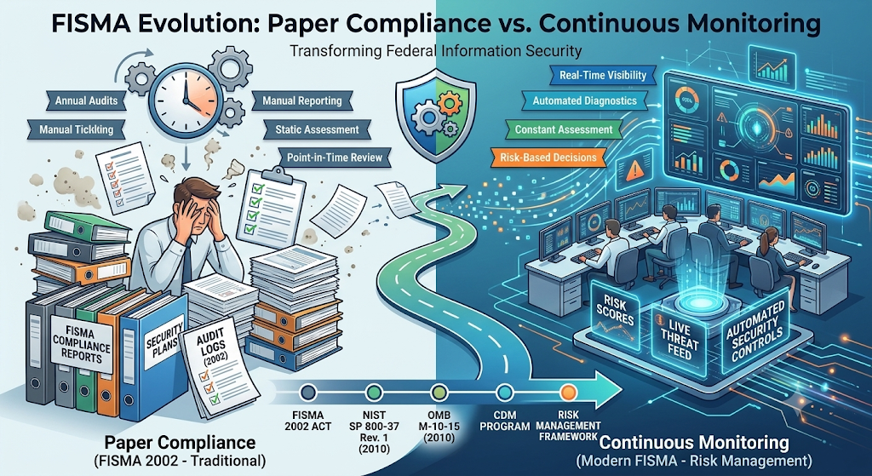
FISMA Evolution: Paper Compliance vs. Continuous Monitoring
Historically, FISMA compliance was treated as a "paperwork exercise"—a point-in-time assessment where organizations completed annual checklists to satisfy external auditors. Modern FISMA mandates have fundamentally shifted this paradigm toward active continuous monitoring. Today, organizations are required to collect and analyze real-time metrics using automated tools. This continuous data collection ensures that security flaws, unauthorized configuration changes, and active network threats are detected immediately rather than remaining hidden until the next annual audit cycle.

Slide 37
  Implementation Metrics: Evaluate whether mandatory security controls and policies have been successfully deployed across all systems (e.g., tracking the percentage of organizational endpoints with mandatory Multi-Factor Authentication enabled).
  Effectiveness Metrics: Measure how well deployed security controls perform under real-world operational conditions (e.g., measuring the mean time required to identify, isolate, and apply critical security patches across servers).
  Impact Metrics: Assess the operational and business damage caused by security failures (e.g., recording total system downtime, financial costs, or lost data records resulting from an incident).
Key Categories of FISMA Metrics

Slide 38
A foundational pillar of modern FISMA metrics is the Continuous Diagnostics and Mitigation (CDM) program. CDM provides organizations with automated tools to constantly monitor network activity and produce actionable risk metrics.
Under the CDM model, an organization’s metric tracking must continuously answer three fundamental operational questions:
  What is on the network? (Continuous asset management of hardware and software).
  Who is on the network? (Continuous identity and privilege management).
  What is happening on the network? (Continuous event and network threat monitoring).
Continuous Diagnostics and Mitigation (CDM) Framework

Slide 39
Strategic Impact of FISMA Security Metrics
Strategic Area | Impact of FISMA Metrics
Risk Reduction | Replaces static guesswork with continuous visibility into system vulnerabilities.
Resource Allocation | Identifies failing security controls, allowing IT leadership to direct budget and manpower effectively.
Audit & Accountability | Provides immutable, data-driven proof of compliance for government oversight and regulatory reviews.

Slide 40
Physical Security and Environmental Events
BORJA

Slide 41
Introduction to Physical Security and Environmental Events
While cybersecurity discussions heavily focus on logical threats like malware, network hacks, and software exploits, physical security and environmental events represent equally catastrophic risks to IT infrastructure. A physical security event involves real-world breaches, unauthorized human access, or hardware theft, while an environmental event involves natural or facility-based disruptions like fires, floods, or power grid failures. Regardless of how sophisticated a network's firewalls or encryption keys are, physical destruction or theft of server hardware completely undermines logical defenses.

Slide 42
Categorizing Physical Security Events
Physical security events stem from human actions—both malicious and accidental—that compromise physical IT assets:
Unauthorized Access & Perimeter Breaches
Intruders bypass security gates, tailgated authorized staff through doors, or gain entry into restricted areas like server rooms or data centers.
Theft and Sabotage
Direct theft of sensitive storage drives, laptops, or networking hardware, as well as intentional physical damage like cutting fiber-optic cables or smashing hardware.
Human Error and Negligence
Accidental damage caused by personnel, such as liquid spills on workstations, tripping over exposed cabling, or leaving server room doors unsecured.

Slide 43
Categorizing Environmental Events
Environmental events arise from natural disasters or facility infrastructure failures that threaten the physical environment hosting IT assets:
Extreme Weather & Disasters
Events such as severe typhoons, earthquakes, and flash floods that damage physical facilities and structural integrity.
Fire, Smoke, and Heat
Grid failures, prolonged blackouts, voltage sags (brownouts), and power surges that cause unexpected system shutdowns or fry sensitive motherboards.
Power Supply Disruptions
Accidental damage caused by personnel, such as liquid spills on workstations, tripping over exposed cabling, or leaving server room doors unsecured.
HVAC & Climate Control Failures
Air conditioning malfunctions that lead to extreme server room overheating or improper humidity levels causing static discharge.

Slide 44
Monitoring & Tracking Physical/Environmental Events
To effectively protect IT infrastructure, security teams must monitor physical and environmental metrics using specialized telemetry tools. Telemetry from biometric access logs, CCTV systems, and physical door sensors tracks physical access events to identify unauthorized entry attempts. Simultaneously, environmental monitoring sensors (thermostats, humidity gauges, liquid leak detectors, and Uninterruptible Power Supply/UPS telemetry) continuously record facility conditions. Tracking metrics such as the frequency of unauthorized access alerts or temperature spikes ensures immediate intervention before physical hardware suffers permanent damage.

Slide 45
Impact of Physical & Environmental Events on IT Resilience
Operational Impact | Description of Consequences
Permanent Data Loss | Destroyed or stolen physical drives without offsite backups lead to irreversible loss of critical institutional data.
Extended System Downtime | Replacing burned, flooded, or damaged physical server hardware takes days or weeks, halting critical operations.
High Financial & Operational Cost | Facility repair, emergency hardware replacement, and operational disruption lead to massive unplanned financial expenditure.
Life & Safety Risks | Environmental events like electrical fires or ungrounded power surges pose immediate physical dangers to facility personnel.

Slide 46

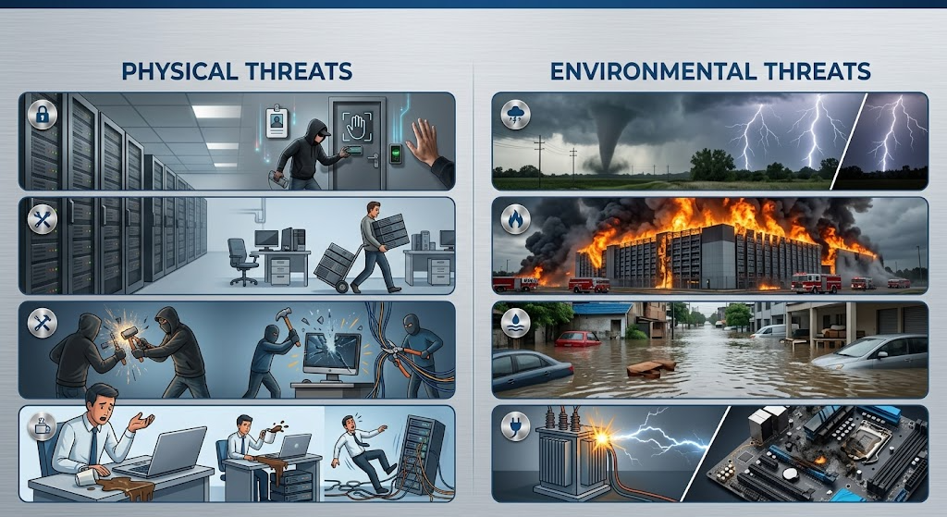
Physical and Environmental Threats
When we talk about IT security, we often focus on hackers and viruses. However, physical and environmental threats are just as dangerous. These threats happen in the real world, not just on a computer screen. If a server room is destroyed or a laptop is stolen, the best firewalls in the world won’t save your data. This section will explore the real-world dangers that put our hardware and data at risk.

Slide 47
Physical threats are dangers caused by people or physical events that can damage or steal IT equipment.
  Unauthorized Access: When people enter restricted areas like server rooms without permission.
  Theft of Equipment: Stealing laptops, hard drives, or servers that contain sensitive data.
  Vandalism and Sabotage: Intentionally destroying hardware, cutting cables, or smashing screens.
  Accidental Damage: When employees accidentally spill coffee on a server or trip over power cords.
Major Physical Threats

Slide 48
Environmental threats come from nature or the conditions around the building. We cannot always stop these from happening, but we must be ready for them.
  Extreme Weather: Typhoons, earthquakes, and heavy storms that can destroy buildings.
  Fire and Smoke: Fires can melt hardware, and even the smoke can ruin sensitive computer parts.
  Water Damage: Floods, leaking roofs, or broken pipes near server racks.
  Power Issues: Sudden blackouts, power surges, or brownouts that can fry motherboards.
Major Environmental Threats

Slide 49


Natural
vs.
Human-Made Threats
Threat Category | Examples | Predictability
Natural Threats | Earthquakes, floods, lightning strikes | Very hard to predict; requires heavy preparation.
Human-Made (Intentional) | Theft, hacking, vandalism | Can be stopped with strict security rules and guards.
Human-Made (Accidental) | Spilled drinks, unplugging wires | Managed by proper training and restricted access.

Slide 50

IMPACT OF PHYSICAL & ENVIRONMENTAL THREATS
Loss of Important Data
If a server is destroyed or stolen without backups, critical information like school records, research datasets, or company files could be lost forever.
System Downtime and Service Failures
Damaged hardware stops operations completely, causing businesses to lose money and preventing essential places like hospitals or government offices from providing emergency services.
Academic and Research Setbacks
A sudden power outage or stolen laptop can ruin heavy data processing, forcing students and developers to restart months of hard work on their capstone projects.
Safety and Health Risks
Environmental threats like equipment fires or exposed electrical wires do not just damage computers; they put the actual lives of the staff inside the building in serious danger.

Slide 51

Physical and Environmental Controls
To keep our computers safe, we need more than just software; we also need to protect them in the real world. Physical and environmental controls are the tools and rules we use to do this. Physical controls stop unauthorized people from getting near the equipment. Environmental controls protect the computers from nature, extreme heat, and power outages. The main goal of both is to keep the machines safe and running smoothly without any problems.

Slide 52
To stop physical threats like theft and vandalism, we use physical controls.
  Biometric Scanners: Using fingerprint or face scanners to open doors so only approved staff can enter the server room.
  CCTV Cameras: Installing cameras in hallways and outside the building to monitor who comes in and out.
  Security Guards: Having trained personnel to check IDs and patrol the area.
  Mantrap Doors: A small room with two doors where the first door must close before the second door opens, preventing people from tailgating.
Defending Against Physical Threats

Slide 53
To keep the room safe from fires, heat, and power loss, we use environmental controls.
  HVAC Systems: High-tech air conditioning that keeps the server room very cool and controls the humidity so machines do not overheat.
  UPS (Uninterruptible Power Supply): Giant battery backups that keep computers running if a brownout or blackout happens.
  Fire Suppression Systems: Special fire extinguishers (like FM-200 gas) that put out fires without using water, which would ruin the electronics.
  Water Detectors: Sensors placed on the floor to sound an alarm if there is a leak or flood.
Defending Against Environmental Threats

Slide 54
THREATS TO CONTROL
If This Threat Happens | We Use This Control
Thief tries to steal a server | Biometric door locks and CCTV cameras.
Sudden city-wide blackout | UPS batteries and backup diesel generators.
Server overheats from heavy use | HVAC (Air conditioning) systems.
Electrical fire in the IT room | Gas-based fire suppression system (no water).

Slide 55
KEY TAKEWAYS
Physical and environmental security must work hand-in-hand with cybersecurity. You cannot have strong software security if anyone can just walk in and steal the hard drive.
By understanding the threats like bad weather, power outages, and theft, and by setting up strong controls like fingerprint scanners, UPS batteries, and cooling systems, we can make sure our IT infrastructure stays safe and operational 24/7.

Slide 56
THANK YOU
August 10, 2025

