Slide 1
Craft of Data Visualization
Intro: what is a good visualization?
Alexey Zaytsev,
Skoltech, CDISE
14 January

Slide 2
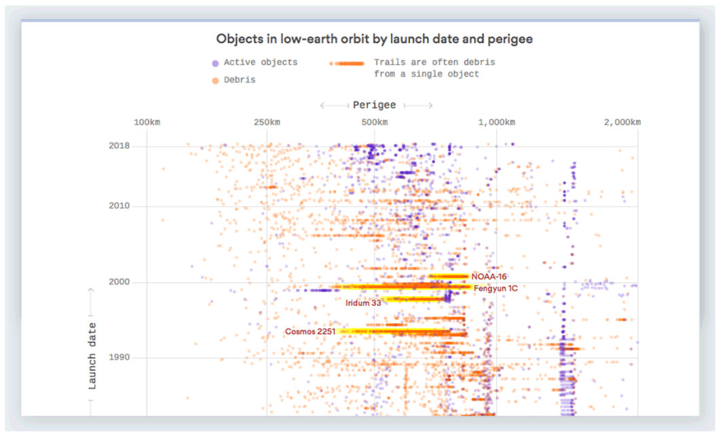
Yes, there really is a lot of space junk
https://visme.co/blog/best-data-visualizations/#GhMQDUYUzb1AvoyD.99
https://www.axios.com/yes-there-really-is-a-lot-of-space-junk-930b166d-68c4-4803-9bd6-9e23514eb942.html

Slide 3
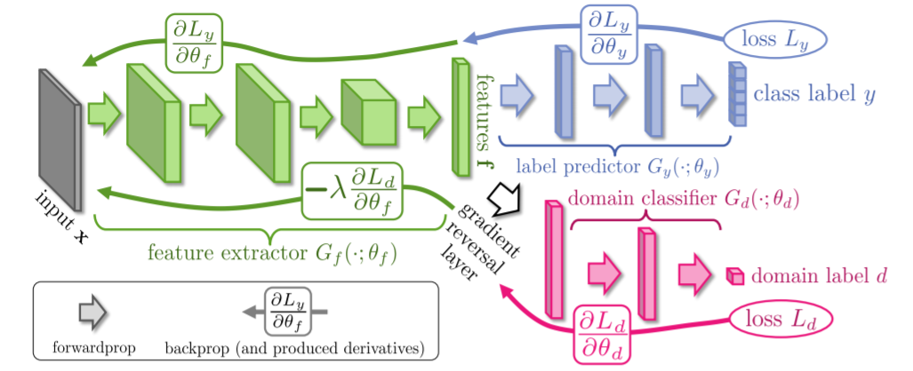
How and how well does our domain adaptation work?
Ganin, Yaroslav, and Victor Lempitsky. "Unsupervised domain adaptation by backpropagation." arXiv preprint arXiv:1409.7495 (2014).
MSCVS2011: V. Lempitsky, Skoltech - Writing a computer vision paper https://youtu.be/-Oq8AHIC92A
How to Write a Great Research Paper, S.P. Jones, Microsoft Research. https://youtu.be/WP-FkUaOcOM

Slide 4
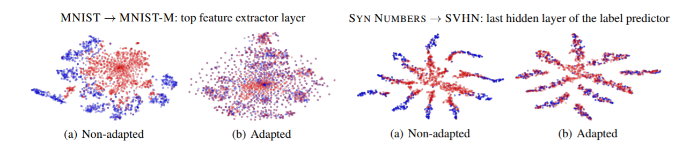
How and how well does our domain adaptation work?
Ganin, Yaroslav, and Victor Lempitsky. "Unsupervised domain adaptation by backpropagation." arXiv preprint arXiv:1409.7495 (2014).
MSCVS2011: V. Lempitsky, Skoltech - Writing a computer vision paper https://youtu.be/-Oq8AHIC92A
How to Write a Great Research Paper, S.P. Jones, Microsoft Research. https://youtu.be/WP-FkUaOcOM

Slide 5
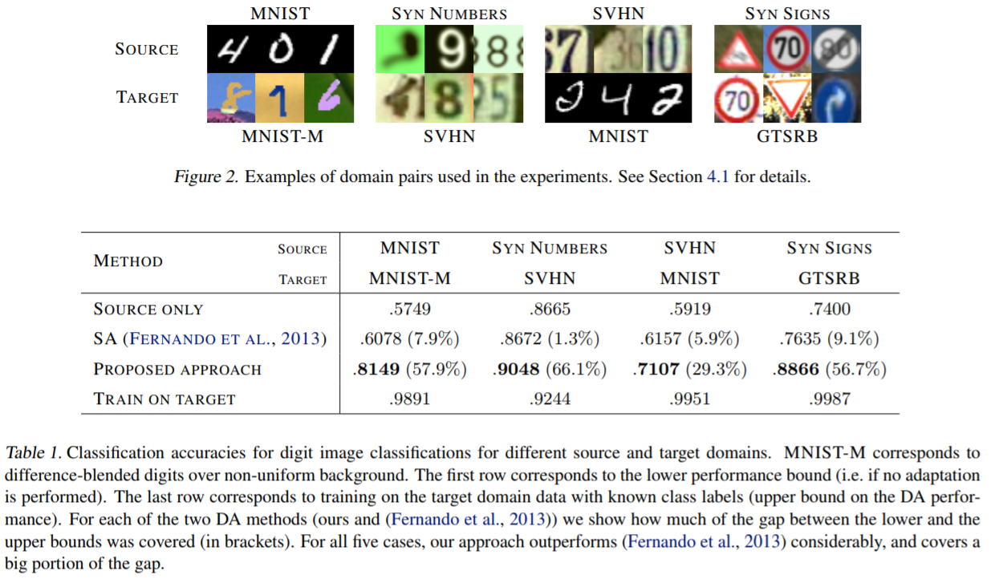
How and how well does our domain adaptation work?
Ganin, Yaroslav, and Victor Lempitsky. "Unsupervised domain adaptation by backpropagation." arXiv preprint arXiv:1409.7495 (2014).
MSCVS2011: V. Lempitsky, Skoltech - Writing a computer vision paper https://youtu.be/-Oq8AHIC92A
How to Write a Great Research Paper, S.P. Jones, Microsoft Research. https://youtu.be/WP-FkUaOcOM

Slide 6
A quick intro on storytelling with data
Understand the context
Choose an appropriate visual display
Eliminate clutter
Focus attention where you want it
Think like a designer
Tell a story
Knaflic, C.N. Storytelling with data: A data visualization guide for business professionals. John Wiley & Sons, 2015. p. 254

Slide 7
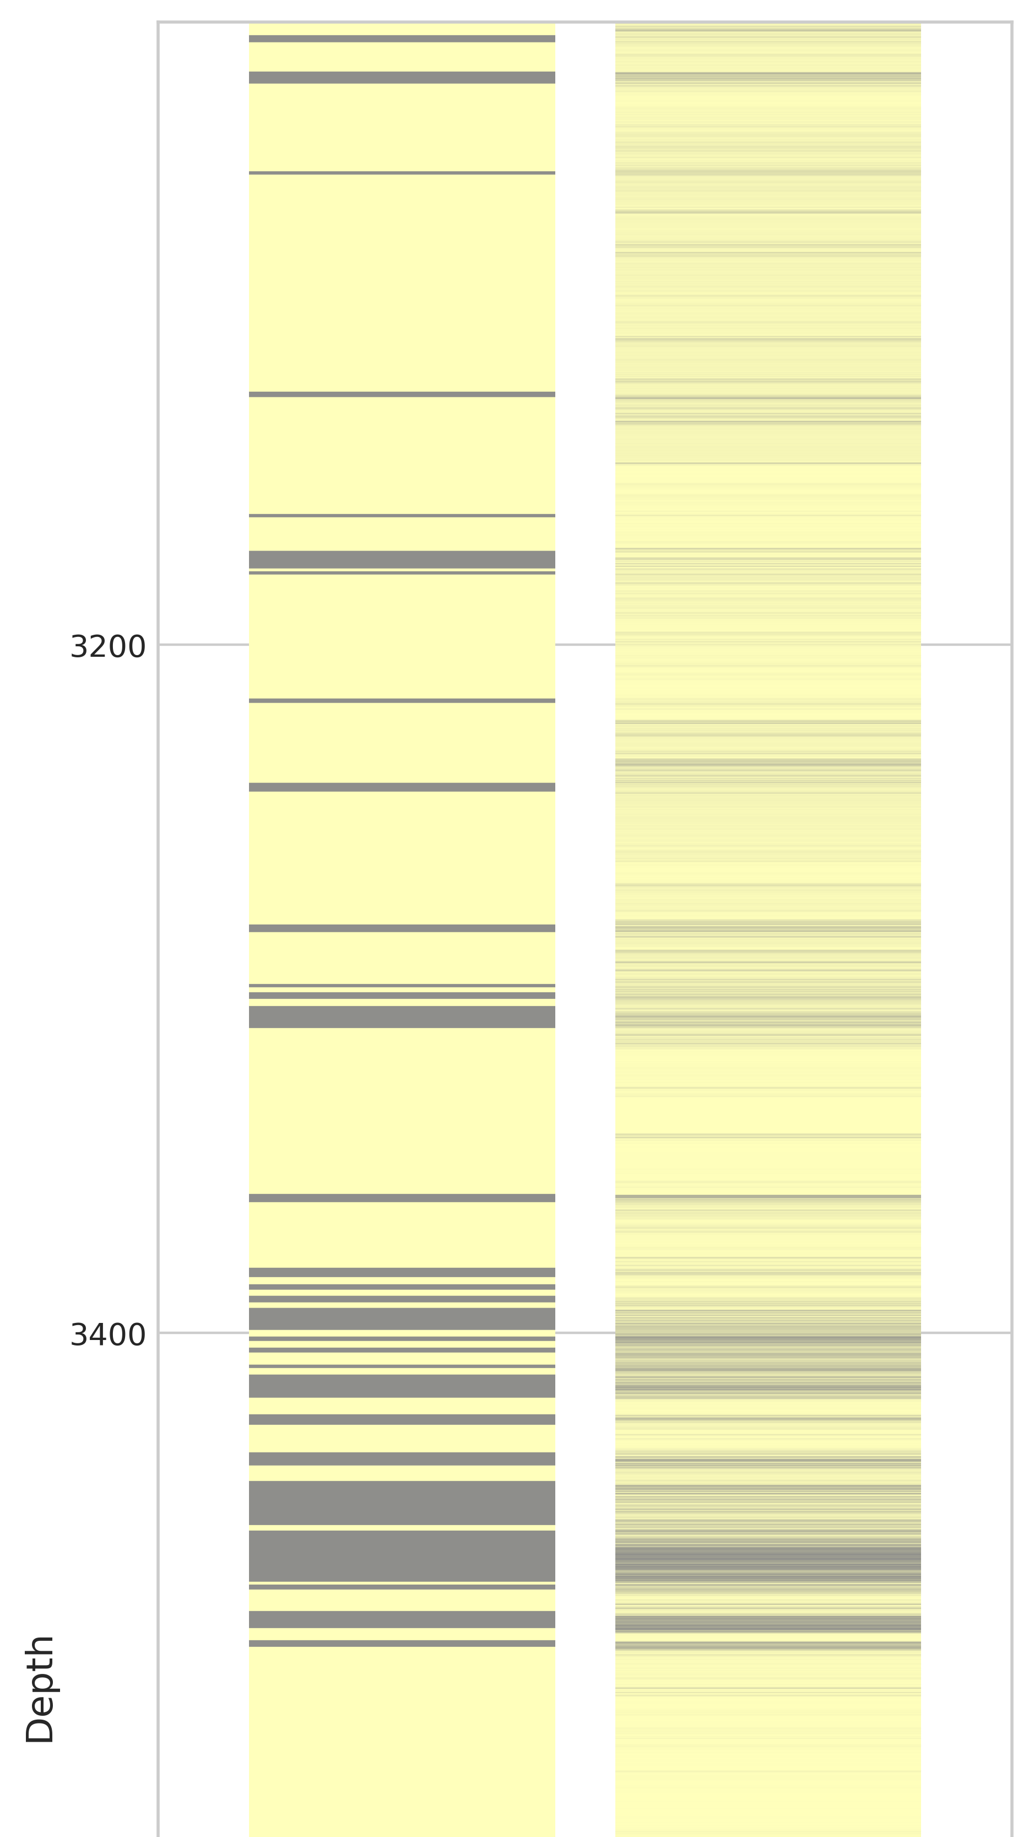
1. Understand the context
Who
Your audience
You
Klyuchnikov, N., Zaytsev, A et al., 2018. Data-driven model for the identification of the rock type at a drilling bit. arXiv preprint arXiv:1806.03218.

Slide 8
1. Understand the context
Who
Your audience
You
What
Action
What do you need your audience to know or do?
Mechanism
How will you communicate to your audience?

Slide 9
1. Understand the context
Who
Your audience
You
What
Action
What do you need your audience to know or do?
Mechanism
How will you communicate to your audience?
How
What data is available that will help make my point?

Slide 10
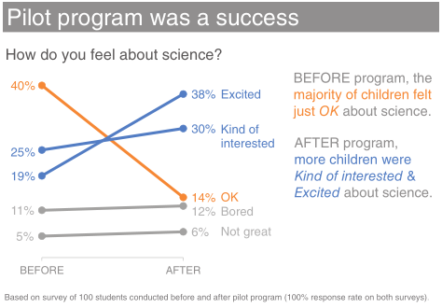
1. Understand the context: example
Who: The budget committee that can approve funding for continuation of the summer learning program.
What: The summer learning program on science was a success; please approve budget of $X to continue.
How: Illustrate success with data collected through the survey conducted before and after the pilot program.

Slide 11
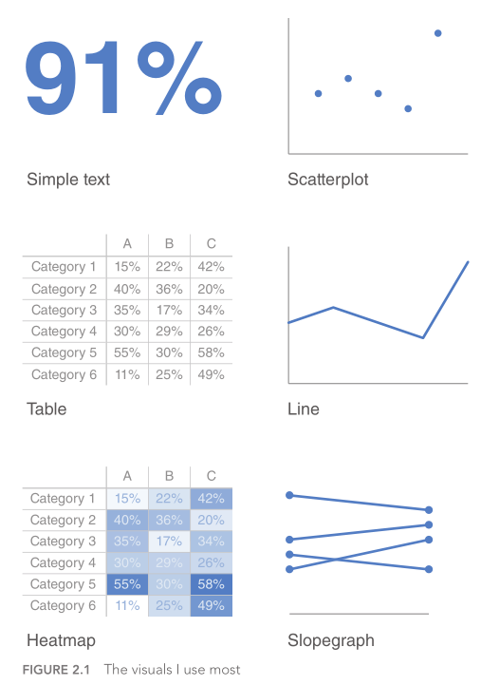
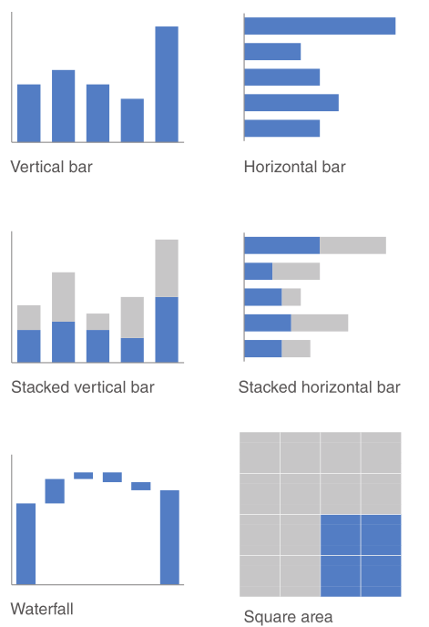
2. Choose an appropriate visual display
Knaflic, C.N. Storytelling with data: A data visualization guide for business professionals. John Wiley & Sons, 2015. p. 37

Slide 12
Main display types
Simple text
Tables
Graphs

Slide 13
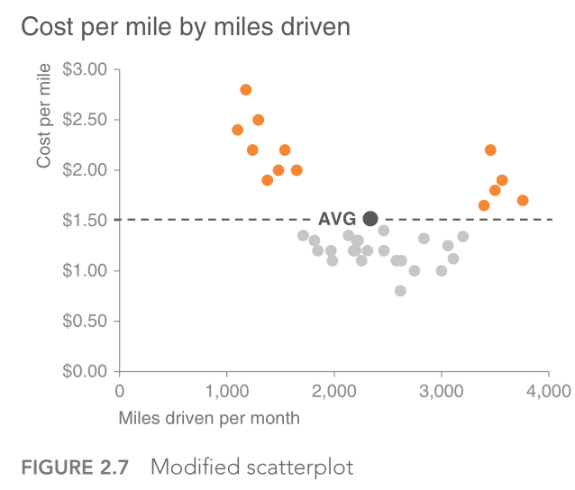
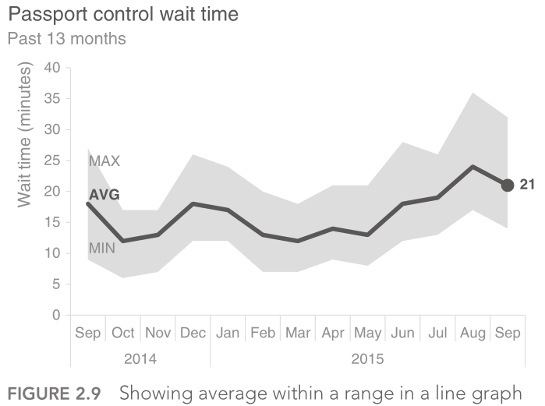
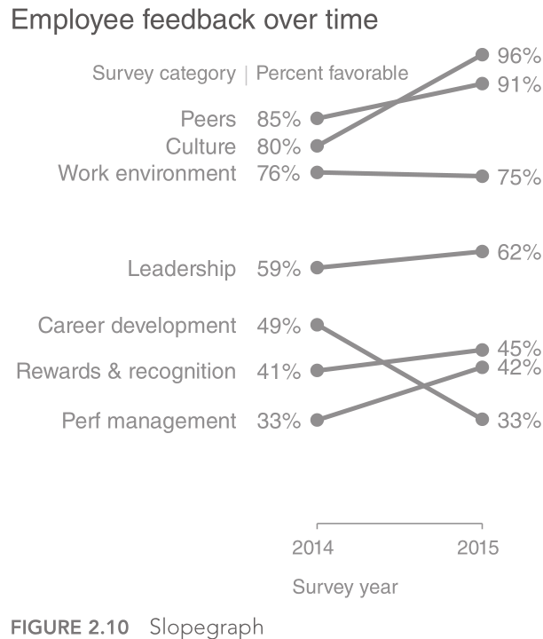
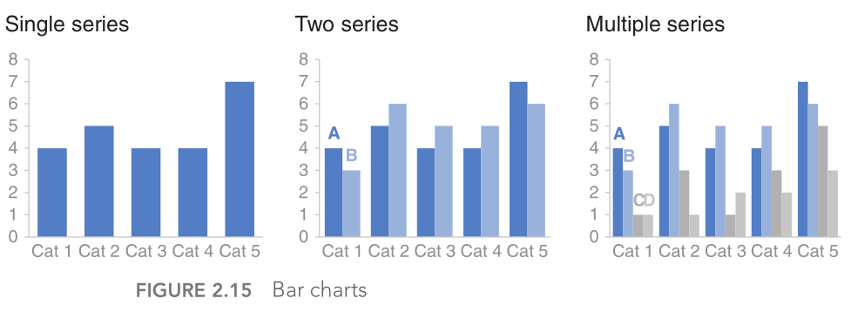
Graph types
Scatter plot
Lines
Slope graph
Bars

Slide 14
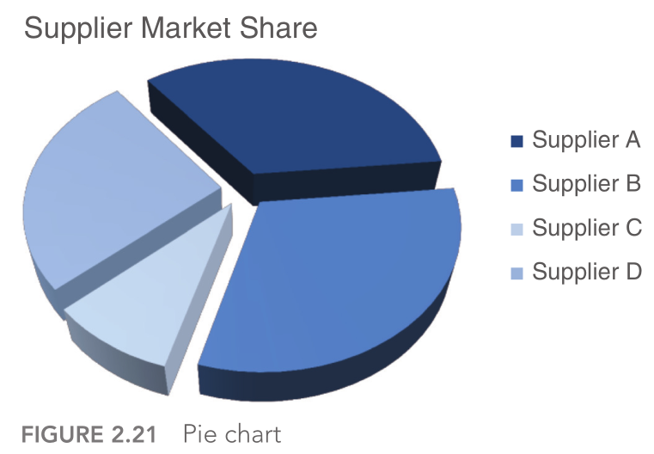
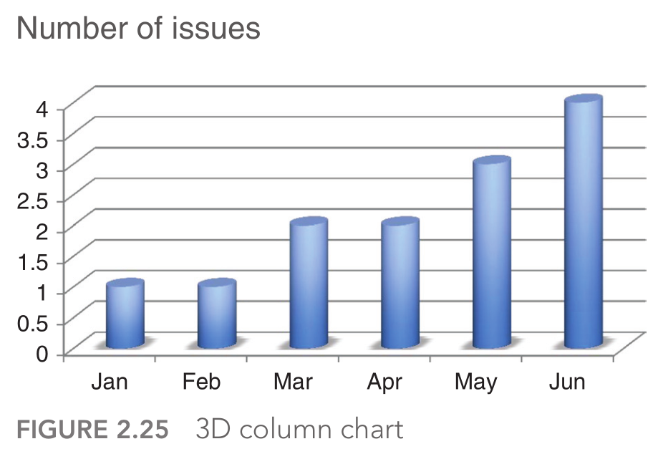
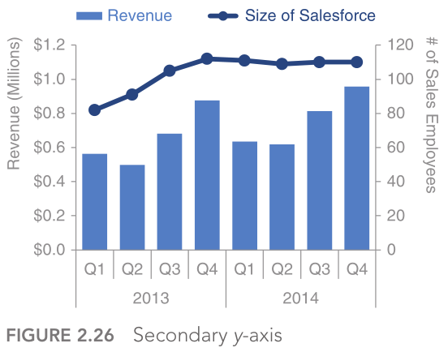
Graph types to avoid
Pie charts are evil
Never use 3D
Secondary y‐axis: generally not a good idea

Slide 15
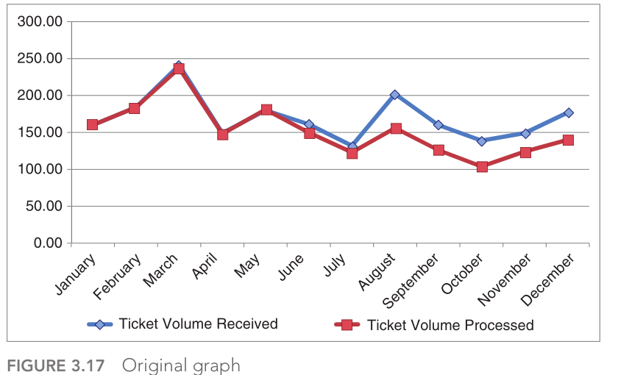
3. Eliminate clutter

Slide 16
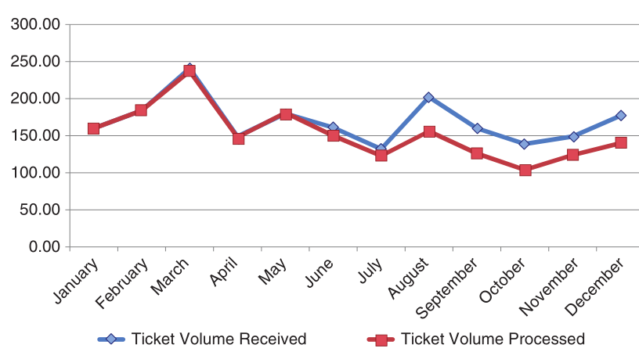
Remove chart border

Slide 17
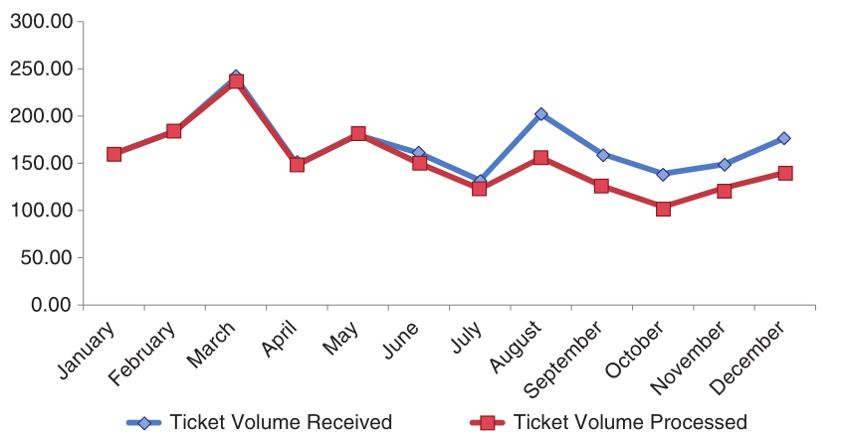
Remove gridlines

Slide 18
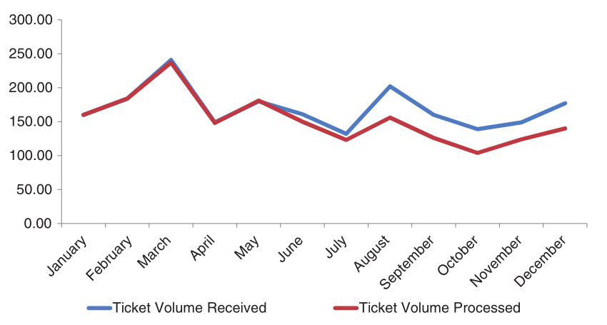
Remove data markers

Slide 19
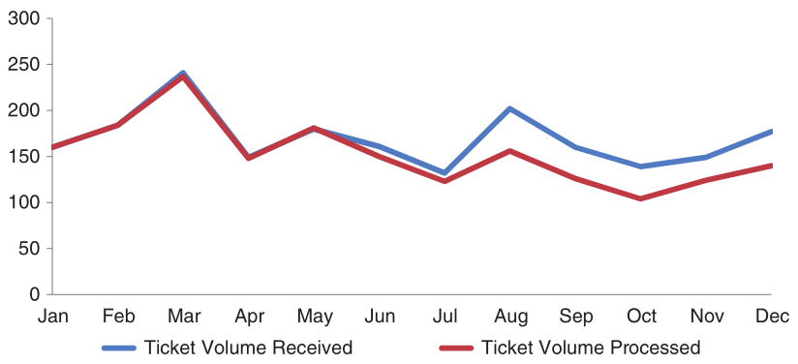
Clean up axis labels

Slide 20
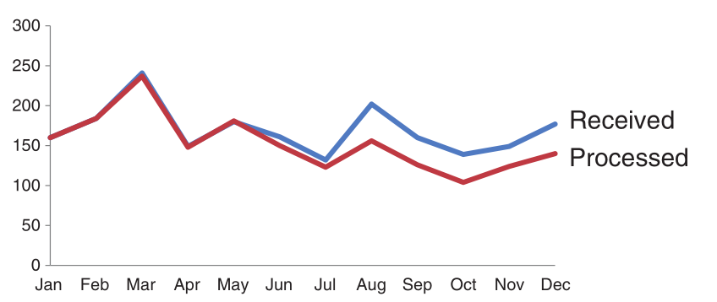
Label data directly

Slide 21
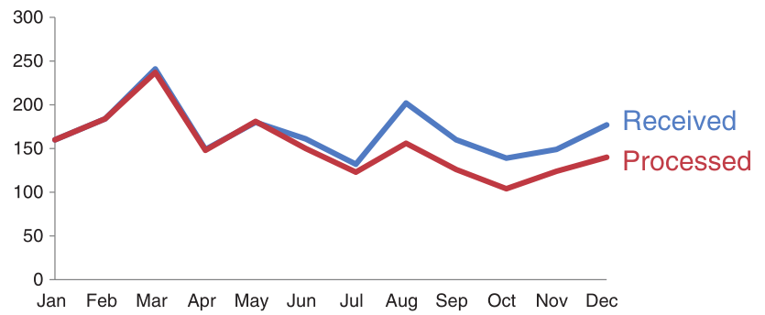
Leverage consistent color

Slide 22
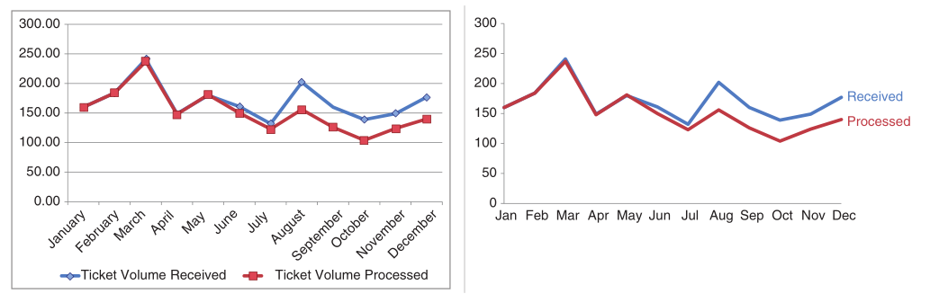
Before and after

Slide 23
4. Focus attention where you want it

Slide 24
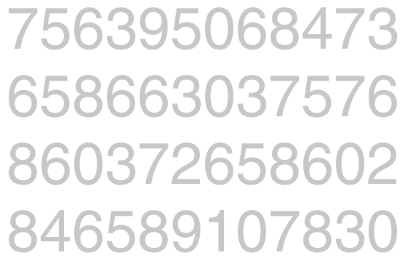
Count the 3s

Slide 25
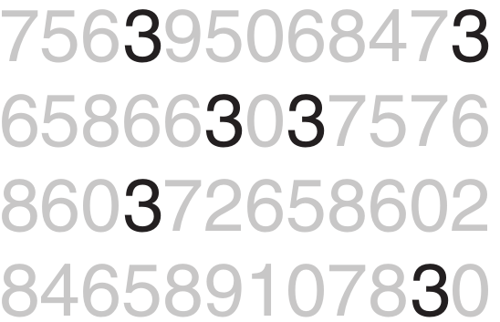
Count the 3s with preattentive attributes

Slide 26
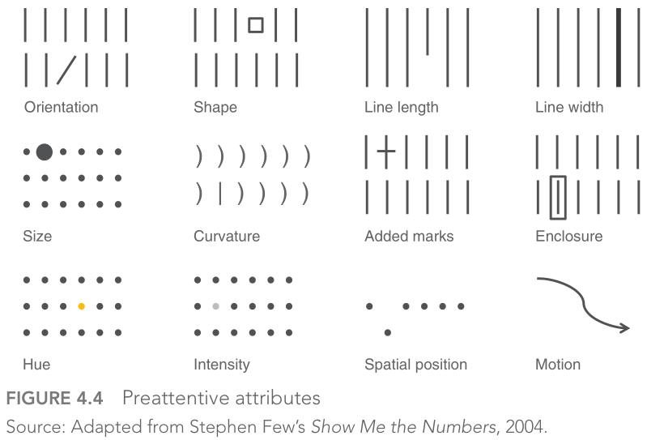
Types of preattentive attributes

Slide 27
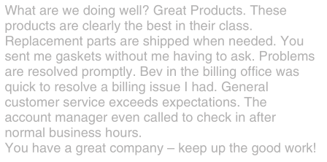
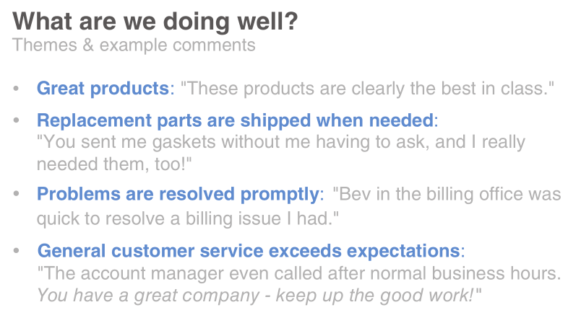
Example of preattentive attributes in text

Slide 28
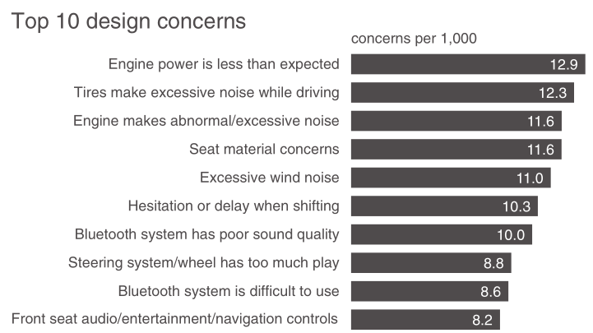
Example of preattentive attributes in graphs

Slide 29
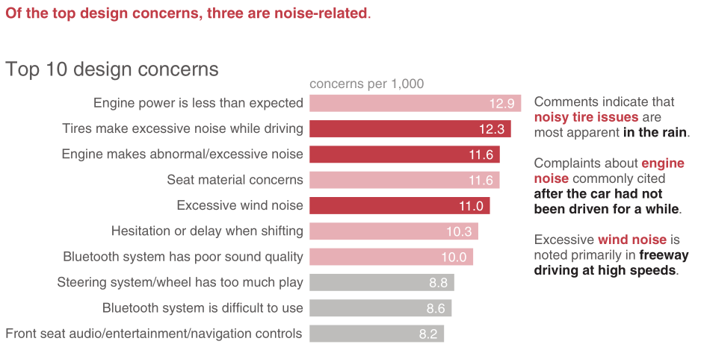
Example of preattentive attributes in graphs

Slide 30
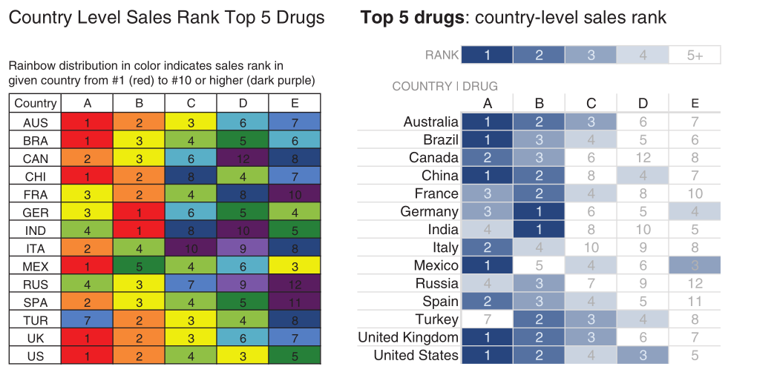
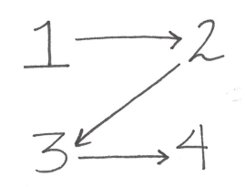
Other preattentive attributes
Size
Color
Position on page

Slide 31
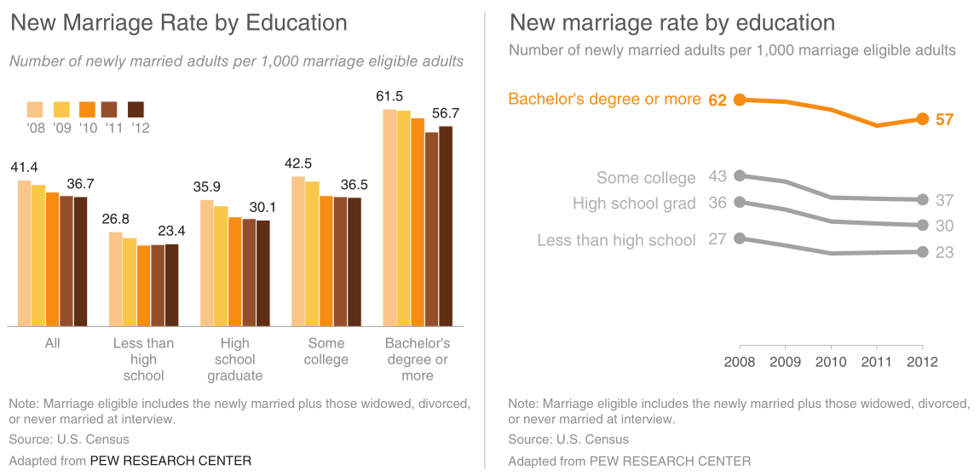
5. Think like a designer
Before After

Slide 32
5. Think like a designer
Before After

Slide 33
5. Think like a designer
Form follows function. This adage of product design has clear application to communicating with data.

Slide 34
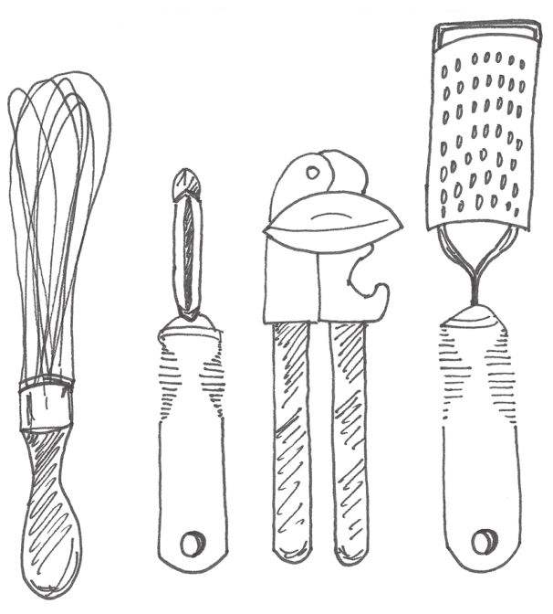
Three A-principles of design
Affordances
Accessibility
Aesthetic

Slide 35
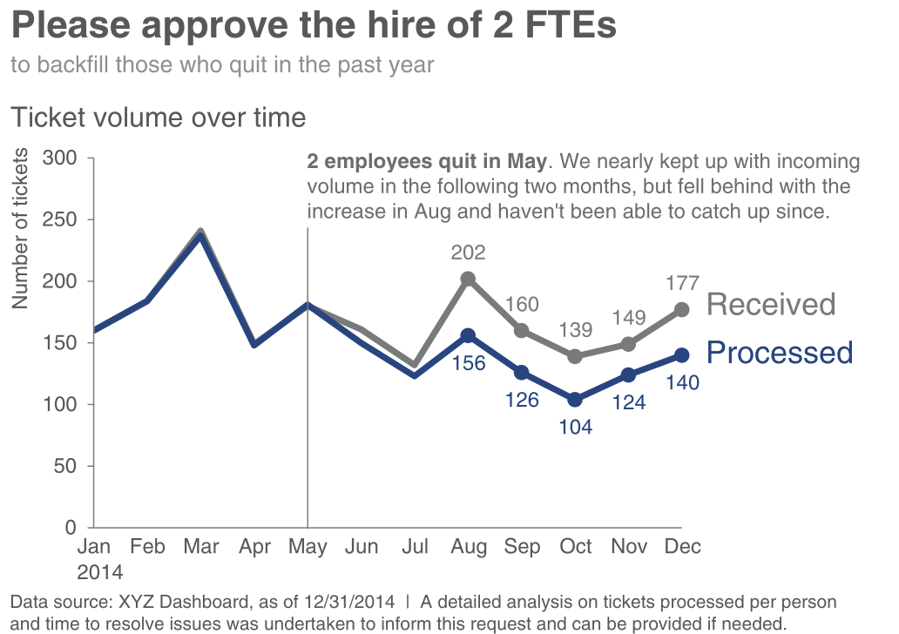
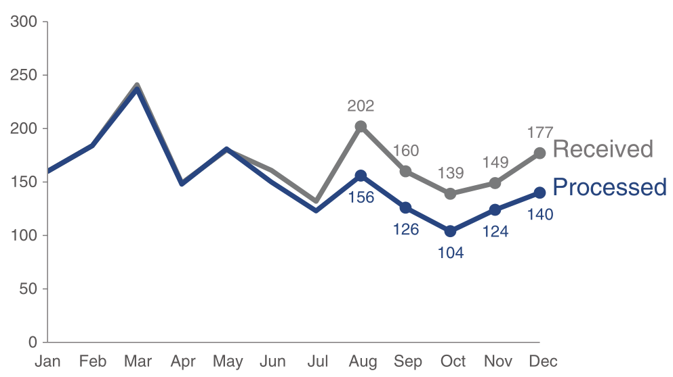
5. Think like a designer
Before After

Slide 36
5. Think like a designer
Before After

Slide 37
5. Tell a story
1. The setting: When and where does the story take place?
2. The main character: Who is driving the action? (This should be framed in terms of your audience!)
3. The imbalance: Why is it necessary, what has changed?
4. The balance: What do you want to see happen?
5. The solution: How will you bring about the changes?
Beyond Bullet Points, Cliff Atkinson

Slide 38
Three arcs structure
The beginning: problem introduced
The middle: how to solve the problem
The end: call to action
tie it back to the beginning

Slide 39
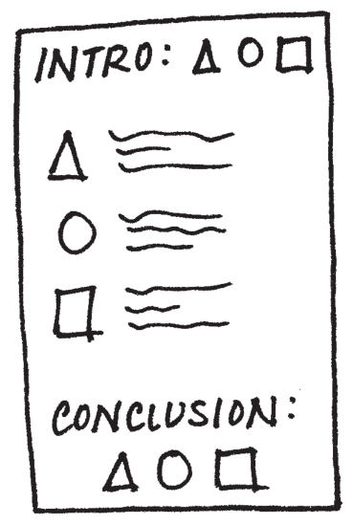
A quick intro on storytelling with data
Understand the context
Choose an appropriate visual display
Eliminate clutter
Focus attention where you want it
Think like a designer
Tell a story

