Slide 1
Craft of Data Visualization
Homework 1
Alexey Zaytsev,
Skoltech, CDISE
14 January

Slide 2
Issues data
 | Received | Processed
January | 160 | 160
February | 184 | 184
March | 241 | 237
April | 149 | 148
May | 180 | 181
June | 161 | 150
July | 132 | 123
August | 202 | 156
September | 160 | 126
October | 139 | 104
November | 149 | 124
December | 177 | 140

Slide 3
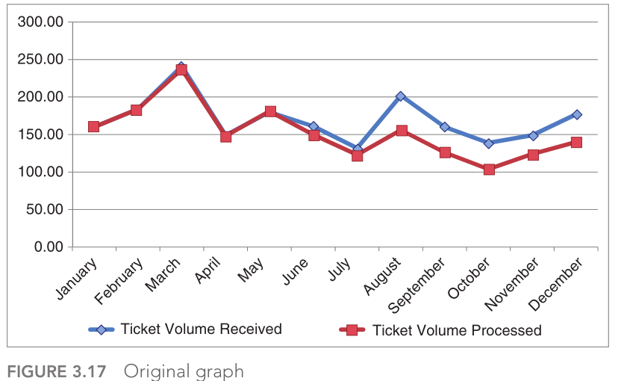
Problem 1: recreate the plot below with python

Slide 4
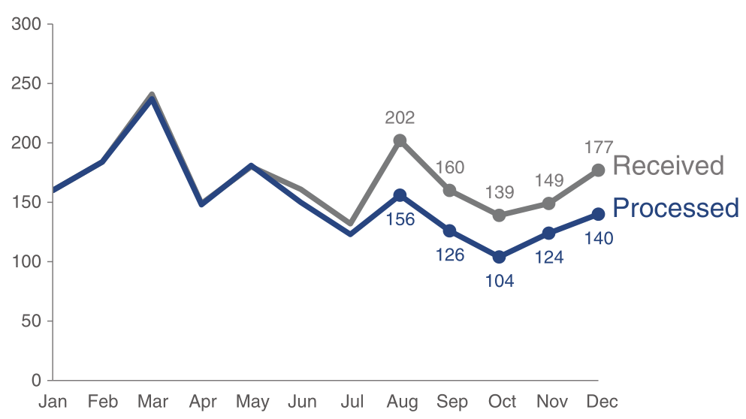
Problem 2: recreate the plot below with python

Slide 5
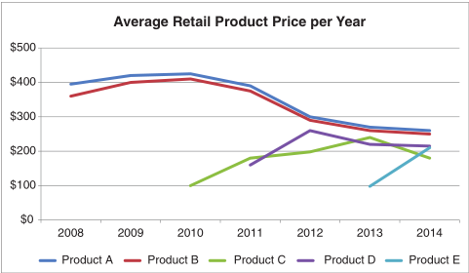
Problem 3: improve the plot below for product price data

Slide 6
The form of the result
You submit Jupyter notebook exported as html
Each problem is a separate top level block

