Slide 1
Craft of Data Visualization
Homework 1: basics
Alexey Zaytsev,
Skoltech, CDISE
14 January

Slide 2
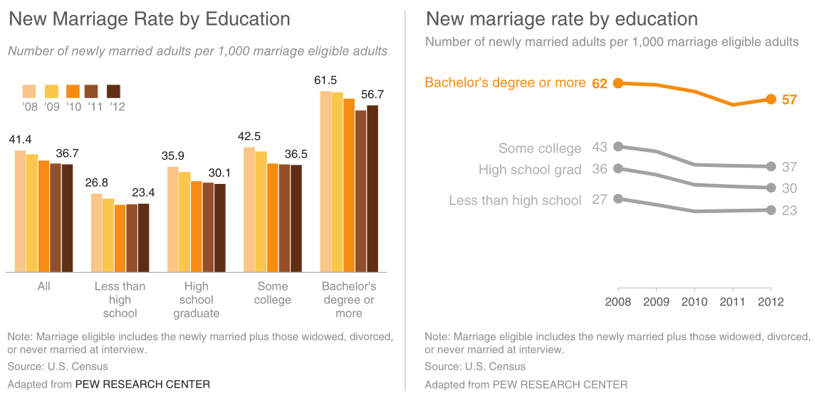
Problem 1: recreate the plot below with python

Slide 3
Problem 2: recreate the plot below with python

Slide 4
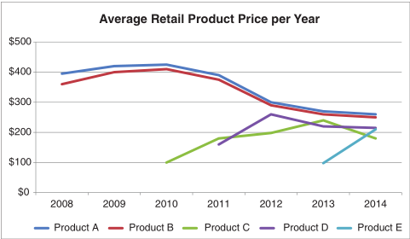
Problem 3: improve the plot below for product price data

Slide 5
The form of the result
You submit Jupyter notebook exported as html
Each problem is a separate top level block

